Slide 1
Heart at Rest

Slide 2

Introduction
The #1 risk factor for stroke
The major risk factor for heart disease
In Canada, nearly 1 in 4 adults are Hypertensive and 1 in 7 are Pre-hypertensive

Slide 3
Our Solution
1
Let’s dive into it

Slide 4
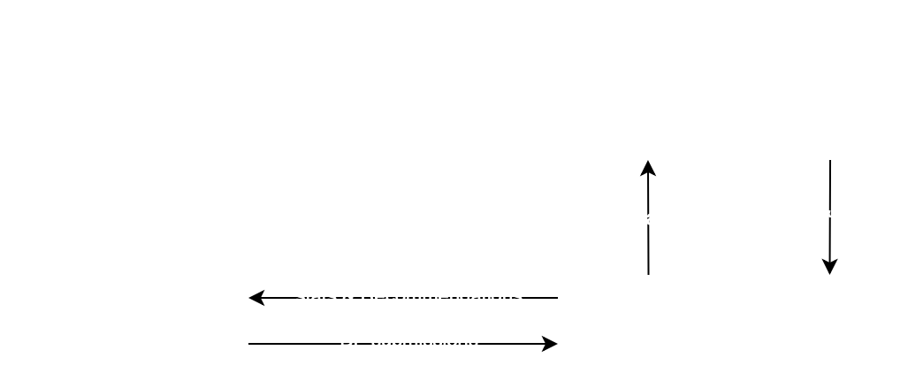
Structure

Slide 5
Demo
2

Slide 6
Our Vision
Feasible improvements
Forecasting daily BP & predicting stroke risk
Virtual Nurse for real time answers to questions
Linking Account with Doctors
Using Google Maps API to find nearest specialist
Route to nearest er if in emergency
Notes:
Our vision was very broad, but we tried to focus on key features of the application challenge
Linking account to docs - they connect doctors so teh doc can see info and keep up to date, and docs can input some info like blood test results

Slide 7
Conclusion
3

