Slide 1

Ahsanullah University of Science and Technology Department of Computer Science & Engineering
Course Name: Microprocessors and Microcontroller Lab
Semester: Spring 2023
Course No: CSE3118
Project name: Automated Toll Collection System
Proposed to:
Prof. Dr. Md. Shamim Akhter,
Professor, AUST CSE
Lomat Haider Chowdhury
Lecturer, AUST CSE
Raiyan Jahangir
Lecturer, AUST CSE
Proposed By:
Naeema Jannat, 20210104005 Mostafiz Fahim, 20210104008
Asadut Jaman, 20210104009
Sayeda Nimu, 20210104022

Slide 2
Automated Toll Collection System
Name:Naeema Jannat ID:20210104005
Name:Mostafiz Fahim ID:20210104008
Name:Asadut Jaman ID:20210104009
Name:Sayeda Nimu ID:20210104022

Slide 3
Objectives
Automation: Implement a fully automated toll collection system to streamline the traffic flow and reduce manual intervention.
Efficiency: Improve efficiency in toll collection by leveraging RFID technology for quick and accurate identification of vehicles.
Sustainability: Integrate sustainable practices, such as energy-efficient hardware and minimized environmental impact, into the design and development process.
Multidisciplinary Approach: Embrace a multidisciplinary approach to address various aspects of hardware and software integration, user experience, and societal impact.
Learning Opportunities: Provide a unique learning experience for computer science and engineering (CSE) students by exposing them to microcontrollers, electrical equipment, and embedded programming.

Slide 4
Social Values
Reduced Traffic Congestion: The system decreases congestion at toll booths, ensuring smoother traffic flow.
Minimized Wait Times: Users experience shorter waiting periods, improving overall efficiency.
Lower Fuel Consumption: Reduced wait times lead to lower fuel consumption and environmental impact.
Decreased Vehicular Emissions: Efficiency improvements contribute to a reduction in harmful emissions.
Environmental Friendliness: The project aligns with green initiatives by promoting sustainable transportation practices.
Enhanced Road Safety: Automated transactions decrease the risk of accidents and improve overall safety.
Stress Reduction for Drivers: Shorter wait times reduce stress and frustration for drivers.
Contribution to Sustainable Transportation: The project supports the broader goal of creating eco-friendly transportation systems.
Alignment with Smarter Urban Transportation Goals: The initiative falls in line with efforts to develop intelligent and efficient urban transportation networks.

Slide 5
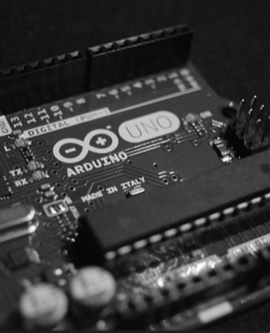
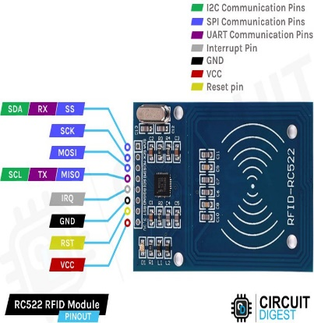
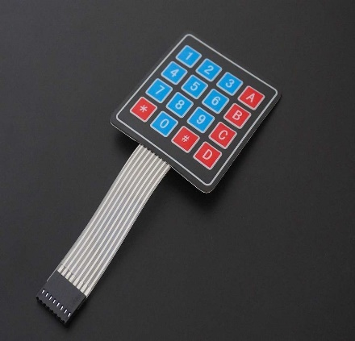
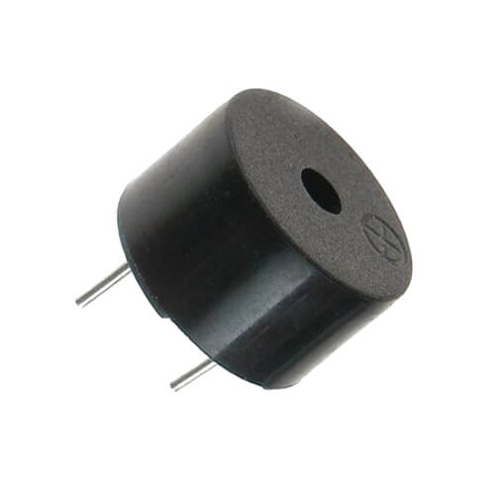
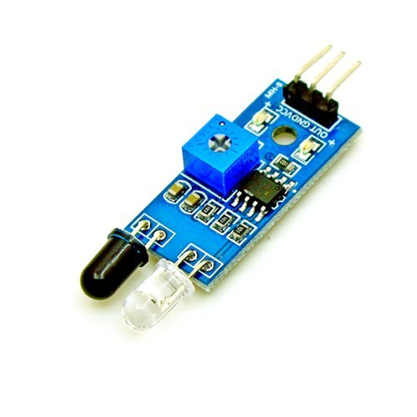
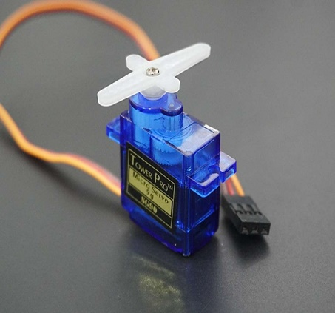
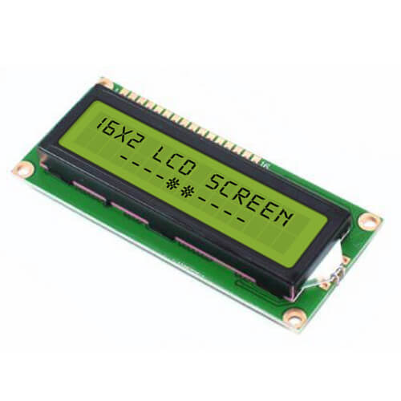
Components
ARDUINO UNO
RC522 RFID
Keypad
Buzzer
IR Sensor
Servo Motor
Lcd display

Slide 6
Total cost
Equipment's | Quantity | Budget (Taka)
Arduino UNO | 1 | 750/=
16*2 LED Display | 1 | 350/=
Keypad | 1 | 150/=
Servo Motor (MG995) | 1 | 200/=
RC522 RFID | 1 | 200/=
RFID Card | 2 | 100/=
IR sensor | 2 | 150/=
Breadboard and Jumper Wires | 1 | 100/=
Buzzer | 1 | 30/=
Battery and Case | 1 | 270/=
Demo car | 1 | 300/=
Extra Expenses |  | 500/=
Total:3100/=

Slide 7
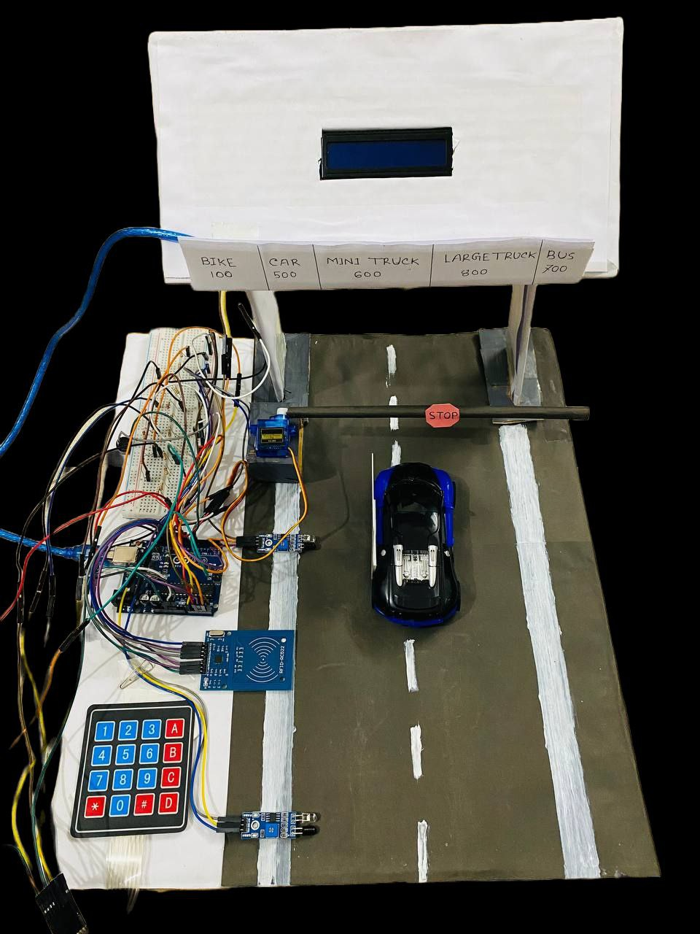
Final project

Slide 8
Working Procedure
RFID Identification: The system wirelessly reads the RFID card in the vehicle for unique identification.
IR Sensors: Infrared sensors monitor vehicle entry and exit to initiate toll transactions.
Keypad: A keypad enables drivers to input information and recharge accounts conveniently.
RFID Verification: The system checks the RFID data against pre-defined codes to identify the vehicle.
Automatic Toll Deduction: Appropriate toll amounts are automatically deducted from the associated account balance.
Account Recharge: The keypad facilitates quick recharging for insufficient account balances.
Servo Motor Integration: A servo motor controls the toll gate, allowing secure and efficient passage for authorized vehicles.
Minimized Waiting Times: Automated processes reduce waiting times, enhancing overall traffic flow.
Streamlined Toll Collection: The system provides a user-friendly and efficient toll collection experience.
Enhanced Security: RFID verification and servo-controlled gate contribute to a secure toll booth operation.

Slide 9
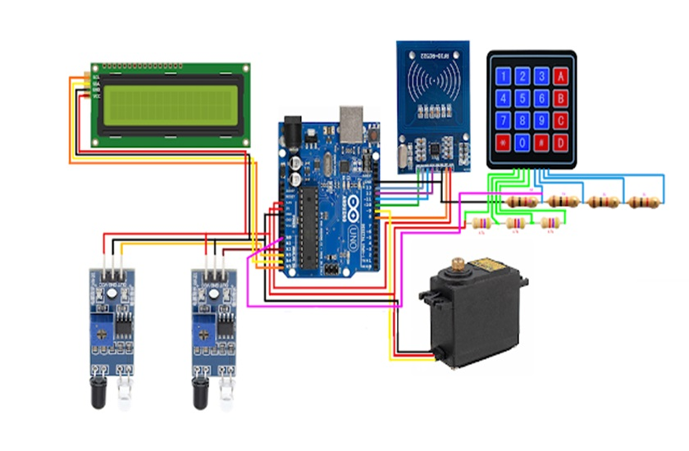
Final project Diagram:

Slide 10
Limitations
We couldn’t use multiple RFID cards for multiple vehicles.
Our keypad wasn’t working properly.
We couldn’t use multiple LCD display for more user-friendly interface.

Slide 11
Challenges on the Project
We have faced several problems while implementing the RFID sensor and card. Some cards weren’t working properly and sensor had some loose connection.
We have faced problems while implementing the 16*2 LCD monitor. The backlight of the monitor was too high that we couldn’t see any output.
We have faced several problems while implementing the keyboard. We used a 4*4 matrix keyboard. We tried to short the row and columns and assign the keyboard in one pin. Unfortunately, that didn’t work.

Slide 12
Maximum Energy Efficiency
Low-Power Sleep Mode:
Implement a sleep mode during non-operational periods to minimize power consumption.
Energy-Efficient Components:
Use sensors with low standby power to reduce continuous power consumption.
Optimize the servo motor's power usage during barrier movements.
Renewable Energy Integration:
Incorporate solar panels to harness renewable energy for powering the system.
Holistic Design:
Take a comprehensive approach to energy-efficient design, considering both hardware and software optimizations.

Slide 13
Stakeholders
Government Authorities
Toll Collection Agencies
Technology Suppliers
RFID Technology Providers
Servo Motor Manufacturers
Solar Power Solution Providers

Slide 14
Multidisciplinary Approach
Electrical and Electronics Engineering
Computer Science
Mechanical Engineering
Civil Engineering
Environmental Science
Information Technology

Slide 15
Safety Norms
Electrical Safety: Implementation of standard electrical safety measures, including insulation and grounding, to reduce the risk of electric shock and fire hazards.
Mechanical Safety: Ensuring the robustness of components and installations to prevent physical harm or system damage.
RFID Card Handling: Educating users on the proper handling of RFID cards to prevent damage or corruption of card data.
Buzzer Use: Setting appropriate sound levels for the buzzer to avoid discomfort or disturbances caused by excessive noise.
IR Sensor Usage: Correct calibration and positioning of IR sensors to prevent false readings or failures in vehicle detection.

Slide 16
Team Contribution
Team Member | Contribution
Naeema Jannat (20210104005) | 20%
Mostafiz Fahim (20210104008) | 30%
Asadut Jaman (20210104009) | 30%
Sayeda Nimu (20210104022) | 20%

Slide 17
Conclusion
The automatic toll collection system, integrating RFID, keypad, and servo motor technologies, marks a milestone in streamlining toll booth operations. Enhancing efficiency and user convenience, the project showcases the importance of ongoing maintenance and collaborative multidisciplinary efforts for sustained success and innovation in toll collection systems.
Our goal of this project was to implement an efficient and automated toll collection system using RFID technology, keypad input, and servo motor control. This system aims to enhance user convenience, reduce traffic congestion, and contribute to the modernization of toll booth operations.

Slide 18
Thank You Do you have any question?

