Slide 1

Automated robust first peak detection in a time signal using computational intelligence
Computational Intelligence
Prof. Andreas Pech
Presented by
Farjana Akter(1344037)
Syed Mostain Ahmed(1390214)
Al Rahat Hossain(1345285)

Slide 2
Overview
Introduction
Implemented Algorithm
Result

Slide 3
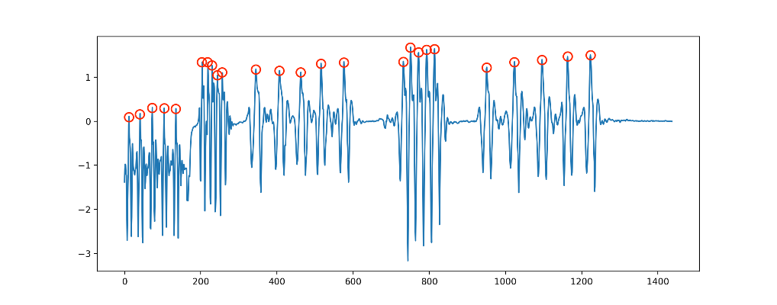
Introduction
Peak detection in a signal finds relevance across a wide spectrum of applications, allowing for a better understanding of abrupt fluctuations in diverse datasets.
For signal processing applications using computational intelligence, peak detection is an important step.

Slide 4
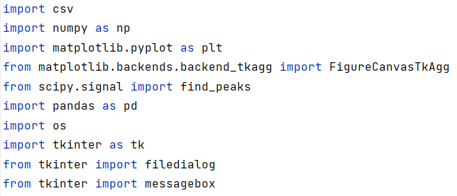
Implemented Algorithm
Step 1: Import Library and Function in Signal Processing Approach
Our peak detection model relies on the SciPy library for identifying the first peak in the signal.
SciPy is closely integrated with NumPy, offering efficient N-dimensional array manipulation capabilities.
The SciPy library enhances the functionality of NumPy arrays by providing a range of user-friendly and efficient numerical routines, including those for numerical integration and optimization.
Selected function on snippet, takes a 1-D array and finds all local maxima by simple comparison of neighboring values. Optionally, a subset of these peaks can be selected by specifying conditions for a peak’s properties.

Slide 5

Implemented Algorithm(Cont..)
pandas is a Python package providing fast, flexible, and expressive data structures designed to make working with “relational” or “labeled” data both easy and intuitive.
In our given test file, there is some string values. We use pandas to convert all the values to float64

Slide 6


Implemented Algorithm(Cont..)
The tkinter package (“Tk interface”) is the standard Python interface to the Tcl/Tk GUI toolkit.
tkinter import filedialog, this function offers a dialog that can be used while working with files.
We used this package to create Graphical User Interface for uploading our test file.

Slide 7
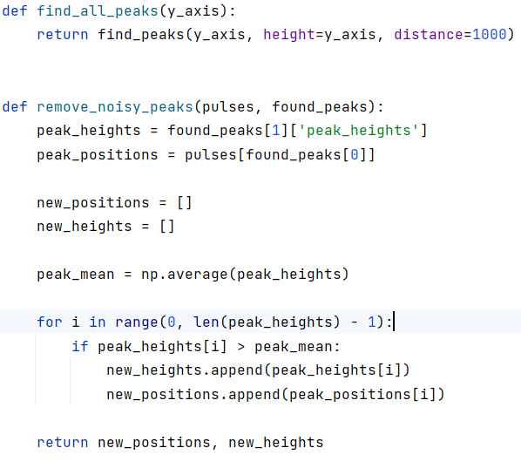
Implemented Algorithm(Cont..)
Step2: First Peak Detection in Signal Processing Approach

Slide 8
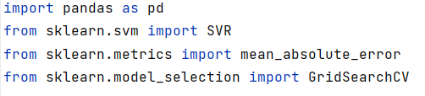
Implemented Algorithm(Cont..)
Step3: Machine Learning Approach (Library and Functions)
As our second approach we used Scikit-learn library.
Scikit-learn is an open source data analysis library, and the gold standard for Machine Learning (ML) in the Python ecosystem
The sklearn.svm module includes Support Vector Machine algorithms.
The sklearn.metrics module includes score functions, performance metrics and pairwise metrics and distance computations.

Slide 9
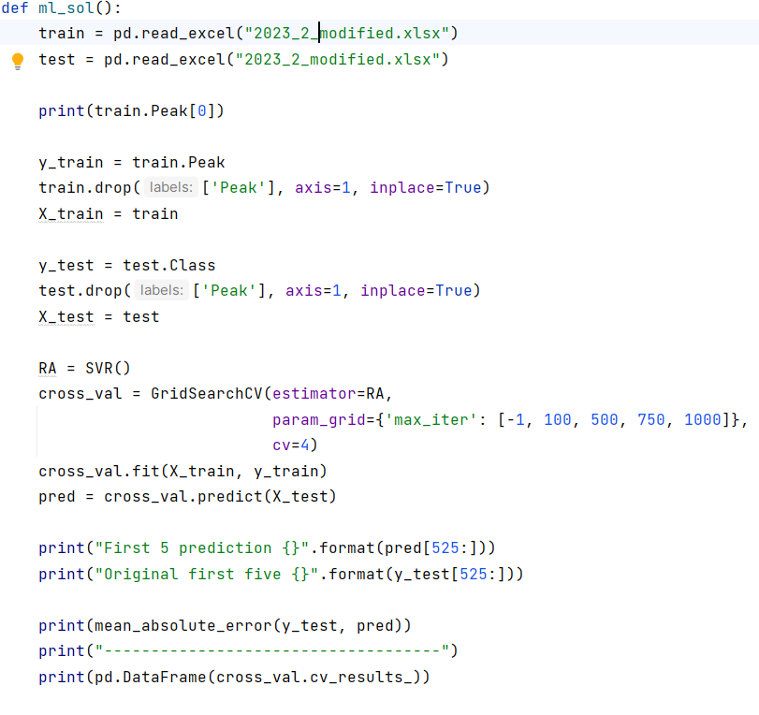
Implemented Algorithm(Cont..)
Step 4: First Peak Detection in Machine Learning Approach

Slide 10
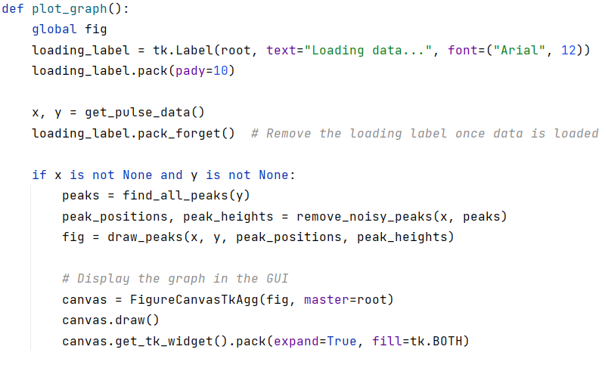
Implemented Algorithm(Cont..)
Step 5: For the input, we used a GUI in our model.

Slide 11
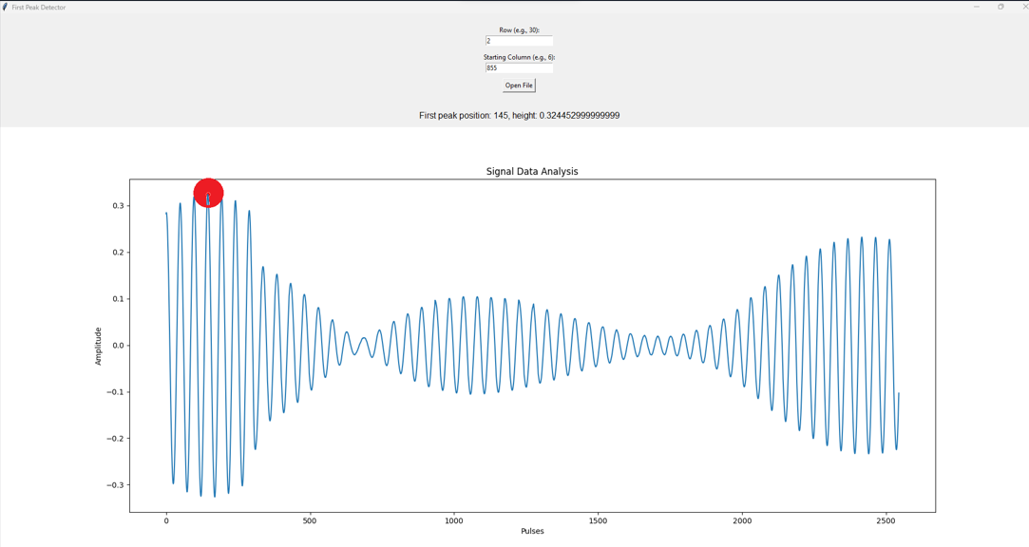
Implemented Algorithm(Cont..)
GUI

Slide 12
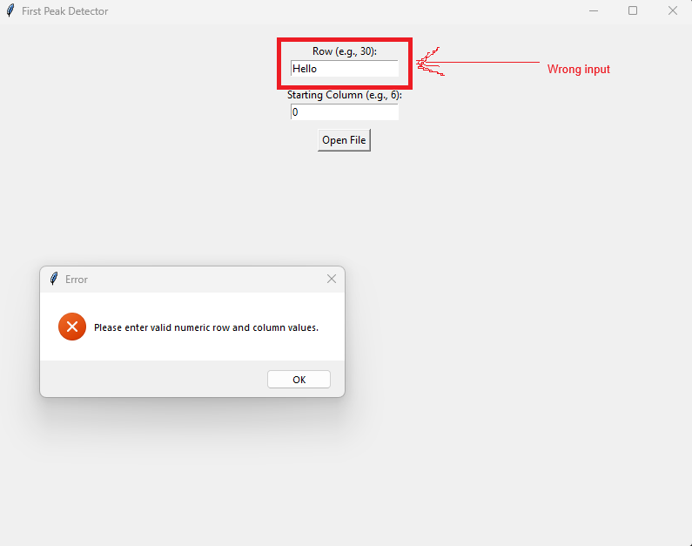
Implemented Algorithm(Cont..)
GUI
Invalid input warning

Slide 13
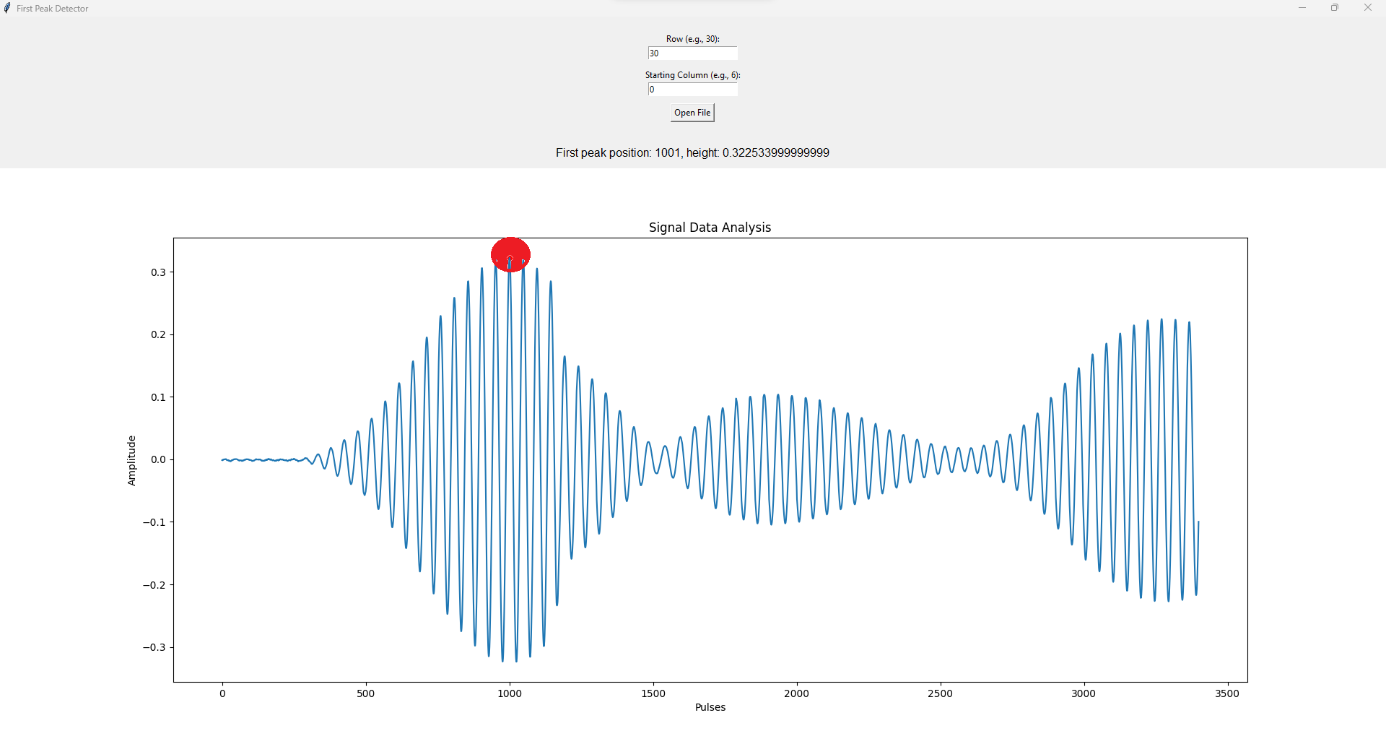
Output

Slide 14
Thank You

