Slide 1

Fetching and Analyzing Ethereum Blockchain Data Using AWS Managed Blockchain and EC2
S M Mostaq Hossain
CSC 6570 Cloud Security Fundmntl/Pract
Spring 2025
Email: shossain42@tntech.edu
Date: 29th April 2025

Slide 2
Table of Contents
1. Overview
2. Motivation
3. Scope of Work
4. Creating a Node and Billing Token in AMB
5. Connecting to AWS Managed Blockchain
6. Experiment Setup
7. Setting up the EC2 Instance
8. Fetching Latest Block Data
9. Analyzing Blockchain Data
10. Results and Observations
11. Future Work and Improvements
12. Conclusion
02

Slide 3
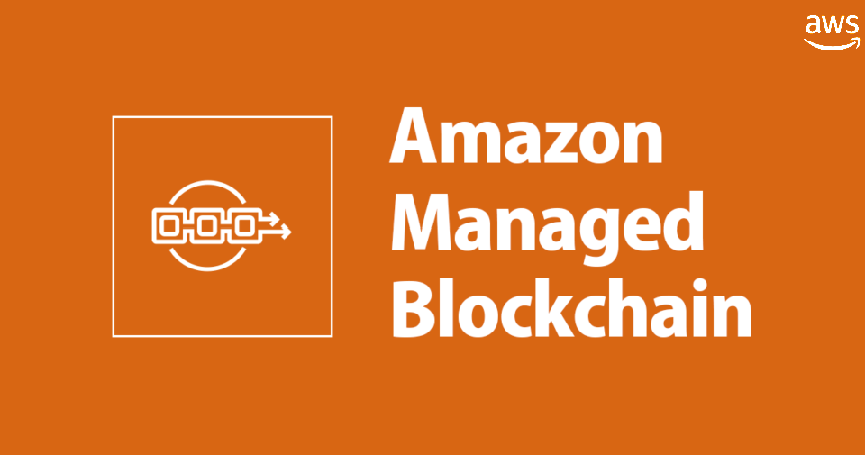
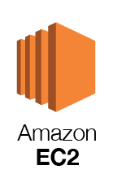

Overview
Project Summary:
- Setup an EC2 instance on AWS
- Connect to AWS Managed Blockchain Ethereum Node
- Fetch the latest blockchain block and transaction data using Python and Web3.py
- Save blockchain data in JSON format
- Analyze key metrics like gas usage and transaction count
Key Technologies:
- Amazon EC2
- AWS Managed Blockchain (Ethereum)
- Python (web3.py, JSON handling)
03

Slide 4
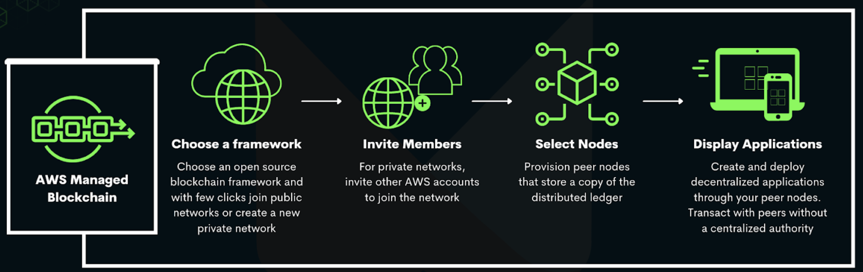
Motivation
Why this work?
Need real-time access to blockchain data for research and analytics
Cloud-hosted nodes (like AWS Managed Blockchain) are secure and scalable
EC2 provides flexibility to automate data extraction and analysis
Applications:
Smart contract monitoring
Blockchain analytics
Cybersecurity insights
Fig. 1: AMB, how does it work?
04

Slide 5
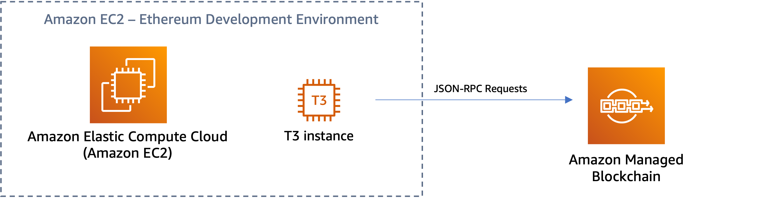

Scope of Work
Tools:
PythonWeb3.py
AWS Services (EC2, Managed Blockchain)
Goal:
Set up an EC2 instance
Connect to AWS Managed Blockchain (Ethereum node)
Fetch latest blockchain blocks and transactions
Save and analyze the data
JSON-RPC Requests
SSH
SSH
Local PC
Fig. 2: High-level Architecture of the Project.
05

Slide 6
Setting up the EC2 Instance
Steps:
Launch Amazon Linux 2 EC2 Instance
Open Ports if needed (for future, but HTTP calls were fine here)
Install necessary libraries:
pip3 install web3
sudo yum install python3
Security:
Key Pair to SSH
IAM Roles (if needed for automated billing token refresh)
06

Slide 7
Creating a Node and Billing Token in AWS Managed Blockchain
Step 1: Create a Blockchain Network
Go to AWS Management Console → Managed Blockchain
Choose Public Networks → Ethereum
Click Create network
Step 2: Create a Node
Choose an availability zone (e.g., us-east-1)
Select an instance type (e.g., bc.t3.small)
Confirm and launch the node
Step 3: Access Endpoint Information
After the node is active:
Get the HTTP and WebSocket endpoints
Copy the Node ID and Network ID
Step 4:
Generate a Billing Token
In the node's details page, click Generate Billing Token
Copy the token securely (one-time view).
07

Slide 8
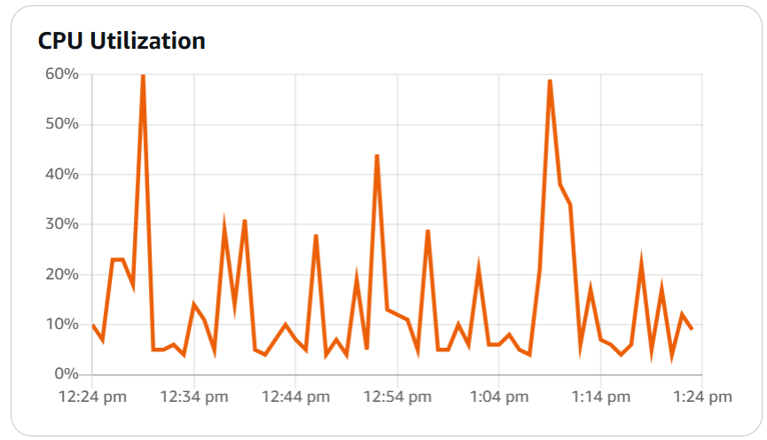


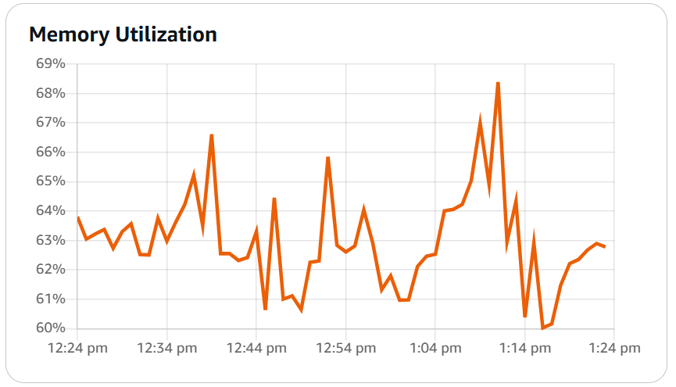
Connecting to AWS Managed Blockchain
Steps:
Get Endpoint URLs and Billing Token from AWS Console
Use Web3.py to create connection:
Verify connection:
Notes:
Billing token required if using "Accessor" endpoints
Use HTTPS, not WebSocket
08

Slide 9
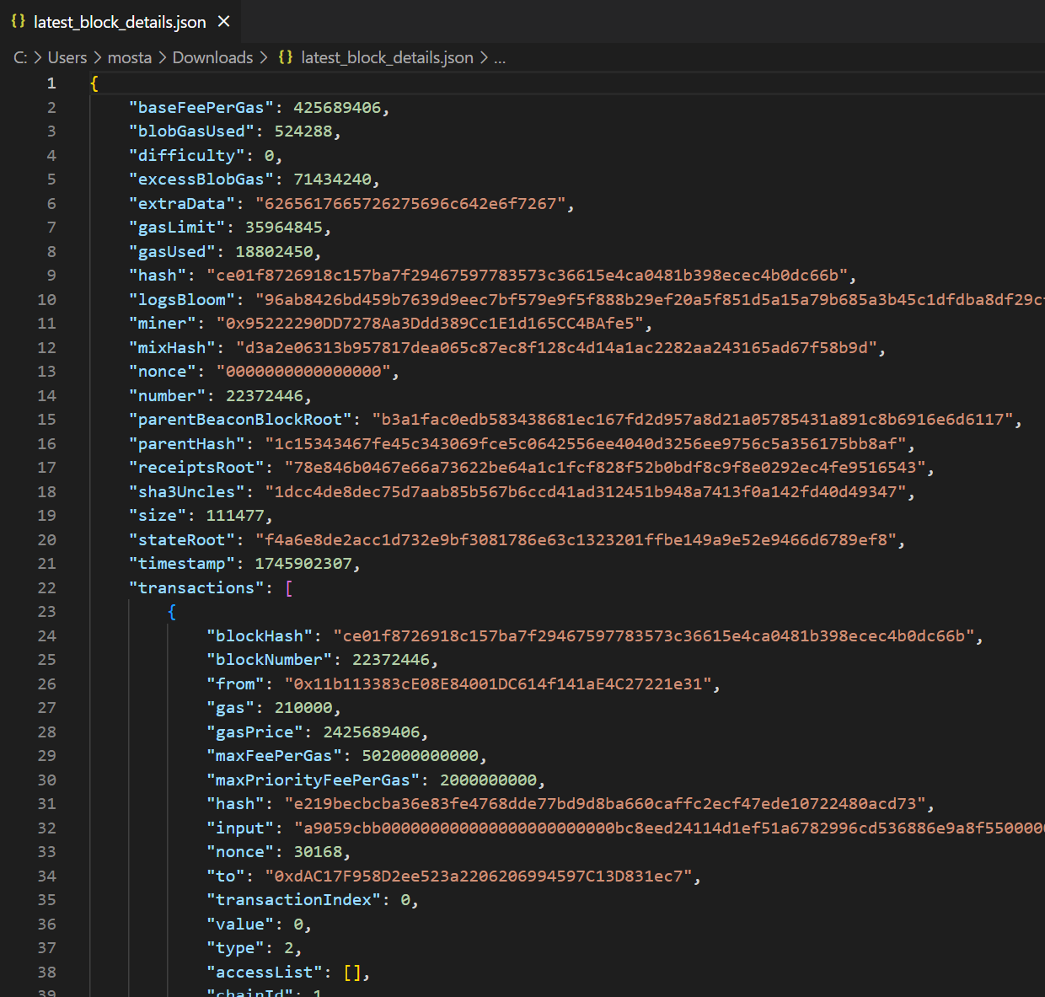
Fetching Latest Block Data
Script Structure:
fetch_latest.py
Connect to node
Fetch latest block
Print block details
save_latest.py
Save block details to a JSON file
Important Fields:
Block Number
Block Hash
Gas Used
Transaction Count
09

Slide 10
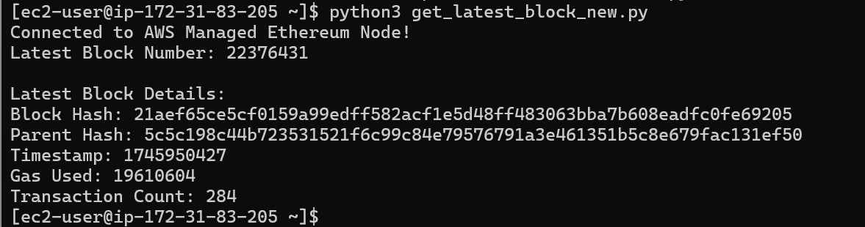
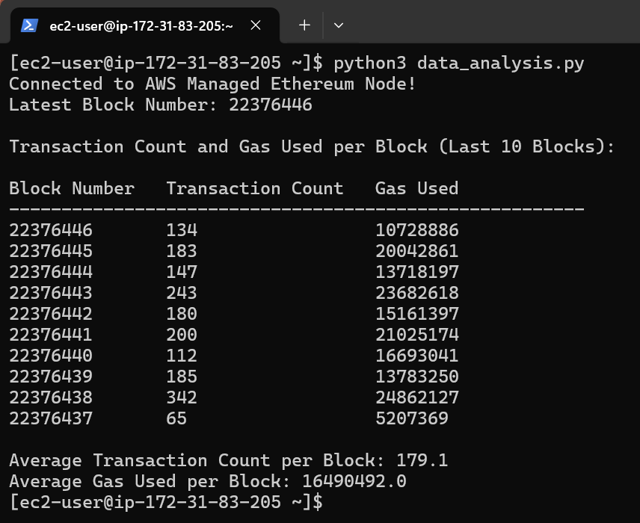
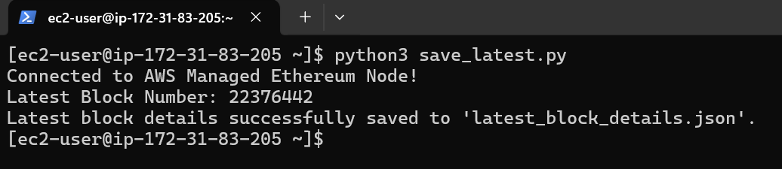
Results and Observations
Results:
Successfully connected and fetched latest blockchain data
Gas usage and transaction count trends visible
Observations:
High variation in transaction counts block-to-block
Some blocks consume a lot of gas but have fewer transactions (heavy computation)
10

Slide 11
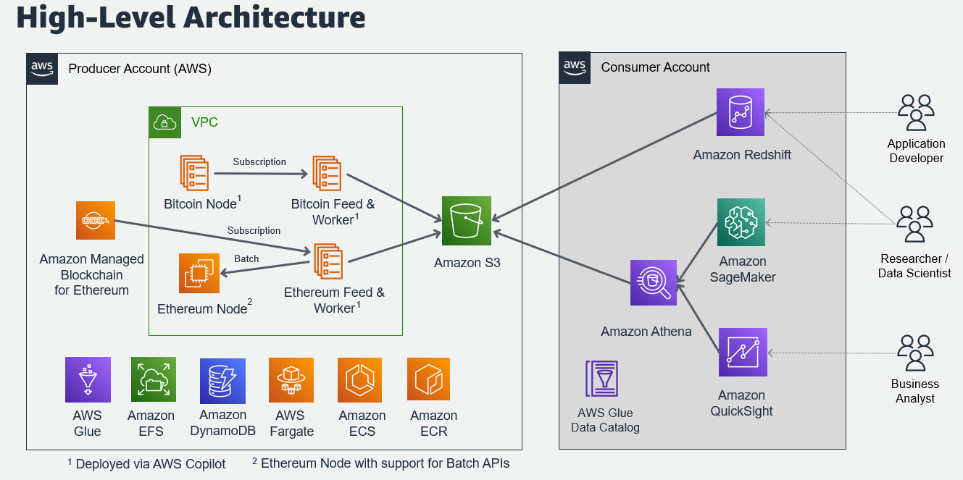
Future Work and Improvements
Future Scope:
Automate fetching and storing data every minute/hour
Visualize trends (later, using saved JSON data)
Analyze smart contracts activity specifically
Switch to WebSocket endpoints for real-time event monitoring
Enhancements:
Connect EC2 to S3 bucket to store data
Build dashboards with AWS QuickSight
Fig. 3: High-level Architecture of the Future Scope of the Project.
11

Slide 12
Conclusion
Successfully demonstrated how to:
Create and configure an Ethereum node using AWS Managed Blockchain (AMB)
Connect securely to the Ethereum node from an EC2 instance
Fetch the latest block data using Web3.py
Analyze and interpret blockchain data through command-line-based summaries
Motivation Realized:
Simplified blockchain access without running full nodes locally
Opened the path for further large-scale blockchain analytics on cloud infrastructure
Key Takeaways:
AWS AMB makes blockchain infrastructure manageable and scalable
Using cloud resources like EC2 with AMB enables real-time data retrieval and analysis.
12

Slide 13
References
AWS Managed Blockchain (Ethereum) Official Documentation. https://docs.aws.amazon.com/managed-blockchain/latest/ethereum-dev/what-is-managed-blockchain-ethereum.html
Making JSON-RPC API calls to an Ethereum node in Amazon Managed Blockchain (AMB). https://docs.aws.amazon.com/managed-blockchain/latest/ethereum-dev/json-rpc-api-examples.html
Web3.py Documentation (Python library for Ethereum interaction). https://web3py.readthedocs.io/en/stable/
AWS EC2 Documentation. https://docs.aws.amazon.com/ec2/
AWS SDK for Python Documentation. https://boto3.amazonaws.com/v1/documentation/api/latest/index.html
13

Slide 14

Thanks!
Questions?

