Slide 1
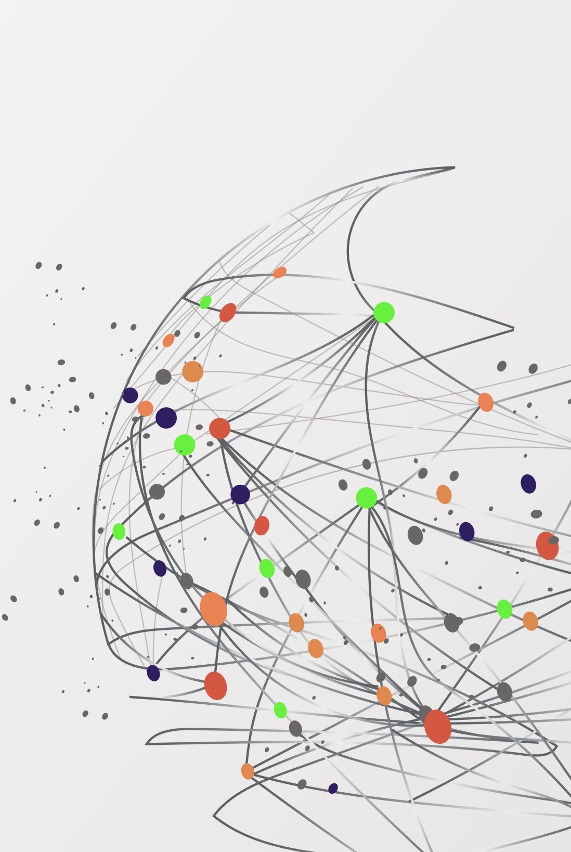
Paper Title: Unsupervised and Supervised Vulnerability Detection in Smart Contracts with Large Language Models (LLM).
Authors: S M Mostaq Hossain, Jesse Roberts and Amani Altarawneh
Presented by: S M Mostaq Hossain
CSC-7970-001 - SpTp: Large Language Models
Fall 2024

Slide 2
Table of Contents
1. Overview
2. Motivation
3. Related Works
4. Contributions
5. Experiment
6. Results
7. Discussion
8. Future Work
9. Conclusion
02

Slide 3
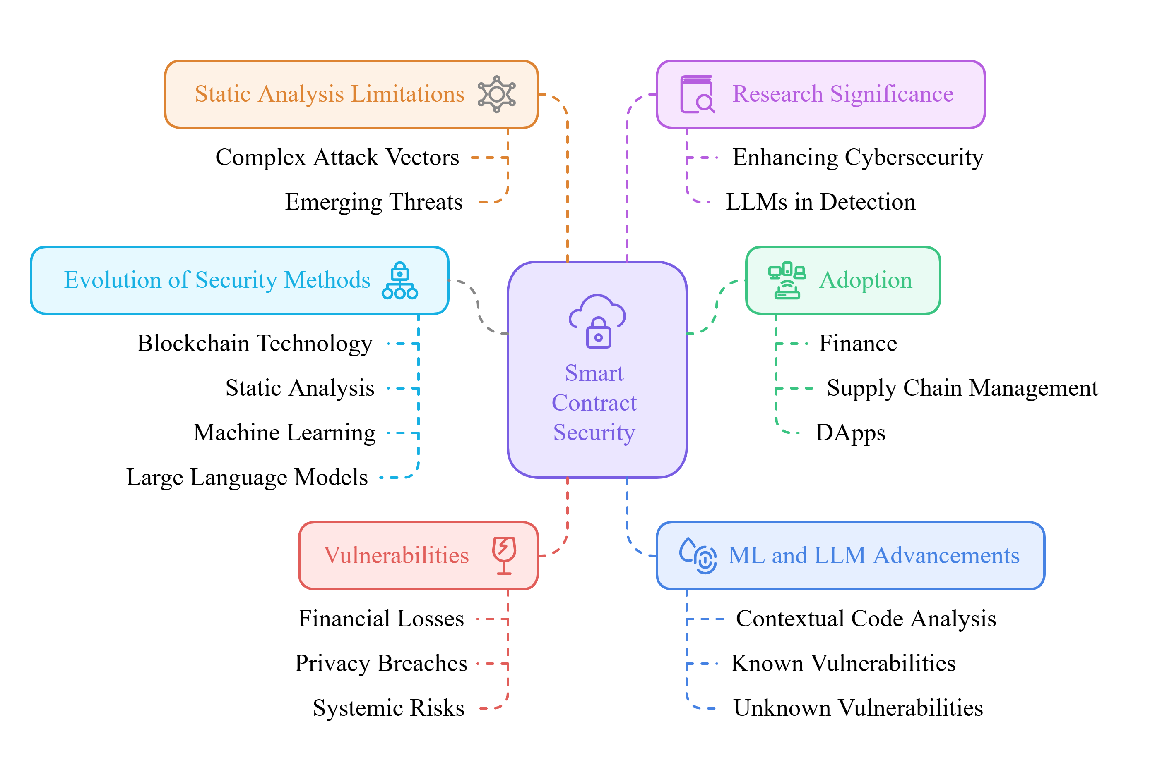
Overview
A smart contract is a self-executing piece of code on a blockchain that automatically enforces and executes the terms of an agreement without the need for intermediaries.
03

Slide 4
Motivation
Escalating Threats: The sophisticated security challenges, with smart contract vulnerabilities leading to financial losses and systemic risks.
Limitations of Current Methods: Traditional static analysis and classical ML models struggle to adapt to evolving attack patterns and lack the contextual understanding required for effective vulnerability detection.
Need for Advanced Approaches: There is a pressing demand for intelligent, adaptive frameworks that leverage LLM to detect vulnerabilities by capturing complex code semantics.
Impact on Blockchain Security: Developing robust and generalizable detection methods is essential to reduce economic and technological risks while fostering trust in decentralized systems.
Driving Innovation: This research seeks to bridge gaps in existing methodologies by exploring fine-tuned LLMs, integrating supervised and unsupervised learning, and establishing a scalable, multi-dimensional security paradigm.
04

Slide 5
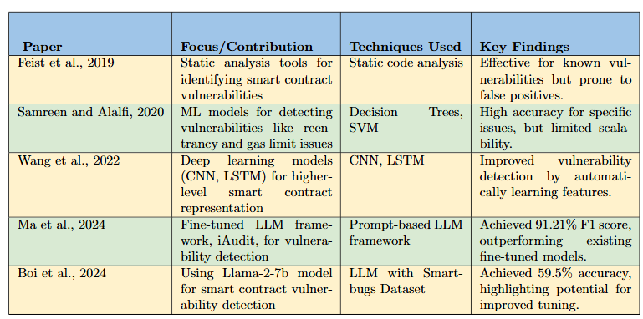
Related Works
07

Slide 6
Contribution
Comparative Evaluation: A systematic comparison is carried out, contrasting classical ML models such as LSTM and fine-tuned large language models, like ALBERT, BERT, DistilBERT and RoBERTa
Detection of Subtle Code Patterns: Determining intricate code patterns and dependencies this classical model misses in vast applications, more prominently with regards to vulnerabilities like Reentrancy, Integer Overflow, Timestamp Dependency and Dangerous Delegatecall to show improved pattern recognition.
Enhancing Scalability through Unsupervised Learning: Expanding the scope of vulnerability detection by integrating unsupervised learning techniques.
Understanding the Impact of Fine-Tuning: We evaluate how fine-tuning LLMs on domain specific smart contract data improves model performance and generalization, giving better precision and recall with respect to complex vulnerabilities.
Benchmarking and Future Directions: In this work, we establish thorough benchmarks in vulnerability detection, expanding the scope of future research with an eye toward additional dataset expansion, wider LLM explorations, and the use of semi-supervised learning methods for improvement in generalization.
05

Slide 7
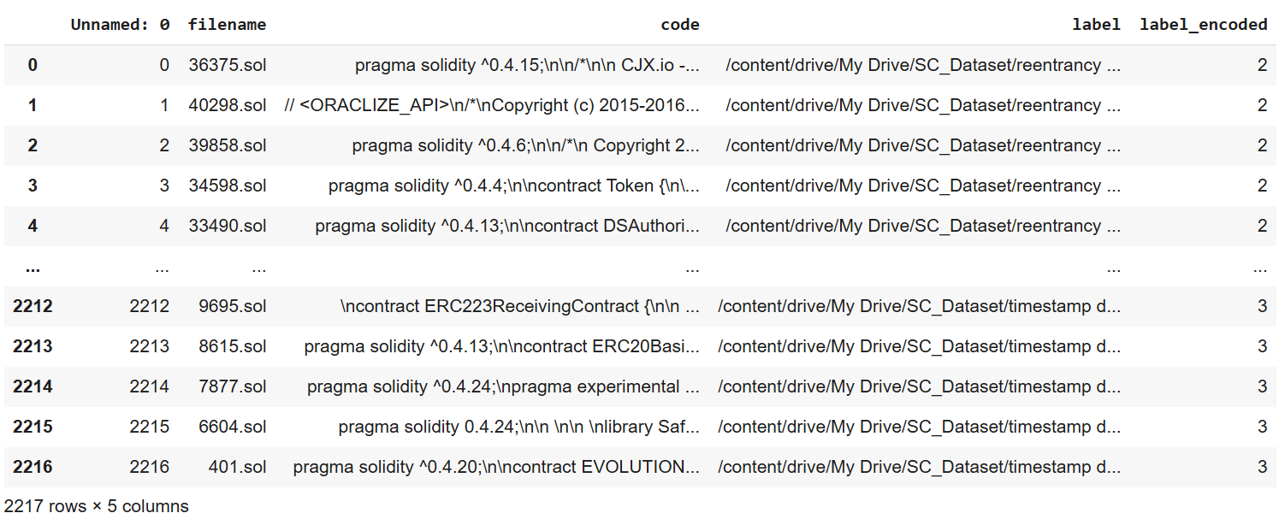
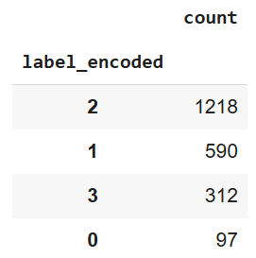
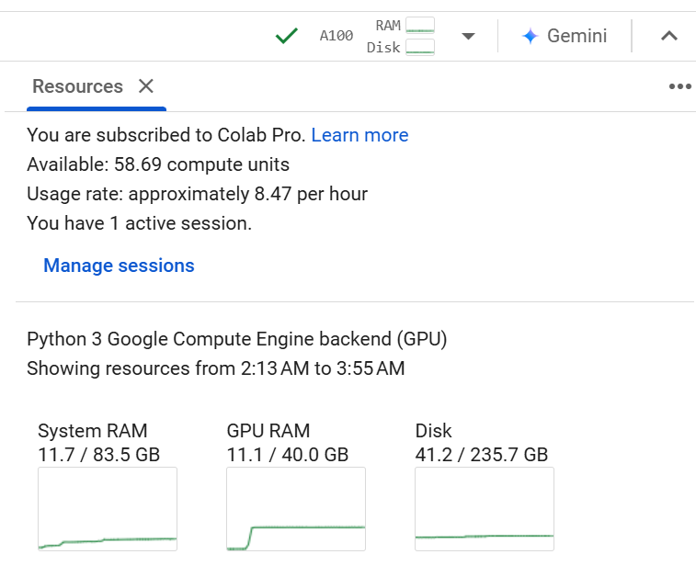
Experiment
Dataset: The primary dataset for this work consisted of an annotated smart contract dataset (Liu et al., 2023) from Kaggle.
Hardware and Computational Resources: Google Colab Pro with an NVIDIA A100 GPU (40 GB RAM), 83.5 GB system RAM, and 58.69 compute units at 8.47 units/hour, ensuring efficient model training and testing for vulnerability detection.
06

Slide 8
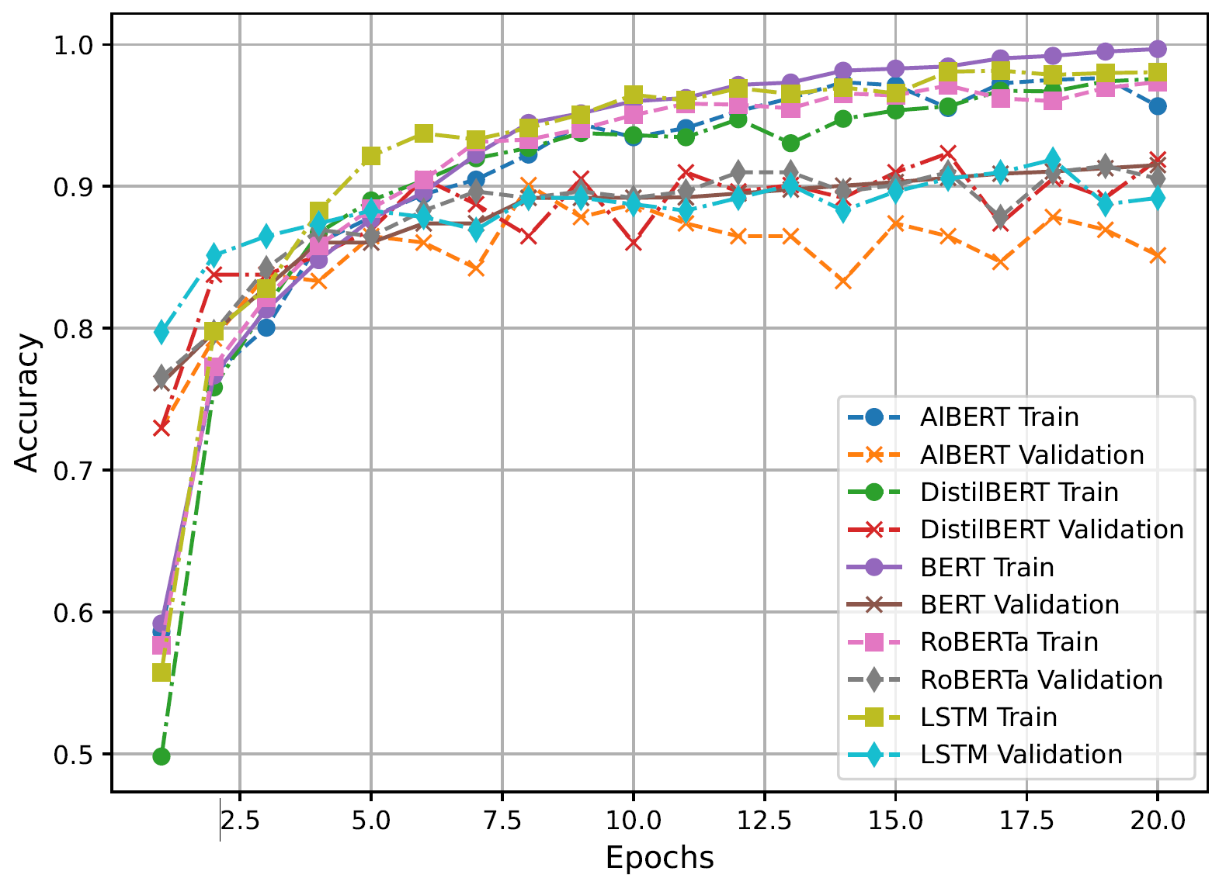
Results
This plot shows training and validation accuracy over 20 epochs for ALBERT, DistilBERT, BERT, RoBERTa, and LSTM, highlighting accuracy trends and model performance.
All models show increasing accuracy, with validation closely tracking training, reflecting their generalization ability.
08

Slide 9
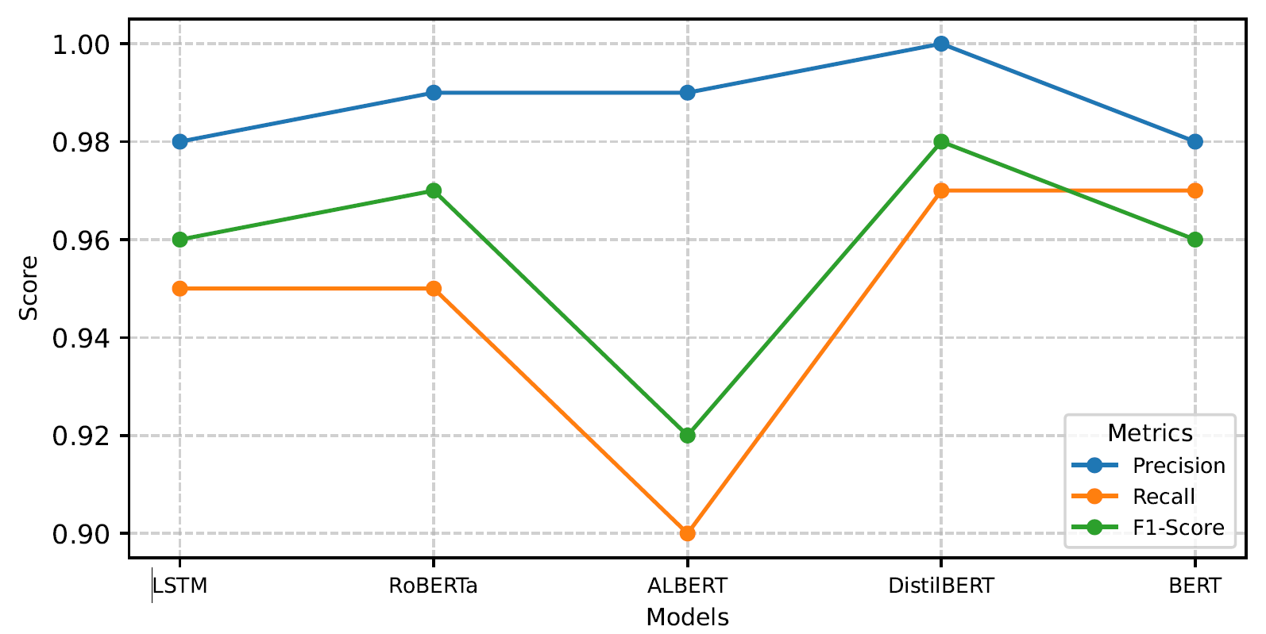
Results
Performance comparison of five models (LSTM, RoBERTa, ALBERT, DistilBERT, and BERT) based on precision, recall, and F1-score metrics.
The plot highlights the metrics as connected lines across the models, with LSTM and DistilBERT demonstrating consistently high scores across all metrics, while ALBERT shows relatively lower recall and F1-score.
09

Slide 10
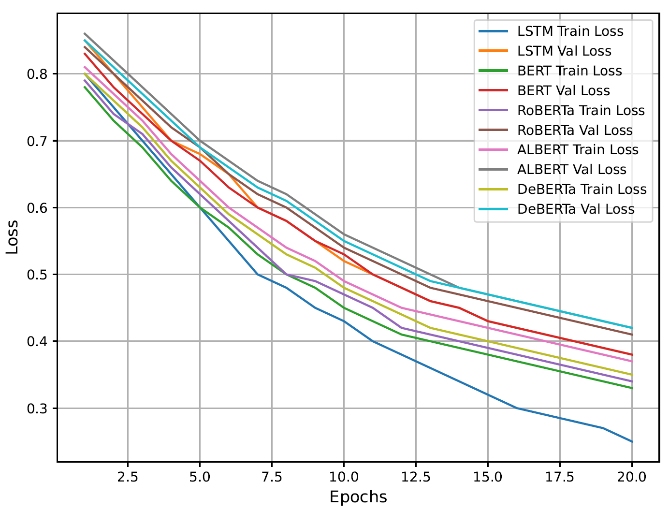
Results
Combined training and validation loss curves
for LSTM, BERT, RoBERTa, ALBERT, and DeBERTa models over 20 epochs.
The plot illustrates the comparative performance trends, with separate lines for training and validation losses for each model.
10

Slide 11
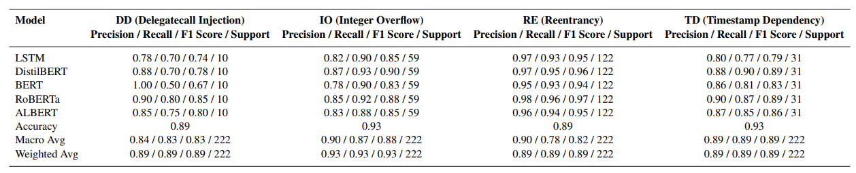
Results
Precision, recall, F1-score, and support for each vulnerability class (DD, IO, RE, TD) and overall macro and weighted averages for LSTM, DistilBERT, BERT, RoBERTa, and ALBERT models.
DistilBERT generally outperforms LSTM and BERT across almost all metrics, especially in terms of macro and weighted averages. This would imply that DistilBERT offers a more balanced performance across the different vulnerability classes.
BERT achieved relatively high precision for the "DD" class but low recall and F1-score, indicating that it may be better at identifying actual true positives but constantly struggles against false positives.
11

Slide 12
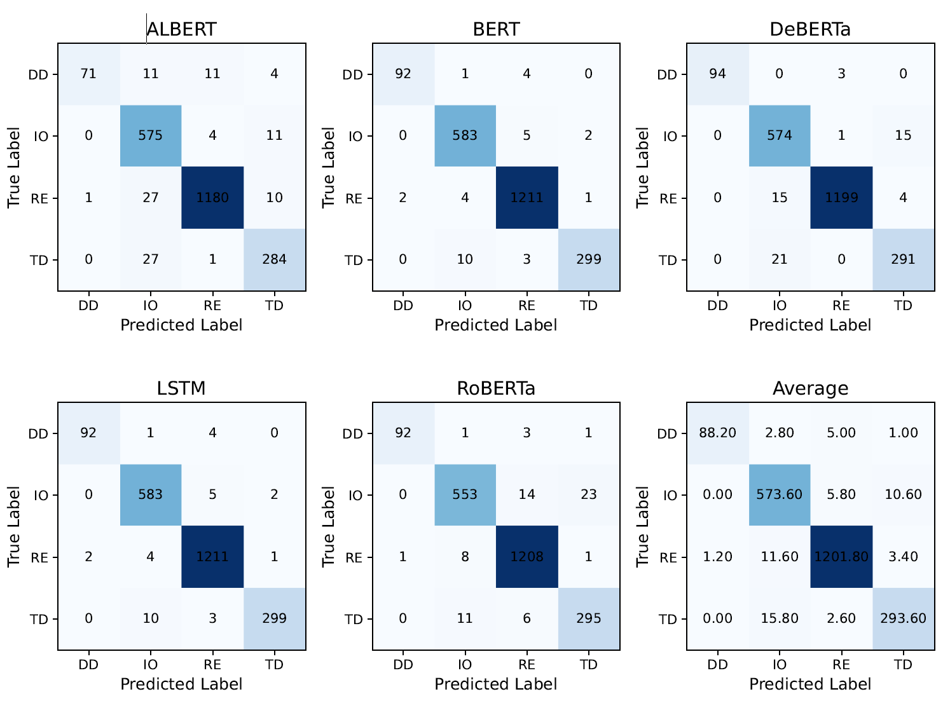
Results
Confusion Matrices for ALBERT, BERT, DeBERTa, LSTM, RoBERTa, and their Average in an unsupervised setting.
This figure compares the classification performance of five models on unlabeled data across four categories (DD, IO, RE, TD).
DeBERTa and BERT achieve the highest accuracy with minimal misclassifications, particularly in the RE and TD classes, while RoBERTa shows slightly higher errors in IO and TD.
The averaged matrix highlights overall consistent performance, with DeBERTa and BERT demonstrating superior generalization.
12

Slide 13
Discussion
Model Efficiency: LSTM achieved 89% accuracy with good generalizability, but LLMs like BERT and DistilBERT better captured context-dependent vulnerabilities (e.g., "TD" and "RE"). Overfitting issues were observed in BERT with smaller datasets.
Pattern Recognition: LLMs outperformed LSTM in detecting hidden patterns and dependencies in smart contracts, though challenges remained with underrepresented classes (e.g., "DD").
Fine-Tuning Benefits: Fine-tuning LLMs on labeled datasets significantly improved precision and recall, but overfitting highlights the need for larger, diverse datasets.
Unsupervised Testing Results: LLMs demonstrated the ability to identify hidden patterns and dependencies in smart contracts without explicit annotations, effectively highlighting vulnerabilities like "RE."
13

Slide 14
Future Work
Future work includes expanding datasets with labeled and unlabeled smart contracts to address underrepresented classes and improve model generalization.
New LLMs, such as GPT-4 and Gemini, could be explored for their effectiveness in detecting complex and contextual vulnerabilities.
Additionally, integrating Explainable AI techniques will enhance the interpretability of predictions, fostering greater trust in these models for blockchain security.
14

Slide 15
Conclusion
This research compared classical ML models like LSTM with fine-tuned LLMs, including ALBERT, BERT, DistilBERT, and RoBERTa, for smart contract vulnerability detection.
Fine-tuned LLMs excelled in identifying complex patterns and context-specific vulnerabilities, with DistilBERT achieving the highest accuracy and balanced performance.
Unsupervised testing demonstrated consistent generalization across models, confirming their potential for real-world applications.
Challenges remain in addressing underrepresented vulnerability types, highlighting the need for more diverse and extensive datasets.
Future work will focus on expanding datasets, exploring advanced LLM architectures, and adopting semi-supervised learning to enhance robustness and scalability.
15

Slide 16

Thanks!
Questions?

