Slide 1
Faculty name : Computers and Artificial Intelligence
Course name : Selected Topics in Computer Science – 1
Cover-sheet
Name | ID
مصطفي علاء الدين مصطفي احمد | 202000906
معتز محمد بصرى حجاج | 202000926
مهتدى سامح صبرى عبد العظيم | 202000953
زياد احمد محمد رفعت | 202000351
نادر سعيد جلال السيد | 202000975
نور الدين ايمن عيسي | 202001000

Slide 2
a) General Information on dataset:
The name of dataset for numerical used : Telco customer churn | Total number of sample for numerical : 7032 rows | Number of classes and their labels for numerical : 2 classes , their labels are 0 and 1 | The number of sample in training for logistic :5063 The number of sample in testing for logistic : 1969 | The number of sample in training for SVM : 4711 The number of sample in testing for SVM : 2321
The name of dataset for Image used : 7-Character Recognation in Natural imges | Total number of sample for numerical : 11007 | Number of classes and their labels for Images: 36 classes , their labels are 0-9,A-Z | The number of sample in training for ANN :7685 The number of sample in testing for logistic : 3322 | The number of sample in training for SVM-SVC:7685 The number of sample in testing for SVM :3322

Slide 3
b) Implementation details:
20 features were extracted , and their names are ( SeniorCitizen , tenure , PhoneService ,MultipleLines OnlineSecurity, OnlineBackup , DeviceProtection TechSupport , StreamingTV , StreamingMovies PaperlessBilling , MonthlyCharges , TotalCharges InternetService_DSL , InternetService_No , Contract_Month-to-month, Contract_Oneyear , PaymentMethod_Banktransfer(automatic), PaymentMethod_Creditcard(automatic), PaymentMethod_Mailed check ) | Hyperparameters used in Logistic regression for numerical : penalty='l2' , solver='sag' , C=1.0 , max_iter=1000 , random_state=44) | Hyperparameters used in SVM for numerical : kernel= 'rbf' , max_iter=10000 , C=1 , gamma='auto '
36 Classes for images and their names are (0,1,2,3,4,5,6,7,8,9,A ,B ,C,D,E,F,G,H,I,J,K,L,M,N,O,P ,Q,R,C,T,U,V,X,Y,Z | Hyperparameters used in ANN regression for images : Input_shape=3072,4 Hidden layer 1-hidden layer=512,2-hiddn layer =256 3-4hidden=128,activation=relu | Hyperparameters used in SVM for images :decision_function_shape='ovo'

Slide 4
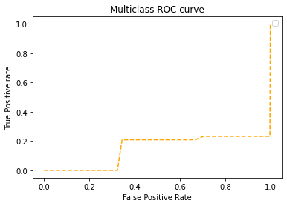
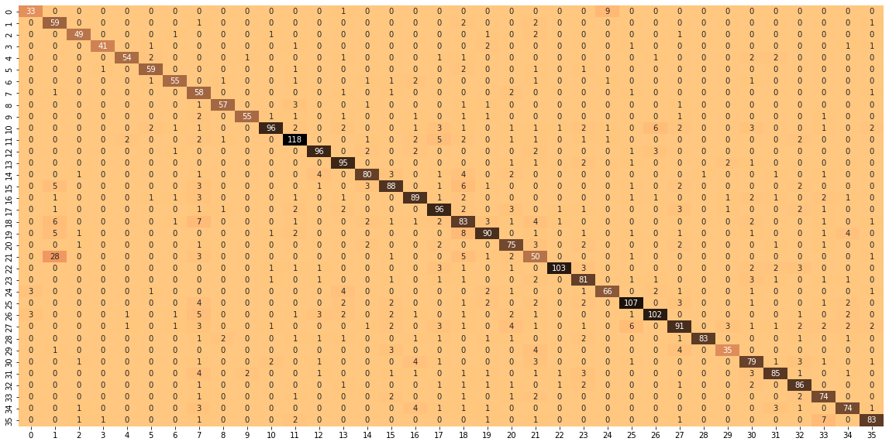
Result for dataset for images ANN model
accuracy of the model: 0.8158682584762573
roc_auc_score :0.9886000127270729

Slide 5
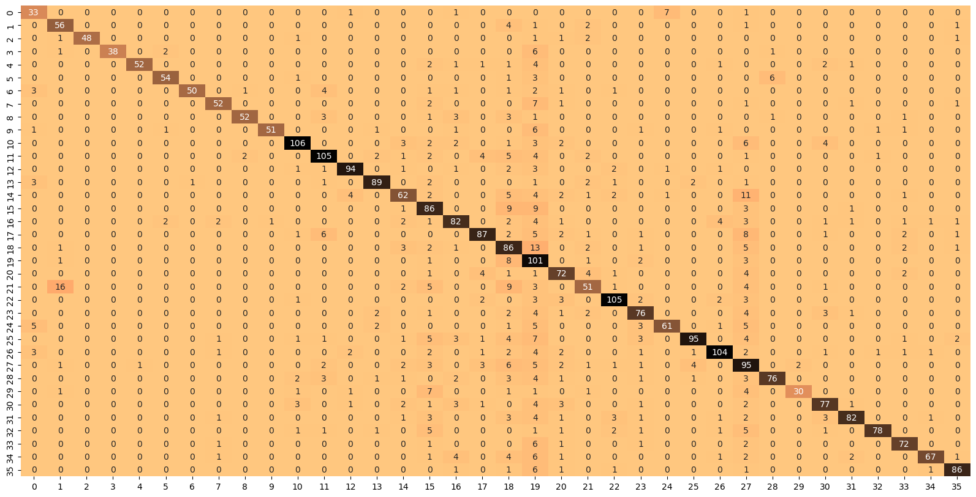
Result for dataset for images SVM model
Confusion matrix
model Test Score is : 0.7859723058398556
accuracy 0.79 3322
macro avg 0.84 0.79 0.80 3322
weighted avg 0.82 0.79 0.80 3322

Slide 6
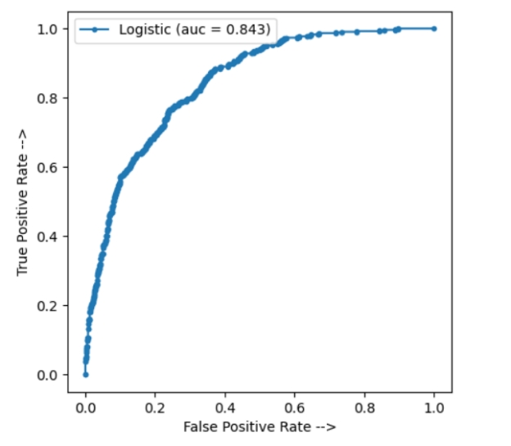

Result for dataset for numerical
For logistic regression
Accuracy of testing data : 0.805485017777

Slide 8
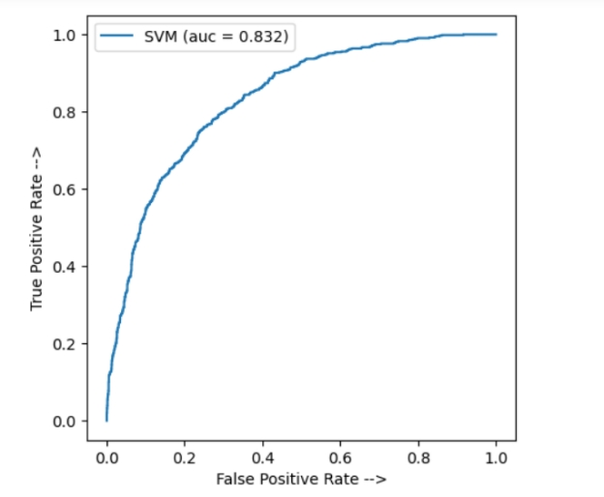

For SVM
Accuracy of testing data : 0.801809564842

