Slide 1
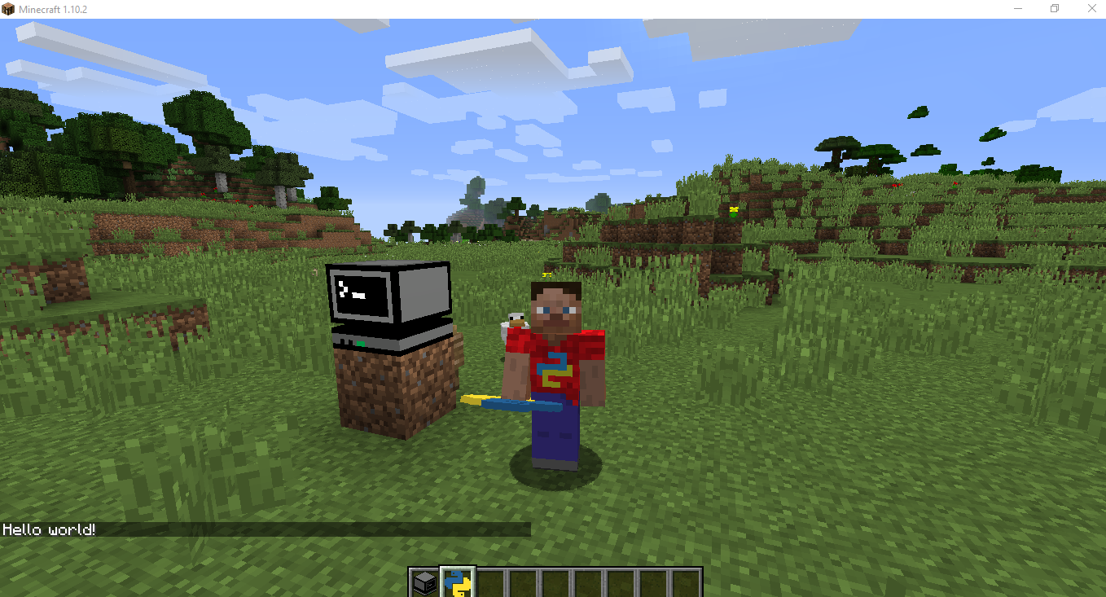

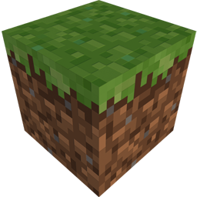
Python with Minecraft
10 Minute Programming Challenge!
Try to complete as many of the programming tasks below in 10 minutes…
Task 1
Find and use the computer block to get the yellow and blue item called “hello.py”

