Slide 1
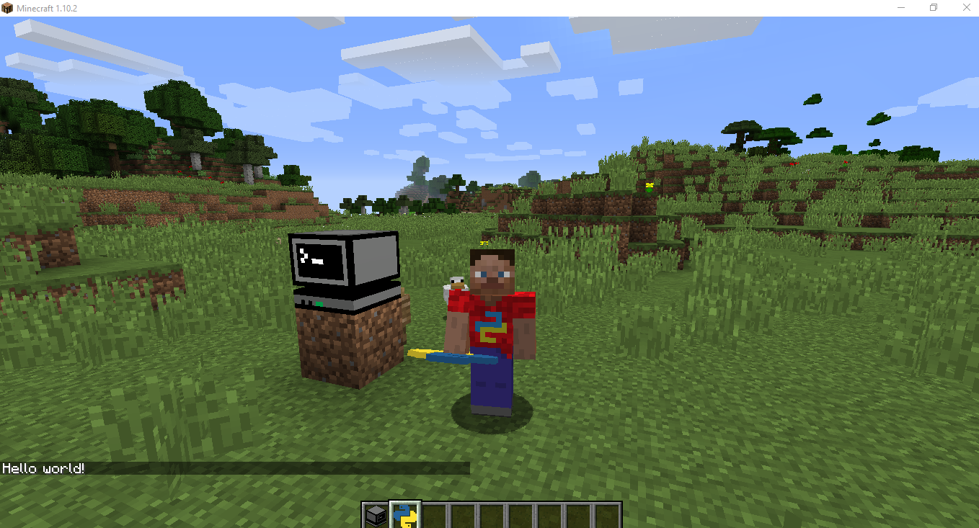

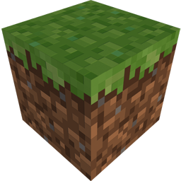
Python with Minecraft
10 Minute Programming Challenge!
Try to complete as many of the programming tasks in 10 minutes…
Task 1
Find and right-click the computer block, then get the yellow and blue item called “hellominecraft”, this is called a script
Right-click with the script in your hand
Next we’ll look at the script itself, look on the right hand side of your screen
Open the file called “hellominecraft.py”
Fine the line that says “mc.post_to_chat(“Hello World!”)
Change the word “World” to your name and save the file
Repeat the 1st and second steps, what changed?

