Slide 1
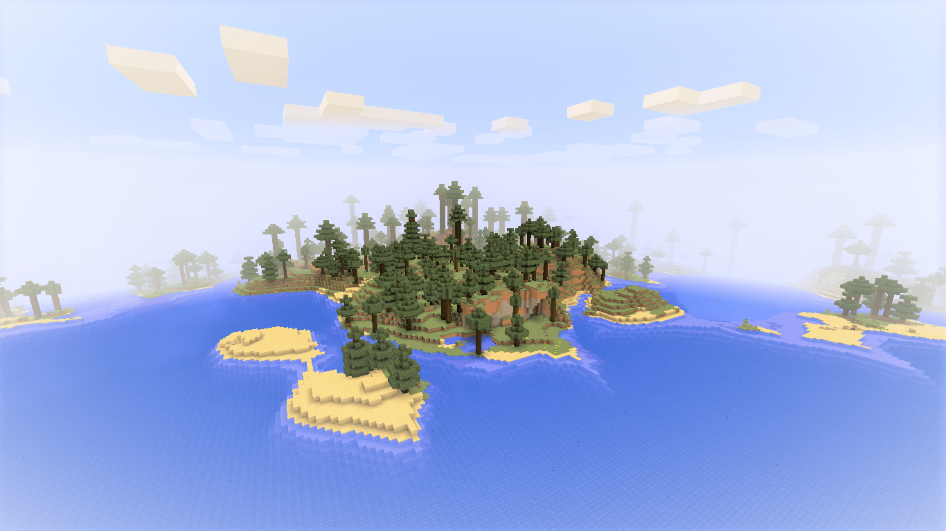



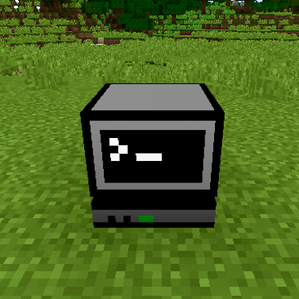
10 min programming challenge!
Use Python in Minecraft!
How many programming tasks can you complete in 10 minutes?
TASK 1
Find and right-click the computer block
Next, we’ll look at the script itself, first pause the game by pressing Esc
Now look on the right hand side of your screen and double-click the file called helloworld.py
Fine the line that says mc.postToChat(“Hello World!”)
Change the word “World” to your name and then save the file
Repeat steps 1, 2, 3, and 4. What changed?
Drag the yellow and blue item called “helloworld” to your inventory: this is called a SCRIPT
Close the computer by pressing E
Right-click with the script in your hand, what happens?

