Slide 1
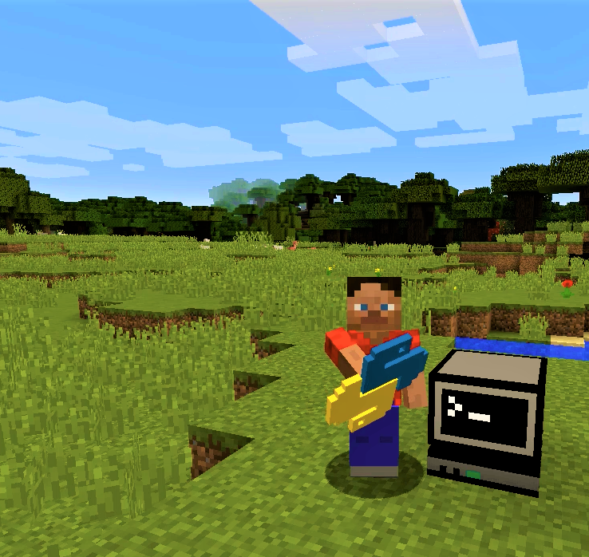
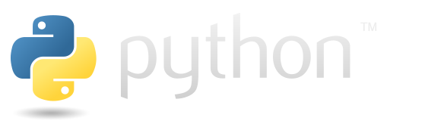
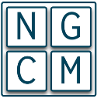

What is Minecraft?
What is Python?
Python is a very common and powerful -yet simple- programming language that can be used to modify your Minecraft worlds in real time.
PythonTool Mod:
PythonTool Mod provides an interactive way to get started with Python programming inside your Minecraft adventures.
Build arbitrary things, turn blocks into bombs or create interactive games, just with one click!
PytonTool Mod
Learning programming with Python and Minecraft
Learn more:
https://ngcm.github.io/PythonTool-Mod/

Slide 2
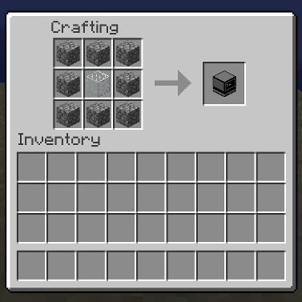
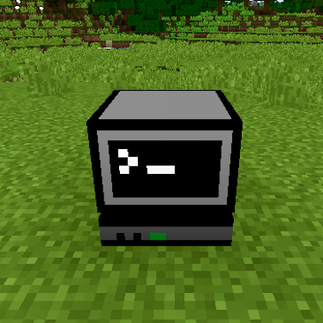
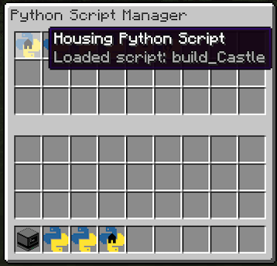

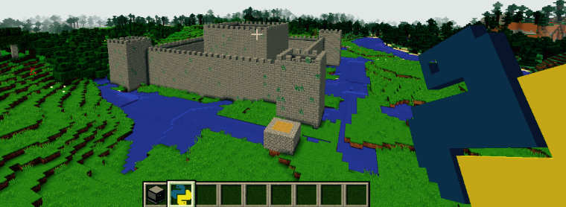
Ever wanted to learn how to program?
Write your own scripts or get plenty of examples online, and use them inside the game with the mighty Computer Block and Python Script items.
PythonTool Mod for Minecraft interactively alters your Minecraft world in real time, using Python
Get more examples and
start coding at:
https://ngcm.github.io/
PythonTool-Mod/
Get in touch:
PythonTool Mod
a.perez-diaz@soton.ac.uk
MIT License
Copyright (c) 2016, Alvaro Perez-Diaz
& Hans Fangohr.
NGCM, University of Southampton, UK

