Slide 1
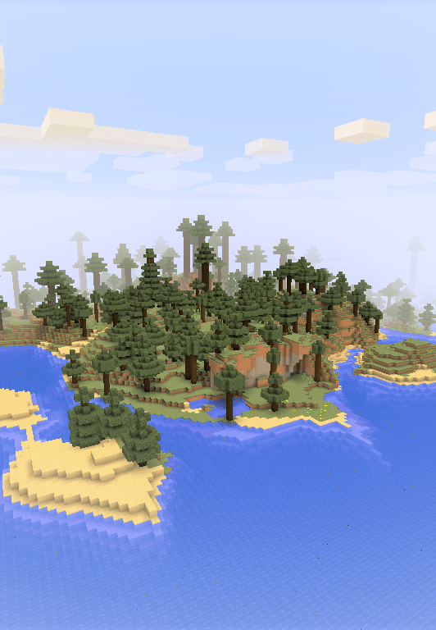



10 min programming challenge!
Use Python in Minecraft!
How many programming tasks can you complete in 10 minutes?
TASK 1
Find and right-click the computer block
Get the yellow and blue item called “hellominecraft”: this is called a SCRIPT
Right-click with the script in your hand. Did something happen?
Next, we’ll look at the script itself: look on the right hand side of your screen
Open the file called “hellominecraft.py”
Fine the line that says “mc.post_to_chat”: “Hello World!”
Change the word “World” to your name
Repeat the FIRST, SECOND and THIRD steps. What changed?

Slide 2
10 min programming challenge!
Use Python in Minecraft!
How many programming tasks can you complete in 10 minutes?
TASK 2

