Slide 1

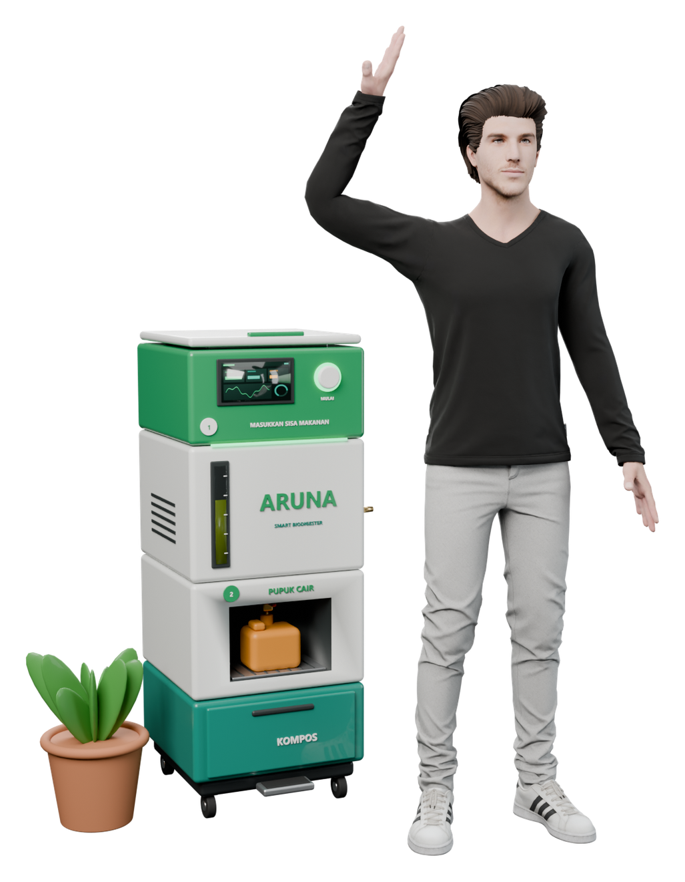
RESEARCH & DEVELOPMENT · ENVIRONMENTAL ENGINEERING
ARUNA
Kinetic-based design of an IoT-enabled household anaerobic digester for food waste
Anaerobic Recycling and Upcycling of Nutrient-rich food wAste: sized from mass balance and Gompertz kinetics, instrumented with NDIR methane sensing and safety interlocks.
SDG 7.1
SDG 11.6
SDG 12.3
SDG 13.2
[Team name] · [Supervisor] · [Institution] · 2026
ARUNA · smart home biodigester
01

Slide 2



02 · BACKGROUND
Food waste is Indonesia's largest organic waste stream.
53 kg
household food waste per capita per year
UNEP (2024)
14.7 Mt
household food waste per year, Indonesia
UNEP (2024)
≈40%
of municipal solid waste is food waste
SIPSN KLHK (2023)
1.7 Gt
CO₂e from food loss & waste, 2000–2019
Bappenas (2021)
Why anaerobic digestion?
Research questions
Property of food waste | Typical value | Source
Total solids (TS) | 23–27 % | Xu et al. (2018)
Volatile solids (VS/TS) | 90–95 % | Xu et al. (2018)
Biochemical CH₄ potential | 330–490 mL CH₄/g VS | Zhang et al. (2007)
Theoretical (Buswell) | ≈ 643 mL CH₄/g VS | Buswell & Mueller (1952)
● RQ1 What digester volume, OLR and HRT keep household food-waste digestion stable?
● RQ2 How much biogas, cooking time and avoided CO₂e can one unit deliver?
● RQ3 Can sensor feedback make the process usable for non-experts (SUS ≥ 68)?
Sources: UNEP Food Waste Index Report 2024; SIPSN KLHK 2023; Bappenas 2021 FLW study; Zhang et al. 2007, Bioresour. Technol. 98:929; Xu et al. 2018, Bioresour. Technol. 247:1047.
ARUNA · smart home biodigester
02

Slide 3

03 · STATE OF THE ART
Current options trade energy, space or visibility.
Approach | Footprint / scale | Input | Energy balance | Monitoring | Main limitation
Electric food recycler (Lomi) | countertop | food scraps | consumes 0.6–1.0 kWh/cycle | app | no energy recovery
HomeBiogas 2 | 2.1 × 1.15 m, 2.0 m³ | 4 L FW + 4 L water/d | up to 2 h cooking/d | visual | outdoor, 2.4 m² footprint
Fixed-dome digester (BIRU) | masonry, outdoor | livestock manure | household cooking gas | none | needs manure; 25,157 units (2021)
IoT digester research | pilot / lab | mixed organics | measured, not productised | ESP32: T, pH, CH₄, H₂S | not a household device
ARUNA | 0.44 × 0.44 m, 100 L | 1.5 kg FW + 1.5 L water/d | ≈43 min cooking/d (predicted) | NDIR CH₄, pH, T, level + interlocks | to be field-validated
Research gap
No household option combines food-waste input, energy recovery, indoor footprint and real-time process monitoring. Low-cost MQ-type gas sensors (300–10,000 ppm) cannot quantify biogas CH₄ (50–70 % vol); an NDIR sensor (0–100 % vol) is required.
Sources: Lomi (2024) energy use; HomeBiogas (2024) HB2 specifications; ESDM/Hivos BIRU (2021); Prasetyono et al. 2026, J. Mechatron. Electr. Power Veh. Technol. 17(1):29; Rajendran et al. 2012, Energies 5:2911; Winsen MQ-4 & MH-440D datasheets.
ARUNA · smart home biodigester
03

Slide 4


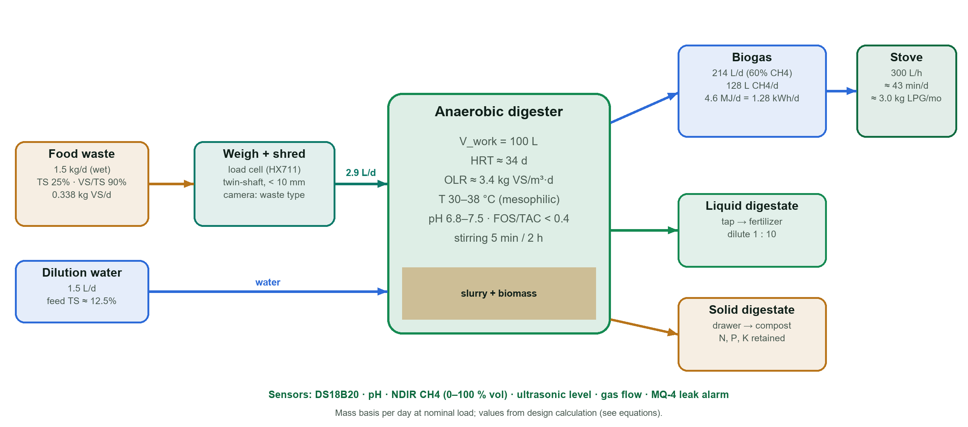

04 · SOLUTION
Shred, stir, digest, measure: three outputs.
1
Biogas
214 L/d · 1.3 kWh/d
2
Liquid digestate
N-rich fertilizer, dilute 1:10
3
Solid digestate
compost drawer
SDG 7.1
clean cooking fuel ≈ 3.0 kg LPG-eq/month
SDG 11.6
0.55 t/yr diverted from municipal waste
SDG 12.3
food waste valorised at source
SDG 13.2
0.72 t CO₂e/yr avoided (potential)
H1 At OLR ≤ 3.4 kg VS/m³·d and HRT ≈ 34 d: CH₄ ≥ 50 %, ≥ 0.30 m³ CH₄/kg VS, FOS/TAC < 0.4. H2 SUS ≥ 68.
Sources: Design calculation (this work) using Zhang et al. 2007; Xu et al. 2018; IPCC 2006 Vol. 5 Ch. 3; IPCC AR5 GWP100 = 28; UN A/RES/70/1 (SDG targets).
ARUNA · smart home biodigester
04

Slide 5


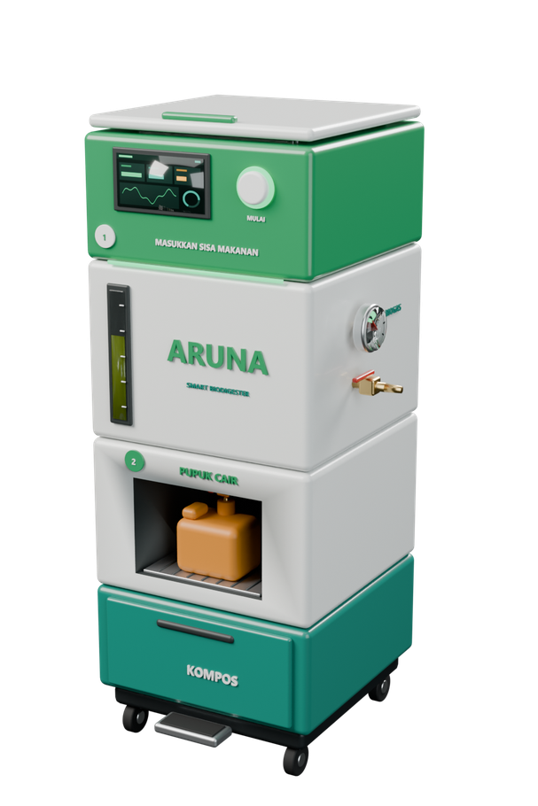
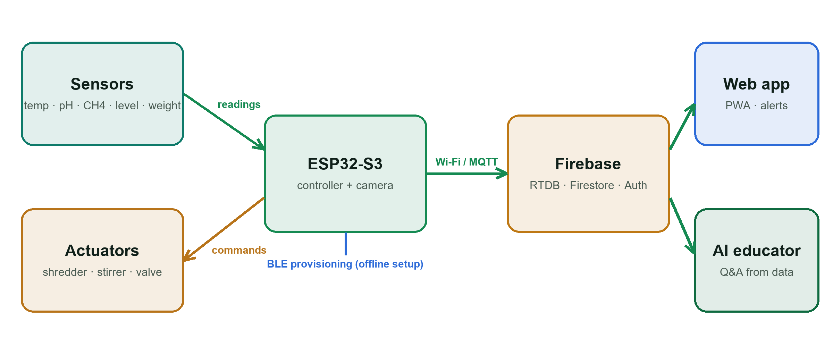
05 · THE PRODUCT
A 0.19 m² digester with a digital twin.
Hardware | Value
Footprint × height | 44 × 44 × 112 cm
Working volume | 100 L
Nominal / peak load | 1.5 / 3.0 kg FW/d
HRT / OLR | 34 d / 3.4 kg VS/m³·d
Controller | ESP32-S3 (Wi-Fi, BLE)
Process sensors | T, pH, NDIR CH₄, level, mass
Safety | MQ-4 leak alarm, valve
Software | Implementation
Telemetry | 15-min sampling → Firebase RTDB
Interface | PWA, live at aruna-id.web.app
Guidance | interlock alerts + AI educator
Setup | BLE provisioning, offline
Sources: This work (3D model & live app); Espressif ESP32-S3 datasheet; Google Firebase Realtime Database documentation.
ARUNA · smart home biodigester
05

Slide 6
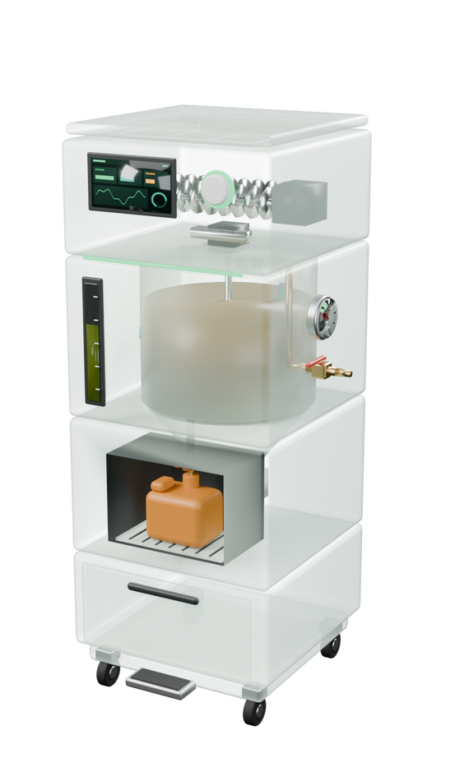

06 · THE HARDWARE
Gravity-fed layout, instrumented for process control.
7″ panel + ESP32-S3
Parameter | Sensor | Range | Accuracy / role
Temperature | DS18B20 | −55–125 °C | ±0.5 °C
CH₄ in biogas | NDIR MH-440D | 0–100 % vol | T90 < 30 s
CH₄ leak | MQ-4 | 300–10,000 ppm | alarm 10 % LEL
pH | glass probe | 0–14 | 3-pt calibration
Level | ultrasonic | 0–100 % fill | ≈ ±1 cm
Input mass | load cell + HX711 | 0–5 kg | 24-bit ADC
Gas volume | diaphragm meter | L/d | reference
Twin-shaft shredder
Load cell (HX711)
Stirrer, 5 min / 2 h
Liquid digestate tap
Safety & process interlocks
leak > 5,000 ppm → close valve · pH < 6.5 → pause feeding · T < 30 °C → insulation alert · level > 90 % → harvest prompt
Solid digestate drawer
Sources: Maxim/Analog Devices DS18B20 datasheet; Winsen MH-440D (NDIR, 0–100 % vol) & MQ-4 (300–10,000 ppm) datasheets; CH₄ LEL 5 % vol.
ARUNA · smart home biodigester
06

Slide 7


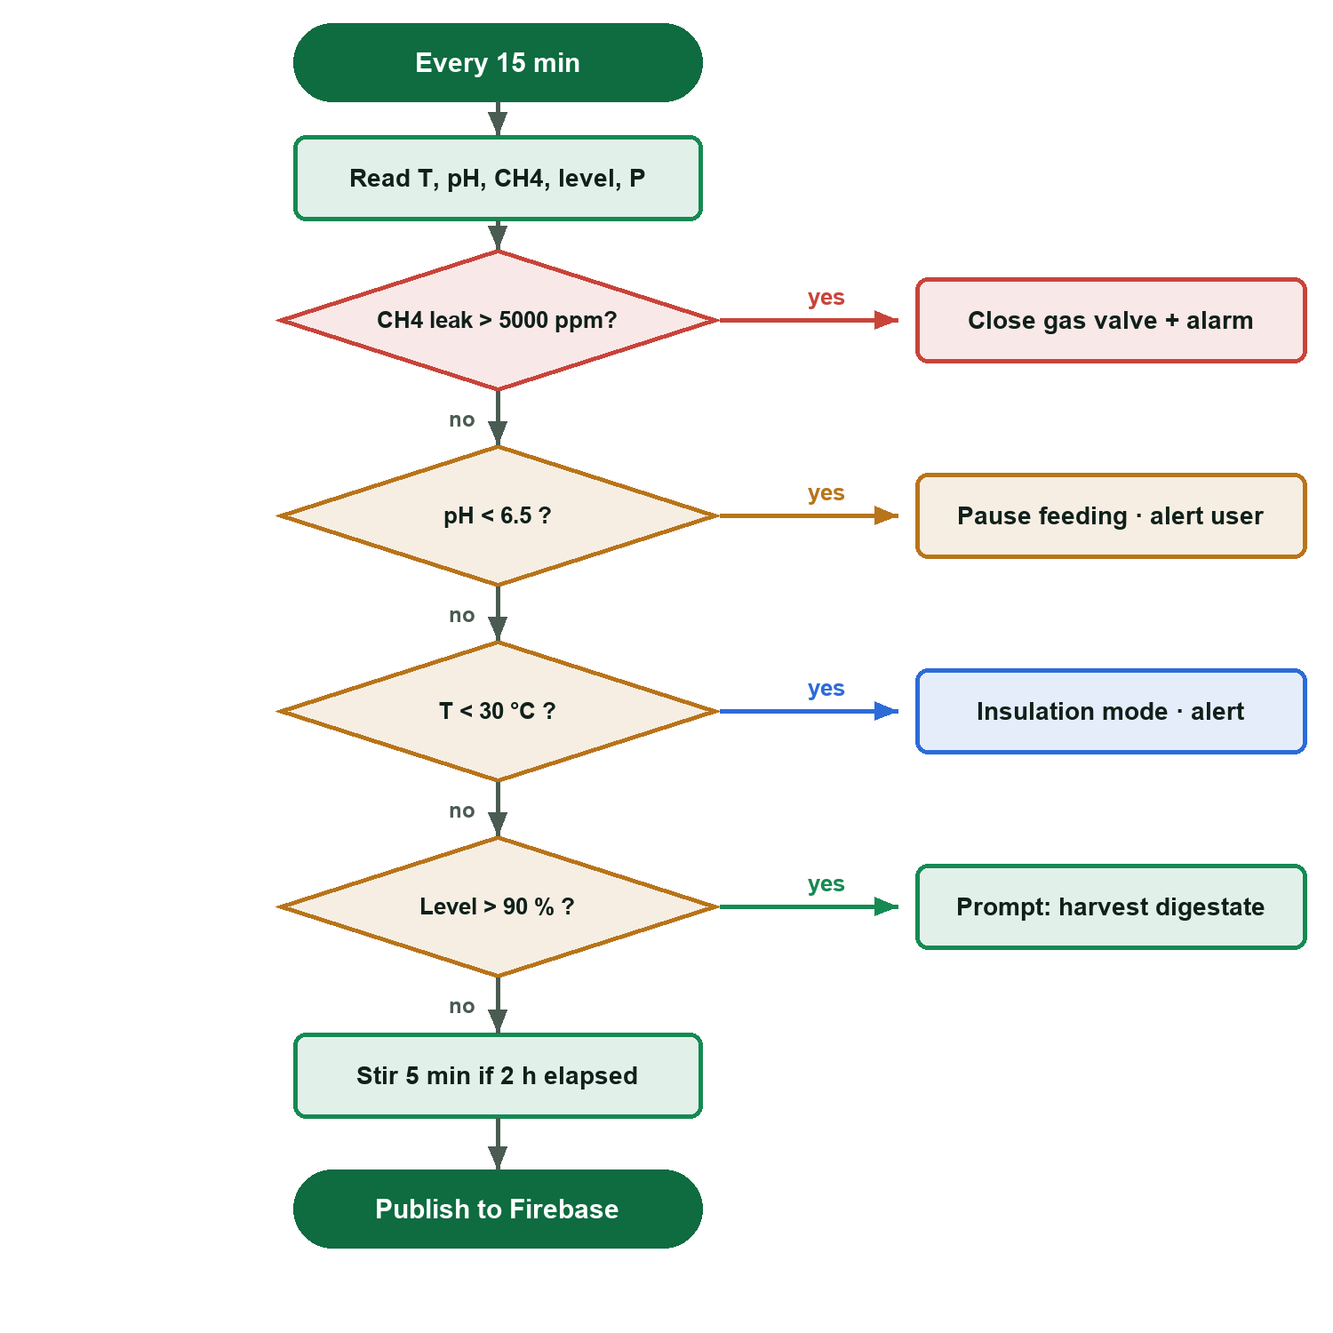
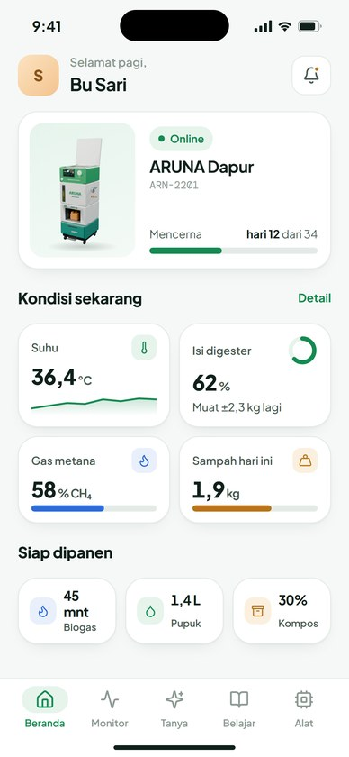
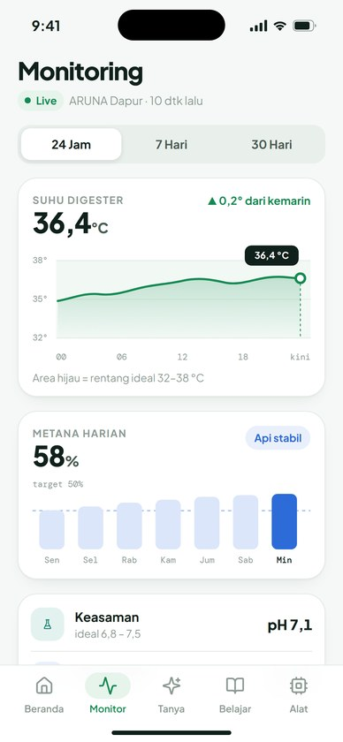
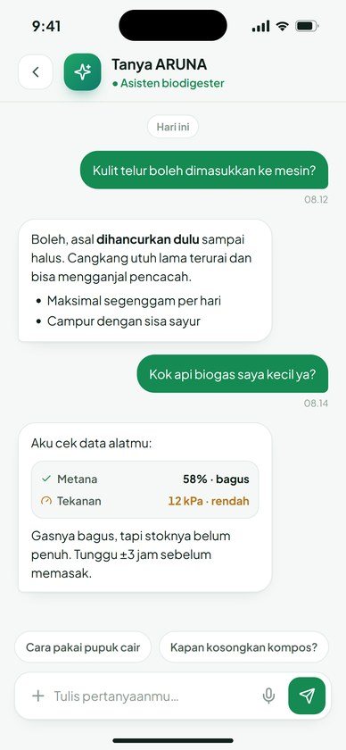
07 · THE SOFTWARE
From raw signals to plain-language decisions.
Status
Trends + ideal band
AI educator
Sources: This work (rule-based controller, live PWA). Rule thresholds: pH 6.5–7.5 and FOS/TAC < 0.4 (Chen et al. 2008, Bioresour. Technol. 99:4044; Liu et al. 2021, Appl. Sci. 11:11843).
ARUNA · smart home biodigester
07

Slide 8

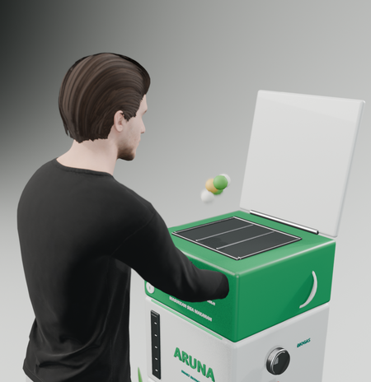
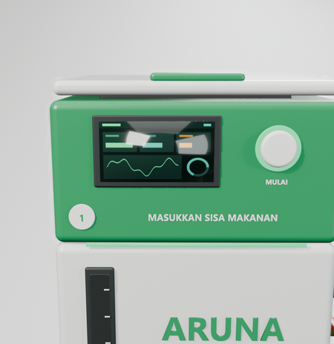
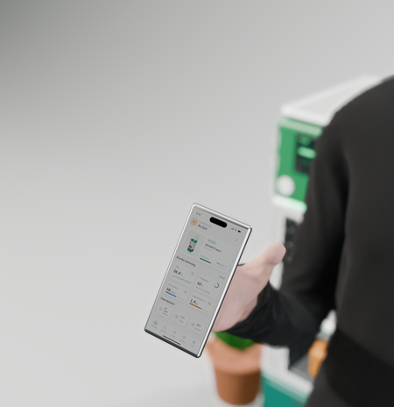
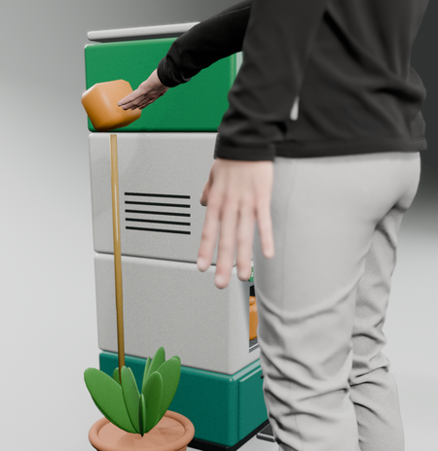
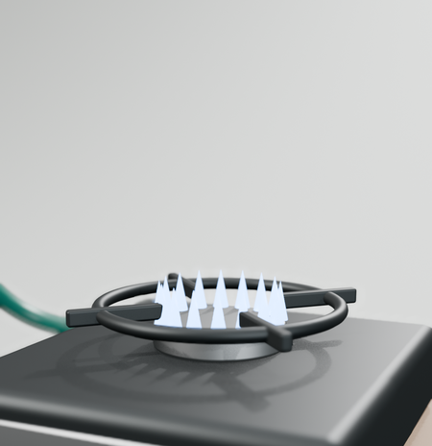
08 · USE CASE
One day of operation, quantified.
1
2
3
4
5
Feed
1.5 kg FW + 1.5 L water; weighed & shredded
Digest
OLR 3.4 kg VS/m³·d, stir 5 min / 2 h
Monitor
15-min telemetry; alert if pH < 6.5
Fertilize
liquid digestate diluted 1:10
Cook
214 L biogas ≈ 43 min at 0.30 m³/h
Sources: Design calculation (this work); stove demand 0.2–0.45 m³/h (SSWM/Akvopedia, Biogas combustion, 2019).
ARUNA · smart home biodigester
08

Slide 9


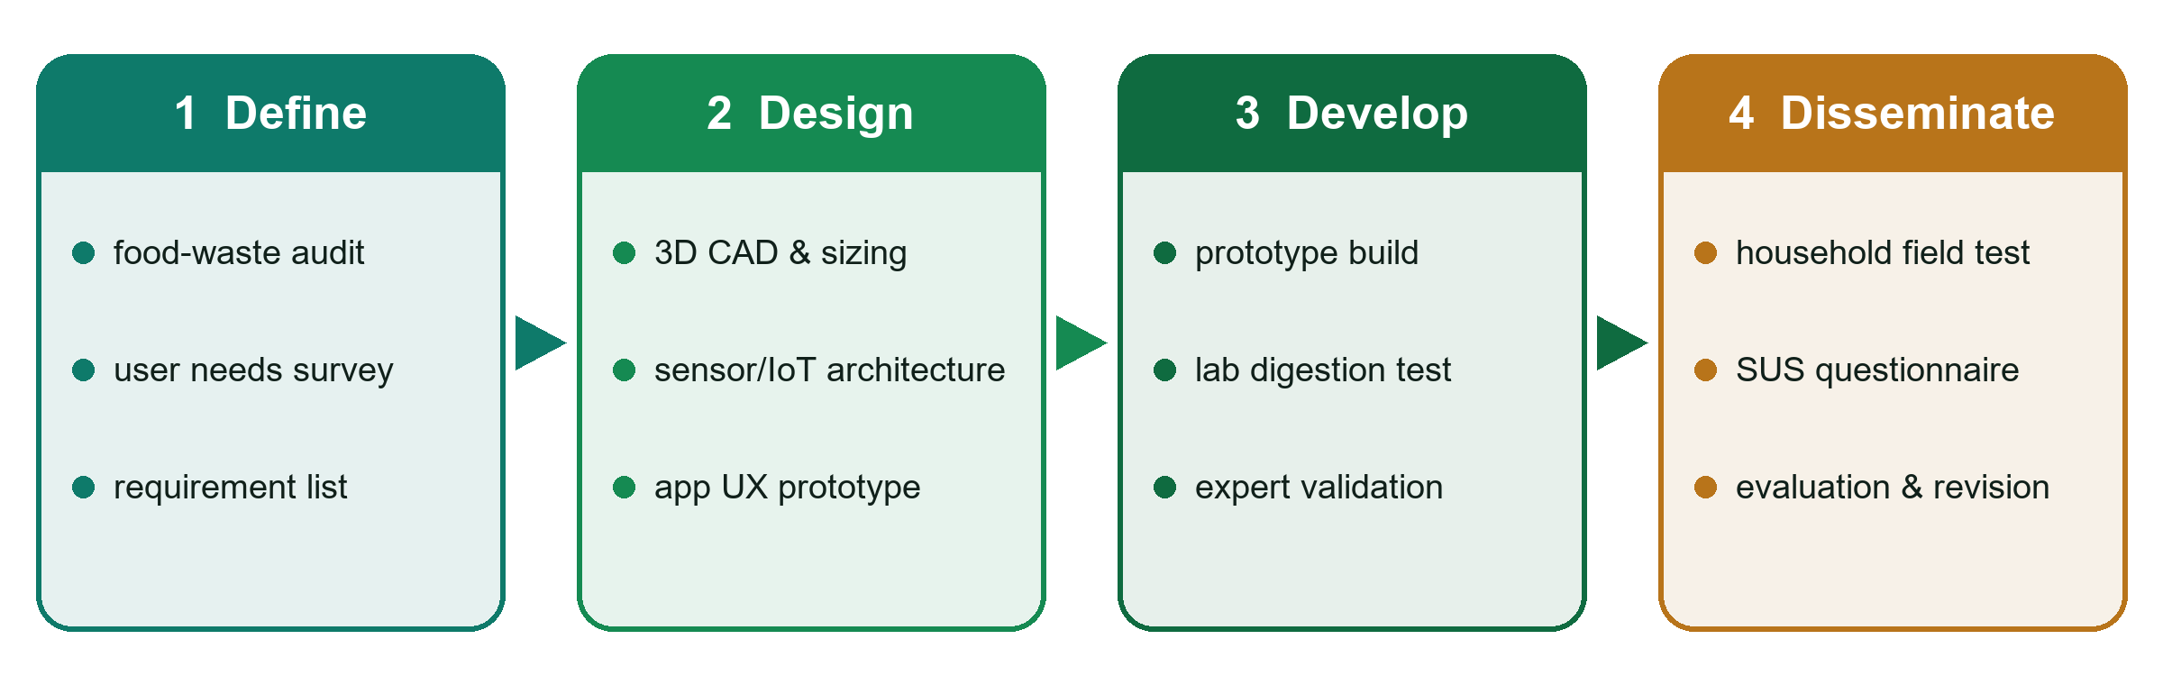

09 · RESEARCH METHOD
R&D (4D model) with quantitative exit criteria.
Mass balance
OLR = F·TS·(VS/TS) / V_{w} HRT = V_{w} / Q
Kinetics (Gompertz)
M(t) = P·exp{−exp[(R_{m}·e/P)(λ − t) + 1]}
Theoretical CH₄ (Buswell)
C_{c}H_{h}O_{o}N_{n} + H₂O → CH₄ + CO₂ + NH₃
Energy & cooking
E = V_{CH4} · 35.8 MJ/m³ ; t_{cook} = V_{biogas} / q_{stove}
Avoided landfill CH₄ (IPCC)
W · DOC · DOC_{f} · MCF · F · 16/12 · (1 − OX)
Experiment | Design | Standard / method | Output
BMP assay | ISR ≥ 2, 37 °C, triplicate | VDI 4630 | P, Rm, λ
Semi-continuous | OLR 2.0 / 3.4 / 4.5 × 3 reps, 2 HRT | APHA 2540 G; FOS/TAC | yield, stability
Field test | [n] households × 30 d | telemetry + logbook | CH₄ %, L/d, kg/d
Usability | post-test questionnaire | SUS (Brooke 1996) | score 0–100
● Kinetics: non-linear least squares, R², RMSE
● Comparison: one-way ANOVA + Tukey, α = 0.05
● Biodegradability: BMP(exp) / BMP(theoretical)
Sources: Thiagarajan et al. 1974; Buswell & Mueller 1952, Ind. Eng. Chem. 44:550; Zwietering et al. 1990, Appl. Environ. Microbiol. 56:1875; VDI 4630 (2016); APHA 2540 (2017); Brooke 1996.
ARUNA · smart home biodigester
09

Slide 10

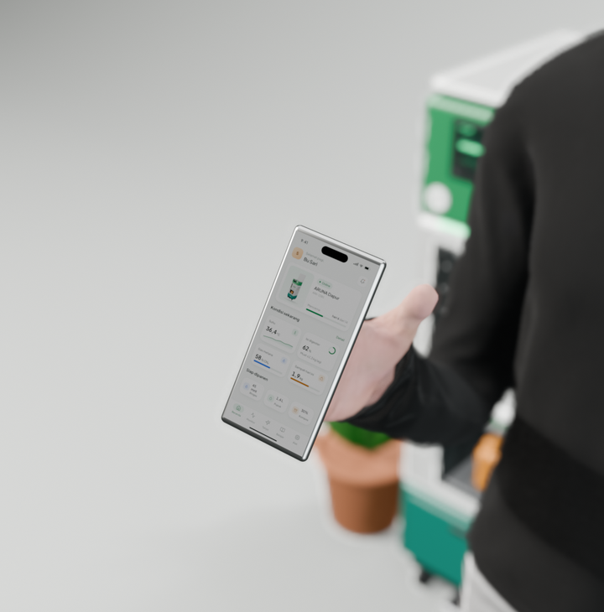
10 · FIELD TESTING
Measurement plan with acceptance criteria.
ILLUSTRATIVE DATA · replace with field results
Parameter | Instrument / method | Frequency | Acceptance | Basis
Temperature | DS18B20 | 15 min | 30–38 °C | Weiland (2010)
pH | calibrated probe | 15 min | 6.8–7.5 | Chen et al. (2008)
FOS/TAC | two-point titration | weekly | < 0.4 | Liu et al. (2021)
CH₄ content | NDIR + [ref. analyser] | continuous | ≥ 50 % vol | Xu et al. (2018)
Biogas volume | diaphragm gas meter | daily | ≥ 171 L/d | this work (−20 %)
TS / VS | APHA 2540 G | weekly | VS removal ≥ 70 % | Mata-Alvarez (2000)
Digestate N, P, K | lab analysis | end of cycle | [standard] | national fertilizer standard
Usability | SUS | end of test | ≥ 68 | Bangor et al. (2009)
Rendered scenario; replace with field photos.
Sources: Weiland 2010; Chen et al. 2008; Liu et al. 2021, Appl. Sci. 11(24):11843; Xu et al. 2018; Mata-Alvarez et al. 2000, Bioresour. Technol. 74:3; APHA 2540 (2017); Bangor et al. 2009, J. Usability Stud. 4:114.
ARUNA · smart home biodigester
10

Slide 11

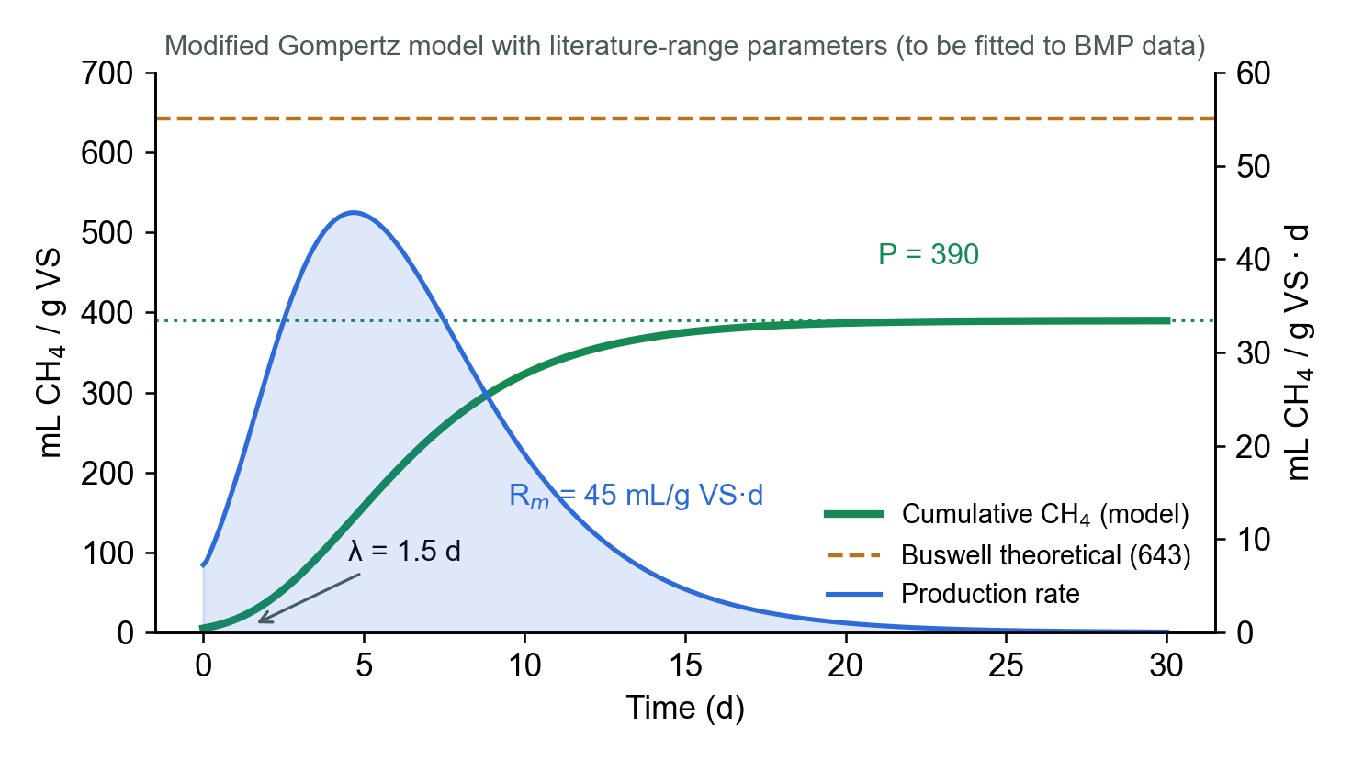
11 · RESULT & DISCUSSION
Design predictions against the literature.
PREDICTED FROM DESIGN CALCULATION · measured data pending
Parameter | Household of 4 | Nominal | Peak
Input (kg FW/d) | 0.58 | 1.5 | 3.0
OLR (kg VS/m³·d) | 1.3 | 3.4 | 6.8
HRT (d) | 88 | 34 | 17
Biogas (L/d) | 83 | 214 | 428
Cooking (min/d) | 17 | 43 | 86
LPG-eq (kg/month) | 1.2 | 3.0 | 6.0
Avoided (t CO₂e/yr) | 0.28 | 0.72 | 1.44
● Biodegradability ≈ 61 %: BMP 390 vs Buswell 643 mL CH₄/g VS, within reported food-waste range (Zhang et al., 2007).
● Stability: nominal OLR 3.4 is within stable ranges; peak OLR 6.8 at HRT 17 d risks VFA accumulation → pH interlock (Chen et al., 2008).
● Scale: a household of 4 yields ≈ 17 min/d; nominal load fits extended families or small eateries.
Sources: Design calculation (this work); Gompertz parameters from literature ranges, to be fitted (Zwietering et al. 1990); Zhang et al. 2007; Chen et al. 2008; UNEP 2024 (53 kg/cap/yr).
ARUNA · smart home biodigester
11

Slide 12


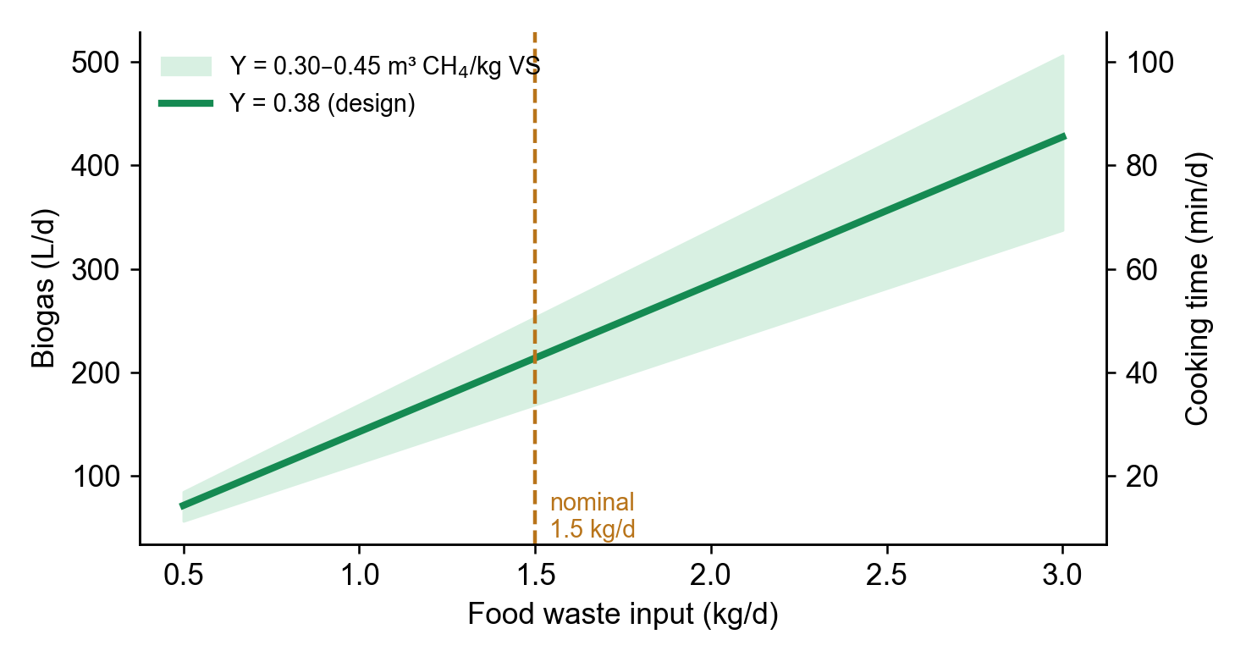

12 · FUTURE DEVELOPMENT
From prototype to verified impact.
1
0–6 months · Validate
● BMP + semi-continuous tests; fit P, Rm, λ
● calibrate NDIR vs gas analyser
2
6–12 months · Optimise
● co-digestion to C/N 20–30
● H₂S scrubber; insulation for T < 25 °C
3
12–36 months · Scale
● on-device AI waste recognition
● MBG school-kitchen pilots with MRV
Sources: Sensitivity analysis (this work); C/N 20–30 and H₂S removal (Weiland 2010, Appl. Microbiol. Biotechnol. 85:849; Mata-Alvarez et al. 2000).
ARUNA · smart home biodigester
12

Slide 13


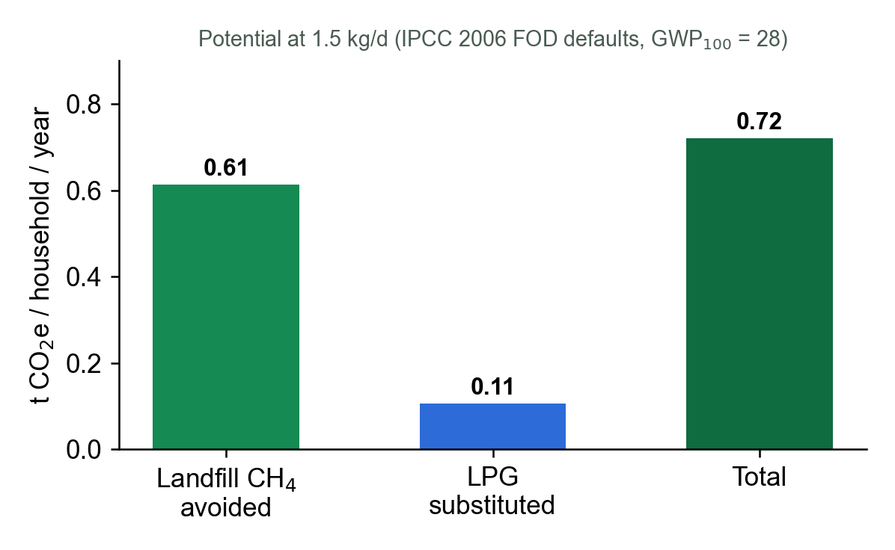


13 · CONCLUSION
Answers to the research questions.
RQ1
A 100 L digester at OLR 3.4 kg VS/m³·d and HRT ≈ 34 d is predicted to be stable for 1.5 kg/d; peaks above ≈ 3 kg/d require pausing.
RQ2
≈ 214 L biogas/d → ≈ 43 min cooking, ≈ 3.0 kg LPG-eq/month and ≈ 0.72 t CO₂e/yr avoided.
RQ3
NDIR sensing, rule-based interlocks and app guidance close the monitoring gap; SUS to be measured.
Live prototype app aruna-id.web.app
Values are design predictions; measured results will replace them after testing.
Sources: This work; IPCC 2006 Vol. 5 Ch. 3 (FOD defaults); IPCC AR5 (GWP100 = 28).
ARUNA · smart home biodigester
13

Slide 14

14 · REFERENCES
Literature and data sources.
1. APHA (2017). Standard Methods for the Examination of Water and Wastewater, 23rd ed., Method 2540.
2. Appels, L. et al. (2008). Prog. Energy Combust. Sci. 34(6), 755–781. doi:10.1016/j.pecs.2008.06.002
3. Bangor, A., Kortum, P., Miller, J. (2009). J. Usability Stud. 4(3), 114–123.
4. Bappenas (2021). Food Loss and Waste in Indonesia. Ministry of National Development Planning.
5. Brooke, J. (1996). SUS: a 'quick and dirty' usability scale. Usability Evaluation in Industry, 189–194.
6. Buswell, A. M., Mueller, H. F. (1952). Ind. Eng. Chem. 44(3), 550–552. doi:10.1021/ie50507a033
7. Chen, Y., Cheng, J. J., Creamer, K. S. (2008). Bioresour. Technol. 99(10), 4044–4064. doi:10.1016/j.biortech.2007.01.057
8. ESDM (2021). Strategi pengembangan biogas menuju target 1 juta biodigester. Ditjen EBTKE.
9. HomeBiogas (2024). HomeBiogas 2 product specifications. homebiogas.com
10. IPCC (2006). Guidelines for National GHG Inventories, Vol. 5 Waste, Ch. 3.
11. IPCC (2014). Climate Change 2014: Synthesis Report (AR5).
12. KLHK (2023). SIPSN: Komposisi sampah. sipsn.menlhk.go.id
13. Liu, X. et al. (2021). Appl. Sci. 11(24), 11843. doi:10.3390/app112411843
14. Lomi (2024). How much energy does Lomi use? lomi.com
15. Mata-Alvarez, J., Macé, S., Llabrés, P. (2000). Bioresour. Technol. 74(1), 3–16. doi:10.1016/S0960-8524(00)00023-7
16. Prasetyono, S. et al. (2026). J. Mechatron. Electr. Power Veh. Technol. 17(1), 29–38. doi:10.55981/j.mev.2026.1352
17. Rajendran, K. et al. (2012). Energies 5(8), 2911–2942. doi:10.3390/en5082911
18. SSWM / Akvopedia (2019). Biogas combustion. sswm.info
19. Thiagarajan, S., Semmel, D. S., Semmel, M. I. (1974). Instructional Development for Training Teachers of Exceptional Children. Indiana Univ.
20. UNEP (2024). Food Waste Index Report 2024. Nairobi.
21. VDI 4630 (2016). Fermentation of organic materials. Verein Deutscher Ingenieure.
22. Weiland, P. (2010). Appl. Microbiol. Biotechnol. 85(4), 849–860. doi:10.1007/s00253-009-2246-7
23. Winsen (n.d.). MH-440D NDIR CH₄ sensor; MQ-4 gas sensor datasheets.
24. Xu, F. et al. (2018). Bioresour. Technol. 247, 1047–1058. doi:10.1016/j.biortech.2017.09.020
25. Zhang, R. et al. (2007). Bioresour. Technol. 98(4), 929–935. doi:10.1016/j.biortech.2006.02.039
26. Zwietering, M. H. et al. (1990). Appl. Environ. Microbiol. 56(6), 1875–1881. doi:10.1128/aem.56.6.1875-1881.1990
ARUNA · smart home biodigester
14

