Slide 1
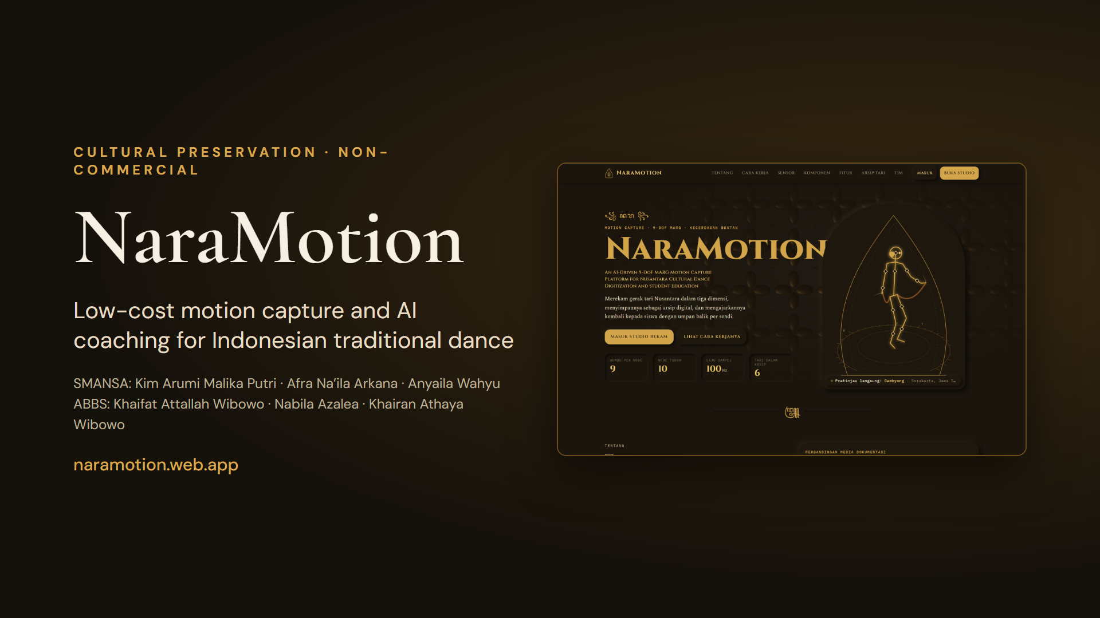
Notes:
NaraMotion records, archives and teaches Indonesian traditional dance. It combines a ten-node 9-DoF sensor suit, a browser platform, and AI models trained on open Balinese dance videos. The project is non-commercial and focused on cultural preservation.

Slide 2
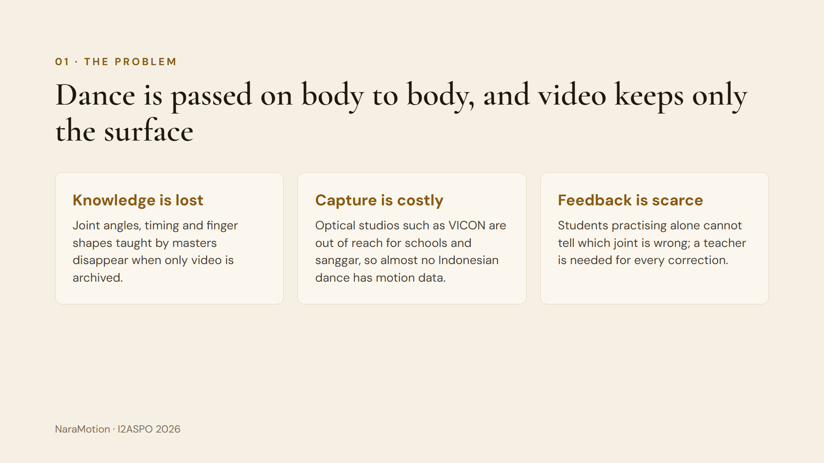
Notes:
Traditional dance knowledge lives in the bodies of masters. Video archives keep the look, but not measurable joint angles, timing or hand shapes. Optical motion capture exists, but it costs too much for schools and sanggar, so there is almost no open motion data for Indonesian dance. Students practising alone also get no joint-level feedback.

Slide 3
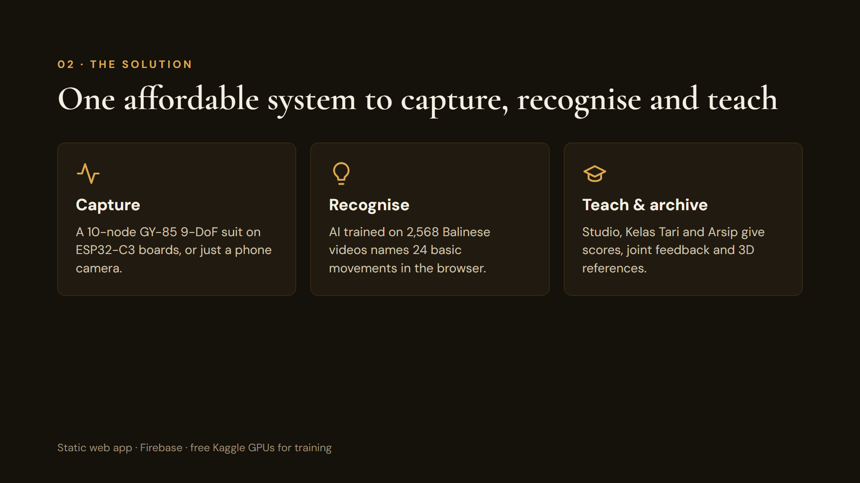
Notes:
NaraMotion has three parts. Capture: a ten-node inertial suit, or simply the camera of a phone or laptop. Recognise: AI models trained on 2,568 open Balinese videos identify 24 basic movements, running fully in the browser. Teach and archive: the Studio shows 3D motion and sensors, Kelas Tari scores a student against references, and the Arsip preserves movements with 3D characters.

Slide 4
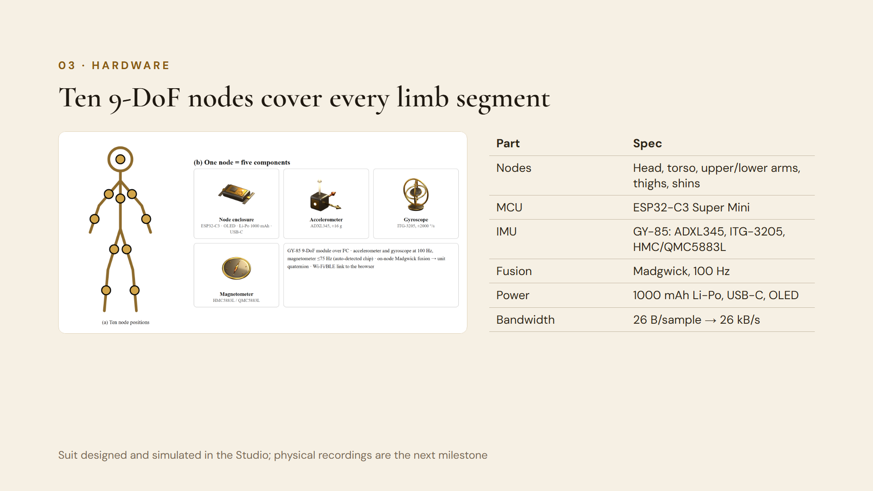
Notes:
Each node pairs an ESP32-C3 Super Mini with a GY-85 board: accelerometer ADXL345 (±16 g), gyroscope ITG-3205 (±2000°/s) and a magnetometer, auto-detected as HMC5883L or QMC5883L. Orientation is fused with Madgwick at 100 Hz. A sample is 26 bytes, so ten nodes stream about 26 kB/s. Be honest: the suit is designed and its signals are simulated; recordings from physical nodes are the next step.

Slide 5
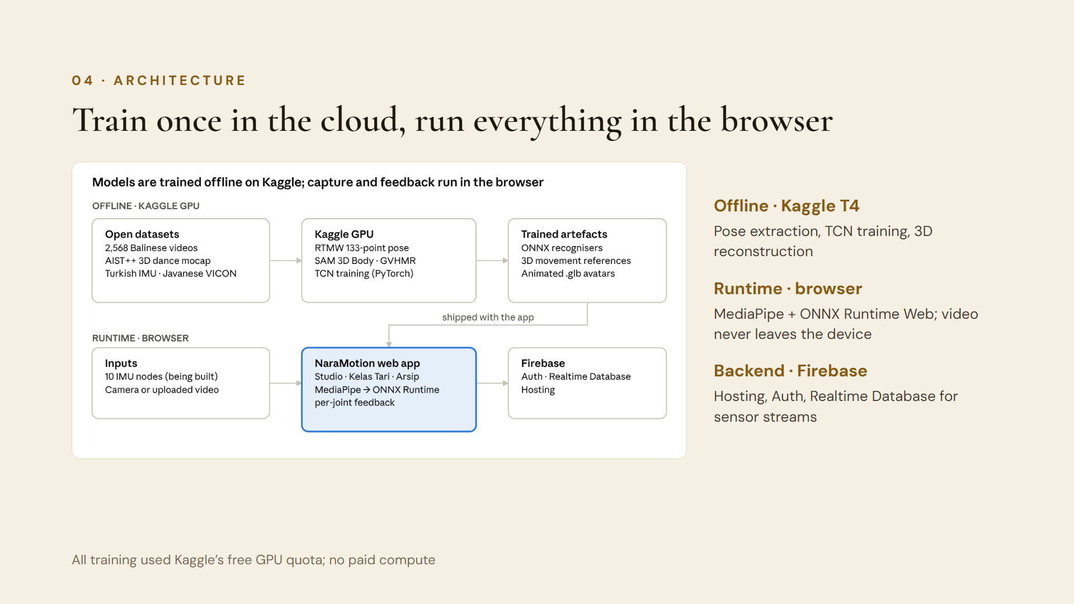
Notes:
Heavy work happens once, offline, on Kaggle’s free Tesla T4 GPUs: whole-body pose extraction, recogniser training and 3D reconstruction. The outputs are small ONNX models and reference files served as a static site on Firebase Hosting. In the browser, MediaPipe finds the body and ONNX Runtime Web runs the recogniser, so the student’s video stays on their device.

Slide 6
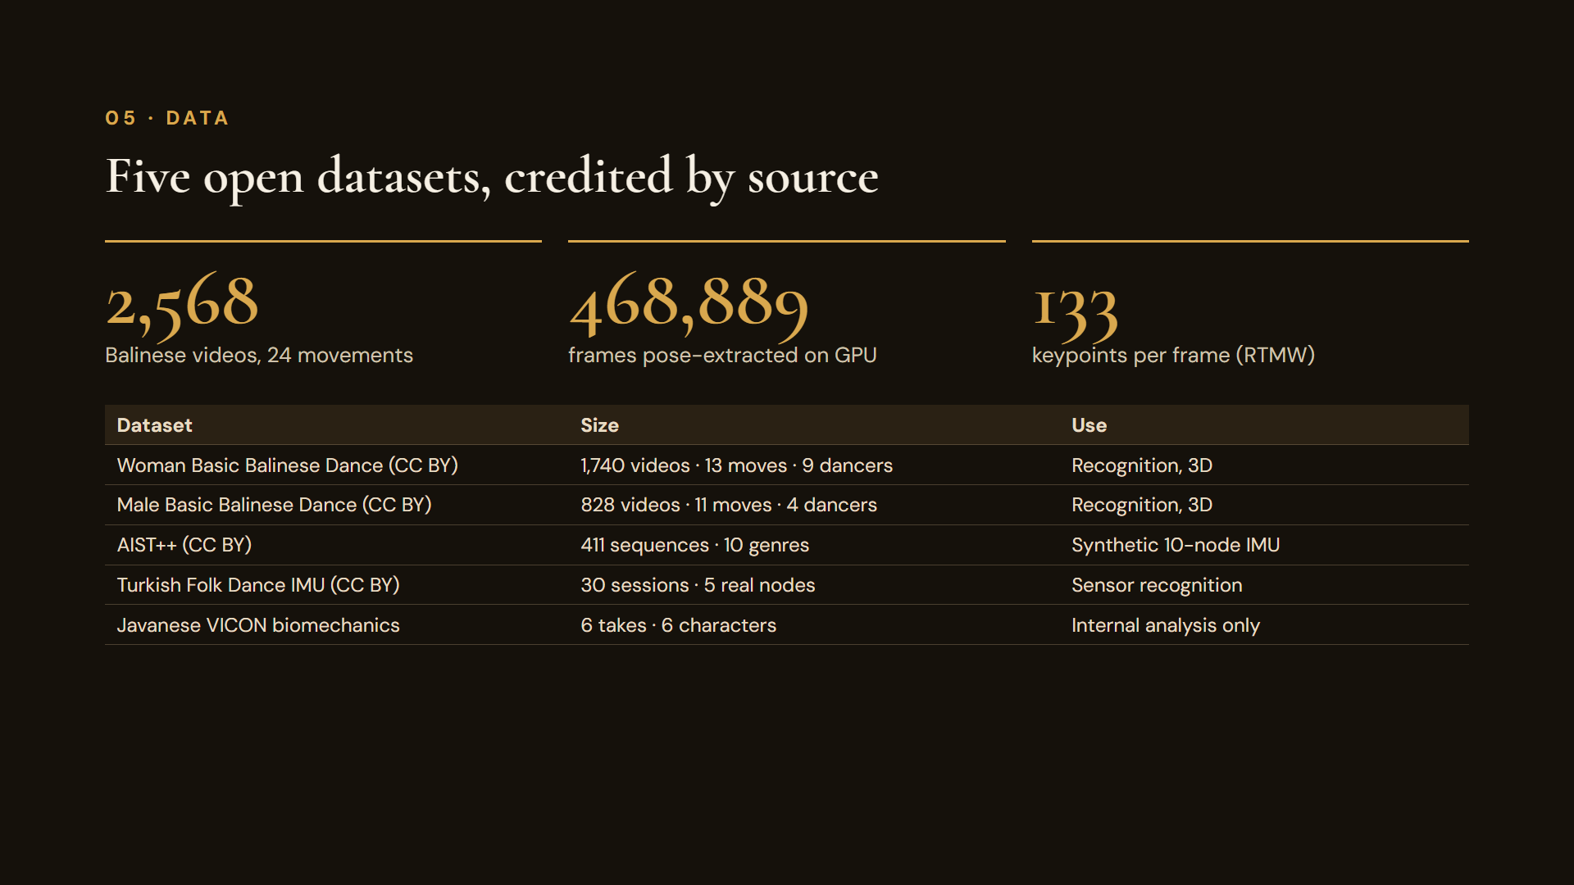
Notes:
Recognition uses two CC BY 4.0 Mendeley datasets of basic Balinese movements: 1,740 female videos with 13 movements and 828 male videos with 11 movements, filmed from three cameras. In total 468,889 frames were processed with the RTMW whole-body estimator, giving 133 keypoints per frame including hands and face. AIST++ is used to synthesise ten-node IMU signals, a Turkish folk-dance set gives real five-node IMU data, and an unlicensed Javanese VICON set is used only for internal analysis.

Slide 7
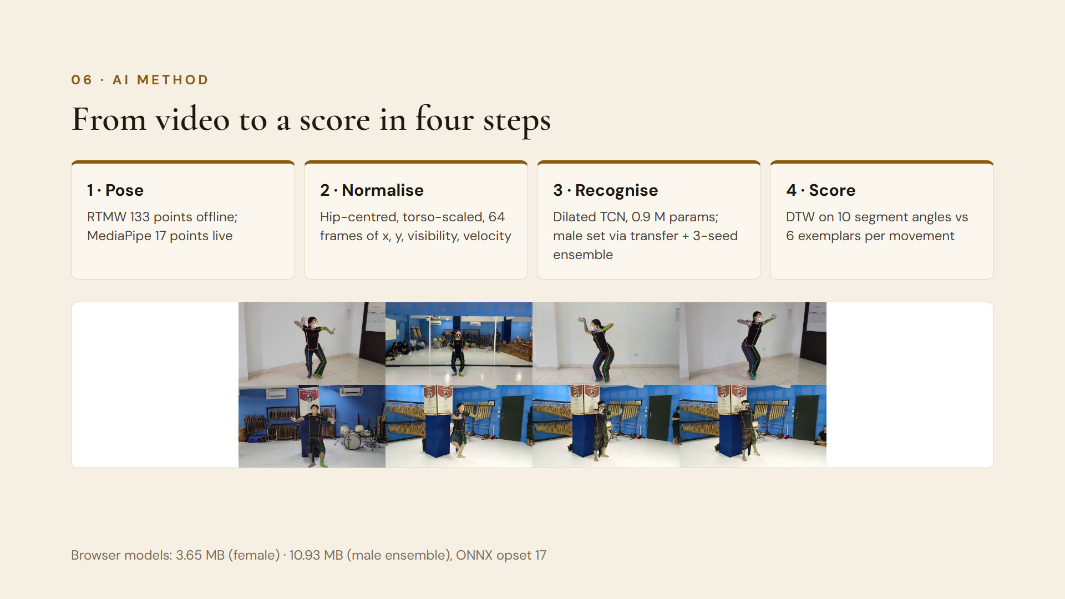
Notes:
Step 1: RTMW extracts 133 whole-body keypoints offline; in the browser MediaPipe supplies 17 body points. Step 2: poses are centred on the hips, scaled by torso length and resampled to 64 frames, with position, binary visibility and velocity features. Step 3: a temporal convolutional network with four dilated residual blocks, about 914 thousand parameters, classifies the movement; the small male set starts from the female model and uses a three-seed ensemble. Step 4: dynamic time warping over ten segment angles compares the student with six exemplars per movement and gives a calibrated 0–100 score plus the worst joints.

Slide 8
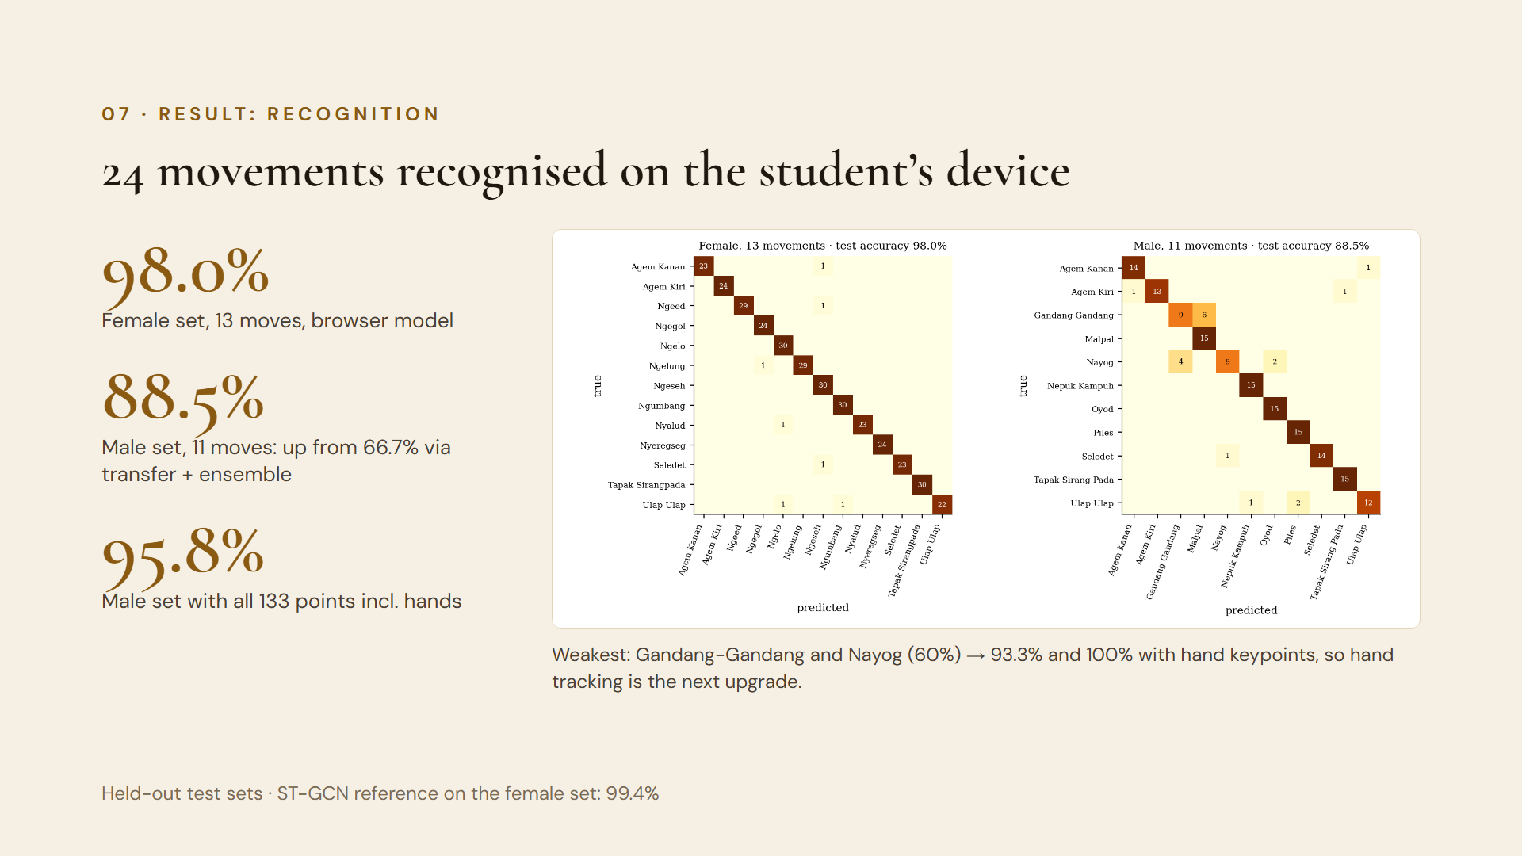
Notes:
On held-out test videos, the browser model reaches 98.0% on the female set, close to the 99.4% reported for ST-GCN, but small enough to run in a web page. The male set has only four dancers; from scratch it reached 66.7%. Starting from the female model and averaging three seeds lifted it to 88.5%, and 95.8% with all 133 keypoints. The two weakest male movements, Gandang-Gandang and Nayog, depend on hands and feet, which is why browser hand tracking is the next priority. In the browser, the Camera AI recognised a training clip of Agem Kanan at 87% confidence and an unseen Ngeseh clip at 94%.

Slide 9
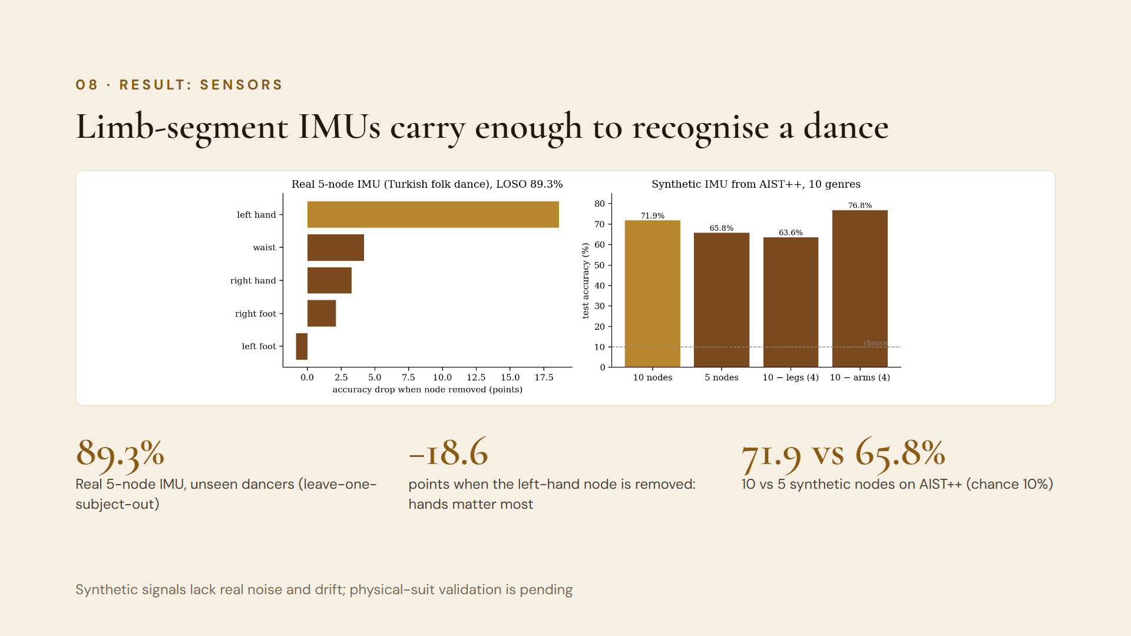
Notes:
Two experiments test whether the suit design makes sense. With a public Turkish folk-dance set recorded with five real IMU nodes, the recogniser reached 89.3% on dancers it had never seen; removing the left-hand node cost 18.6 points, far more than any other node. With synthetic ten-node IMU signals generated from AIST++ motion, ten nodes beat five, 71.9% versus 65.8%, on ten dance genres. Caveat: synthetic data has no real noise, drift or magnetic disturbance.

Slide 10
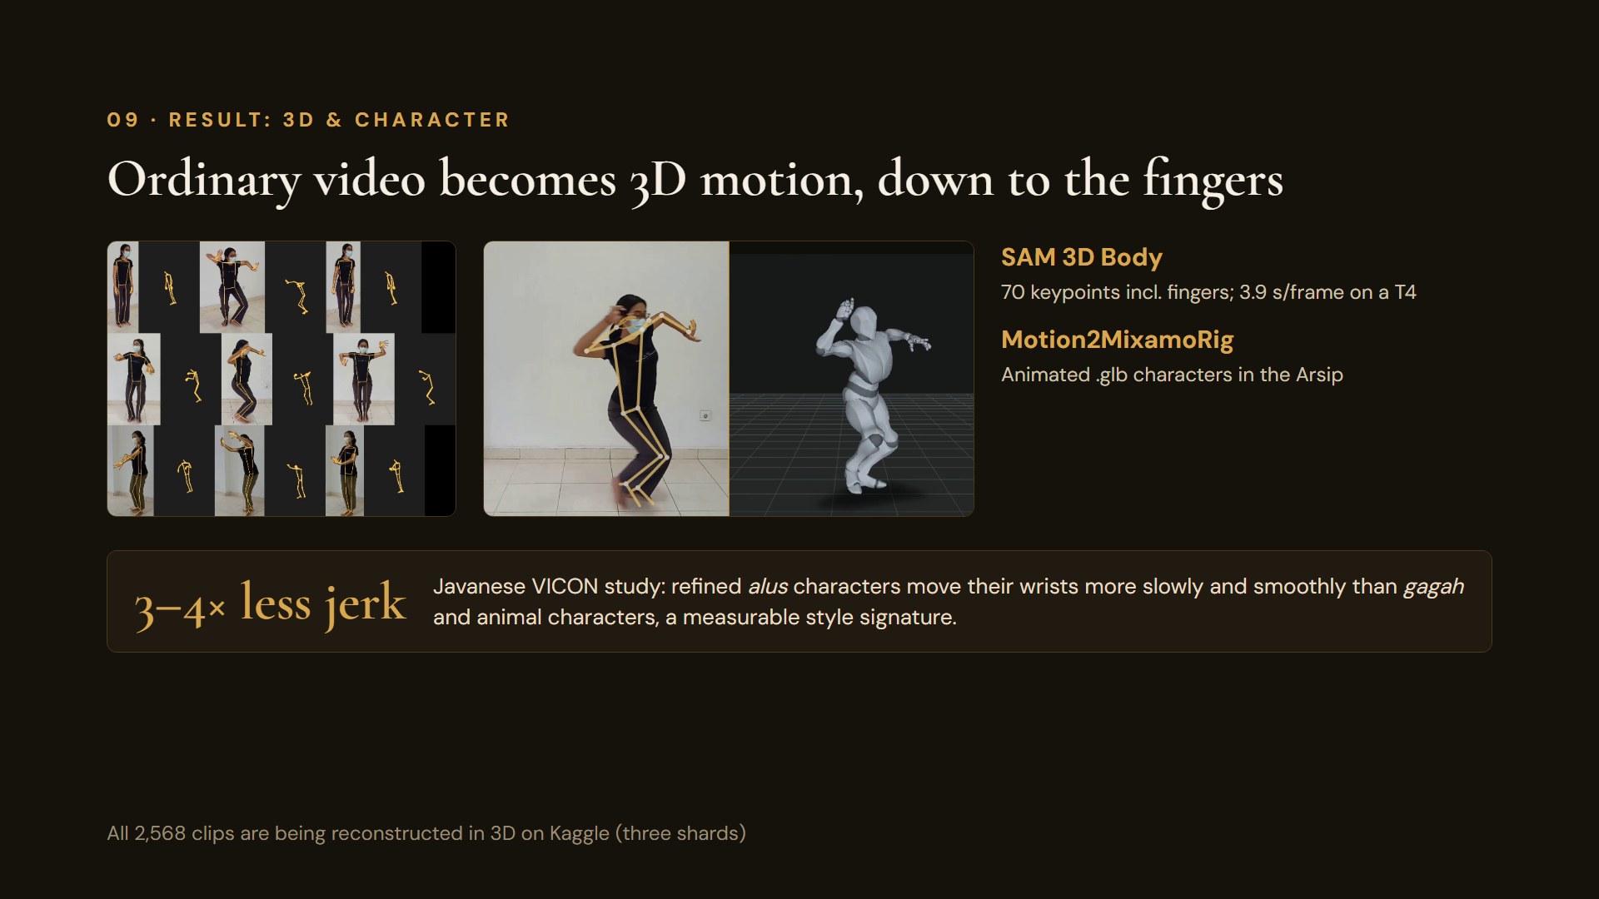
Notes:
SAM 3D Body from Meta reconstructs 70 keypoints per frame, including individual finger joints, from a single camera. Motion2MixamoRig turns the same clips into animated characters, now shown in the Arsip. Processing all 2,568 clips is under way. From six Javanese VICON takes, the refined alus characters show three to four times less wrist jerk than the strong and animal characters: the kind of quantitative style signature NaraMotion can teach.

Slide 11
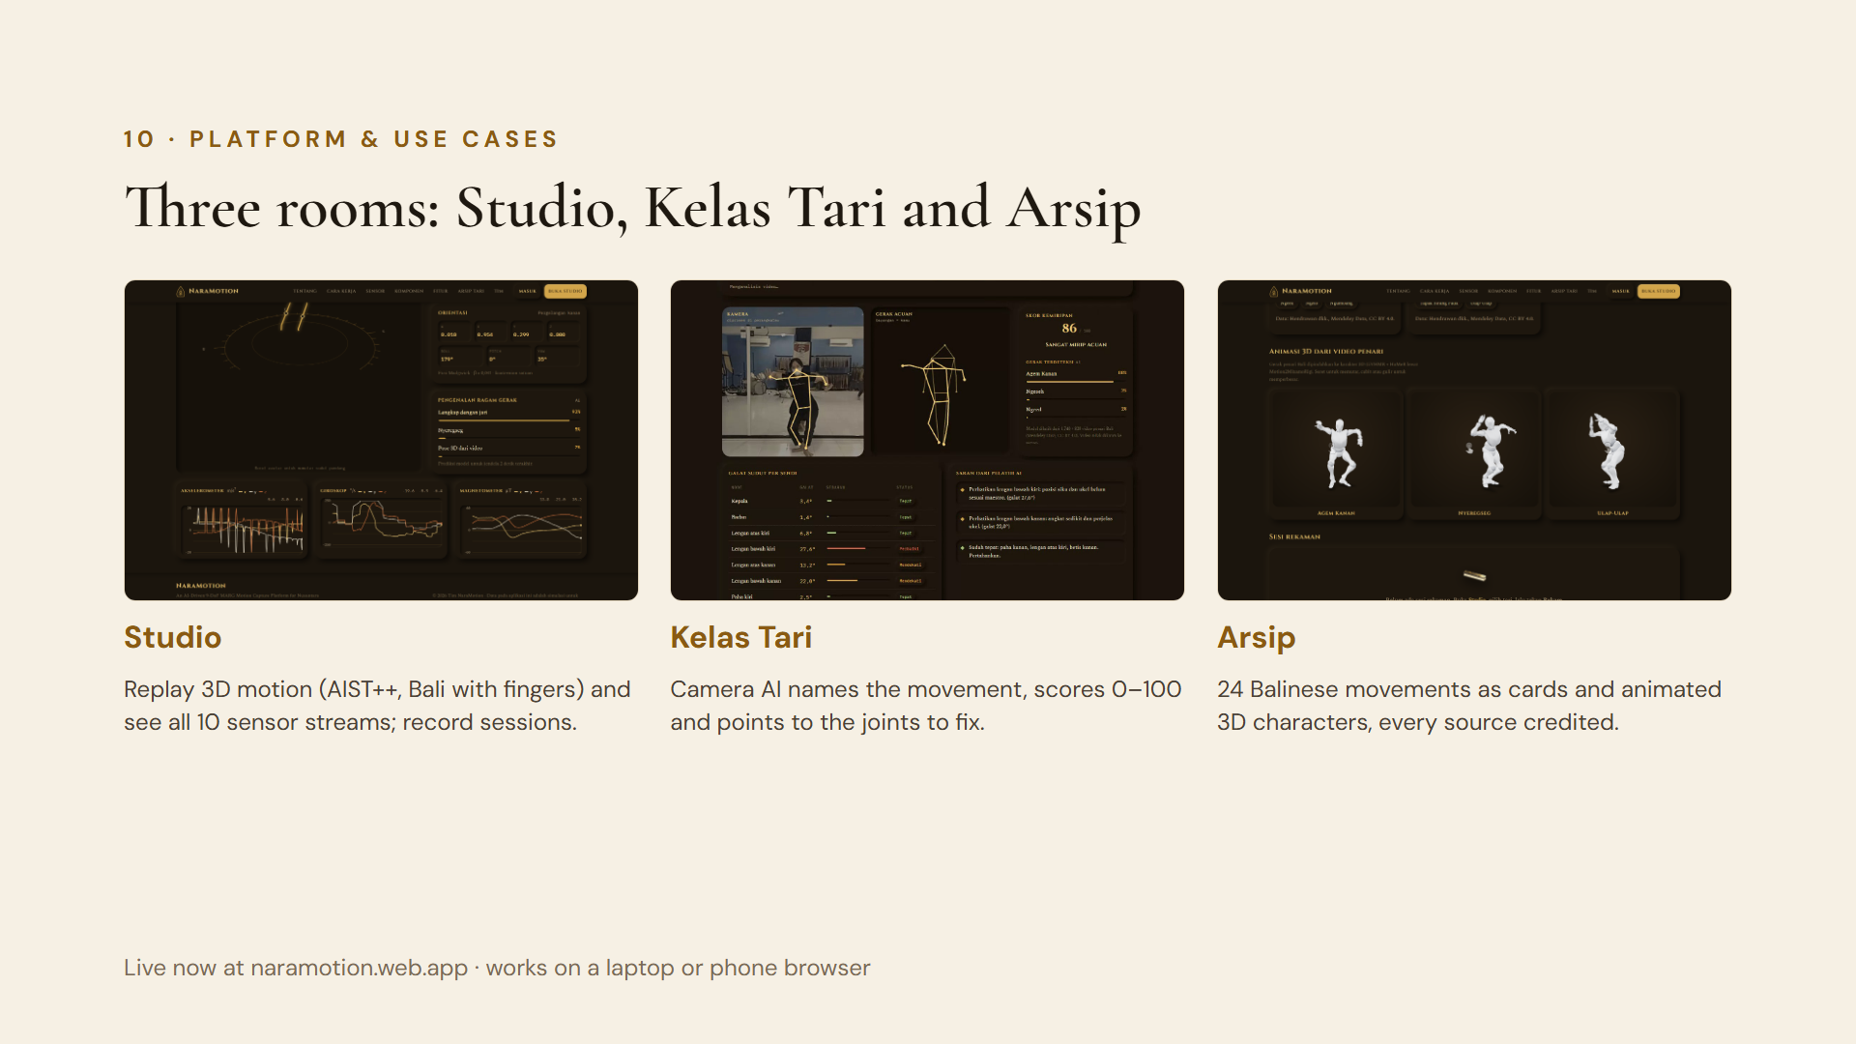
Notes:
The platform is live. The Studio replays 3D motion, including Balinese movements reconstructed with fingers, and shows what each of the ten sensors would record. Kelas Tari lets a student dance in front of the camera or upload a video; the AI names the movement, gives a score and highlights the joints to correct. The Arsip preserves the 24 Balinese movements with reference cards and animated 3D characters, with every dataset credited.

Slide 12
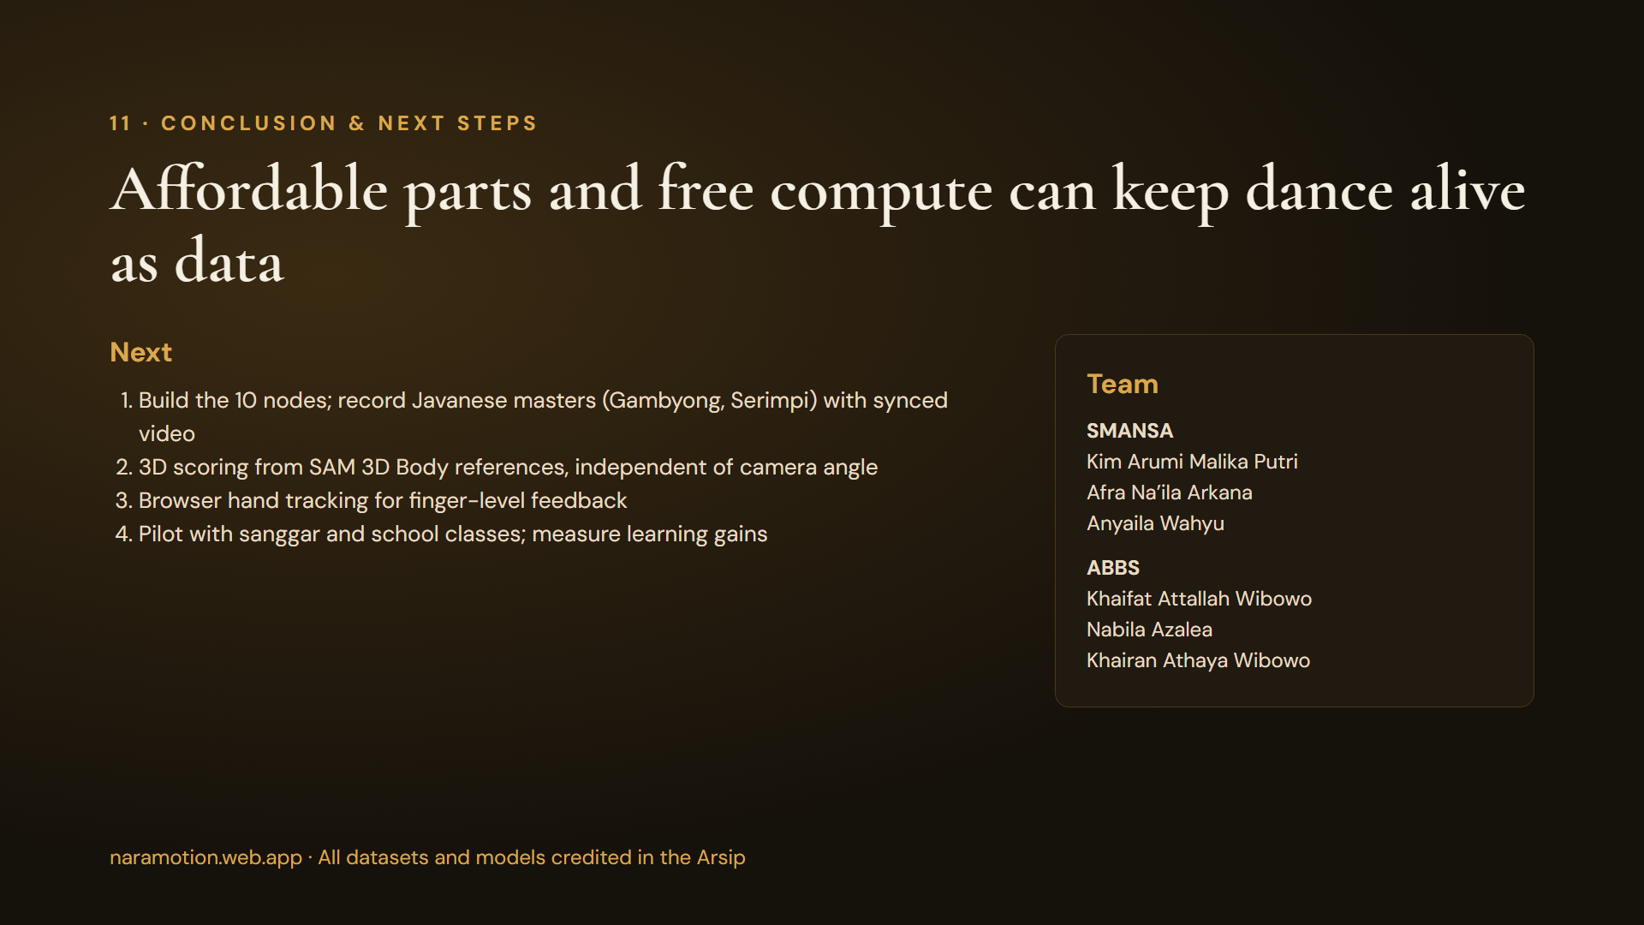
Notes:
NaraMotion shows that dance movement can be captured, recognised and taught with affordable components and free cloud compute. Next we will assemble the ten nodes and record Javanese masters with synchronised video, the first open inertial dataset of Indonesian dance; move scoring to 3D so it no longer depends on camera angle; add hand tracking; and pilot with sanggar and schools. Thank you.

