Slide 1
Introduction to Statistics
What is Statistics ?
Why is it Important ?
What is Data Mining ?
Notes:
Definition: the science of collecting, analyzing, interpreting, and presenting data.
Importance: helps in making informed decisions by providing a way to process and understand large amounts of data.
Data Mining: Briefly introduce data mining as the process of discovering patterns and knowledge from large amounts of data, often using statistical methods.

Slide 2
Types of Statistics
Descriptive Statistics: Summarizing and organizing data.
Inferential Statistics: Making predictions or inferences about a population based on a sample.
Notes:
Descriptive Statistics: describe the basic features of the data in a study. Provide examples like mean, median, mode, and standard deviation.
Inferential Statistics: takes data from a sample and makes inferences about the larger population. Mention techniques like hypothesis testing and confidence intervals.

Slide 3
Which part is Descriptive, and which is inferential ?
In a recent study, a researcher collected data on the salaries of 200 employees at a tech company. She calculated the average salary, which was $75,000, and noted that the most common salary (mode) was $70,000. Additionally, she found that the salaries ranged from $50,000 to $100,000. Using this sample data, she estimated that the average salary for all employees in the tech industry is likely between $73,000 and $77,000. She also conducted a hypothesis test to determine if the average salary in this company is significantly different from the industry average of $78,000.

Slide 4
Descriptive Statistics
Descriptive Statistics - Data Types
Descriptive Statistics - Central Tendency
Descriptive Statistics – Dispersion
Descriptive Statistics – Data Visualization
Descriptive Statistics – Sample and Population

Slide 5
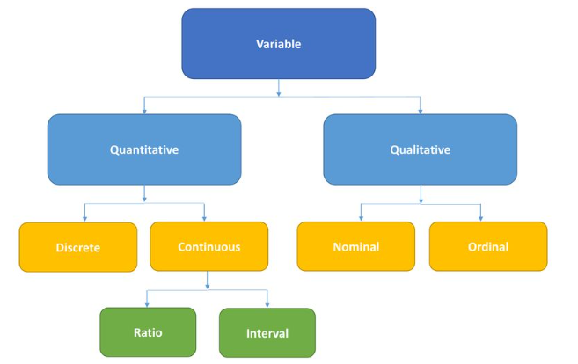
Descriptive Statistics - Data Types
Notes:
Qualitative vs. Quantitative Data: Define and give examples of qualitative data (e.g., colors, names) and quantitative data (e.g., height, weight).
Scales of Measurement: Describe the different scales of measurement:
Nominal: Categories without a specific order (e.g., gender).
Ordinal: Categories with a specific order (e.g., rankings).
Interval: Numerical scales with equal intervals, but no true zero (e.g., temperature in Celsius).
Ratio: Numerical scales with a true zero (e.g., weight).
Population and Sample: Define population as the entire group being studied and sample as a subset of the population.

Slide 6
Central Tendency : Mean
Example: Five employees have the following salaries:
[$40,000, $50,000, $60,000, $70,000, and $80,000]
Mean salary = ($40,000 + $50,000 + $60,000 + $70,000 + $80,000) / 5 = $60,000.
Usefulness: a general idea of the overall salary levels.

Slide 7
Central Tendency : Median
Example: Five employees have the following salaries:
$40,000, $50,000, $60,000, $70,000, and $80,000.
Median salary = $60,000 (the middle value when the salaries are ordered).
Usefulness: shows the middle point of the salary distribution, which is useful to understand the central tendency without being affected by extremely high or low salaries.

