Slide 1

First Project Supervised Learning Regression Problem (Structured Dataset)

Slide 2
What is the dataset we used?
What is the code ?
What is the out put?

Slide 3
Vgsales.csv is the dataset we used for modelling it
What is dataset?

Slide 4
We successfully get a good score for both MSE and R^2 then we visualize which will work better on our models! Mean Squared Error: 0.00047807235299513384 R-squared: 0.9998862102032399
What's the output?

Slide 5
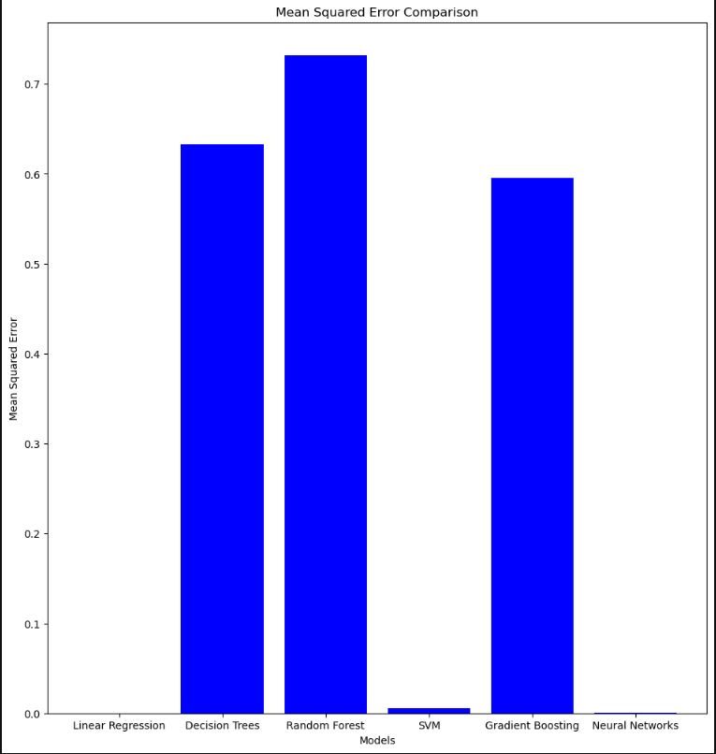
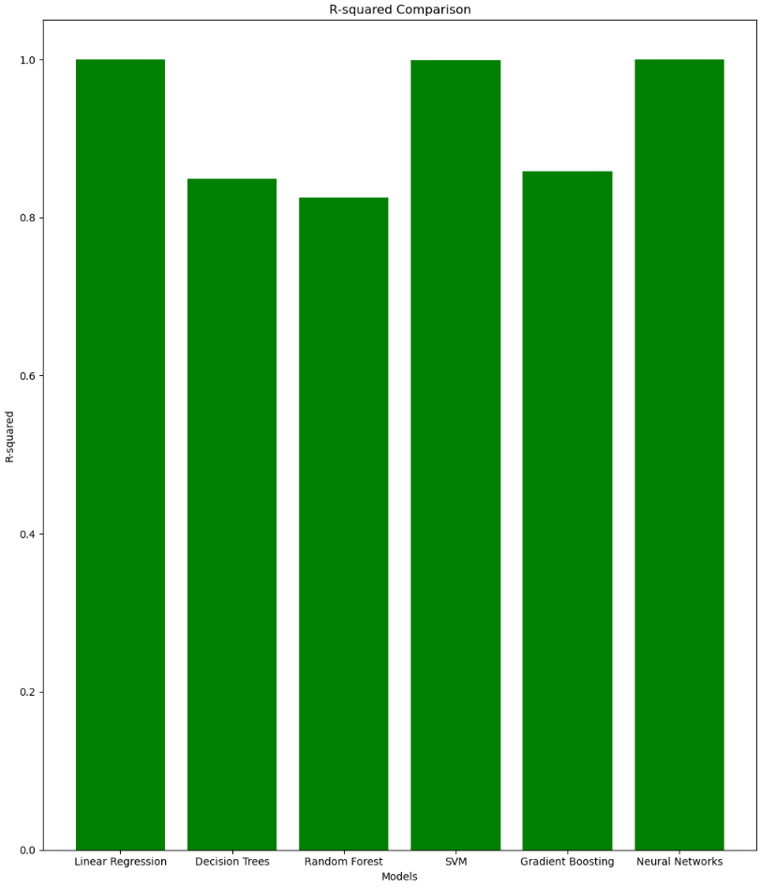

Slide 6
Second Project Supervised Learning Classification Problem (Structured Dataset)

Slide 7
Employee.csv is the dataset we used for modelling it
What is dataset?

Slide 8
Data Handling and Exploration:
Reads employee data from a CSV file and checks its information, removes duplicates, and checks for missing values.
Encodes categorical columns (like 'Gender', 'EverBenched', and 'Education') into numerical values.
Visual Exploration:
Creates visual plots (count plots) to show the distribution of different aspects such as gender, age, city, payment tier, experience in the current domain, joining year, education, and leave status.
Correlation Analysis:
Generates a heatmap to display the relationships between different numerical features in the dataset.
Machine Learning Modeling:
Trains and tests several machine learning models (Logistic Regression, Decision Tree, Random Forest, Support Vector Machine, K-Nearest Neighbors, and Multi-Layer Perceptron) to predict whether an employee might leave or not based on various employee-related factors.
The goal is to understand the dataset, visualize its characteristics, and build models to predict whether an employee might leave based on their profile.
What's the output?

Slide 9
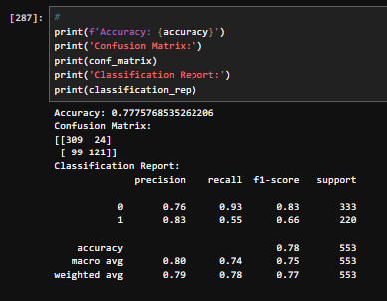
Like shown in the picture, we reached a good accuracy, etc!

Slide 10
Third Project Unsupervised Learning (Structured Dataset)

Slide 11
diabetes.csv is the dataset we used for modelling it
What is dataset?

Slide 12
Objective:
Data Understanding: Explore a diabetes-related dataset to understand its content and structure.
Actions:
Data Loading and Exploration:
Loads dataset, checks for duplicates, null values, and data types.
Identifies unique values in specific columns.
Data Visualization:
Creates visual representations (count plots, bar plots) to show feature distributions and relationships.
Generates a heatmap to display feature correlations.
Unsupervised Learning Techniques:
K-Means Clustering: Groups data based on similarities.
PCA (Principal Component Analysis): Reduces data dimensions.
ICA (Independent Component Analysis): Identifies independent components.
DBSCAN: Identifies clusters based on feature density.
t-SNE: Reduces dimensions while preserving local structure.
Purpose:
Gain insights into potential patterns, correlations, and groupings within the data, aiding in feature selection and understanding relationships between variables in the context of diabetes-related information.
What's the output?

Slide 13
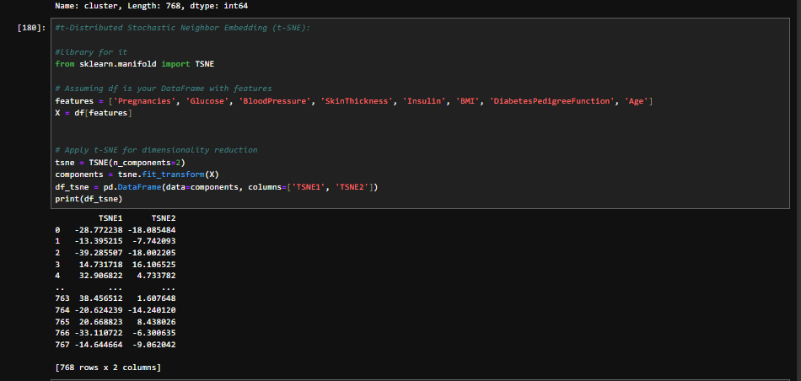
a

Slide 14
Fourth Project Supervised Learning Classification Problem (Unstructured Dataset - Image Dataset)

Slide 15
What is the dataset we used?
fashion-mnist_train.csv dataset

Slide 16
What is the code ?
Prepares Data:
Loads Fashion MNIST dataset, separates labels from pixel data, and splits it into training and testing sets.
Visualizes Data:
Shows a few clothing item images from the dataset.
Prepares for CNN:
Shapes images for CNN input, expands dimensions, and scales pixel values.
Builds CNN Model:
Constructs a CNN model using Keras with convolutional and dense layers.
Trains Model:
Trains the CNN model on the training data for 20 epochs.
Evaluates Model:
Predicts labels for test data and evaluates model accuracy.
Displays sample test images with actual and predicted labels.
Generates a confusion matrix and classification report for performance evaluation.
Saves Model:
Saves the trained CNN model for future use.

Slide 17
What is the output?
Prediction: The trained model assigns a label to each image, indicating the type of clothing it represents.
Example Output:
For instance, if an image is predicted as a "T-shirt/top" (class 0)
the output might look like:
Actual = T-shirt/top / 0 Predicted = T-shirt/top / 0
This shows the model correctly identified the image as a T-shirt/top with class label 0.
Visual Display: Some code might display test images with their actual and predicted labels for visual inspection.
Evaluation Metrics: The code might also produce metrics like accuracy, a confusion matrix, and a classification report to assess overall model performance across all clothing classes.

Slide 18
