Slide 1

Exploratory Data Analysis
G2M insight for Cab Investment firm
06 – 09 – 2021

Slide 2

Agenda
Background
Data Description
Data Preparation
Data Visualization
Recommendations

Slide 3
Background
Problem Statement:
XYZ is a private equity firm in US. Due to remarkable growth in the cab industry in last few years and multiple key players in the market, it is planning for an investment in Cab industry.
Objective:
Given the data for two cab companies, we analyze and visualize the data to provide useful insights and recommendations to help the investor to choose the right company to invest in.

Slide 4
Data Description
The data are for two cab companies in US. They are collected between 02/01/2016 to 31/12/2018.
These data are divided into four files:
Cab_Data.csv
Contain information related to each trip made by the customer (cost, distance, etc..).
City.csv
Contain information related to different cities (population).
Customer_ID.csv
Contain information related to each customer (gender, age, etc..).
Transaction_ID.csv
Contain information related to each transaction made (payment method).

Slide 5
Data Preparation
Missing Data
There are no missing data in all the files.
Outliers
After investigating the data, there are outliers in the price_charged attribute. Since we don’t have enough information about each trip (ride), we decided upon leaving them.
Data Aggregation
The given four files are connected to each other. For proper studying and ease of analyzing, we merged the files into a single file. This merging allows for connecting all the attributes to describe each trip (ride). The process of data exploring was done on this big file.
Derived Attributes
Profit: price_charged – cost_of _trip
Profit Percentage: (profit/cost_of_trip)*100
Profit Per Km: profit/km_travelled

Slide 6
Data Visualization
We divided the visualization process into:
Demand Analysis
Company-wise
City-wise
Year-wise
Month-wise
Profit Analysis
City-wise
Year-wise
Month-wise
Profit per Km
Customer Analysis
Gender-wise
Age-wise
Profit contribution
Income-wise

Slide 7
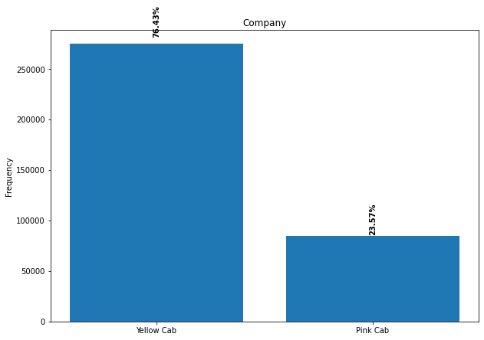
Demand Analysis – Company
From the graph, we can see that about 76% of the rides are fulfilled by the Yellow Cab company.

Slide 8
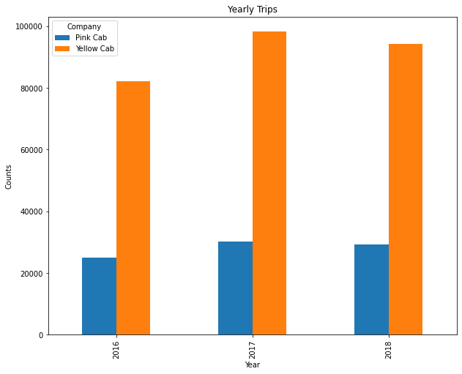
Demand Analysis – Yearly Demand
This graph shows number of trips each year for the companies.
There is an increase in number of trips of about 19.4% for Yellow Cab and 20.9% for Pink Cab between 2016 and 2017.
Overall, trips of Yellow Cab are 2.25 times the trips of Pink Cab in all years.
Year | Yellow Cab | Pink Cab
2016 | 82239 | 25080
2017 | 98189 | 30321
2018 | 94253 | 29310

Slide 9
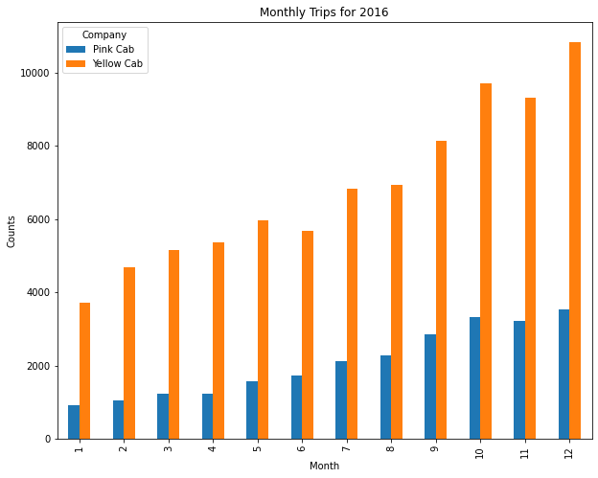
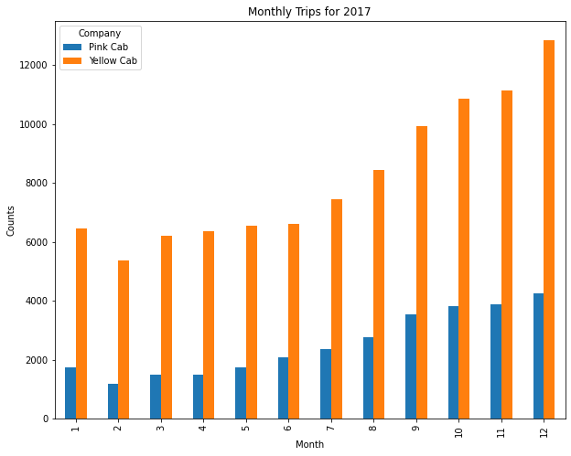
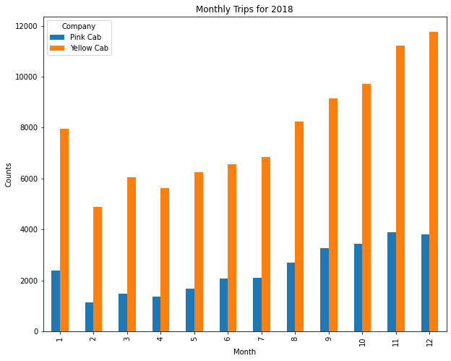
Demand Analysis – Monthly Demand
These graphs show number of trips each month for the companies during the year.
There is an increase in the number of trips during the last four months for both companies. All in all, Yellow Cab has more requests than Pink Cab.

Slide 10
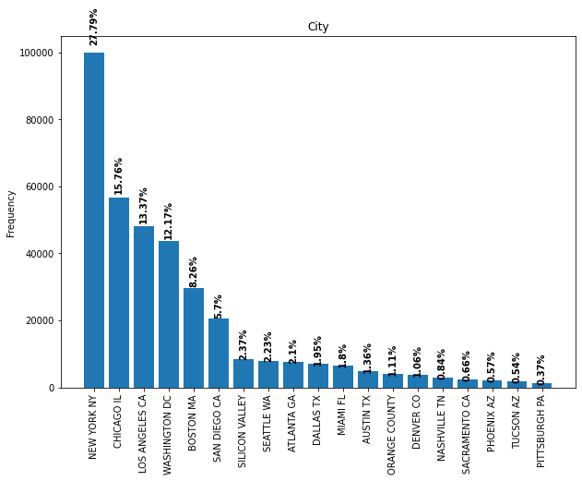
Demand Analysis – City Trips
This graph shows number of trips in each city.
Let us focus on the first four cities.
City | Trips | Percentage %
New York | 99885 | 27.79
Chicago | 56625 | 15.76
Los Angles | 48033 | 12.17
Washington | 43737 | 8.26

Slide 11
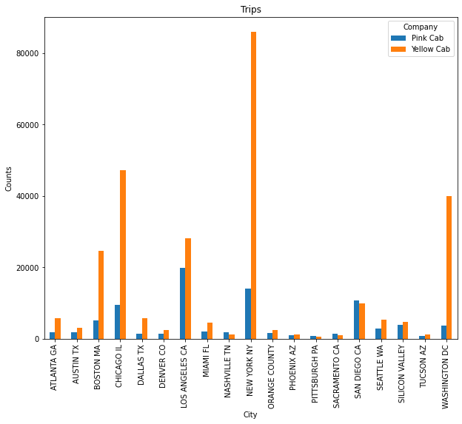
Demand Analysis – City & Company
This graph shows number of trips for the two companies in each city.
Let us focus on the same previous cities and provide each company percentage.
City | Yellow Cab % | Pink Cab %
New York | 86.02 | 13.98
Chicago | 83.47 | 16.53
Los Angles | 58.64 | 41.37
Washington | 91.56 | 8.44

Slide 12
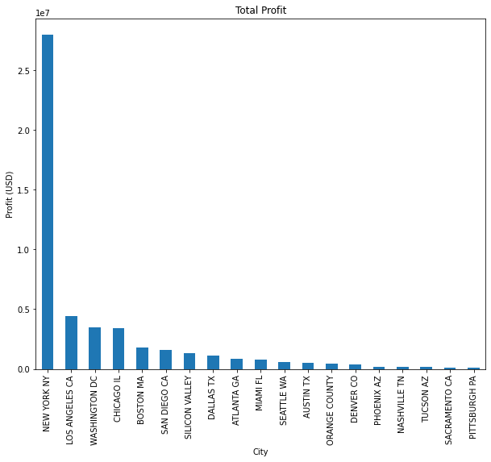
Profit Analysis – City Profit
This graph shows the total profit for each city.
Let us focus on the same previous cities and provide each company percentage.
City | Profit (million)
New York | 27.96
Chicago | 3.4
Los Angles | 4.41
Washington | 3.5

Slide 13
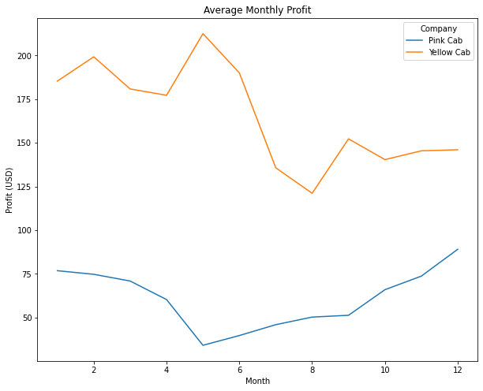
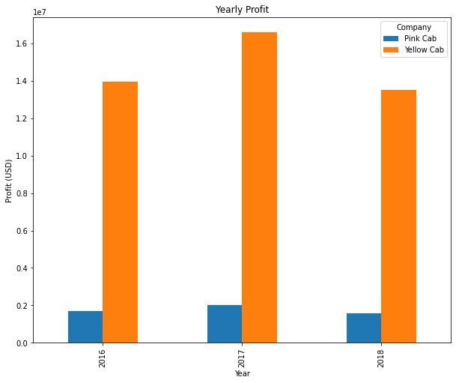
Profit Analysis – Yearly & Monthly Profit
The first graph shows the average profit per month.
Yellow Cab reaches its highest average profit during May (212.56 Dollars), while Pink Cab reaches its lowest (34 Dollars). This means an increase of about 525.18%.
There is an increase in the average profit for Pink Cab starting from June, while Yellow Cab has maintained the lowest Average during that time.
All in all , Yellow Cab has a better average profit in all months.
You can see from the second graph that Yellow Cab company has gained larger profits than Pink Cab for all the years. Between 2016 and 2017, there was an increase of about 19.02% for Yellow and 18.71% for Pink. Between 2017 and 2018, there was a drop in the profits for both companies, a loss of about 18.46% for Yellow and 23.15% for Pink. The highest profit is in 2017, with a profit margin of about 716.75% for Yellow with respect to Pink.

Slide 14
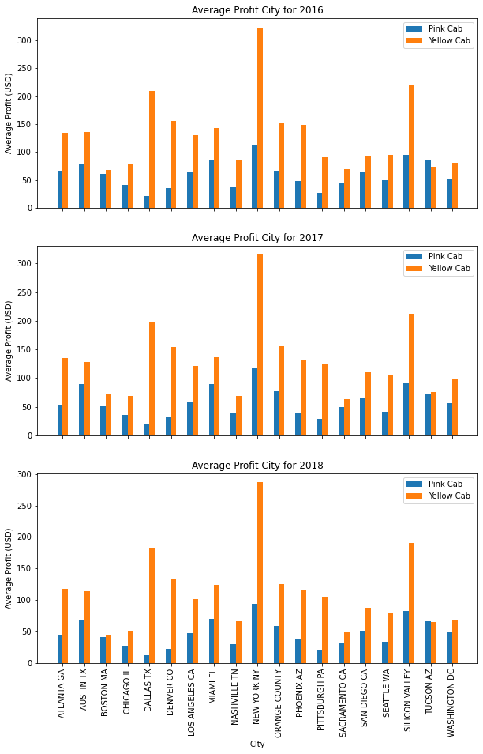
Profit Analysis – Monthly Average Profit City-wise
This graph shows the average profit in each city for the three years.
Both companies maintained the same distribution of average profit in all three years.
Yellow Cab has a better average profit than Pink Cab for all cities.

Slide 15
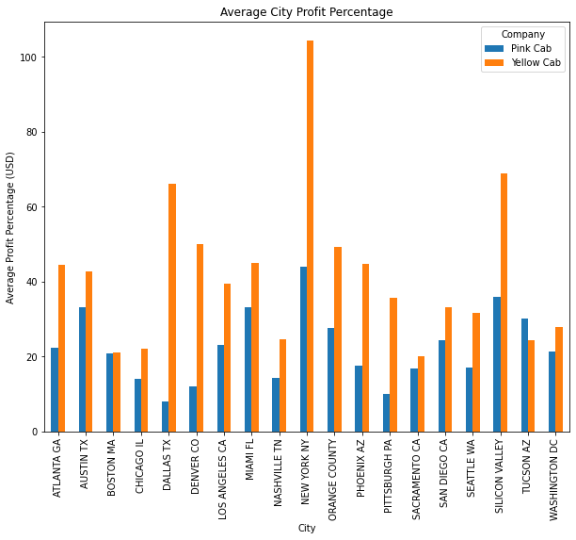
Profit Analysis – Average Profit Percentage City-wise
This graph shows the average profit percentage for companies in each city.
In New York, Yellow Cab has an average profit percentage of 104.3%, which is about 2.4 times the value for Pink Cab (44%).
The least percentage for Yellow Cab is 20.15% in Sacramento, which is about 2.6 times the least percentage for Pink Cab company in Dallas (7.83).

Slide 16
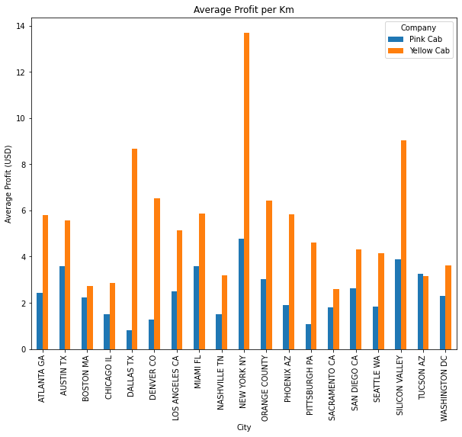
Profit Analysis – Average Profit per Km
This graph shows the average profit per Km for each city.
Yellow Cab range is between 2.6 and 13.7 Dollars (426.9% increase), while the range for Pink Cab is between 0.8 and 4.8 Dollars (500% increase).
In New York city, profit margin of Yellow Cab is 185.4% with respect to the Pink Cab.
in Dallas city, profit margin of Yellow Cab is 987.5% with respect to the Pink Cab.
in Tucson , both companies maintained almost the same profit per Km.

Slide 17
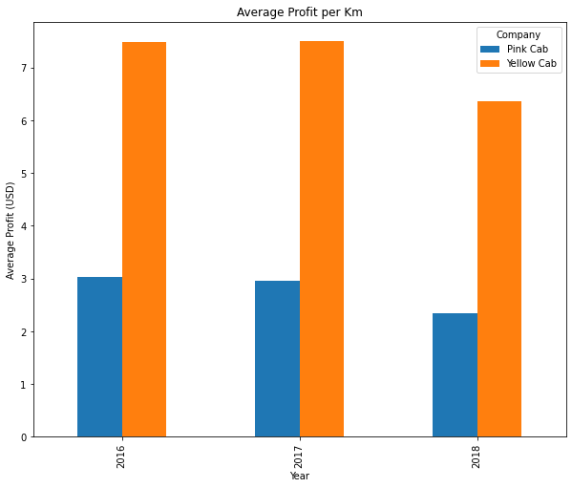
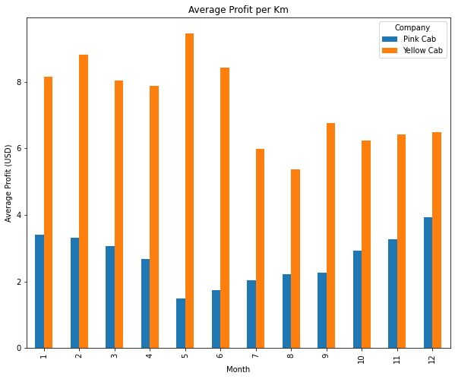
Profit Analysis – Yearly & Monthly Average Profit per Km
The first graph shows the average profit per Km each year.
Both Companies Maintained a fixed profit per Km for 2016 and 2017. In 2018, the profit decreased by 14.7% for Yellow Cab and 20% for Pink Cab.
The second graph shows the average profit per Km in each month.
Yellow Cab has the highest average in February and May.
there is a decrease in the average profit during the first five months for Pink Cab. After that, it starts increasing till the end of the year.

Slide 18
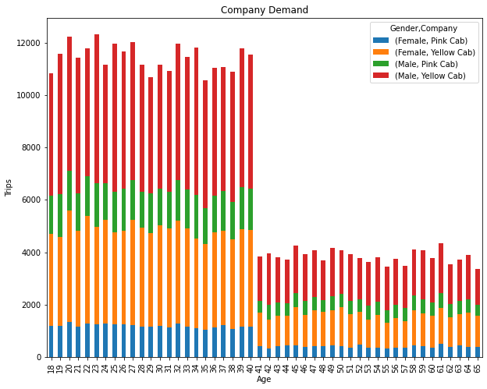
Customer Analysis – Gender & Age
This graph shows the demand age-wise and gender-wise.
Yellow Cab company is the most popular one for ages 18 to 40.
The Demand for cabs is almost constant for ages 18 to 40, which is higher than that for ages 41 to 65.
The Demand for ages 18 to 40 is almost three times that for ages above 40.

Slide 19
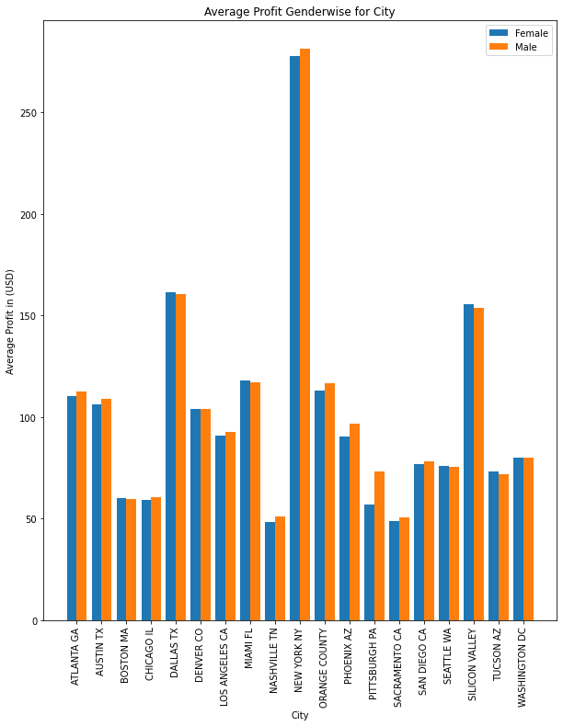
Customer Analysis – Gender Contribution to Average Profit City - wise
This graph shows the contribution of each gender to the average profit in each city.
Both genders contribute equally to the average profit.

Slide 20
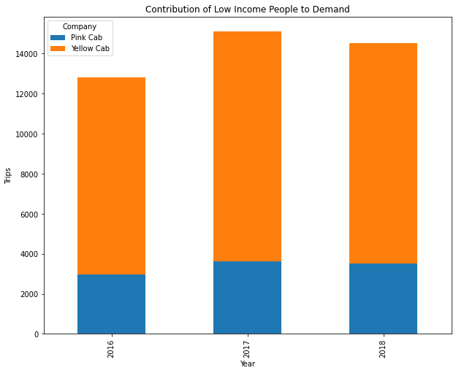

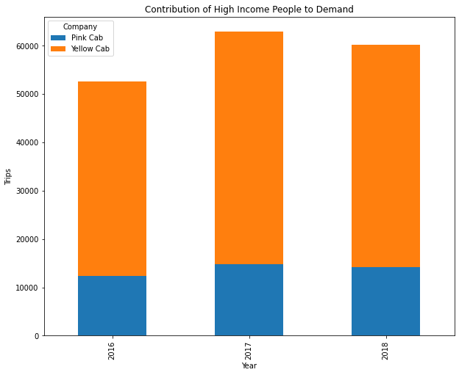
Customer Analysis – Contribution to Demand Based on Income Class
Company | Year | Low Income % | Mid Income % | High Income %
Yellow Cab | 2016 | 23.12 | 22.86 | 22.85
 | 2017 | 27.07 | 27.37 | 27.34
 | 2018 | 25.97 | 26.34 | 26.19
Pink Cab | 2016 | 7.03 | 6.86 | 7.07
 | 2017 | 8.51 | 8.39 | 8.45
 | 2018 | 8.29 | 8.18 | 8.1
Low income: Income < 5000
Mid income: 5000 <= Income < 15000
High income: Income > = 15000

Slide 21
Recommendations
We have evaluated the two companies considering these factors:
Yearly Demand: Trips of Yellow Cab are 2.25 times the trips of Pink Cab in all years.
City Demand: More than 80% of rides are occupied by the Yellow cab Company in the top 3 cities (based on Cab users).
Monthly Demand: Demand of the Yellow Cab is three times the demand of the Pink Cab, especially during the last quarter of the year.
Monthly Profit: On average, Yellow Cab profit is ranging from two times to 5 times the profit of the pink Cab.
Yearly Profit: In all the three years, Yellow Cab total profits are 7 times the total profits of Pink Cab.
Average Profit per Km City-wise: In New York city, profit margin of Yellow Cab is 185.4% with respect to the Pink Cab. Even in Dallas city, profit margin of Yellow Cab has raised to 987.5% with respect to the Pink Cab.
Yearly Average Profit per Km: Both Companies Maintained a fixed profit per Km for 2016 and 2017. In 2018, the profit decreased by 14.7% for Yellow Cab and 20% for Pink Cab.
Gender & Age: Yellow Cab company is the most popular one for ages 18 to 40. Even though, it has a high popularity among people above 40. It means the company provides good services to all categories of customers.
Customer Income: Although the distribution of the demand each year is almost constant for all income classes, more than 22% of all income classes request Yellow Cab taxis in all the three years, while 6 to 8% request the Pink Cab.
Given the Above evaluation factors, we recommend the investor to invest in Yellow Cab company due to its Demand, Profit, and Popularity.

