Slide 1

Enhancing Search Engine Relevance for Video Subtitles
BY,
1.M.Swetha - IN1240561
2.P.Divya - IN1240678
Team ID:-T211177

Slide 2
About me
I am Motapothula Swetha.(IN1240561)
B.Tech
My enthusiasm for data science lies in its ability to drive informed decision-making and foster innovation across industries, ultimately making a tangible impact on business success and societal progress.
Github - https://github.com/Motapothulaswetha12/DS-Intern-Search-Engine-Project
Medium - https://medium.com/@motapothulaswetha566

Slide 3
Objective Of The Project:
Design an advanced search engine algorithm specialized in retrieving
subtitles based on user queries, emphasizing the content within subtitles.
The primary aim is to utilize natural language processing and machine
learning methods to significantly improve the relevance and accuracy of
search results.

Slide 4
Types of Search Engines
Keyword Based Search Engine: These search engines rely heavily on exact keyword matches between the user query and the indexed documents.
Semantic Search Engines: Semantic search engines go beyond simple keyword matching to understand the meaning and context of user queries and documents.

Slide 5
Libraries used in this project
sqlite3: Used for SQLite database operations in Python.
Pandas: Used for data manipulation and analysis, providing data structures like DataFrame.
zipfile: Used for working with ZIP archive files, allowing compression and extraction operations.
io: Used for input/output operations, including handling streams and file-like objects.
tqdm: Used for displaying progress bars and monitoring the progress of iterative tasks.
re: Used for regular expression operations, enabling pattern matching and text manipulation.
nltk: Used for natural language processing tasks such as tokenization, stemming, and part-of-speech tagging.
sentence_transformers: Used for generating sentence embeddings using pre-trained transformer models.
chromadb: Used for accessing and working with data from ChromaDB, a database for chemical compounds.
sklearn: Used for machine learning tasks, providing algorithms for classification, regression, clustering, etc.
joblib: Used for efficient serialization and deserialization of Python objects, particularly useful in machine learning for model persistence.

Slide 6
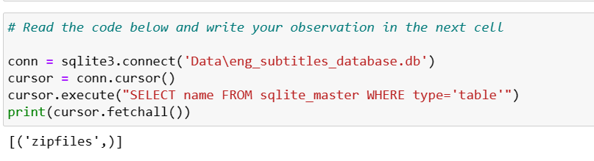
Reading the Tables from Database file
Reading tables from a database file involves extracting structured data stored in tables within a database file.
This process typically includes accessing the database file,

Slide 7
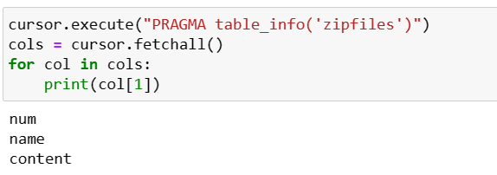
Reading the columns of Table
identifying the tables it contains, and then retrieving the data from those tables for various purposes such as analysis,
Here i Checked column names of table

Slide 8
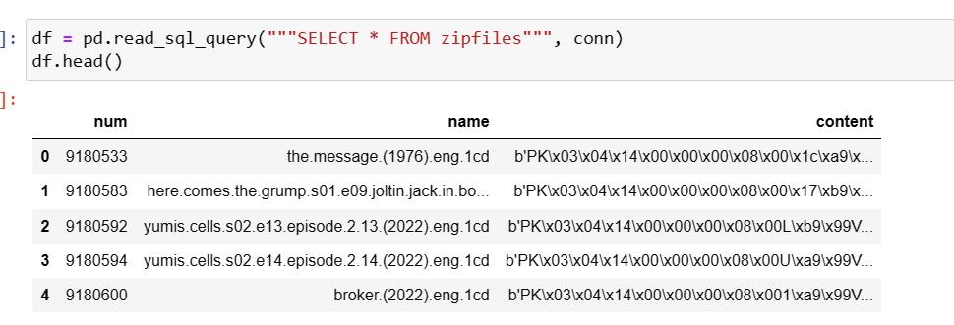
Loading the Database Table inside a Pandas DataFrame
reads all the data from the "zipfiles" table in a SQL database through the connection named conn
extraction of data from a database table into a Pandas DataFrame, enabling further analysis and manipulation of the data within Python.

Slide 9
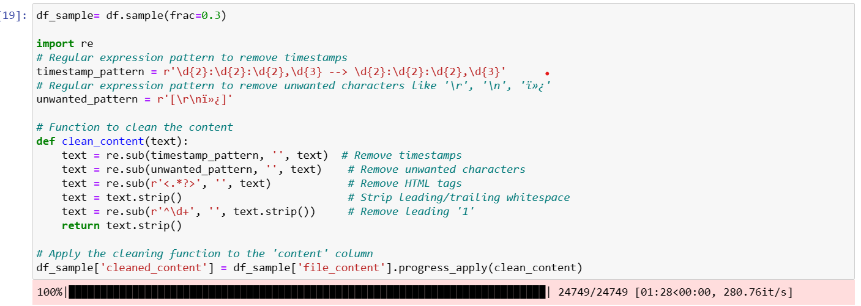
Removing Unwanted information:
Regular expression pattern to remove timestamps
Eliminates unwanted characters,HTML tags,Whitespaces
performs text preprocessing steps such as removing special characters
Getty Images

Slide 10
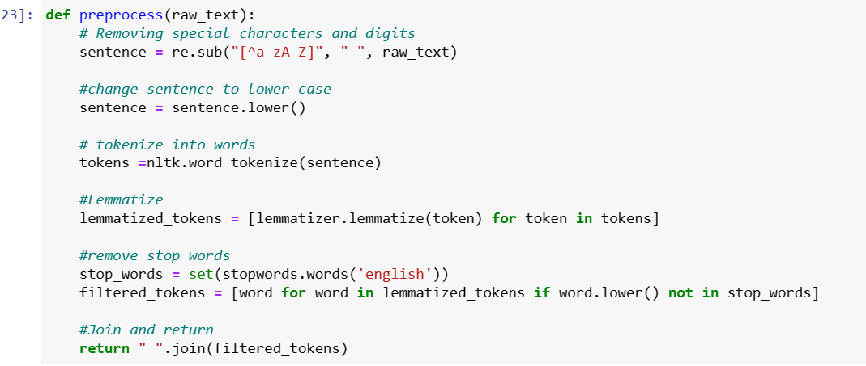
Data Preprocessing
The preprocess function takes raw text as input.
Converting to lowercase, tokenizing, lemmatizing.
Then returns the preprocessed text as a string.

Slide 11
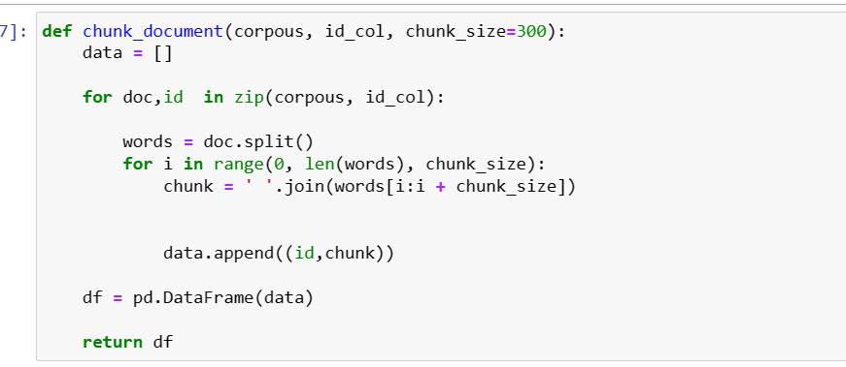
Document Chunker
chunking data is a strategy used to improve the efficiency, scalability, and manageability of data processing tasks, particularly in contexts where dealing with large volumes of data or resource limitations are considerations.
This function essentially breaks down each document in the corpus into smaller chunks based on the specified chunk size.
associates each chunk with its corresponding ID, and returns the chunked data in a Pandas DataFrame format.

Slide 12
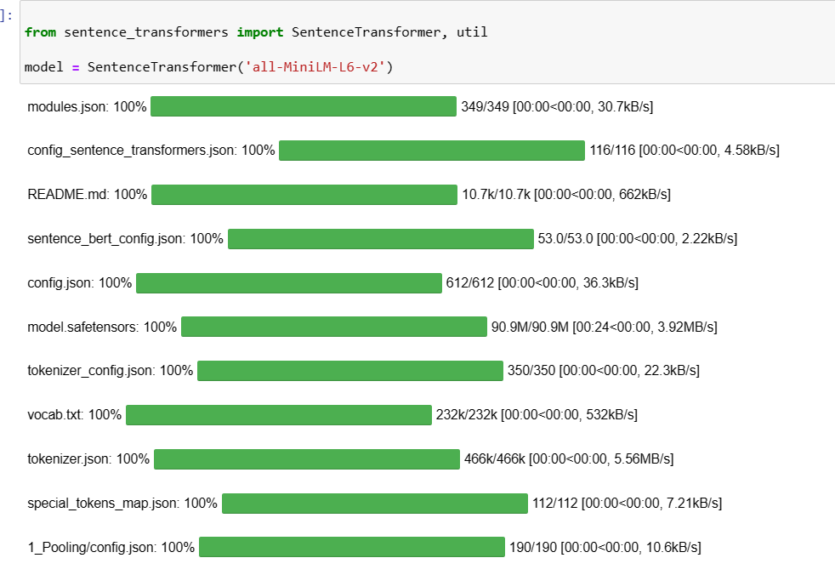
Initializing Sentence Transformer Model
specific pre-trained sentence transformer model, enabling the conversion of text into semantic embeddings for natural language processing tasks.
cosine similarity to find documents that are most similar to a given query, aiding in tasks like document search, recommendation, or information retrieval.

Slide 13
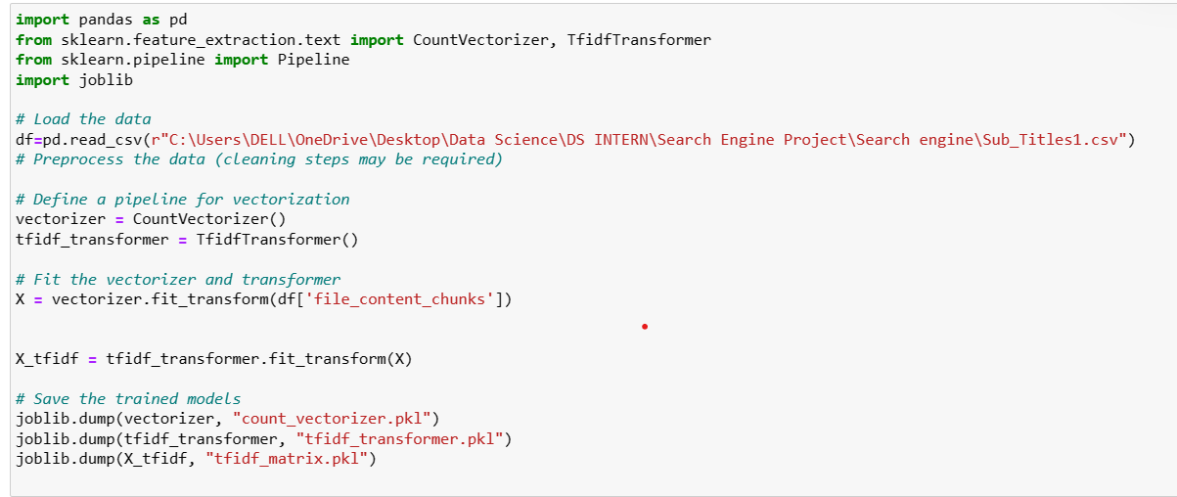
Text Data Vectorization and Model Serialization
This code is used for text preprocessing and vectorization, which are common steps in natural language processing (NLP) tasks.
CountVectorizer and TF-IDF Transformer are used to convert text data into numerical representations (token count matrices.
TF-IDF matrices), which are then used for machine learning tasks such as text classification, clustering, or information retrieval.
Saving the trained models allows for reusing them later without retraining, which is useful for deployment and production environments.

Slide 14

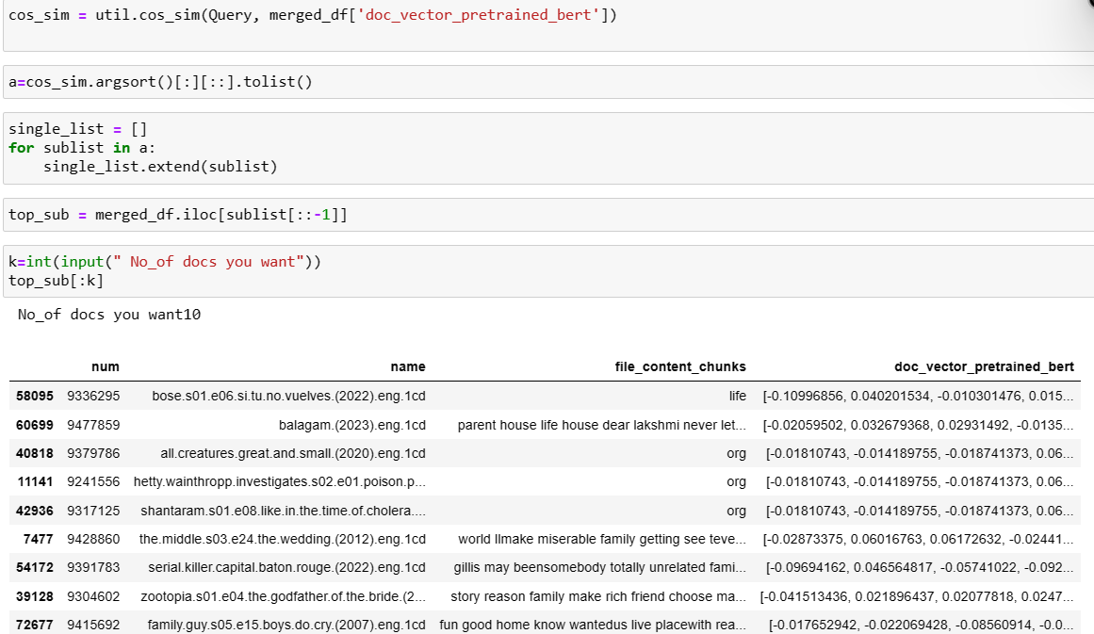
Retrieving Documents
user to input a query, which is then stored in a Pandas Series named User_query. The input function displays the message "Enter a user Query " to guide the user in providing their input.
Retrieve the top documents similar to a given query using cosine similarity scores and user-specified preferences.

Slide 15
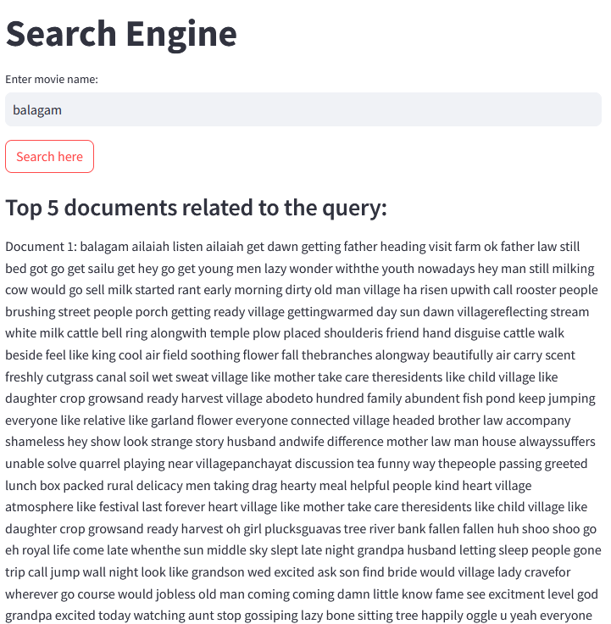
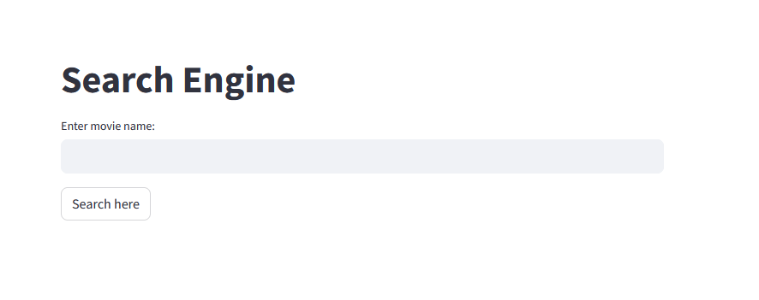
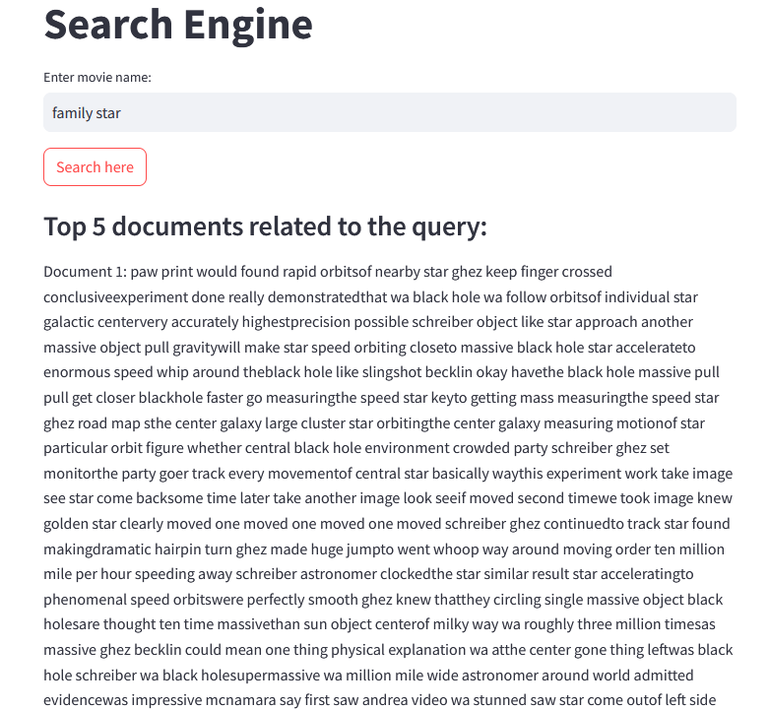
Results:

Slide 16

THANK YOU

