Slide 1
Introduction to Numpy

Slide 2
NumPy
NumPy is a portmanteau from "Numerical Python“
NumPy contains a broad array of functionality for fast numerical & mathematical operations in Python
NumPy functionality is used in other popular Python packages including Pandas, Matplotlib

Slide 3
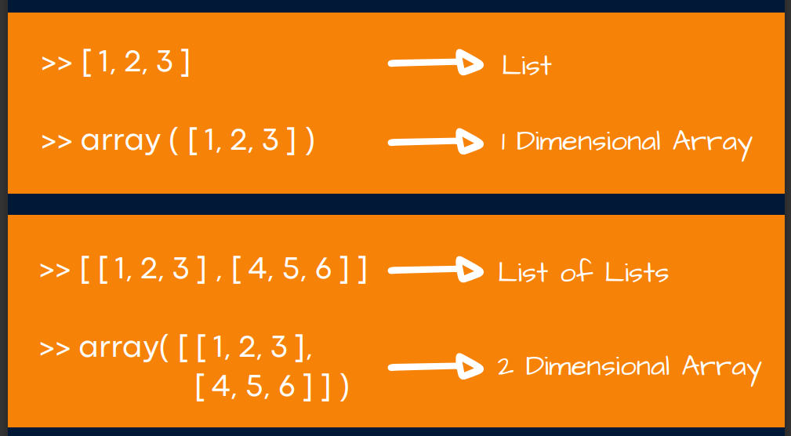
NumPy
At first glance, a NumPy array resembles a List (or in the case of multi-dimensional arrays, a List of Lists...)

Slide 4
Getting started
Importing NumPy
To ensure you can access all of the amazing functionality from within NumPy - you import it like so...
import numpy as np

Slide 5
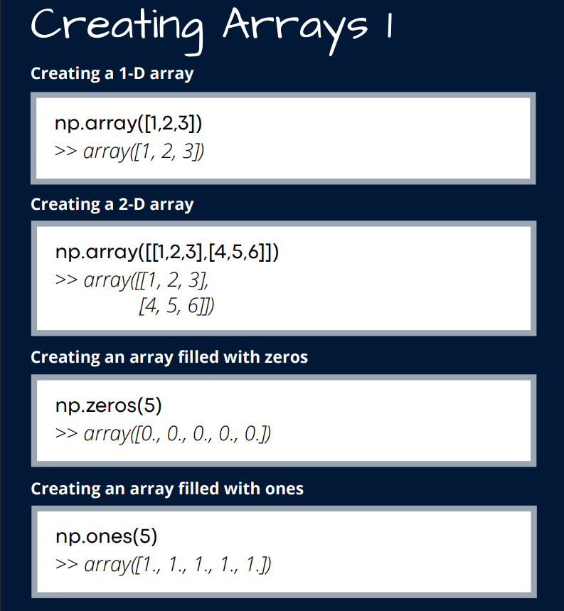

Slide 6
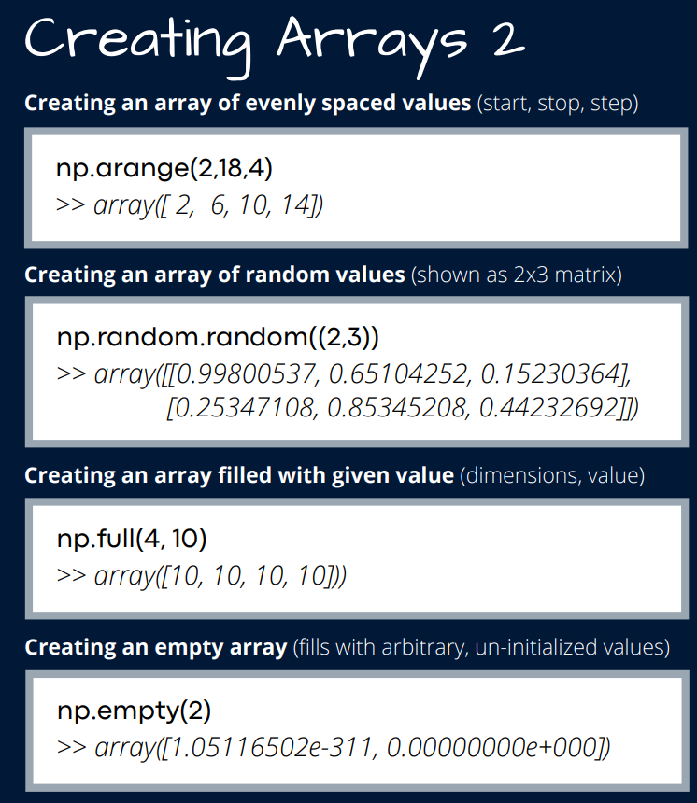
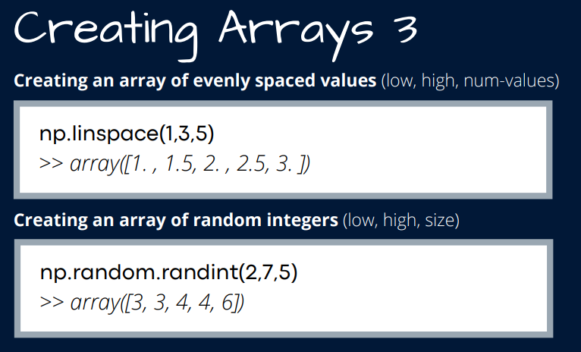

Slide 7
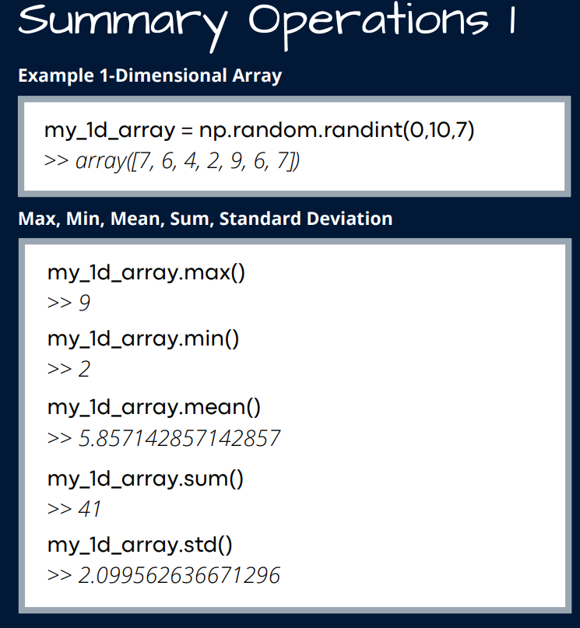

Slide 8
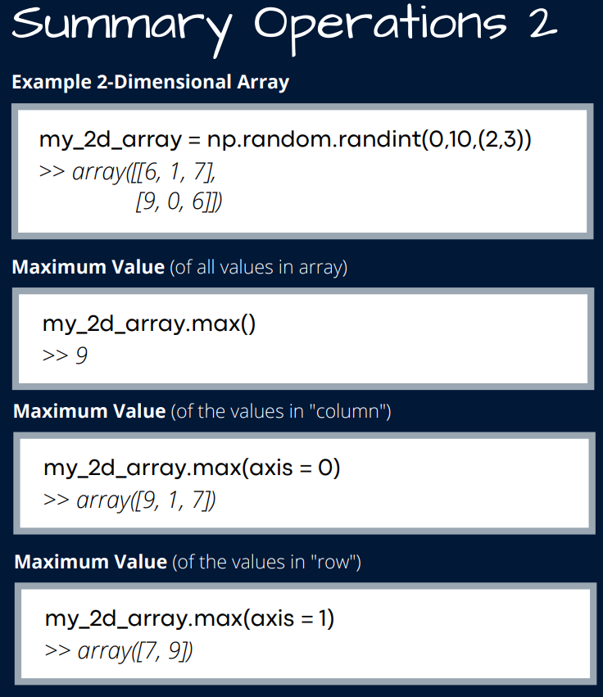

Slide 9
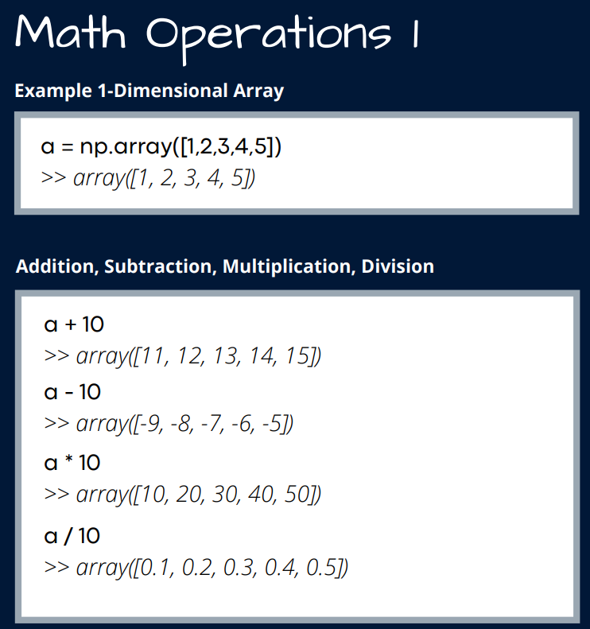

Slide 10
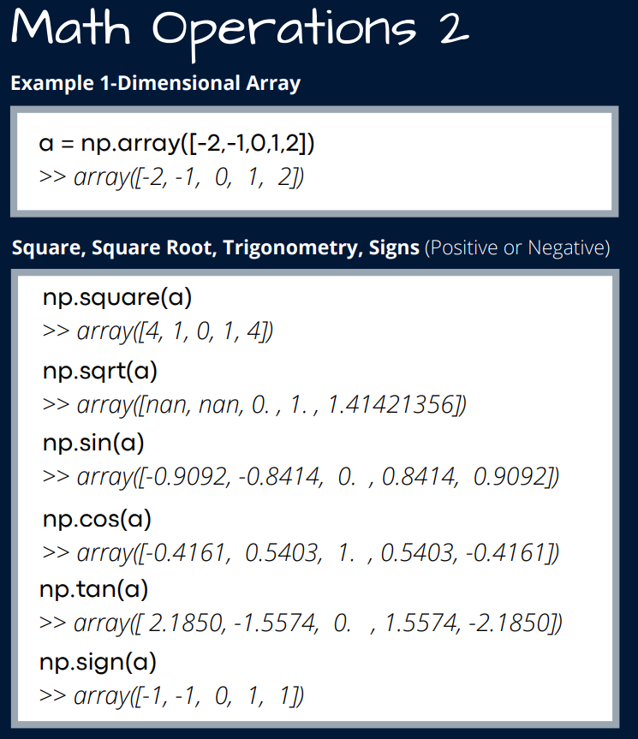

Slide 11
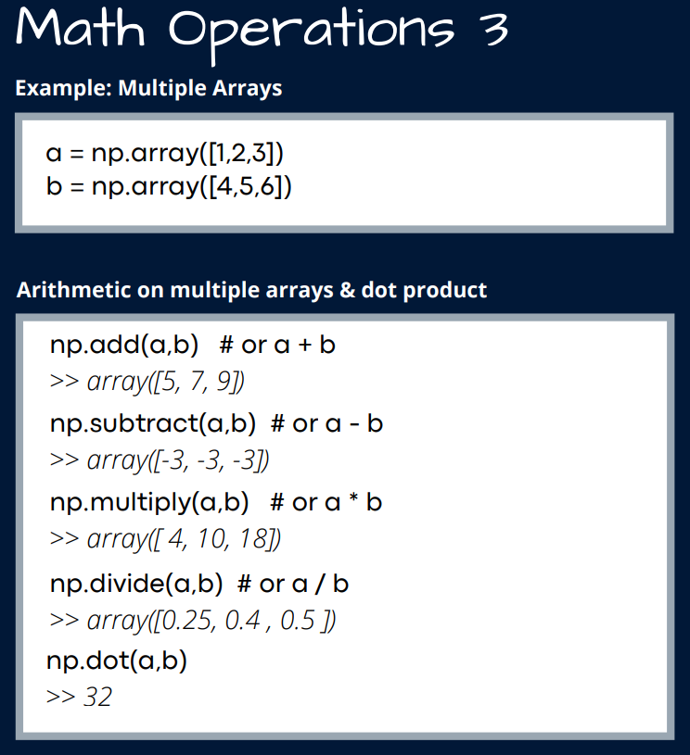

Slide 12
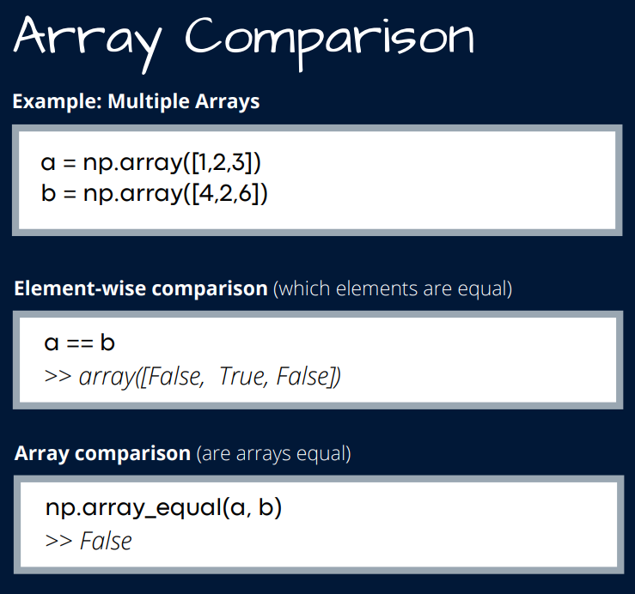

Slide 13
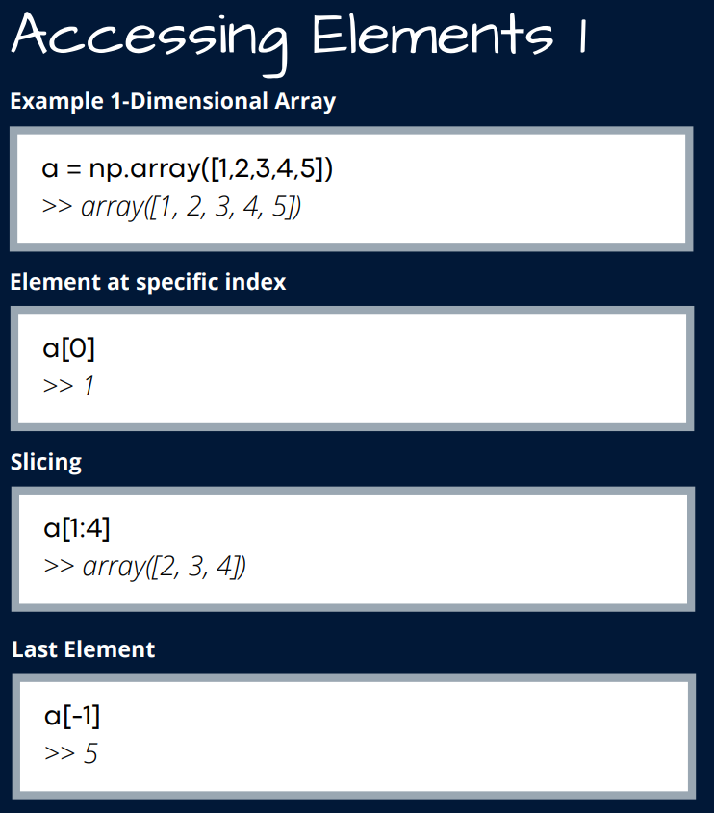

Slide 14
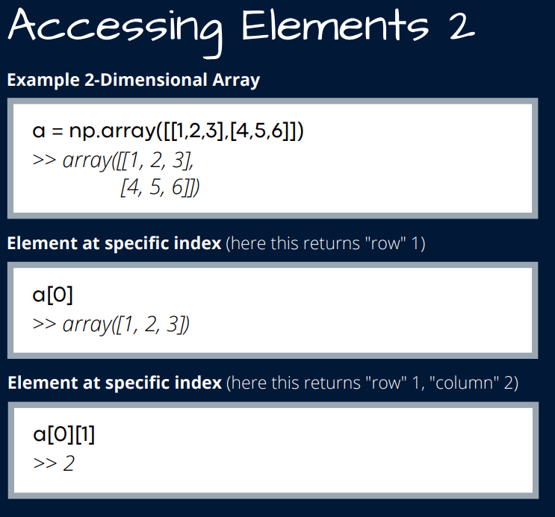

Slide 15
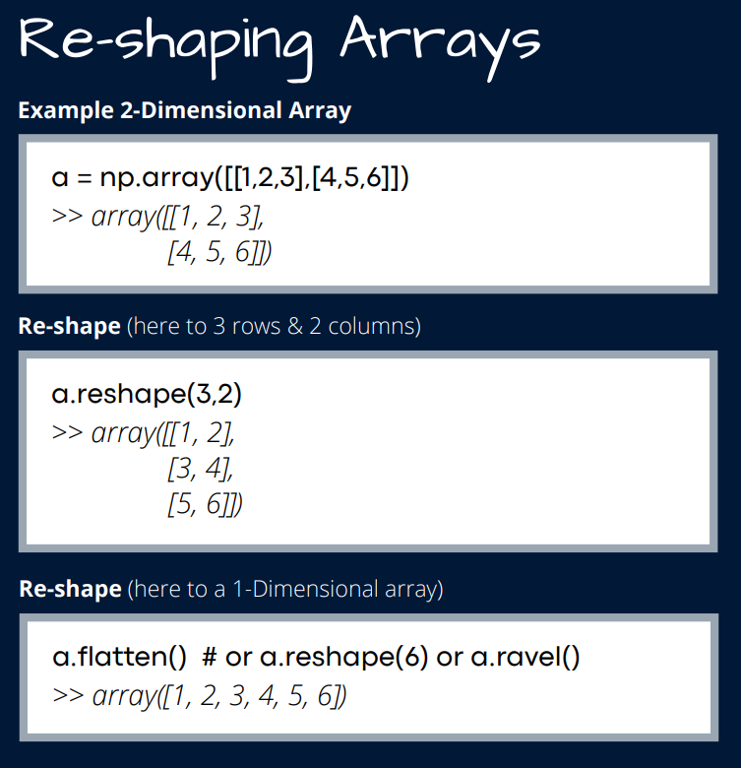

Slide 16
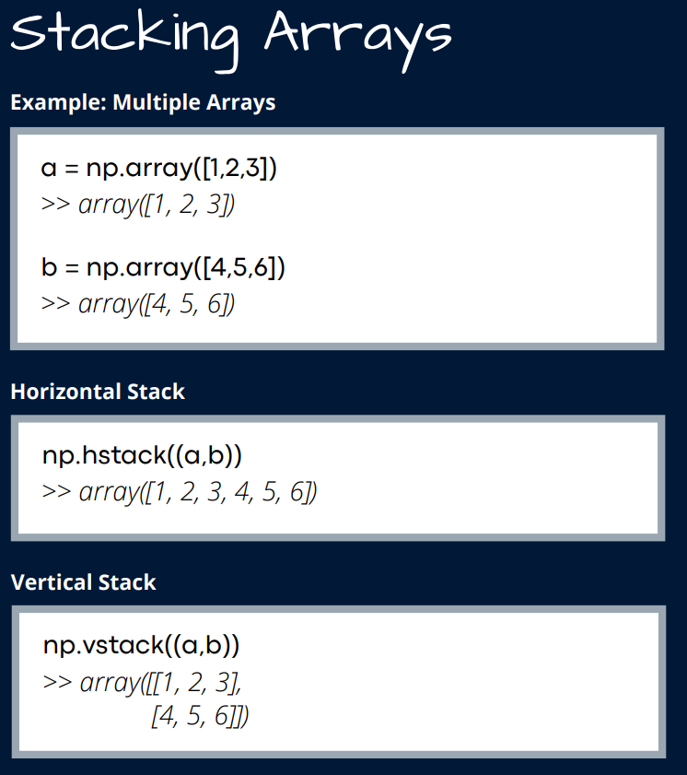

Slide 17
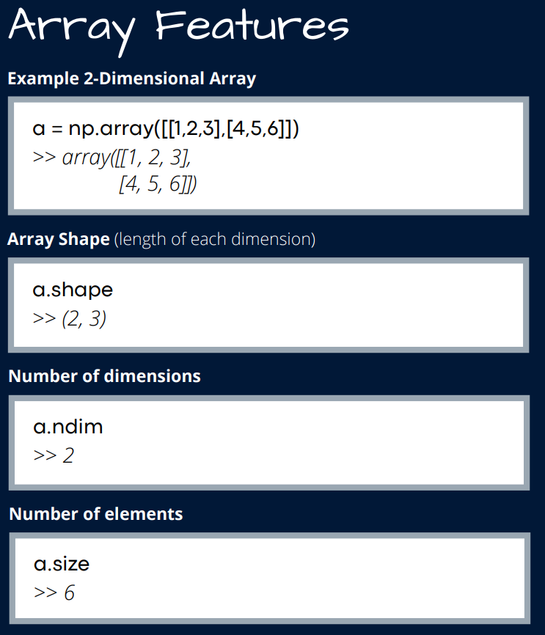

Slide 18
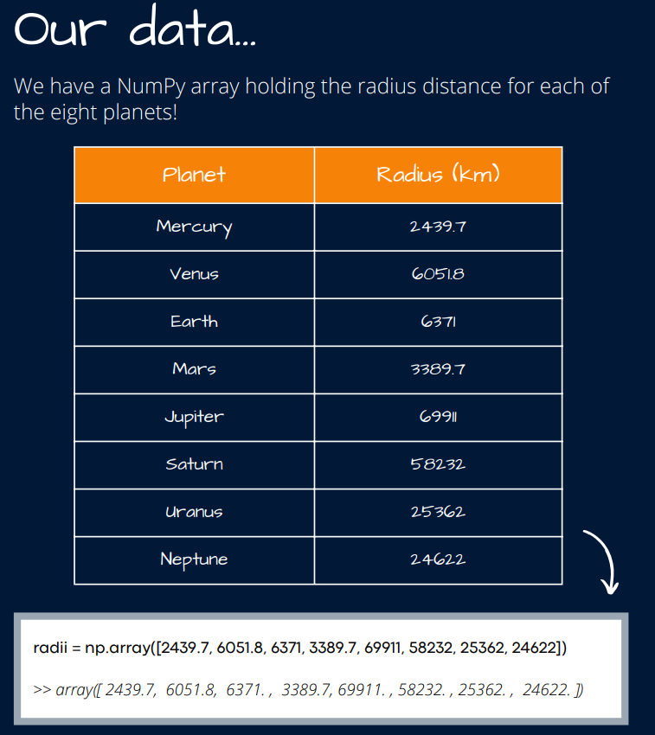
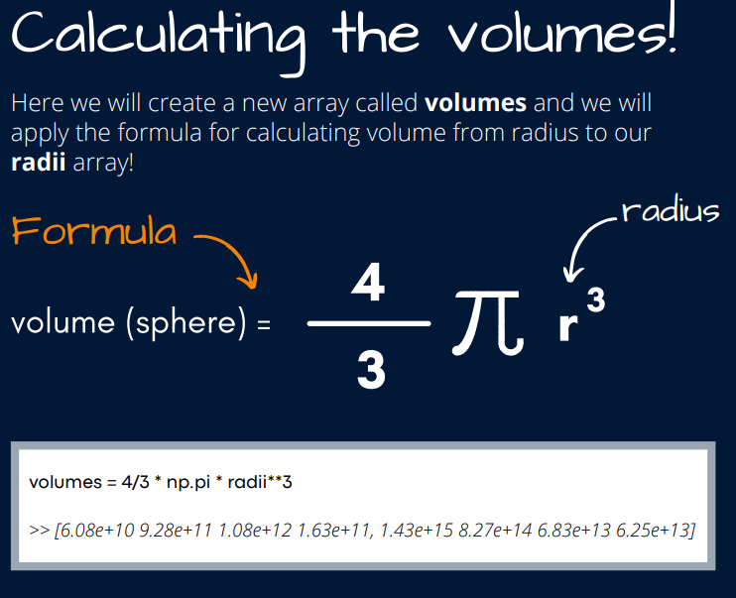

Slide 19
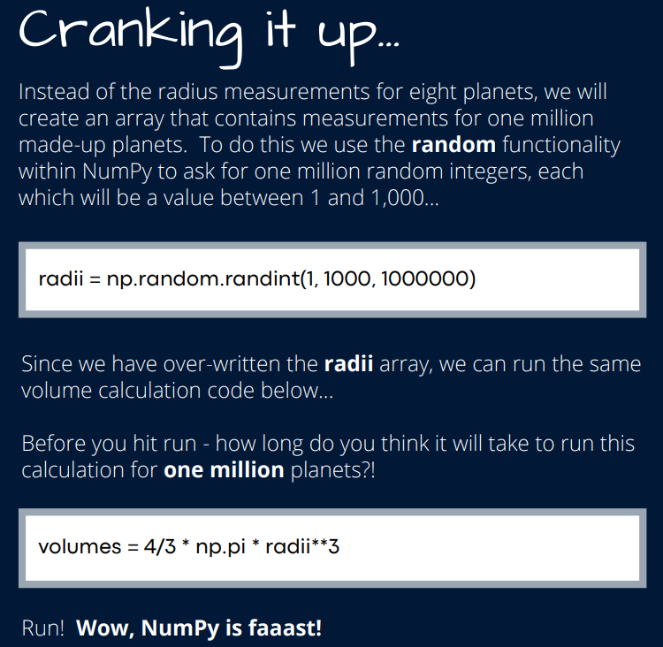

Slide 20
Practice

Slide 21
Practice
Let’s get started!
>>> import numpy as np
>>> a = np.arange(15).reshape(3,5)
What does a look like?
>>> a.shape
>>> a.size
>>> type(a)
What is the type of the output?

Slide 22
NumPy: defining an array
you can start from a list and then convert it into an array
>>> cvalues = [25.3, 24.8, 26.9, 23.9]
>>> C = np.array(cvalues)
or directly
>>> a = np.array([(1.5,2,3),(4,5,6)])
>>> a
>>> b = np.array([(1,2),(3,4)], dtype=complex)
>>> b

Slide 23

NumPy: defining an array
create a sequence of numbers
>>> a = np.arange(10, 30, 5)
>>> a
>>> a = np.arange(0, 2, 0.3)
>>> print (np.arange(10000).reshape(100,100))

Slide 24
NumPy: defining an array
a good way to initialize arrays
>>> a = np.zeros(10)
>>> b = np.zeros((10,2))
if you really need...
>>> a = np.ones((2,3,4), dtype=np.int16)
>>> a

Slide 25
NumPy: basic operations
slicing... works the same way as for lists
>>> a = np.array([[1,2,3,4],[5,6,7,8],[9,10,11,12]])
Exercise: use slicing to pull out the subarray consisting of the blue elements
>>> b = a[:2, 1:3]

Slide 26
NumPy: basic operations
ARRAY MATH
Basic mathematical functions operate elementwise on arrays
to sum arrays you have two options
>>> x = np.array([[1,2],[3,4]], dtype = np.float64)
>>> y = np.array([[5,6],[7,8]], dtype = np.float64)
>>> Result = x + y
>>> Result = np.sum(x)
same for other basic operations...
NOTE: * is elementwise multiplication, not matrix multiplication!
for matrix multiplication you can use:
>>> x.dot(y)
>>> np.dot(x,y)

Slide 27
NumPy: basic operations
Handy functions/methods
>>> x = np.array([[1,2],[3,4]], dtype = np.float64)
Or
>>> y = x.astype(int)
>>> np.sum(x)
>>> np.sum(x, axis=0)
>>> np.sum(x, axis=1)
To transpose a matrix, you can simply use .T
>>> print(x.T)
Some useful methods for arrays:
.mean()
.min()
.max()
.sort()
.diagonal()
.var()
.std()
.clip(min, max)

Slide 28
NumPy: basic operations
Logical expressions
>>> a = np.array([[1, 3, 0]], float)
>>> b = np.array([[0, 3, 2]], float)
>>> a > b
>>> a == b
>>> a > 2
Try these:
Python provides its own functions for if statements: np.where
>>> np.where(a!=0., 1/a, a)
condition
executed assignment if condition == True
executed assignment if condition == False

Slide 29
NumPy: aliasing and copy
>>> a = np.array([1, 3, 0], float)
>>> b = a
>>> c = np.copy(a)
>>> a[0] = 5
>>> a[0] == b[0]
>>> a[0] == c[0]

Slide 30
NumPy: masked arrays
Masked arrays are arrays that may have missing or invalid entries
>>> import numpy.ma as ma
Masked array = array + mask
>>> x = np.array([1, 2, 3, -1, 5])
>>> mx = ma.masked_array(x, mask = [0,0,0,1,0])
>>> mx.mean()
2.75
>>> x.mean()
>>> mx.view(ma.masked_array)
True or 1 = invalid data!!!!
functions/methods of numpy work for masked arrays.

Slide 31
Exercises with Numpy arrays
1) Write a program to create a 5X5 array with random values and find the minimum and maximum values
2) Write a program to create a random 10X4 array and extract the first five rows of the array and store them into a variable
Source: <w3r>esource (https://www.w3resource.com/about.php)

Slide 32
Exercises with Numpy arrays
1) Write a program to create a random vector of size 10 and sort it
2) Write a program to create a random vector of size 15 and replace the maximum value by -1
Source: <w3r>esource (https://www.w3resource.com/about.php)

Slide 33
Thanks

