Slide 1
CUSTOMER ANALYTICS / PROJECT READOUT
Customer Shopping
Behavior Analysis
DATASET
3,900
purchases analyzed across 18 columns.
QUALITY CHECK
37
missing values in Review Rating.
Transactional evidence translated into customer segments, product preferences, subscription behavior, and business actions.
Notes:
Set the scope first: this analysis covers 3,900 purchases and 18 fields, with customer, product, and shopping-behavior variables. The objective is to identify patterns that can guide commercial decisions.

Slide 2
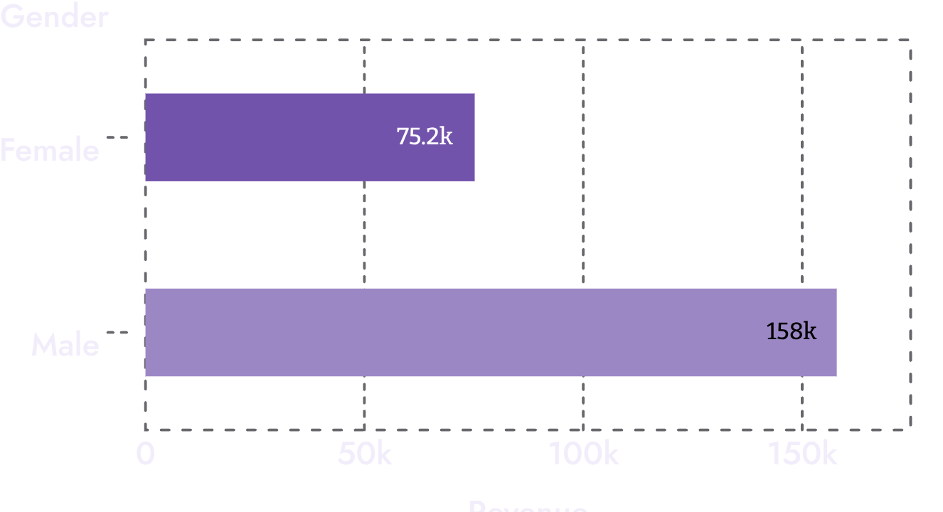

01 — DATA PREPARATION
Clean data before asking business questions.
The workflow moved from Python preparation into PostgreSQL analysis.
Preparation step | Action
Missing data | Imputed Review Rating values using the median rating of each product category.
Standardization | Renamed columns to snake case for readability and documentation.
Features | Created age_group by binning customer ages; created purchase_frequency_days from purchase data.
Consistency | Checked whether discount_applied and promo_code_used were redundant; dropped promo_code_used.
Integration | Connected the Python script to PostgreSQL and loaded the cleaned DataFrame into the database for SQL analysis.
SQL QUESTION 01
Revenue by gender
Total revenue generated by male vs. female customers.
2026
2

Slide 3
02 — DISCOUNT BEHAVIOR / PRODUCT QUALITY
Discounts do not prevent high-value purchases.
HIGH-SPENDING DISCOUNT USERS
TOP 5 PRODUCTS BY RATING
Discount users can still spend above the average purchase amount.
Item purchased | Average product rating
Gloves | 3.86
Sandals | 3.84
Boots | 3.82
Hat | 3.80
Skirt | 3.78
Customers who used discounts were identified where purchase amounts remained above the average. This creates a clear audience for targeted promotions rather than blanket discounting.
Business question: which discount users retain strong purchase value?
Highest average review ratings in the analyzed product set.
2026
3

Slide 4
03 — TRANSACTION DESIGN
Shipping, subscriptions, and discounts reveal different levers.
SHIPPING TYPE
SUBSCRIPTION STATUS
DISCOUNT-DEPENDENT PRODUCTS
Express is higher
Spend is nearly level
Five products lead
60.48
59.87
Hat | 50.00%
Sneakers | 49.66%
Coat | 49.07%
Sweater | 48.17%
Pants | 47.37%
Average purchase amount for Express shipping.
Average spend for non-subscribers.
Subscribers: 59.49 · Revenue: $62,645 vs. $170,436
Standard: 58.46
2026
4

Slide 5
04 — CUSTOMER AND CATEGORY STRUCTURE
Most customers are already loyal.
TOP 3 PRODUCTS PER CATEGORY
Category | Products | Top order count
Accessories | Jewelry Sunglasses Belt | 171 161 161
Clothing | Blouse Pants Shirt | 171 171 169
Footwear | Sandals Shoes Sneakers | 160 150 145
Outerwear | Jacket Coat |  | 163 161
Purchase history creates three practical segments for activation and retention.
Customer segment | Number of customers
Loyal | 3,116
Returning | 701
New | 83
Segments are based on purchase history.
Most purchased products within each category.
2026
5

Slide 6
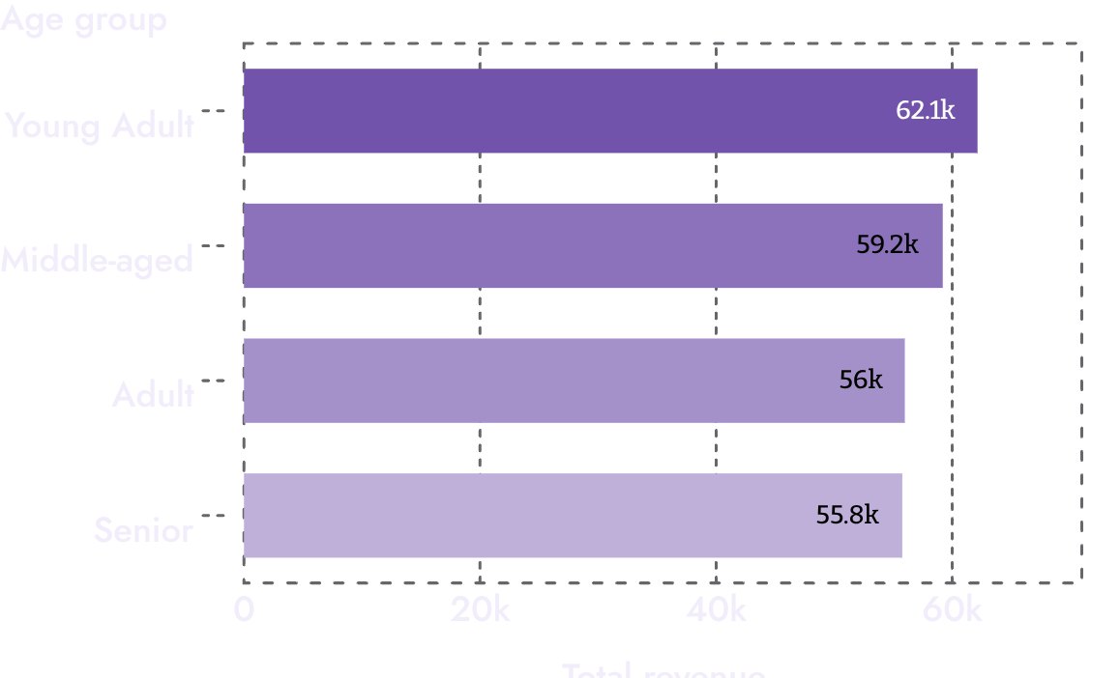
05 — RETENTION AND REVENUE
Repeat buyers are a sizeable subscription audience.
REVENUE BY AGE GROUP
Customers with more than five purchases were checked for subscription behavior.
Subscription status | Repeat buyers
Yes | 958
No | 2,518
Young Adult customers contribute the highest total revenue among the four age groups.
Repeat buyers are defined here as customers with >5 purchases.
2026
6

Slide 7
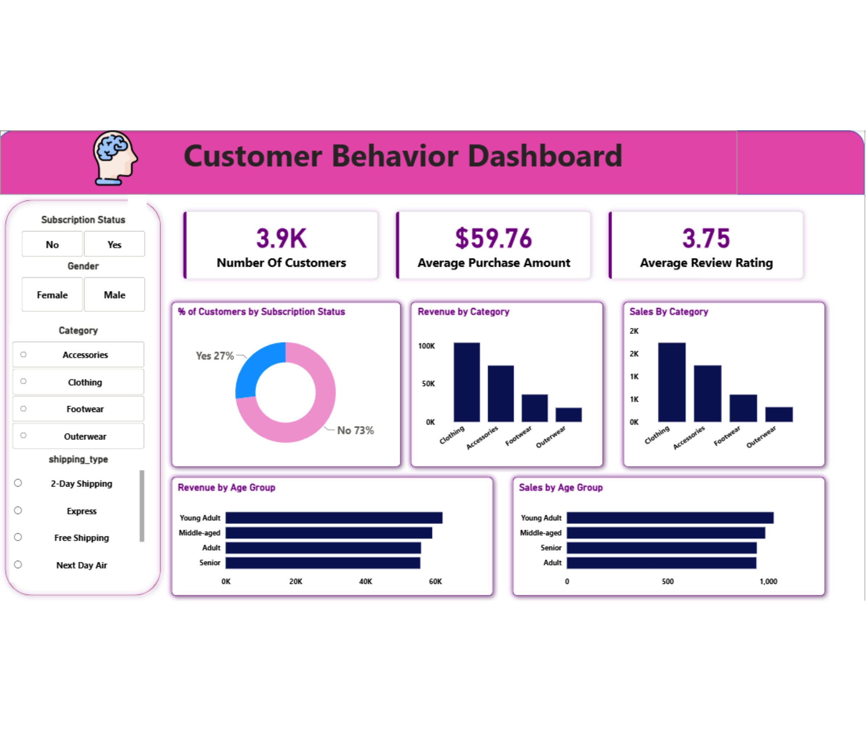
06 — DECISION INTERFACE
Dashboard in
Power BI
An interactive dashboard presents the insights visually and gives users a single view across customer, category, subscription, and age-group measures.
Filters include Subscription Status, Gender, Category, Shipping Type, and purchase timing.
2026
7

Slide 8
07 — BUSINESS RESPONSE
Turn observed behavior into five focused actions.
01
02
03
04
05
Boost subscriptions
Build loyalty
Review discount policy
Position products
Target precisely
Reward repeat buyers to move them into the Loyal segment.
Highlight top-rated and best-selling products in campaigns.
Focus efforts on high-revenue age groups and Express-shipping users.
Promote exclusive benefits for subscribers.
Balance sales boosts with margin control.
Prioritize loyalty and subscription growth, then use product, age, shipping, and discount signals to sharpen targeting.
2026
8
Notes:
Close with the action set. The analysis points toward subscription benefits, loyalty rewards, disciplined discounting, stronger product positioning, and targeting based on the highest-value customer and transaction signals.

