Slide 1

Multimodal Clinical Decision Support for Pulmonary Pathology
SIC – AI803
Notes:
1.7.2013
Note:
1
‹#›

Slide 2
Agenda
    Team Members
    Motivation & Problem
    Targeted audience
    Tools & Technologies
    Our approach
    Final Results
    Deployment
    Future Enhancements
Samsung Innovation Campus

Slide 3
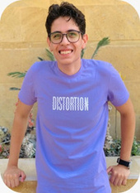
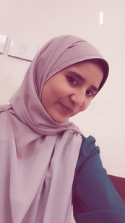
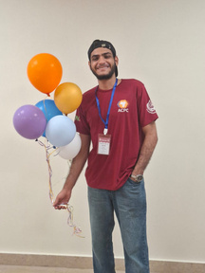

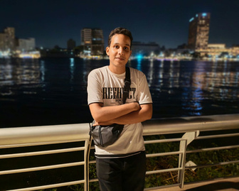
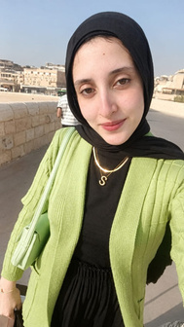
Team Members
Moataz Sameh
Manar Sabry
Mark Sedky
Yusuf Mohamed
Samah Mahmoud
Samsung Innovation Campus

Slide 4
Motivation & Problem
Samsung Innovation Campus
Notes:
1.7.2013
Note:
2
‹#›

Slide 5

Problem Statement
    Pneumonia-related medical information may be difficult to access in Arabic.
    Understanding chest X-ray images requires specialized medical expertise.
    Finding relevant answers across medical FAQs can be time-consuming.
Samsung Innovation Campus

Slide 6
Our Proposed Solution
An AI-powered system that combines:
    Computer Vision: Classifies chest X-ray images as Normal or Pneumonia.
    Arabic RAG Chatbot: Retrieves relevant medical FAQ content and generates answers to users' questions.
Samsung Innovation Campus

Slide 7
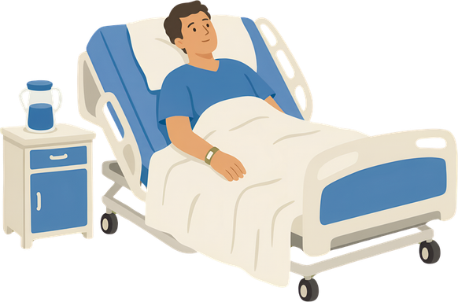
Targeted audience
Doctors
Patients
Samsung Innovation Campus

Slide 8
Tools & Technologies
Samsung Innovation Campus
Notes:
1.7.2013
Note:
2
‹#›

Slide 9
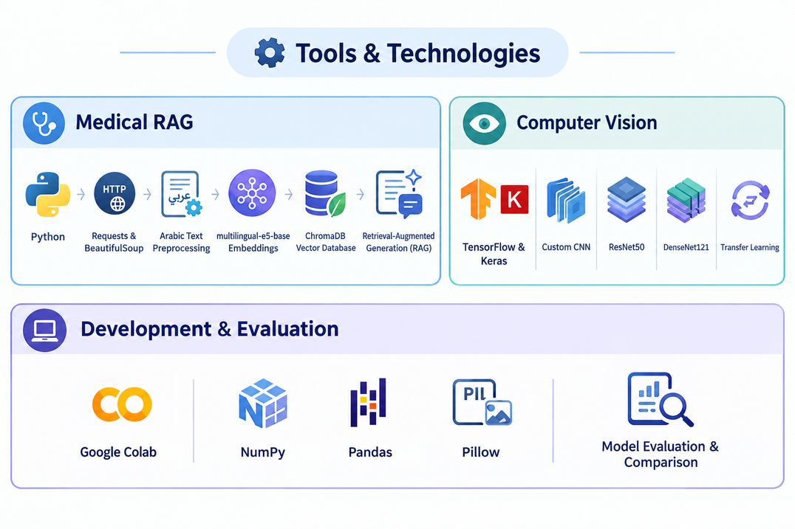
Technology Stack
Samsung Innovation Campus

Slide 10
Components & Models
    Router: decides which path answers the question
    Diagnosis RAG (planned): Arabic medical data scraped from altibbi.com
    Guidelines & Drug RAG (planned): medical guidelines and drug books
    Chest X-ray models
      Custom CNN: built from scratch
      ResNet50: Transfer Learning, pretrained on ImageNet
      DenseNet121: Transfer Learning; dense connections reuse features between layers
Samsung Innovation Campus

Slide 11
Our approach
Samsung Innovation Campus
Notes:
1.7.2013
Note:
2
‹#›

Slide 12
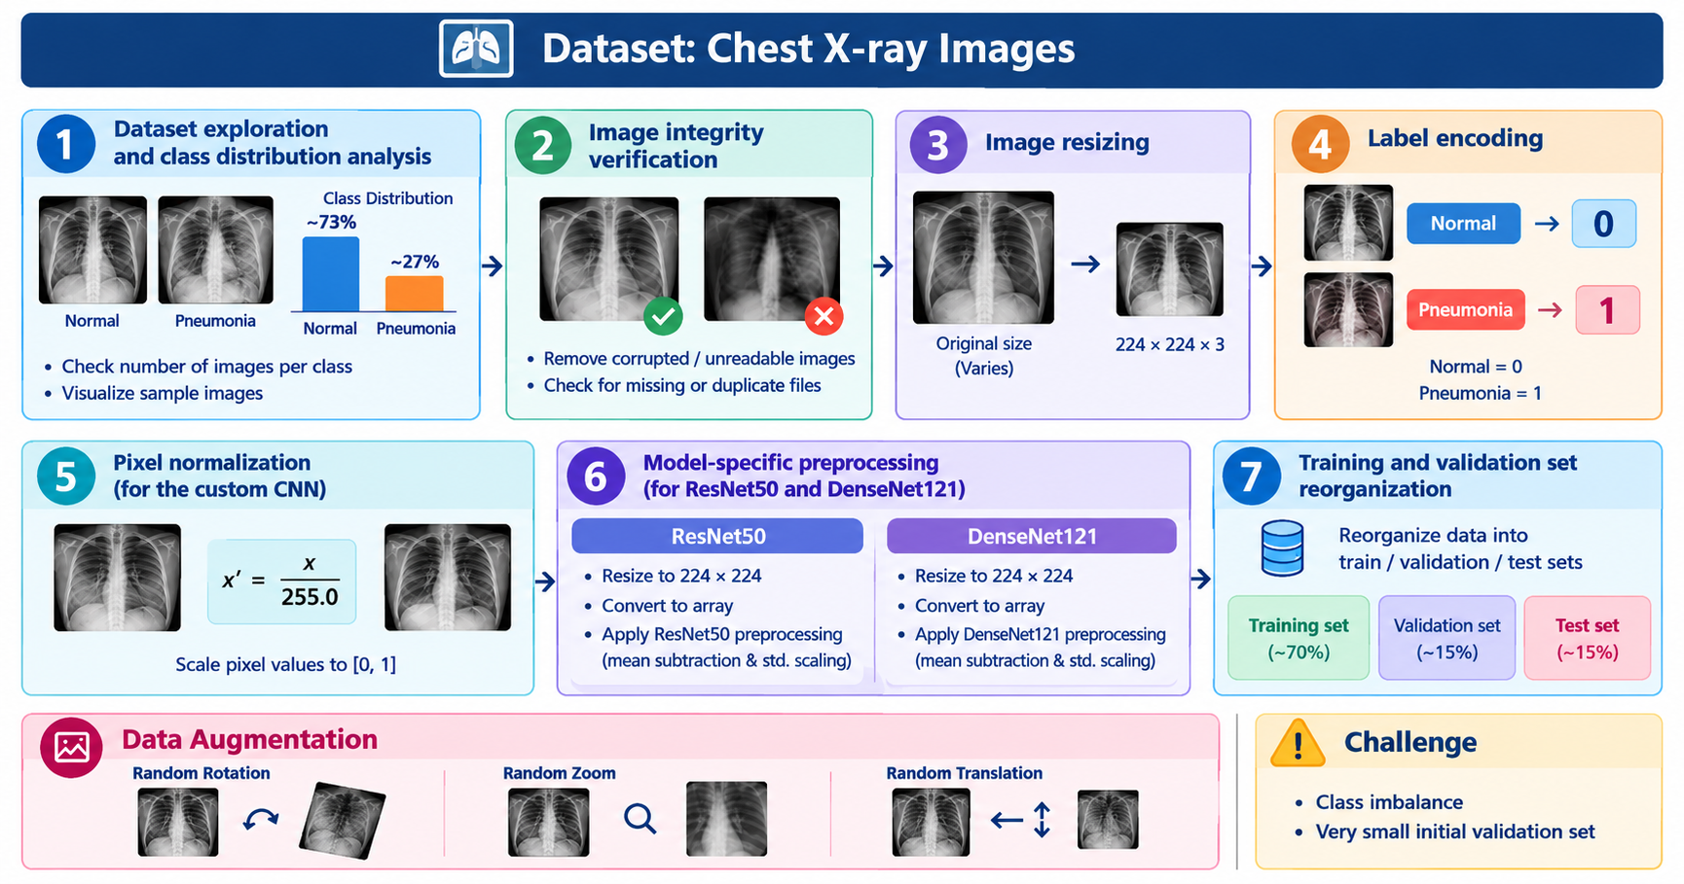
Computer Vision
Data Preprocessing
Samsung Innovation Campus

Slide 13
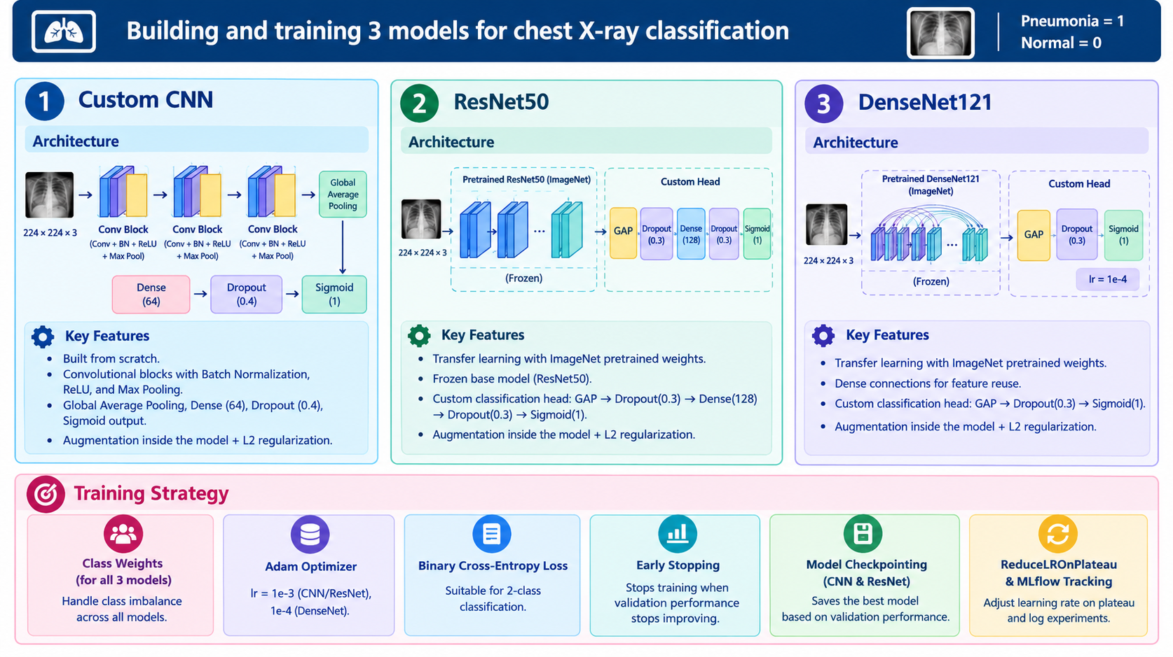
Computer Vision
Model Development
Samsung Innovation Campus

Slide 14
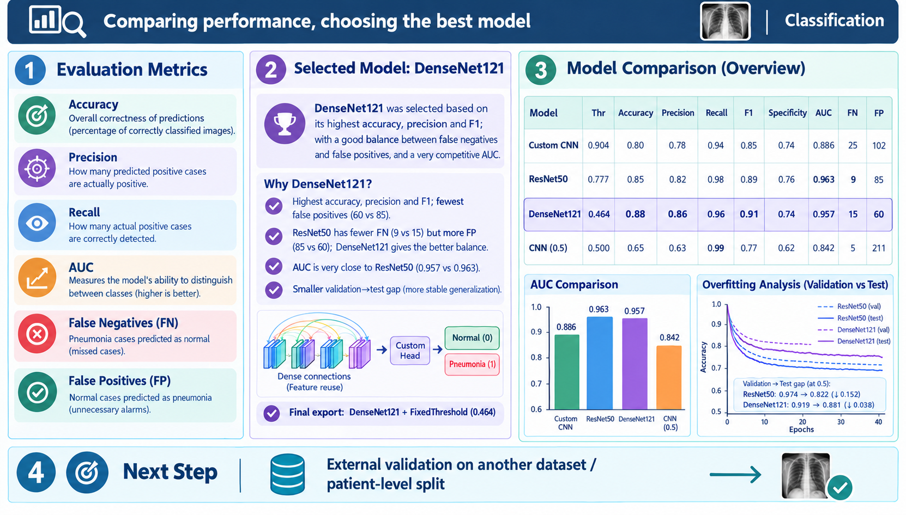
Computer Vision
Evaluation & Selection
Samsung Innovation Campus

Slide 15
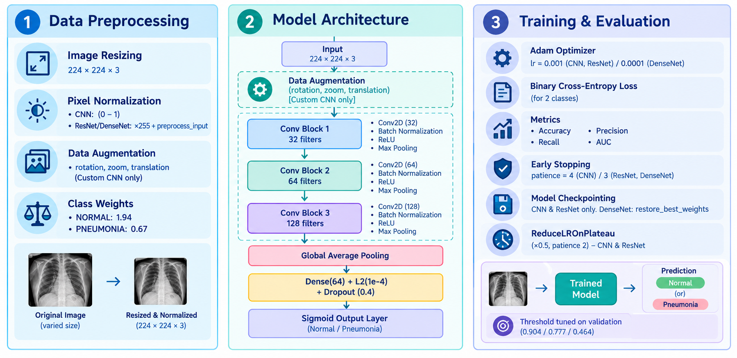
Computer Vision
Pipeline Overview
Samsung Innovation Campus

Slide 16
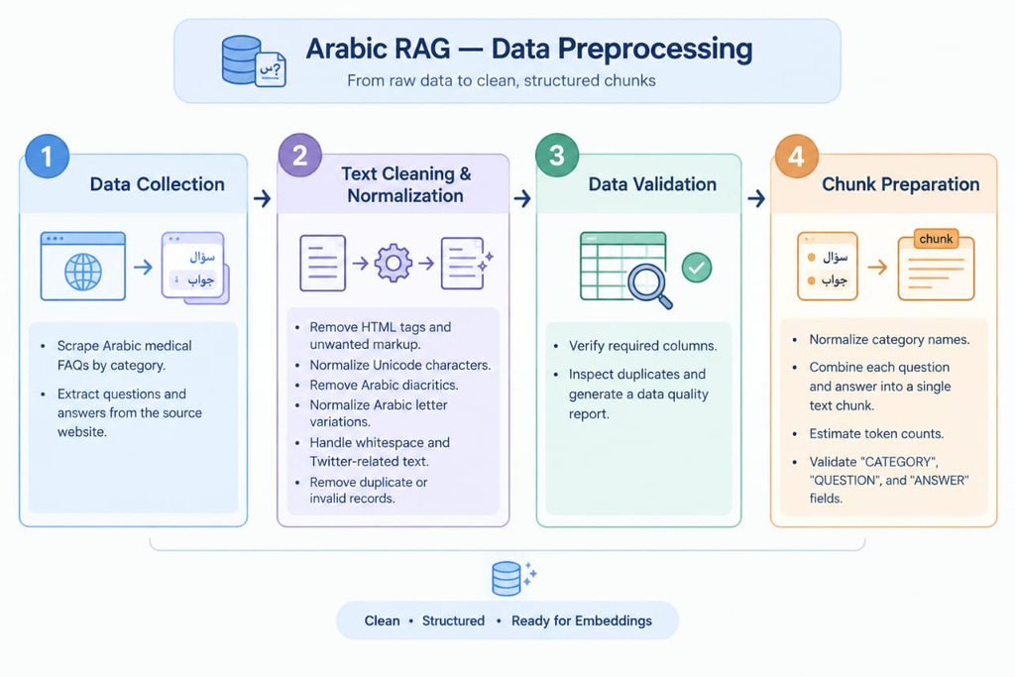
RAG
Arabic Data Preprocessing
Samsung Innovation Campus

Slide 17
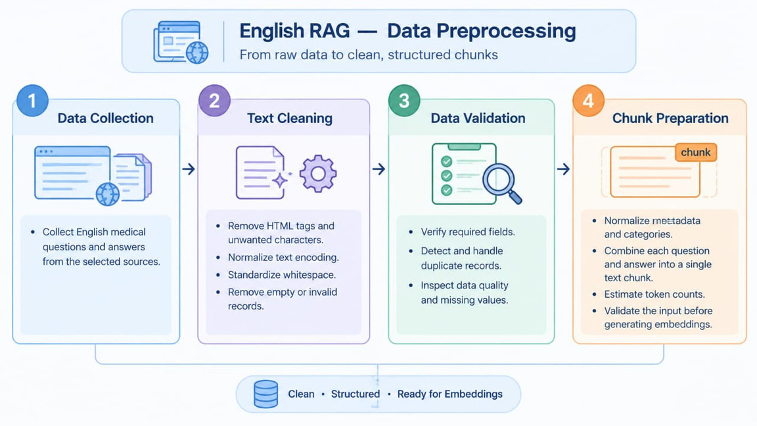
RAG
English Data Preprocessing
Samsung Innovation Campus

Slide 18
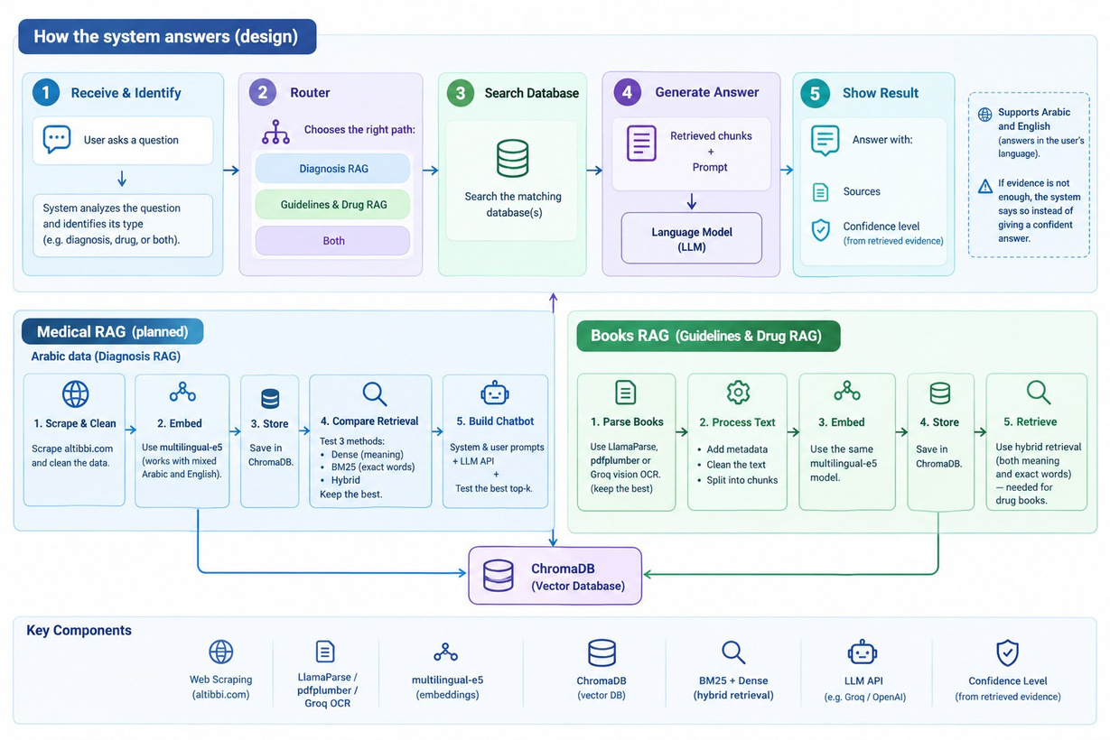
RAG
System Architecture

Slide 19
Final Results
    Computer Vision: Selected Model — DenseNet121
    Arabic & English RAG: Medical FAQ retrieval and answer generation
    Evaluation: Model performance and RAG response quality
    Outcome: An integrated system supporting medical information retrieval in Arabic and English
Samsung Innovation Campus
Notes:
1.7.2013
Note:
9
‹#›

Slide 20
Deployment
Samsung Innovation Campus
Notes:
1.7.2013
Note:
2
‹#›

Slide 21
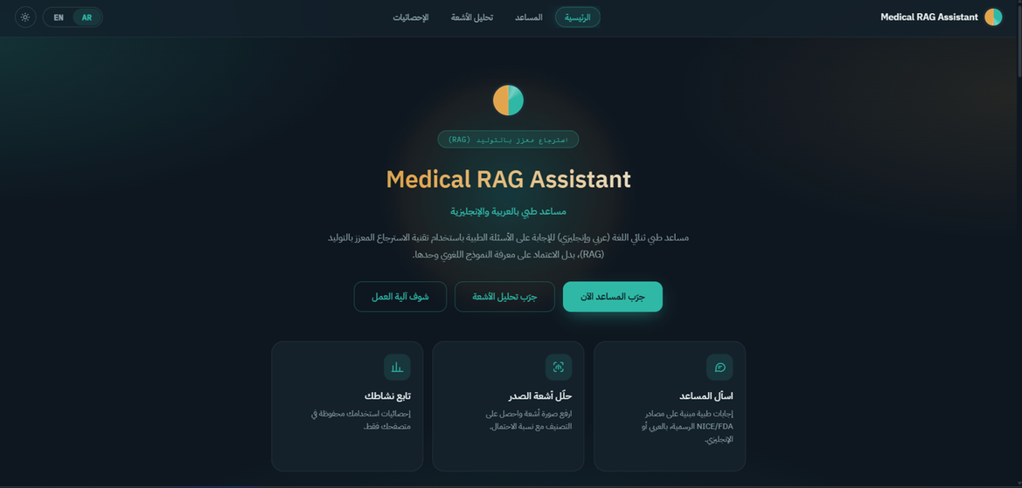
Deployment : Home Page
Samsung Innovation Campus
Notes:
1.7.2013
Note:
2
‹#›

Slide 22
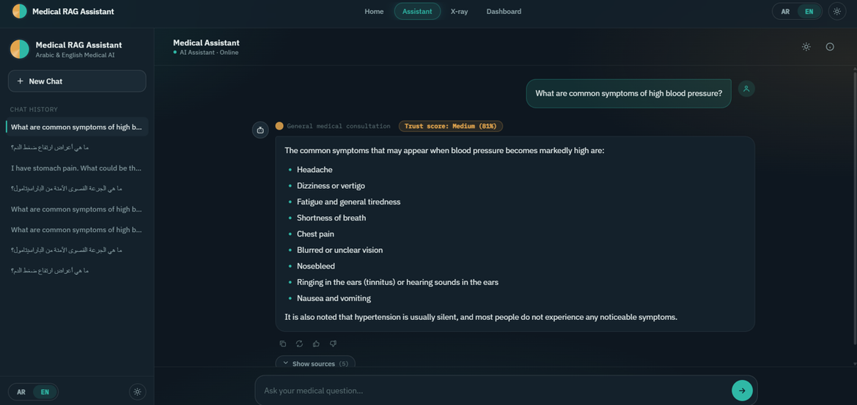
Deployment : Assistant EN
Samsung Innovation Campus
Notes:
1.7.2013
Note:
2
‹#›

Slide 23
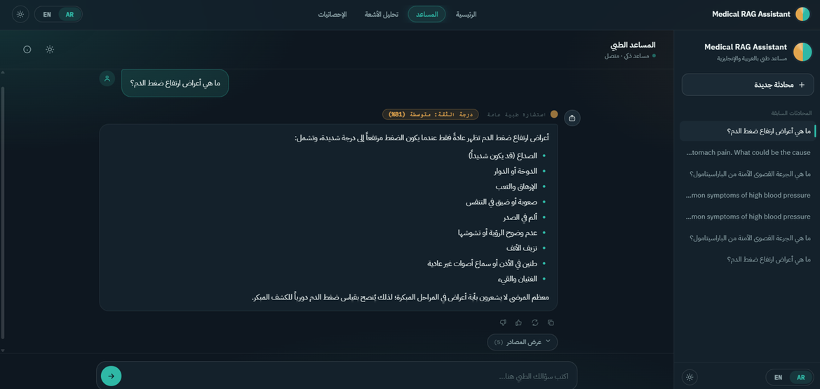
Deployment : Assistant AR
Samsung Innovation Campus
Notes:
1.7.2013
Note:
2
‹#›

Slide 24
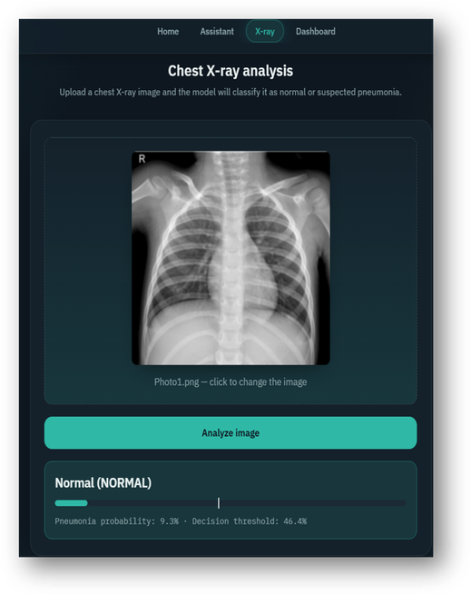
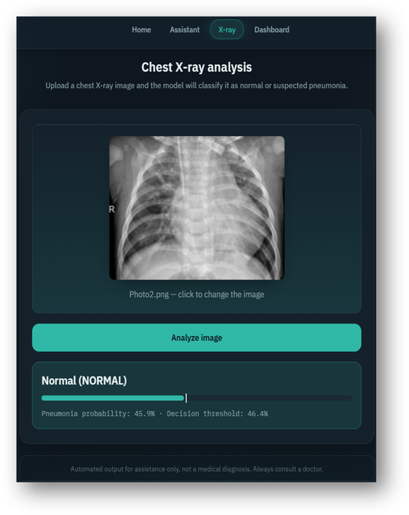
Deployment : X-ray
Samsung Innovation Campus
Notes:
1.7.2013
Note:
2
‹#›

Slide 25
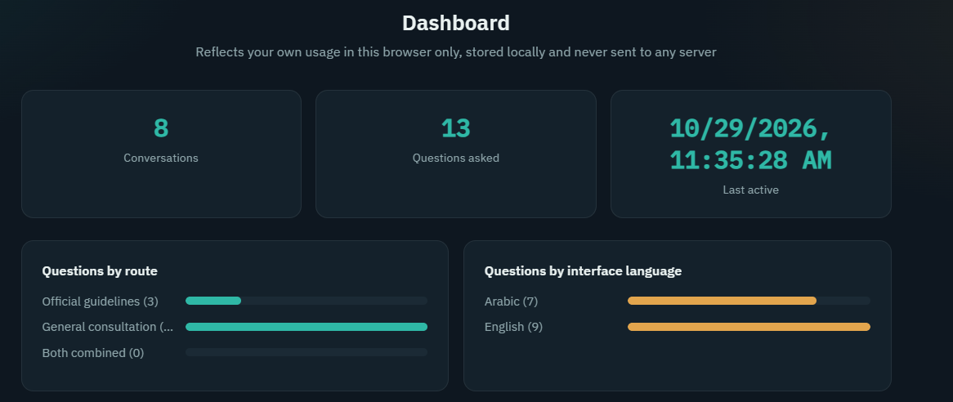
Deployment : DashBoard
Samsung Innovation Campus
Notes:
1.7.2013
Note:
2
‹#›

Slide 26
Future Enhancements
To improve the system's effectiveness and accuracy, several future enhancements can be considered:
    Complete the planned Diagnosis RAG (Arabic medical data from altibbi.com)
    Complete the planned Guidelines & Drug RAG (medical guidelines and drug books)
    Further evaluation on unseen data to confirm generalization and reliability
Samsung Innovation Campus

Slide 27

ⓒ2020 SAMSUNG. All rights reserved.
Samsung Electronics Corporate Citizenship Office holds the copyright of book.
This book is a literary property protected by copyright law so reprint and reproduction without permission are prohibited.
To use this book other than the curriculum of Samsung innovation Campus or to use the entire or part of this book, you must receive written consent from copyright holder.
Notes:
1.7.2013
14
‹#›

