Slide 1
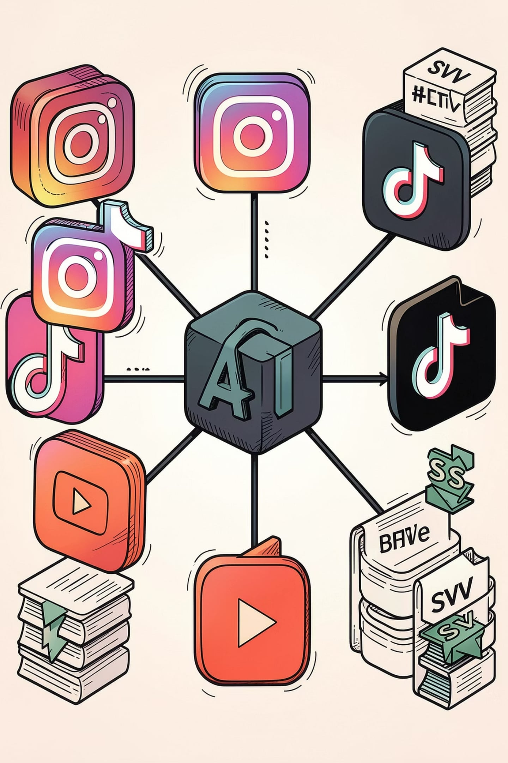
Week 4 Progress Report
Social Media Data Collection
GenAI Carbon Footprint
Moteba Rehman (Research Intern)
Supervisor: Ms. Zahida Kausar
Faculty Coordinator: Dr. Mehwish Fatima

Slide 2

Data Collection Workflow
Research Tags
Jupyter Notebook
Platforms
CSV Dataset
Target hashtags: #ghibliart, #ghiblistyle, #ghiblistudio, #ghiblitrend. Data collection automated via platform‑specific Jupyter notebooks; scraping, basic validation, and CSV export implemented.

Slide 3



Collected Dataset
Instagram — 93 posts
TikTok — 400 videos
YouTube — 400 videos
Caption
Hashtags
Likes · Comments
Timestamp · Username · Location
Caption · Hashtags
Views · Likes · Comments · Shares
Author · Timestamp
Title · Uploader
Views · Duration
Keyword · Video URL

Slide 4
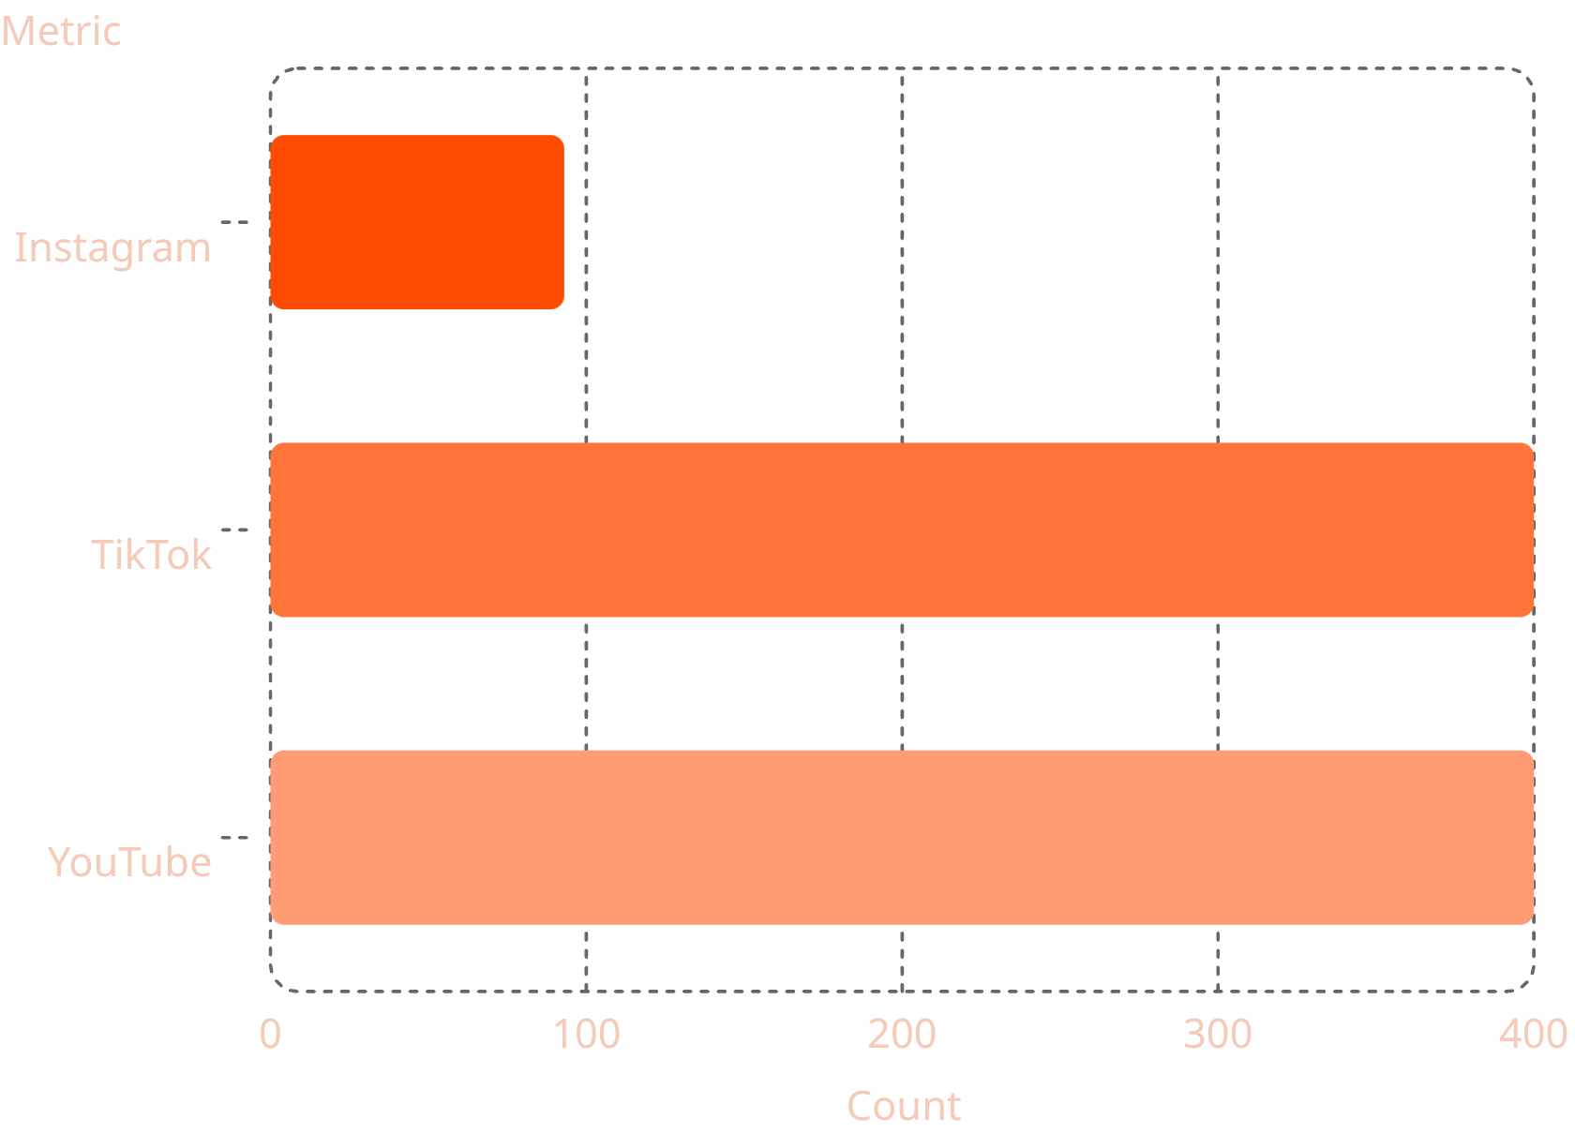
Dataset Summary
Observations:
TikTok and YouTube contributed the majority of records; platform metadata varies (engagement vs. video metrics). Combined dataset provides a diverse foundation for subsequent GenAI trend and carbon‑impact analysis.
Platforms Covered
Target Hashtags
Total Records
3
4
893
Dataset Format
CSV (normalized columns per platform)

Slide 5
Key Outcomes
Data Foundation
Data Acquisition
Structured dataset with post/video metadata and engagement metrics for trend analysis and lifecycle estimation.
Reusable Tools
Successfully gathered 893 records across Instagram, TikTok, and YouTube; exported clean CSVs.
Developed modular Jupyter notebooks for each platform enabling repeatable, parameterised collection.

