Slide 1

République Tunisienne — Ministère de l'Enseignement Supérieur et de la Recherche Scientifique
END-OF-YEAR PROJECT PRESENTATION
OSINT INTELLIGENCE PLATFORM FOR LEAKED DATA RESEARCH
LeakLens — Cybersecurity · iTeam University
Prepared by:
Supervised by:
Motez Machghoul
Mr. Raihane Modhaffer
Academic Year: 2025 – 2026

Slide 2
Presentation Plan
01
Introduction
Why breach data matters in cybersecurity
02
Problem Statement
The exposure gap defenders face
03
Proposed Solution
LeakLens — our OSINT platform
04
System Design
Architecture, search flow, security
05
Implementation
UI, Docker deployment, live demos
06
Results & Conclusion
What we achieved — Q&A
LeakLens — End-of-Year Project Defense
LeakLens PFA 2026

Slide 3
Introduction
Open-Source Intelligence (OSINT) for breach exposure assessment
Every day, billions of credentials leak onto forums, stealer logs, and combolists.
Attackers use this data for credential stuffing, account takeover, and phishing.
Defenders need the same visibility — to find exposure before attackers exploit it.
LeakLens was built to give authorized analysts a secure way to search breach data.
01 — Introduction
LeakLens PFA 2026

Slide 4
Problem Statement
The defender's blind spot
Breach data stays online long after an incident is announced.
Reused passwords turn one small leak into access to email, cloud, and VPN accounts.
Commercial OSINT tools are expensive, closed, or limited to breach names only.
Students and small security teams lack an affordable, transparent research platform.
02 — Problem Statement
LeakLens PFA 2026

Slide 5
Proposed Solution — LeakLens
An OSINT breach-search platform built for cybersecurity research
Search 7 types: email, username, IP, password, name, hash, domain.
Return real breach records with severity scoring and enrichment context.
Protect access: invite-only signup, JWT auth, RBAC, rate limiting.
Deploy transparently: Next.js on Vercel + FastAPI on Docker VPS.
03 — Proposed Solution
LeakLens PFA 2026

Slide 6
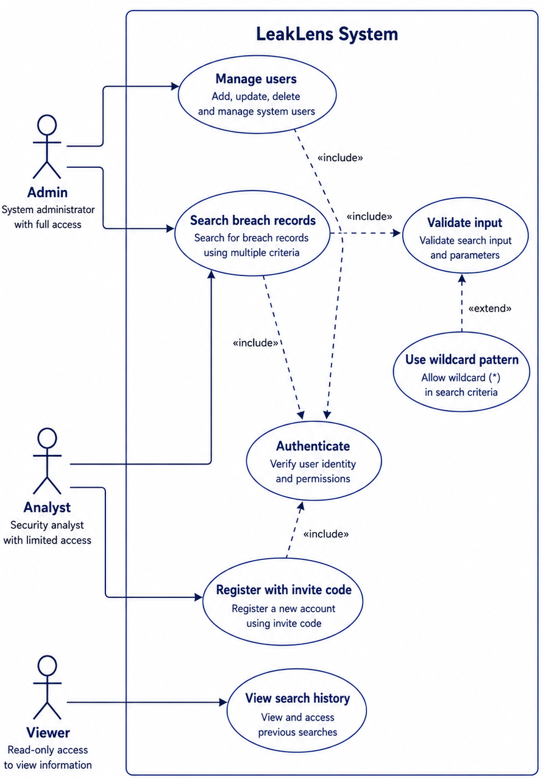
Who Uses the Platform
Role-based access control (RBAC)
Guest registers with invite code · Analyst searches · Admin manages users
04 — System Design
LeakLens PFA 2026

Slide 7
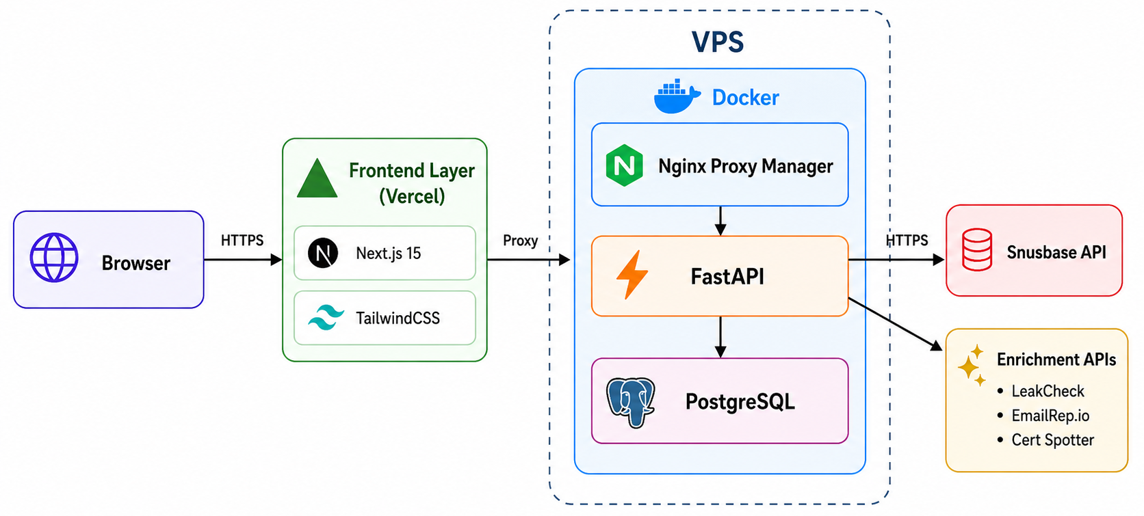
Global Architecture
Split deployment — frontend on Vercel, backend on VPS
Browser → Next.js → Nginx Proxy Manager → Docker (FastAPI + PostgreSQL) → Snusbase & enrichment APIs
04 — System Design
LeakLens PFA 2026

Slide 8
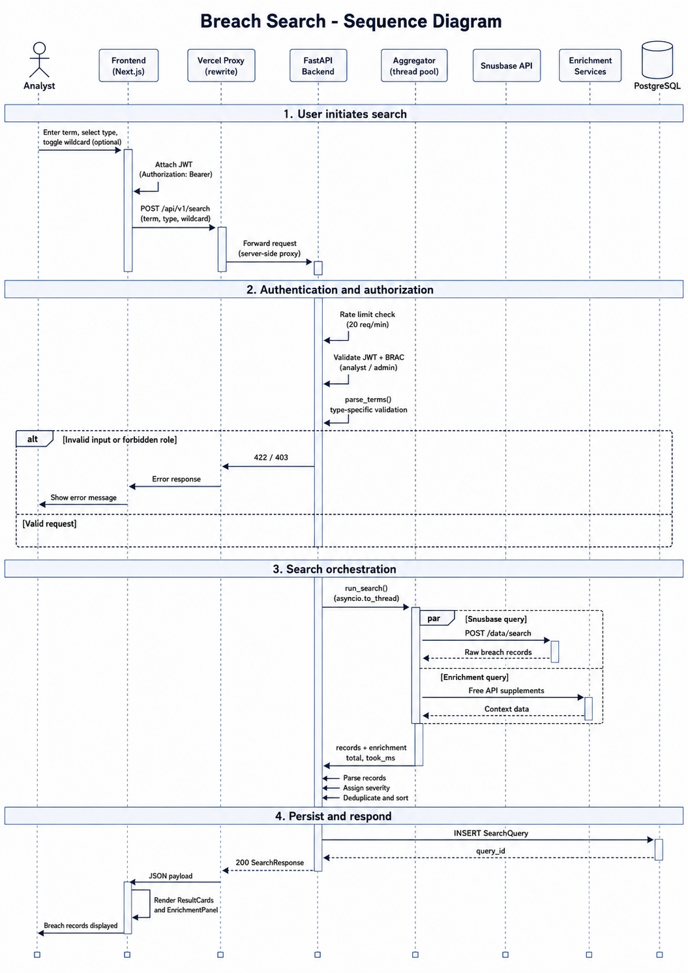
Search Engine Pipeline
From user input to breach results in seconds
POST /api/v1/search → validate → Search Engine → Snusbase + API Services → PostgreSQL audit → response
04 — System Design
LeakLens PFA 2026

Slide 9
Security by Design
Defense-in-depth for a sensitive OSINT capability
JWT access (15 min) + refresh tokens · bcrypt password hashing.
Roles: admin, analyst, viewer — search restricted to analyst/admin.
Rate limits on auth and search · account lockout after failed logins.
Security headers: CSP, HSTS, CORS · no local storage of raw credentials.
04 — Security
LeakLens PFA 2026

Slide 10
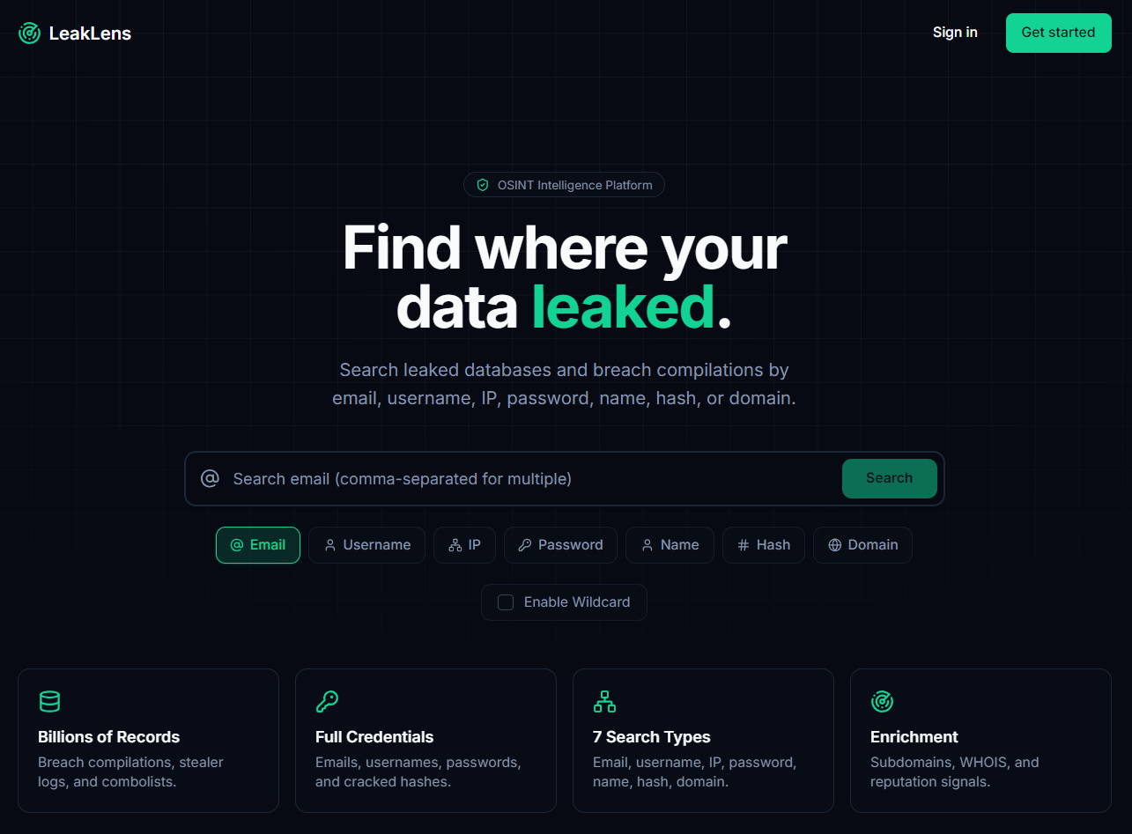
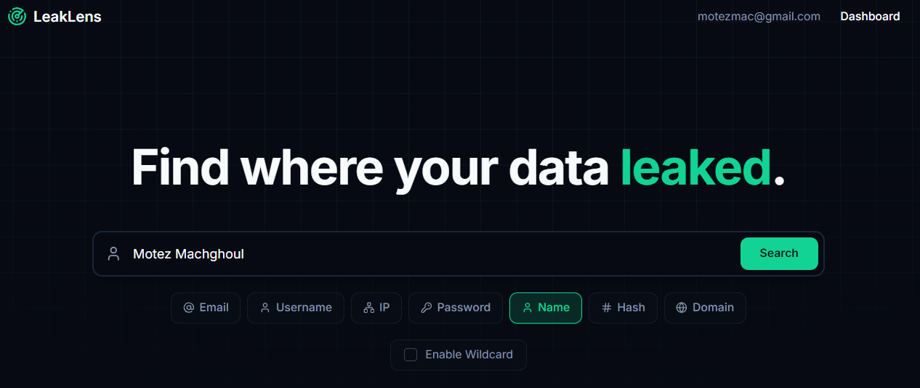
User Interface
Dark-themed UI for security analysts
Public landing page and authenticated search workspace with 7 search types
05 — Implementation
LeakLens PFA 2026

Slide 11
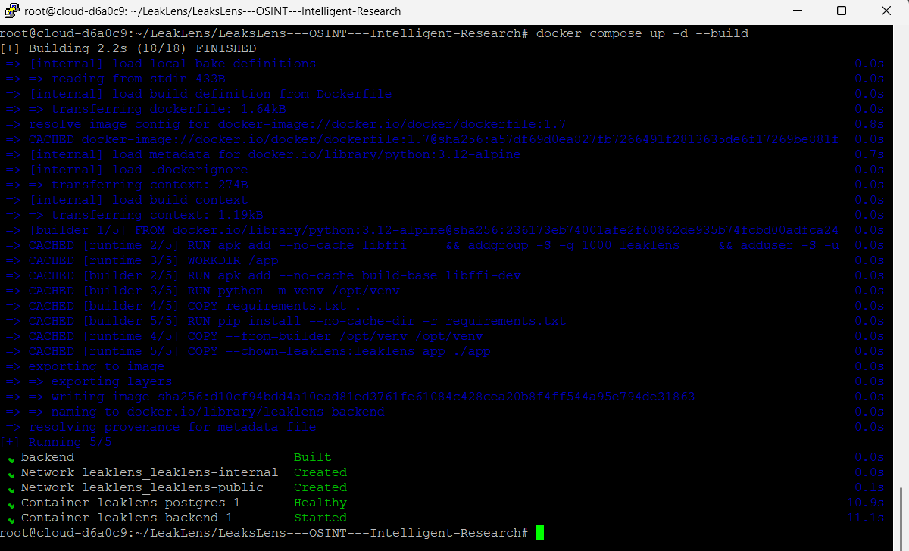
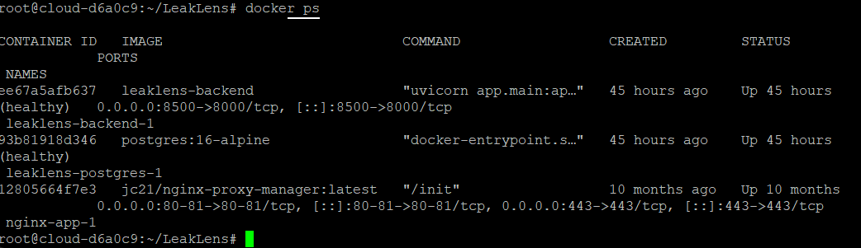
Docker Deployment on VPS
Containerized backend — Alpine, non-root, health checks
docker compose up -d --build · backend + PostgreSQL containers healthy on port 8500
05 — Implementation
LeakLens PFA 2026

Slide 12
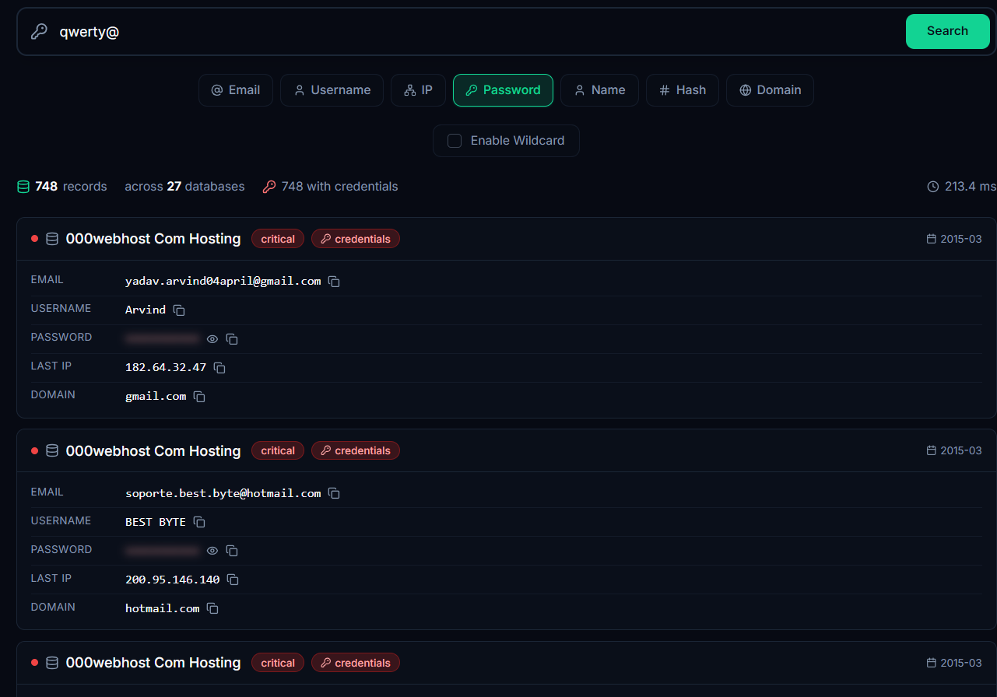
Demo — Password Search
Live query on production — leakslens.vercel.app
Query: qwerty@
Type: Password search
Result: 748 leaked records
Exposure: emails, usernames, plaintext passwords
Severity: mostly CRITICAL
Insight: weak passwords spread across many breaches
06 — Live Demonstration
LeakLens PFA 2026

Slide 13
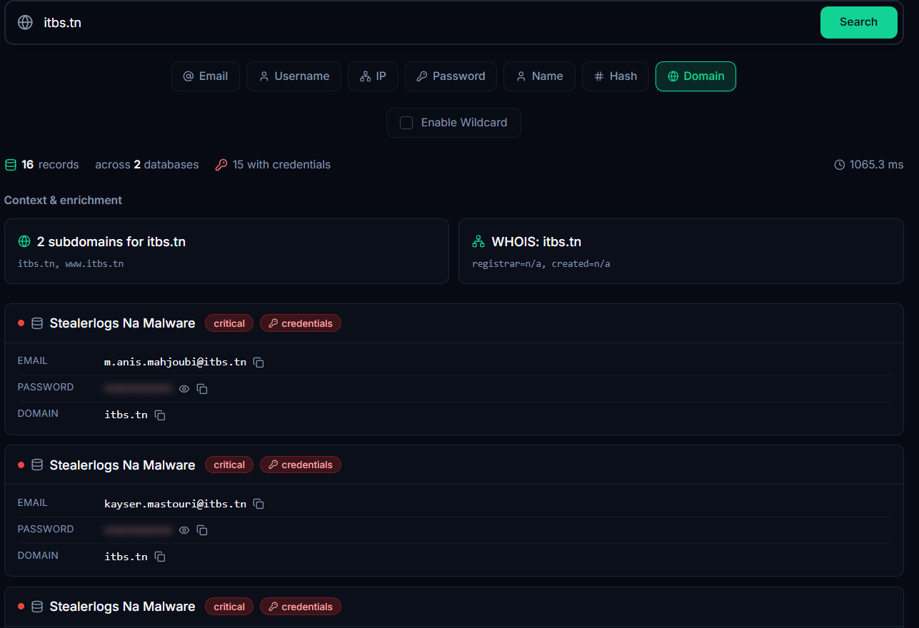
Demo — Domain Search
Live query on production — leakslens.vercel.app
Query: itbs.tn
Type: Domain search
Result: 16 breached student records
Context: institutional email exposure
Enrichment: subdomains + WHOIS data
Use case: campus security & incident response
06 — Live Demonstration
LeakLens PFA 2026

Slide 14
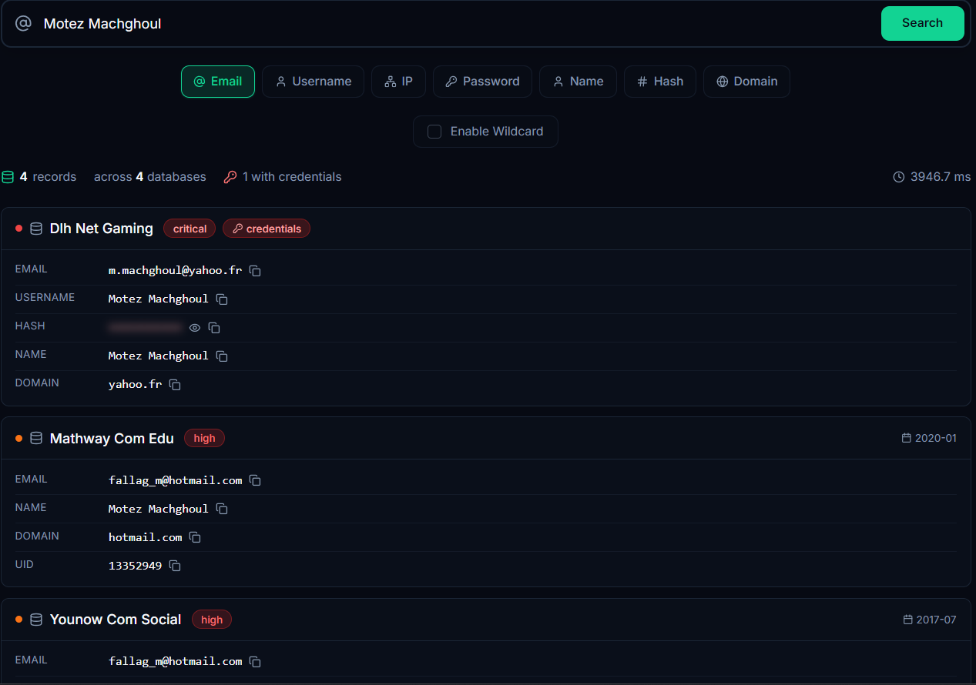
Demo — Name Search
Live query on production — leakslens.vercel.app
Query: personal full name
Type: Name search
Result: matching leak records found
Exposure: linked email + plaintext password
Use case: individual exposure check
Anyone can verify if their identity appears in leaks
06 — Live Demonstration
LeakLens PFA 2026

Slide 15
What We Achieved
From problem to production-ready platform
Built a full-stack OSINT platform deployed at leakslens.vercel.app.
Integrated Snusbase + enrichment APIs with concurrent search engine.
Implemented JWT, RBAC, invite gate, and Docker-hardened backend.
Validated with real queries: 748 password hits, 16 domain records, personal name exposure.
07 — Conclusion
LeakLens PFA 2026

Slide 16
Thank You
Questions & Discussion
leakslens.vercel.app · Motez Machghoul · iTeam University 2026

