Slide 1
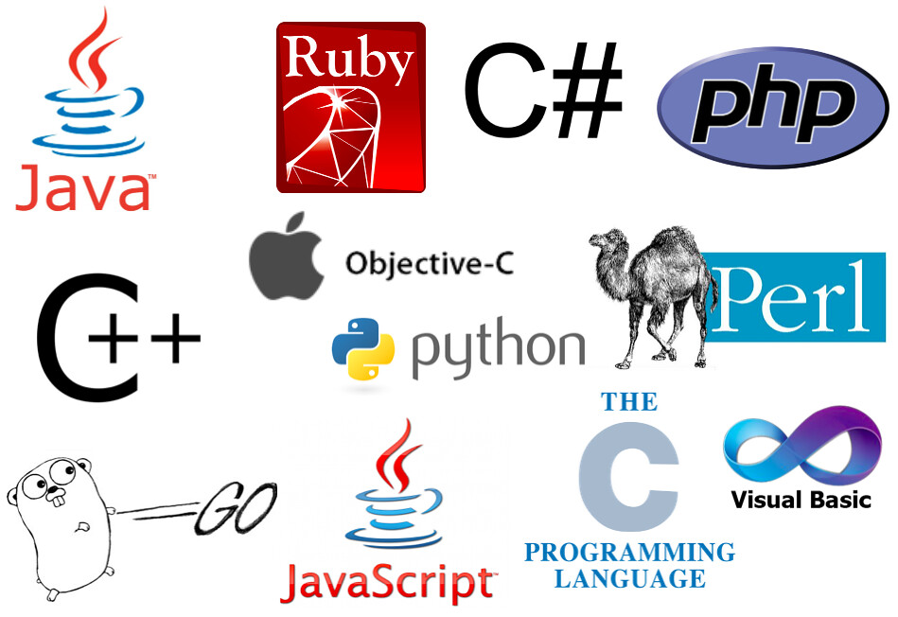
Programming language
A language used to write instructions for the computer.

Slide 2




Translator
English -> Spanish
Hello
Hola
English
Spanish
x=1
Print(x+2)
Compiler
Python -> 1/0
Python
10101

Slide 3
Vocabulary(Keywords)
Grammar(Syntax)
English | Python
Hello | If
Open | Switch
Write | For
English | Python
Cat is. Cats is. | Print ( ) Print { }

Slide 4

Variables(named values)
Placeholder of information for later use.
Value stored is changeable.
We store values inside variables using the “=“ sign (x=2, z=“Hello”).
X
Y
Z
D
Integer
Float
String
Boolean
2
3.62
“Hello”
False
X
H
Float
46
Y +2 -> 5.62

Slide 5
Variable name rules
Valid | Invalid
address | 3address
_address | *address
address99 | my address
my_full_address | my-full-address
Must start with a letter(A-z) or underscore(_)
can only contain alpha-numeric characters and underscores (a-Z 0-9, and _)
names are case-sensitive (address vs ADDRESS)

Slide 6
Operators
Left
Operator
Right
Symbol used to perform operations on variables and other values
Operator | Description | Examples
= | Assignment(bind name to value) | x=2 z = 15 name=“Alex”
+, -, x, / | Arithmetic | 2+5 Y-3 number/2
==, !=, <, <=, >, >= | Comparison. Output is either true or false | 3==5 -> false 5<10 -> true 9<=9 -> true
And(true if both sides are true) Or(true if either side is true) Not(reverse value) | Logical. Output is either true or false | 9<5 AND 2<8 -> false 9<5 OR 2<8 -> true NOT 7==4 -> true

Slide 7
Statement vs expression
Statement: a line of code that does something.
Examples:
1) Import statement:
Import pandas
2) If statement:
If x<3
Expression: a combination of variables, operators, and values that’s evaluated to one single value
Examples:
X=3
Y=6
Z=2
1) X * 2 + Y / Z -> 9
2) X * Y * Z + 5 -> 41
3) X > 9 -> false
4) Y + 6 == 12 -> true

Slide 8
Data structures
Lists and Dictionaries

Slide 9
Data structures
DS NAME
Item1
Item2
Item3
Item4
Item5
ID : 0
ID : 1
Collection of data values
Various types of data structures
Stored under the same variable name
Each item has an ID
We access an element by referencing the DS name and the ID: DS NAME [ ID ]
ID : 2
ID : 3
ID : 4

Slide 10
DS type 1: List
Pets
Grades
Dog
Cat
Bird
Rabbit
Fish
index : 0
78
96
92
84
89
index : 0
Pets [ 0 ] -> Dog
index : 1
index : 1
Pets [ 3 ] -> Rabbit
index : 2
index : 2
Grades [ 2 ] -> 92
index : 3
index : 3
Grades [ 3 ] -> 84
index : 4
index : 4

Slide 11
DS type 2: Dictionary
Student
Key: value
Name: Bob
Age: 36
Weight: 166
GPA: 3.2
Student [ “Age” ] -> 36
Student [ “Weight” ] -> 166

Slide 12
Flow control statements
Conditionals & loops

Slide 13
Statements are normally executed sequentially.
What if wanted to execute a statement only if a certain condition was met?
What if we wanted to execute the same statement(s) a certain number of times?
.
Statement 1
.
Statement 2
.
Statement 3
.
Statement 4

Slide 14
Conditionals
If & if-else statements

Slide 15
Condition
Member?
YES
NO
Actions
Delivered?
-Decline purchase
YES
NO
Obtain address
Calculate sales tax
Calculate delivery fee
Calculate total
Execute transaction
Display receipt
Calculate sales tax
Calculate total
Execute transaction
Display receipt

Slide 16
If(member == true):
if(delivered == true):
Obtain address
Calculate sales tax
Calculate delivery fee
Calculate total
Execute transaction
Display receipt
Else:
Calculate sales tax
Calculate delivery fee
Calculate total
Execute transaction
Display receipt
Else:
Decline purchase

Slide 17
Loops
For loop

Slide 18
Grades
Total =
Grades [ 0 ] +
Grades [ 1 ] +
Grades [ 2 ] +
Grades [ 3 ] +
Grades [ 4 ] +
Grades [ 5 ] +
.
.
.
Grades [ 99 ]
Average = total/100
Print(Average)
78
96
92
84
89
70
.
.
.
97
index : 0
index : 1
index : 2
index : 3
index : 4
index : 5
index : 99

Slide 19
Grades
78
96
92
84
89
70
.
.
.
97
For X in Grades :
Total = Total + X
Average = Total/100
Print(Average)
X | Total
78 | 78
96 | 174
92 | 266
. | #
. | #
. | #
97 | #
index : 0
index : 1
index : 2
index : 3
index : 4
index : 5
Executed 100 times
index : 99

Slide 20
Function
Piece of code that’s executed only when called by its name.
can be reused many times.
Divides a large program into smaller, manageable chunks.
Usually takes in input(s), process it, and then produce an output.
Function
Input 1
Input 2
Output
Input 3

Slide 21
Definition VS Call
Define
Call
Def Function_name ( input1, input2 ):
statement 1
statement 2
.
.
return output
Statement 1
Statement 2
.
.
.
Function_name ( input1_value, input2_value )

Slide 22
Function examples

Slide 23
Definition VS Call
Define
Call
Def Square ( my_number ):
X = my_number * my_number
return X
Statement 1
Statement 2
.
.
.
Num_A = Square ( 3 ) → 9
Num_B = Square ( 9 ) → 81

Slide 24
Definition VS Call
Define
Call
Def find_average ( grade1, grade2, grade3):
total = grade1 + grade2 + grade3
avg = total / 3
return avg
Statement 1
Statement 2
.
.
.
Average_A = find_average ( 93, 86, 90 ) → 89.7
Average_B = find_average ( 95, 97, 72 ) → 88
Average_C = find_average ( 93, 84, 88 ) → 88.3

Slide 25
Definition VS Call
Define
Call
Def welcome_message ( ):
print ( “ Welcome! ” )
Statement 1
Statement 2
.
.
.
welcome_message ( )
Welcome!

Slide 26
Function types
User-Defined
Predefined(built-in/imported)
You define them and then call(use) them
They’re already defined, you just call(use) them
Examples:
Abs(num)
Min(num1, num2, …)
Print(message)

Slide 27
Colon(:) and Indentation( )
Used together to indicate a code block
If ( condition ) :
action1
action2
Else :
action3
action4
For item in my_list :
action1
action2
action3
action4
def my_function( input1 ) :
If ( condition ) :
action1
action2
Else :
action3
action4
For item in my_list :
action5
action6
action7

Slide 28

Code Tracing
Simulating program execution by tracking and updating variable values by hand

Slide 29
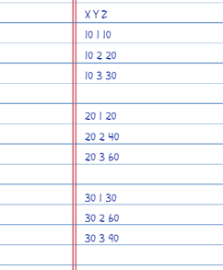
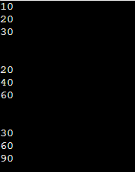
Program
Variable trace
list1 = [10, 20, 30]
list2 = [1, 2, 3]
for x in list1:
for y in list2:
z = x * y
print( z )
print("\n")
Computer Output

Slide 30
How to write a program
The right way!

Slide 31
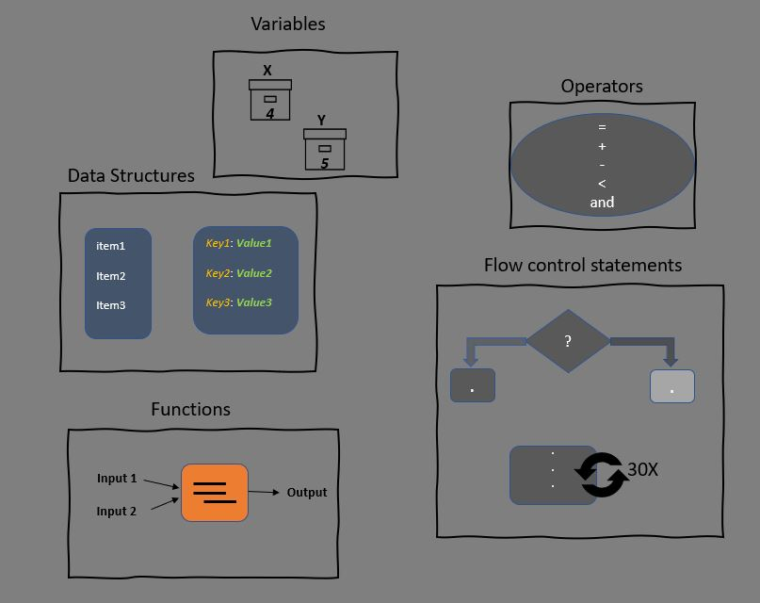
1) Clearly define the goal of the program.
2) Write the steps in your own language.
3) Translate steps into code using the tools available.

Slide 32
Example 1
Write a program that swaps the values of the variables x = 3 and y=8

Slide 33
Example 2
Write a function that that finds the minimum of 3 numbers passed as inputs(parameters).

Slide 34

Variables
X
Operators
4
Y
=
+
-
<
and
Data Structures
5
item1
Item2
Item3
Key1: Value1
Key2: Value2
Key3: Value3
Flow control statements
?
.
.
Functions
.
.
.
30X
Input 1
Output
Input 2

Slide 35
Classes & Objects

Slide 36


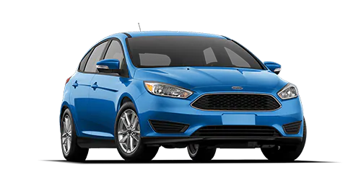
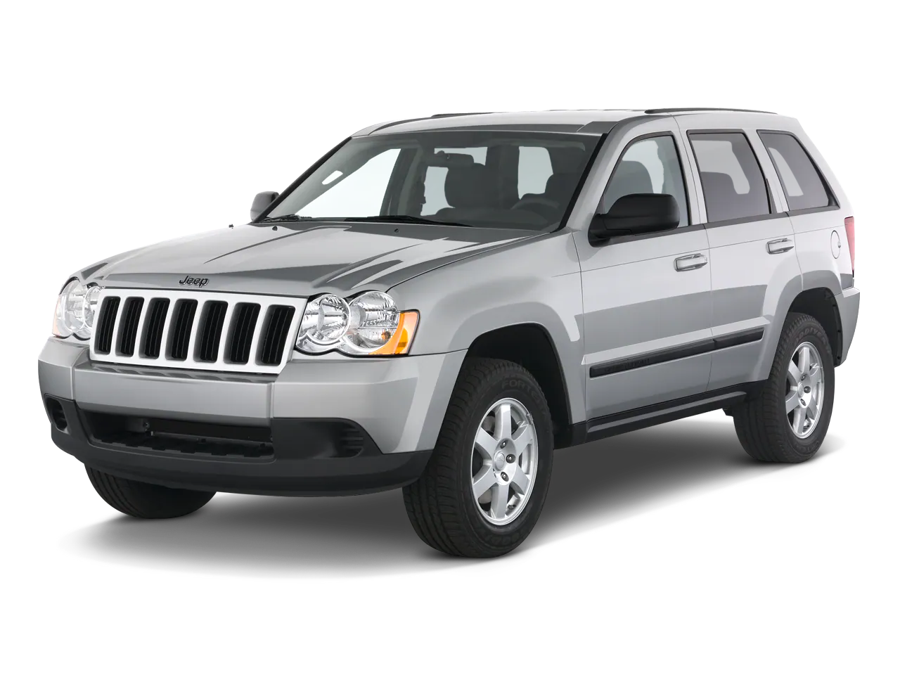
Attributes:
-Color
-Make
-Year
-Milage
-Speed
Methods:
-Accelerate()
-Brake()
-read milage()
Class Car
Object 1
Blue
Ford
2016
4000
0
Object 2
Silver
Jeep
2009
20000
0

