Slide 1
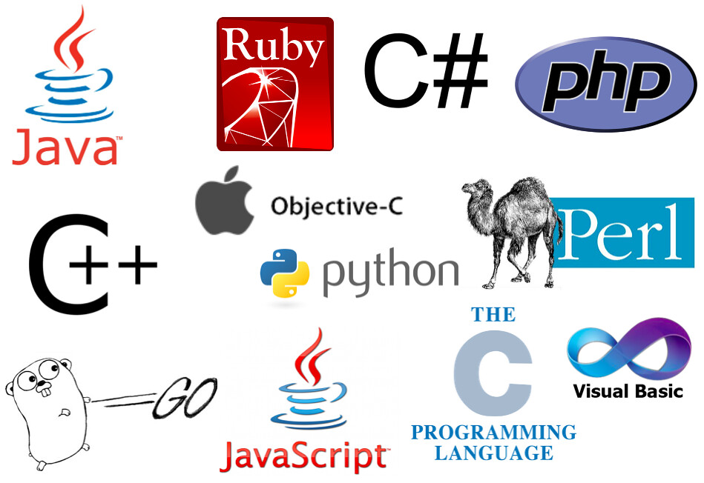
Programming language
A language used to write instructions for the computer.

Slide 2




Translator
English -> Spanish
Hello
Hola
English
Spanish
x=1
Print(x+2)
Compiler
Python -> 1/0
Python
10101

Slide 3
Vocabulary(Keywords)
Grammar(Syntax)
English | Python
Hello | If
Open | Switch
Write | For
English | Python
Cat is. Cats is. | Print ( ) Print { }

Slide 4

Variables(named values)
Placeholder of information for later use.
Value stored is changeable.
We store values inside variables using the “=“ sign (x=2, z=“Hello”).
X
Y
Z
D
Integer
Float
String
Boolean
2
3.62
“Hello”
False
X
H
Float
46
Y +2 -> 5.62

Slide 5
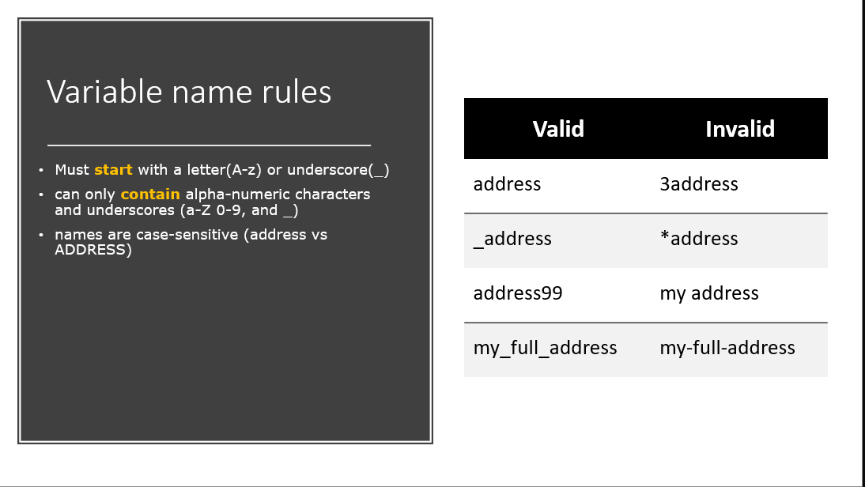

Slide 6
Operators
Left
Operator
Right
Symbol used to perform operations on variables and other values
Operator | Description | Examples
= | Assignment(bind name to value) | x=2 z = 15 name=“Alex”
+, -, x, / | Arithmetic | 2+5 Y-3 number/2
==, !=, <, <=, >, >= | Comparison. Output is either true or false | 3==5 -> false 5<10 -> true 9<=9 -> true
And(true if both sides are true) Or(true if either side is true) Not(reverse value) | Logical. Output is either true or false | 9<5 AND 2<8 -> false 9<5 OR 2<8 -> true NOT 7==4 -> true

Slide 7
Statement vs expression
Statement: a line of code that does something.
Examples:
1) Import statement:
Import pandas
2) If statement:
If x<3
Expression: a combination of variables, operators, and values that’s evaluated to one single value
Examples:
X=3
Y=6
Z=2
1) X * 2 + Y / Z -> 9
2) X * Y * Z + 5 -> 41
3) X > 9 -> false
4) Y + 6 == 12 -> true

