Slide 1

Code Tracing
Simulating program execution by tracking and updating variable values by hand

Slide 2
Program
list1 = [10, 20, 30]
list2 = [1, 2, 3]
for x in list1:
for y in list2:
z = x * y
print( z )
print("\n")

Slide 3
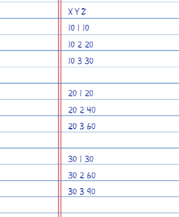
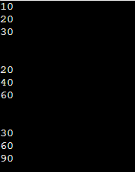
Variable trace
Computer Output

