Slide 1
How to write a program
The right way!

Slide 2
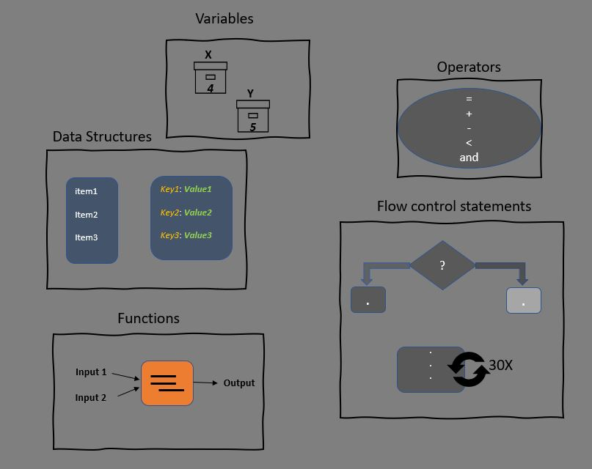
1) Clearly define the goal of the program.
2) Write the steps in your own language.
3) Translate steps into code using the tools available.

Slide 3
Example 1
Write a program that swaps the values of the variables x = 3 and y=8

Slide 4
Example 2
Write a function that that finds the minimum of 3 numbers passed as inputs(parameters).

