Slide 1
Classes & Objects
Everything in python is an object!

Slide 2
Class
Attributes(data fields)
Methods(Functions): used to manipulate the attributes

Slide 3
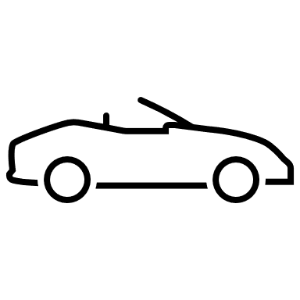

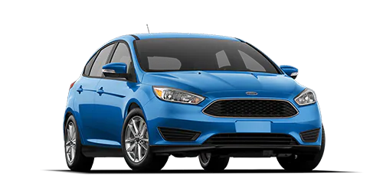
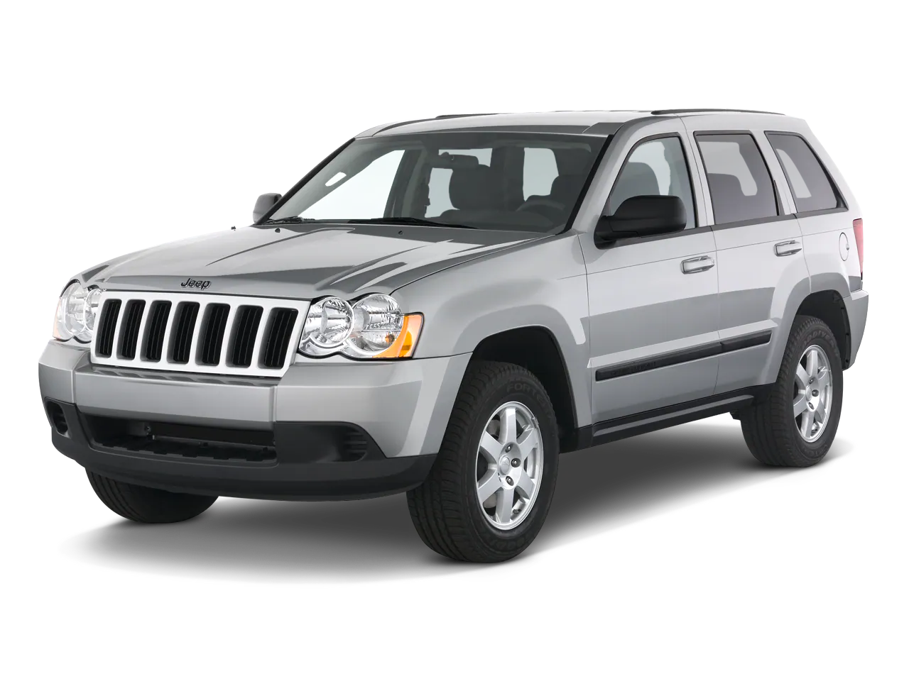
Attributes:
-Color
-Make
-Year
-Milage
-Speed
Methods:
-Accelerate()
-Brake()
-read milage()
Class Car
Object 1
Blue
Ford
2016
4000
0
Object 2
Silver
Jeep
2009
20000
0

