Slide 1
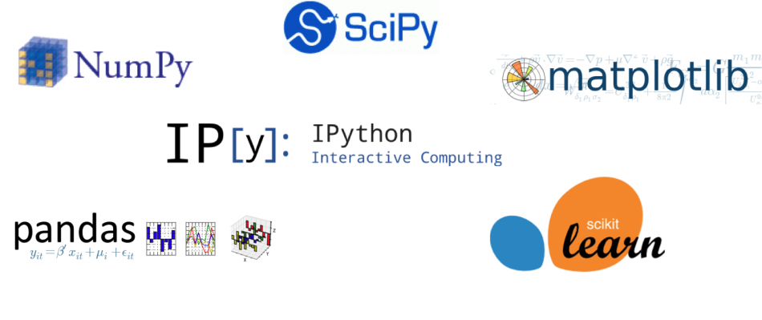
What is a library?
Prewritten code that users can use to optimize tasks

Slide 2
pip
Package Installer for Python
Check if pip is installed & what version.
Install a new package(library)
py -m pip --version
pip install pandas

Slide 3
Jupyter Notebook
Web application to write code, narrative text and display visualizations.

