Slide 1
Setup
Install A code editor
Install python interpreter
Install Python extension

Slide 2
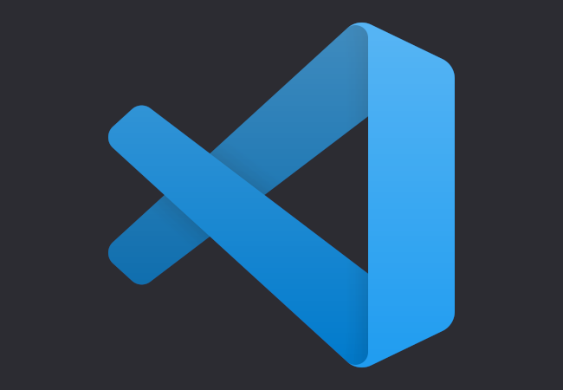
VS code
Debugging
Syntax highlighting
Code completion
Adding extensions

Slide 3

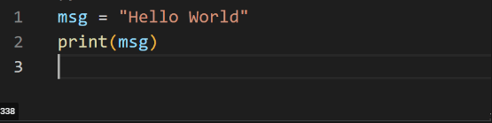
Interpreter
Output
Python(high level)
Hello World

