Slide 1
Tic-Tac-Toe
Matthew Chu

Slide 2
Problem Statement
Create a program that allows the user to play a game of tic-tac-toe with the computer. The program should demonstrate our ability to solve problems using procedural C++ programming focusing on loops, functions, random numbers, and global variables.

Slide 3
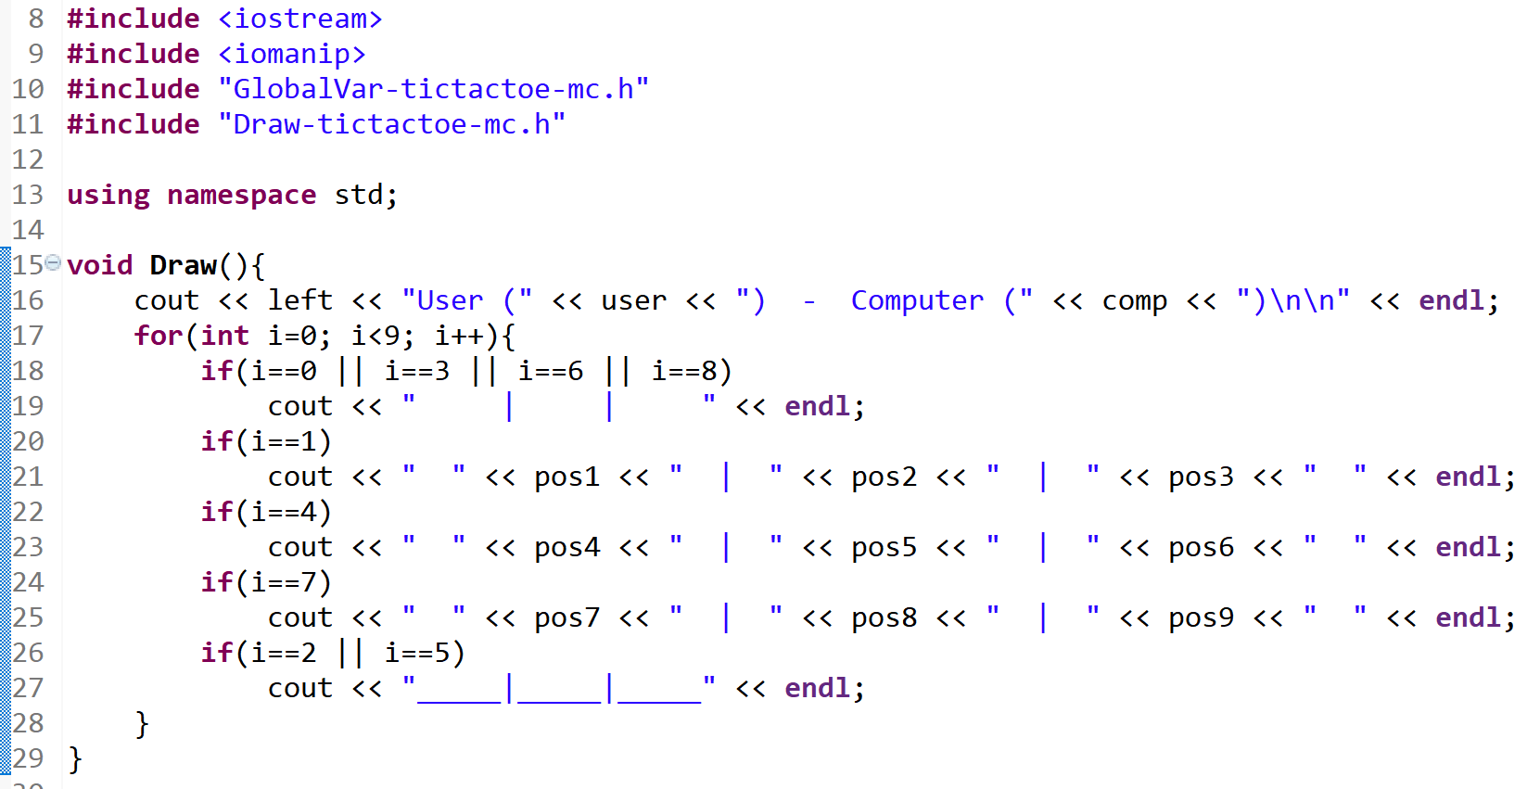
Draw

Slide 4
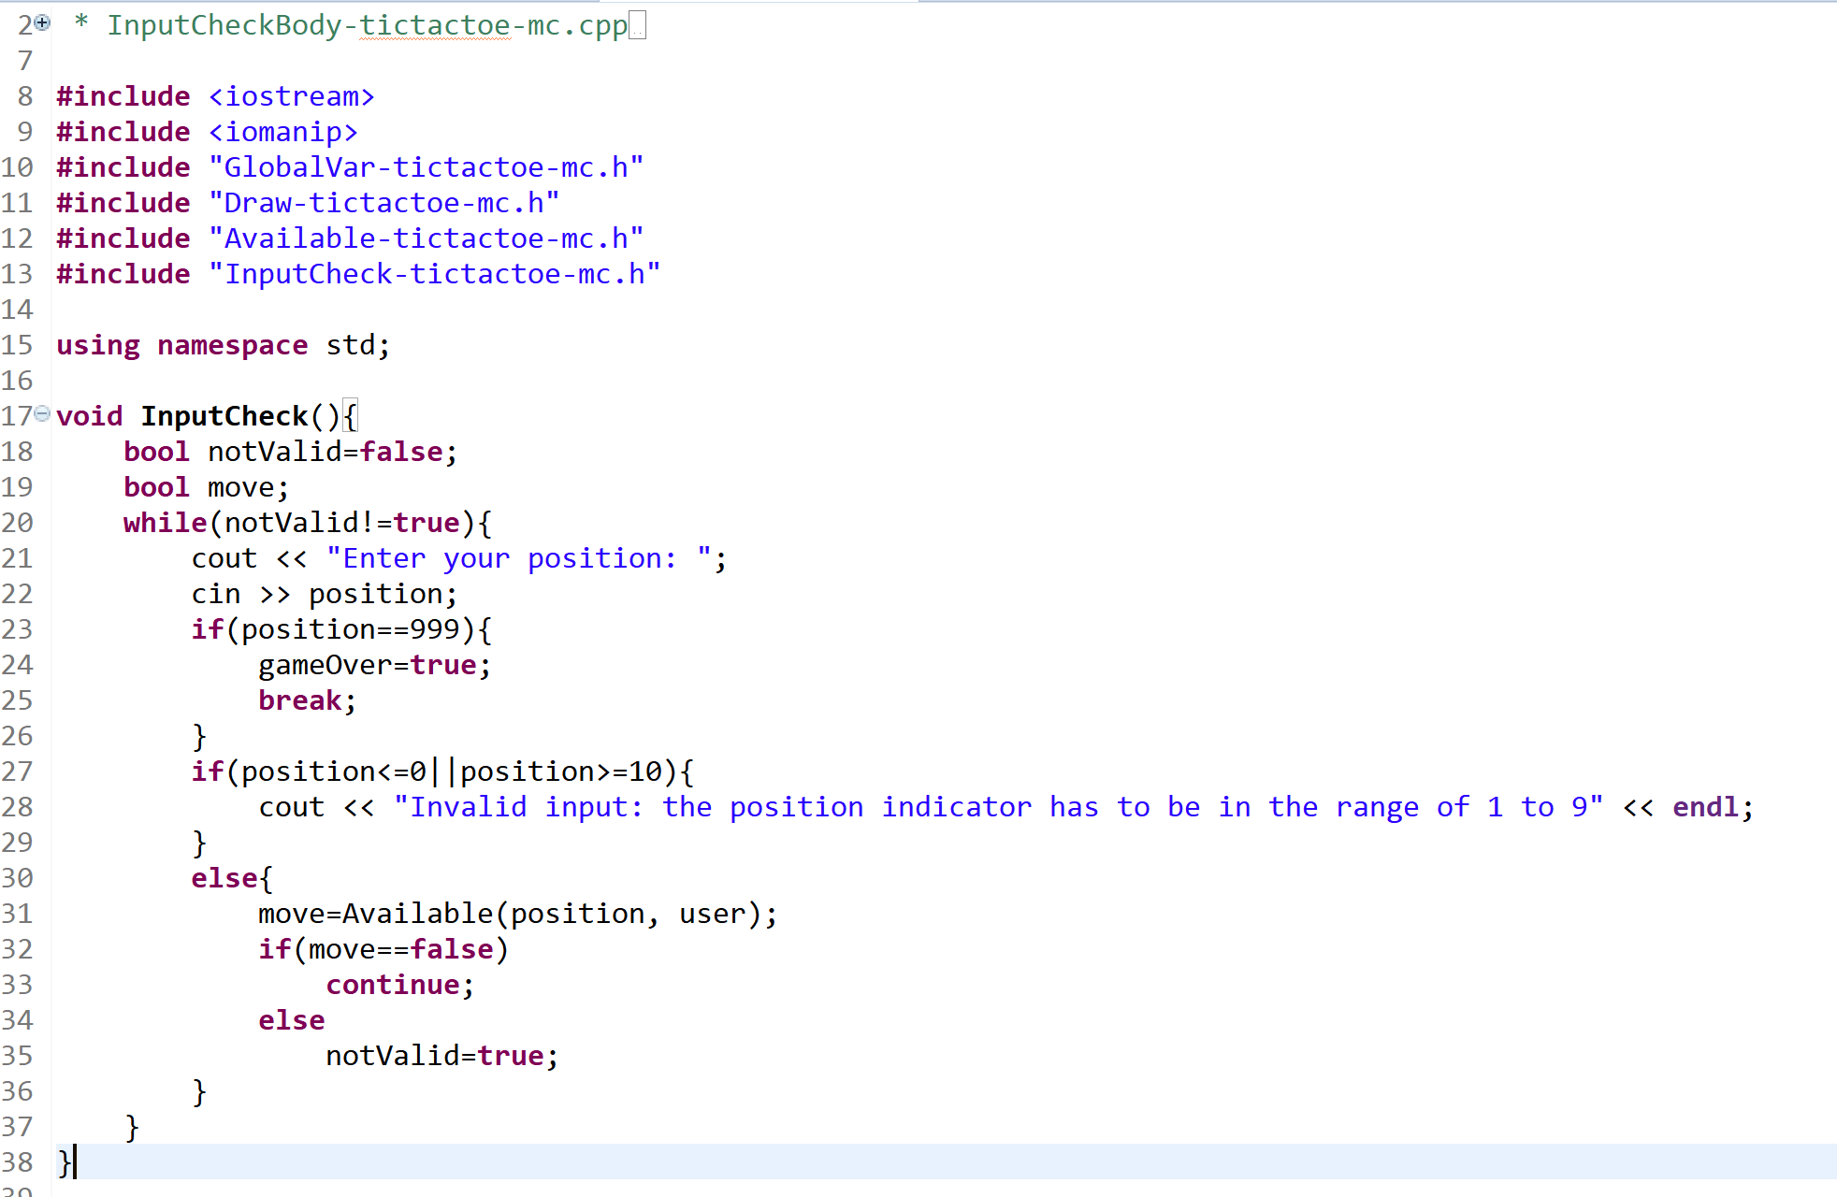
InputCheck

Slide 5
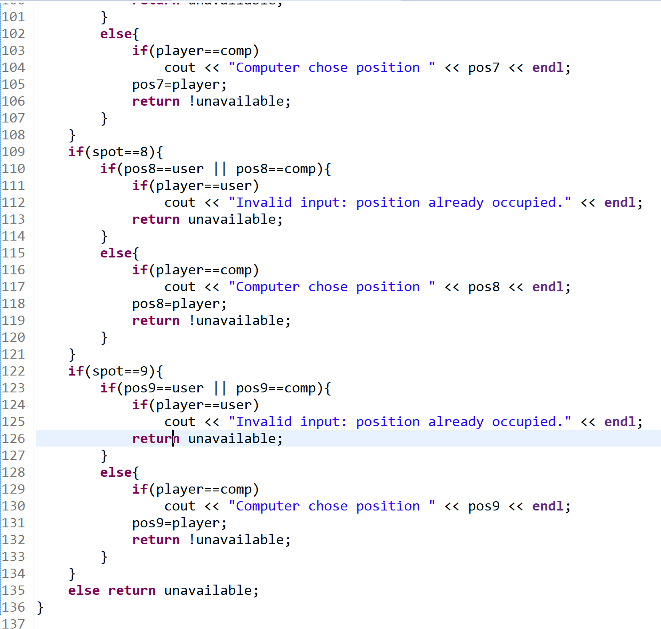
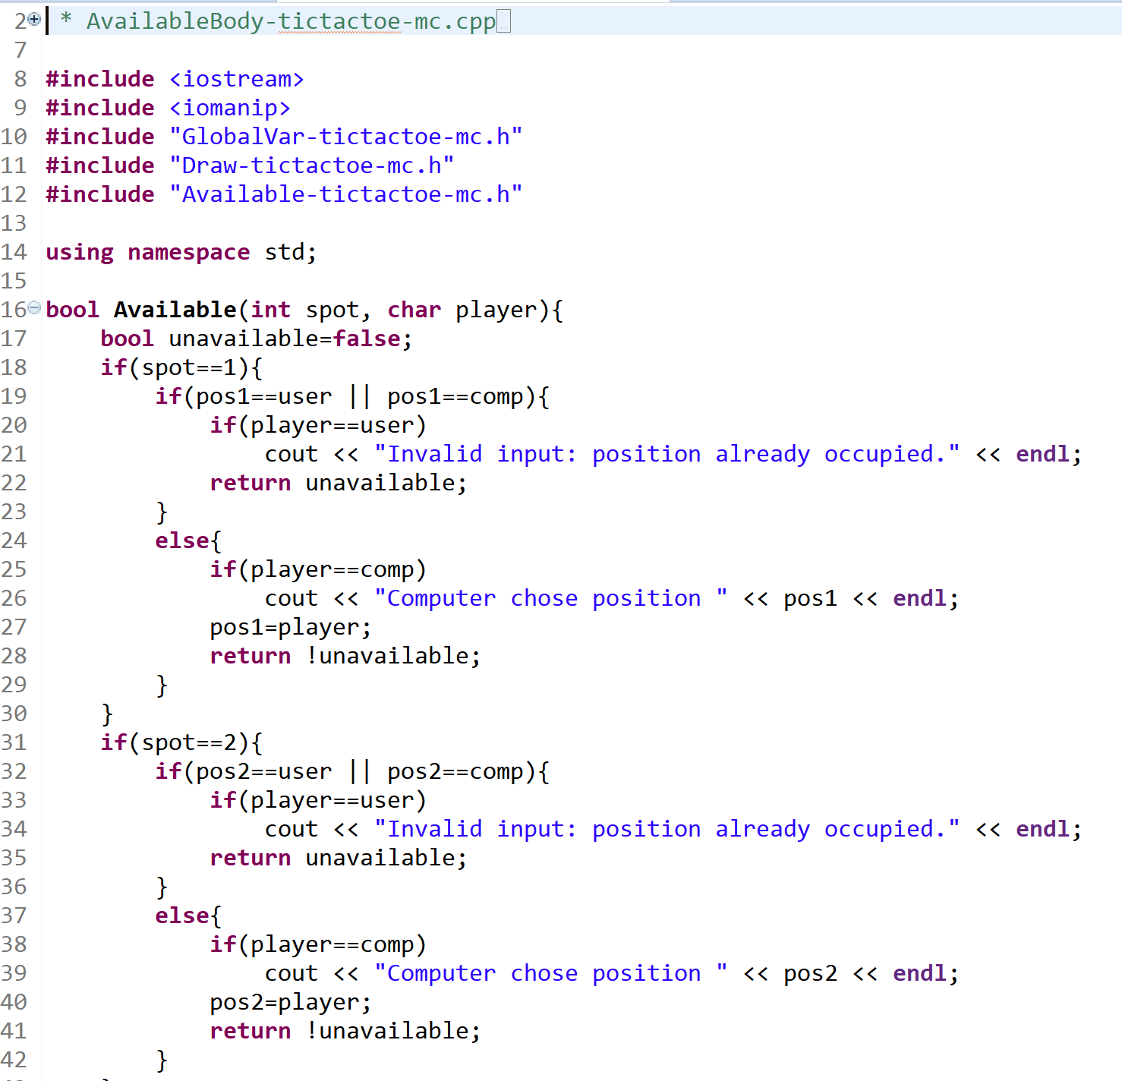
Available

Slide 6
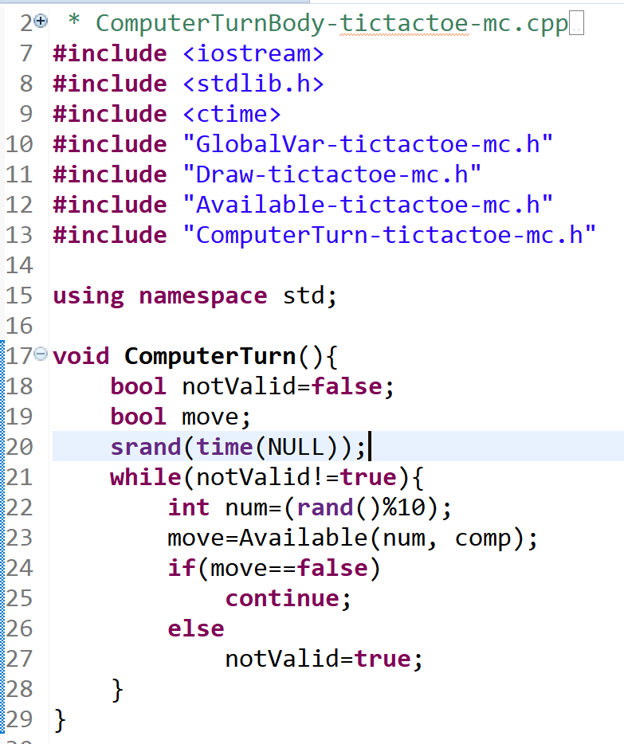
ComputerTurn

Slide 7
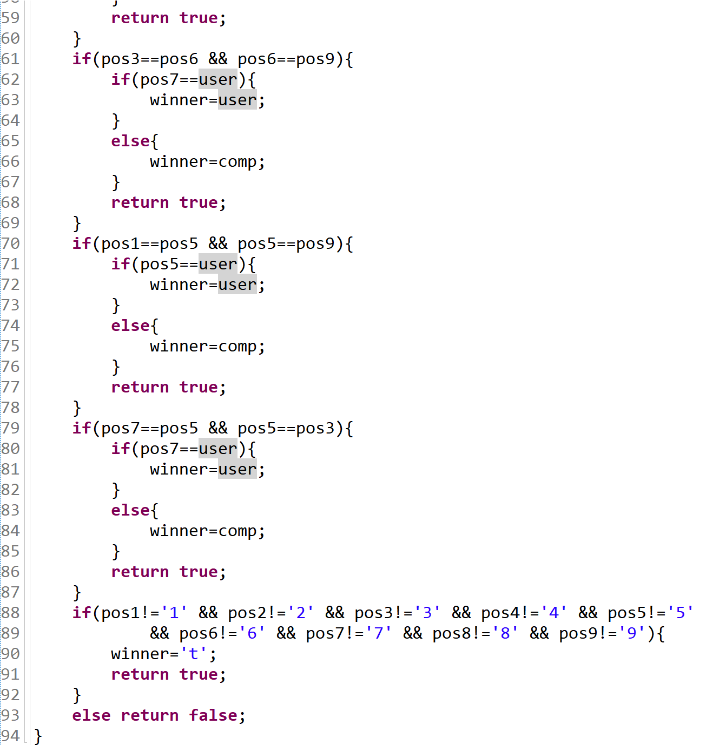
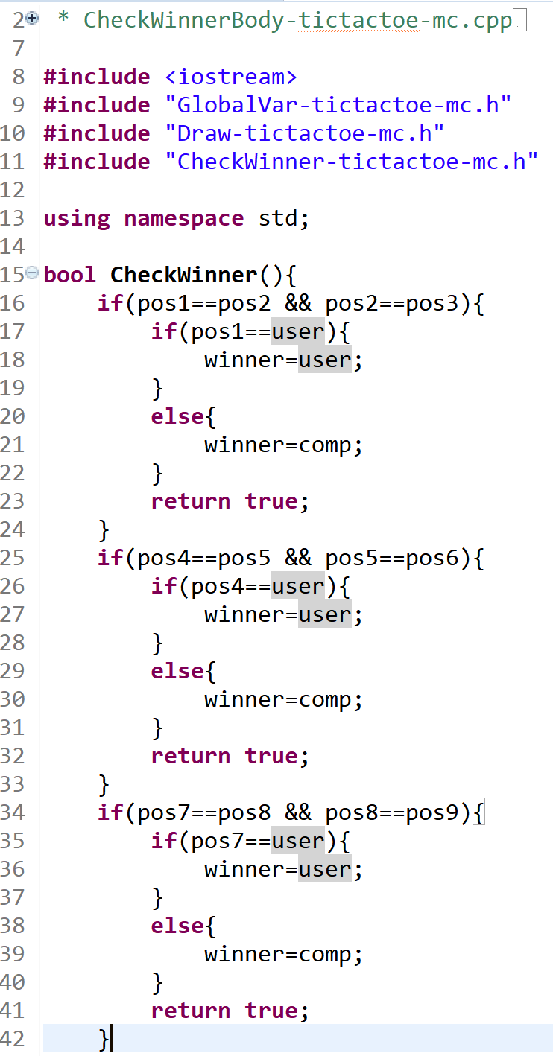
CheckWinner

Slide 8
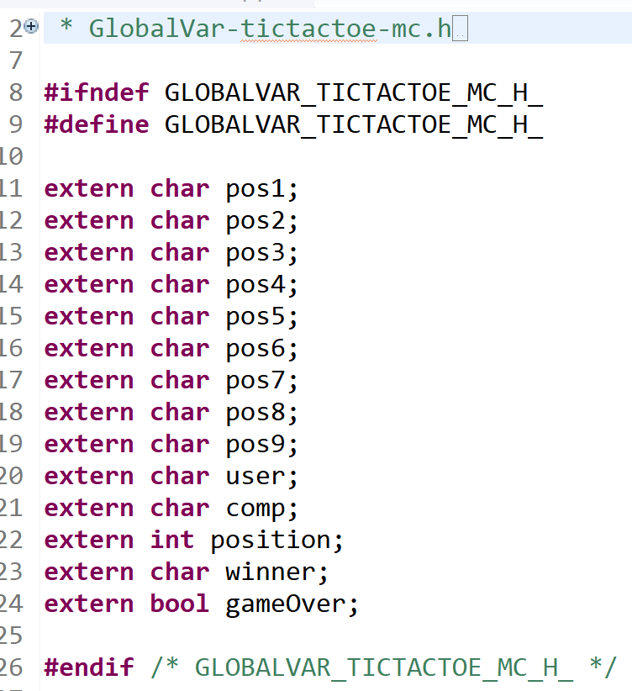
Global Variables

Slide 9
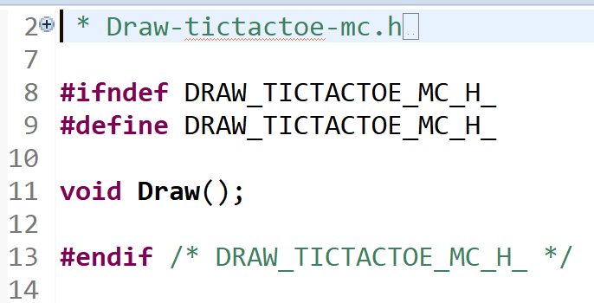
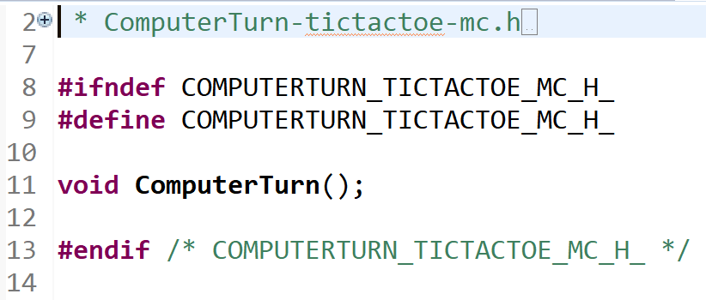
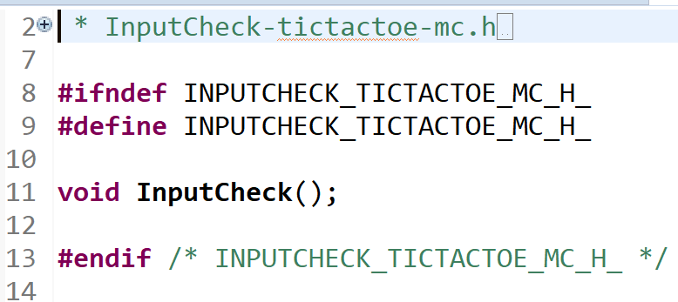
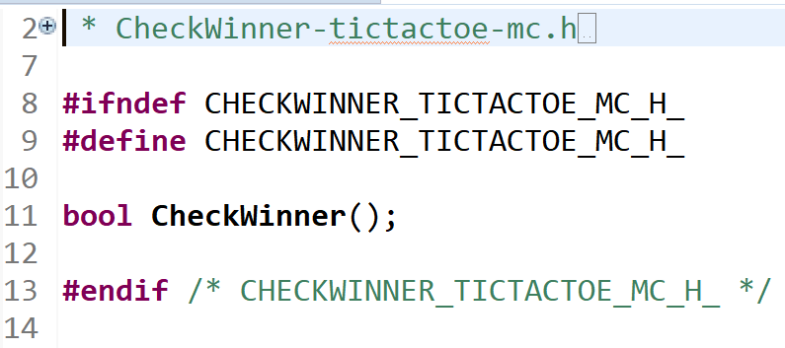
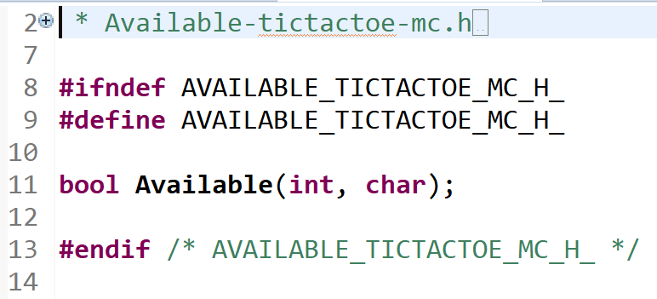
Header Files

Slide 10
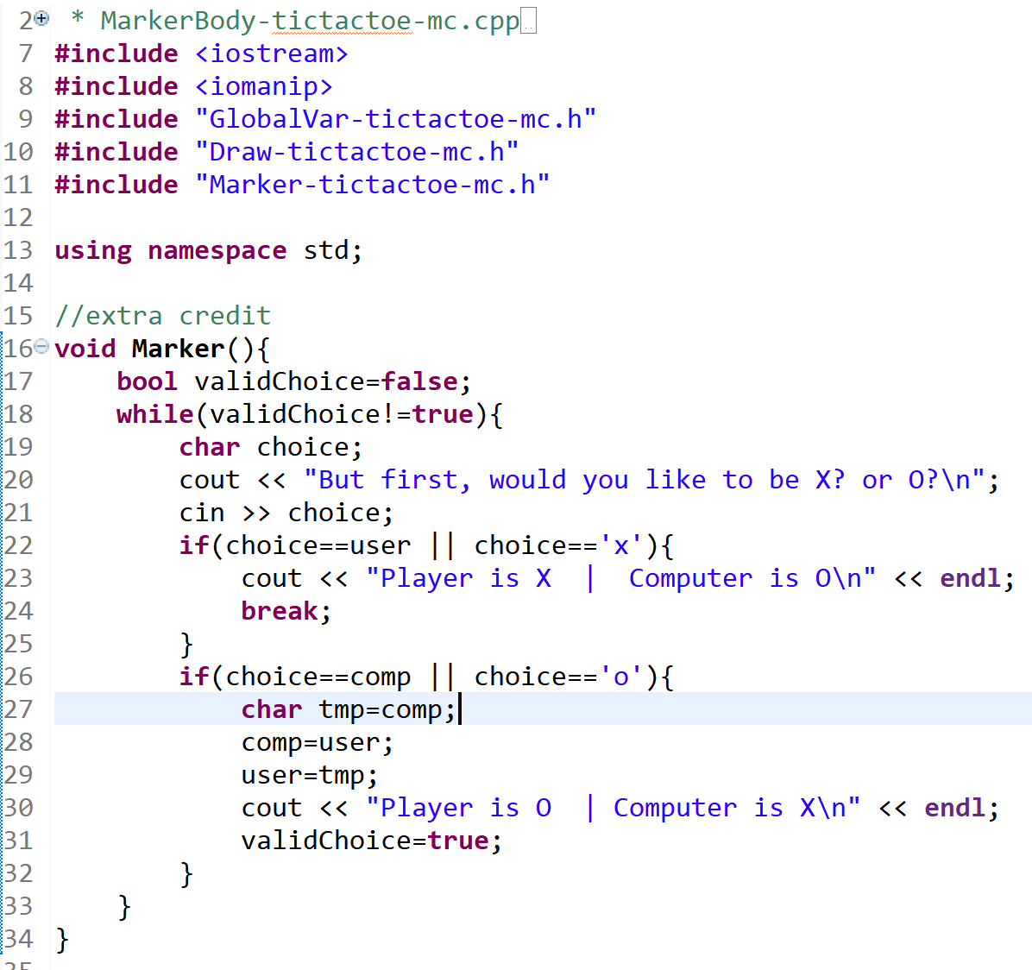
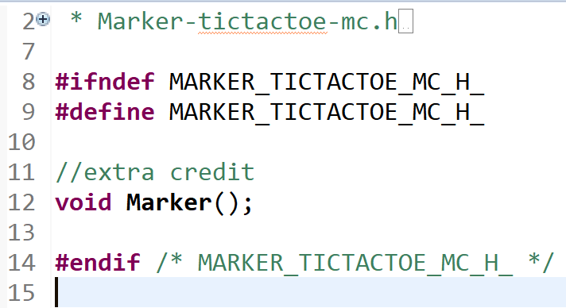
Marker

Slide 11
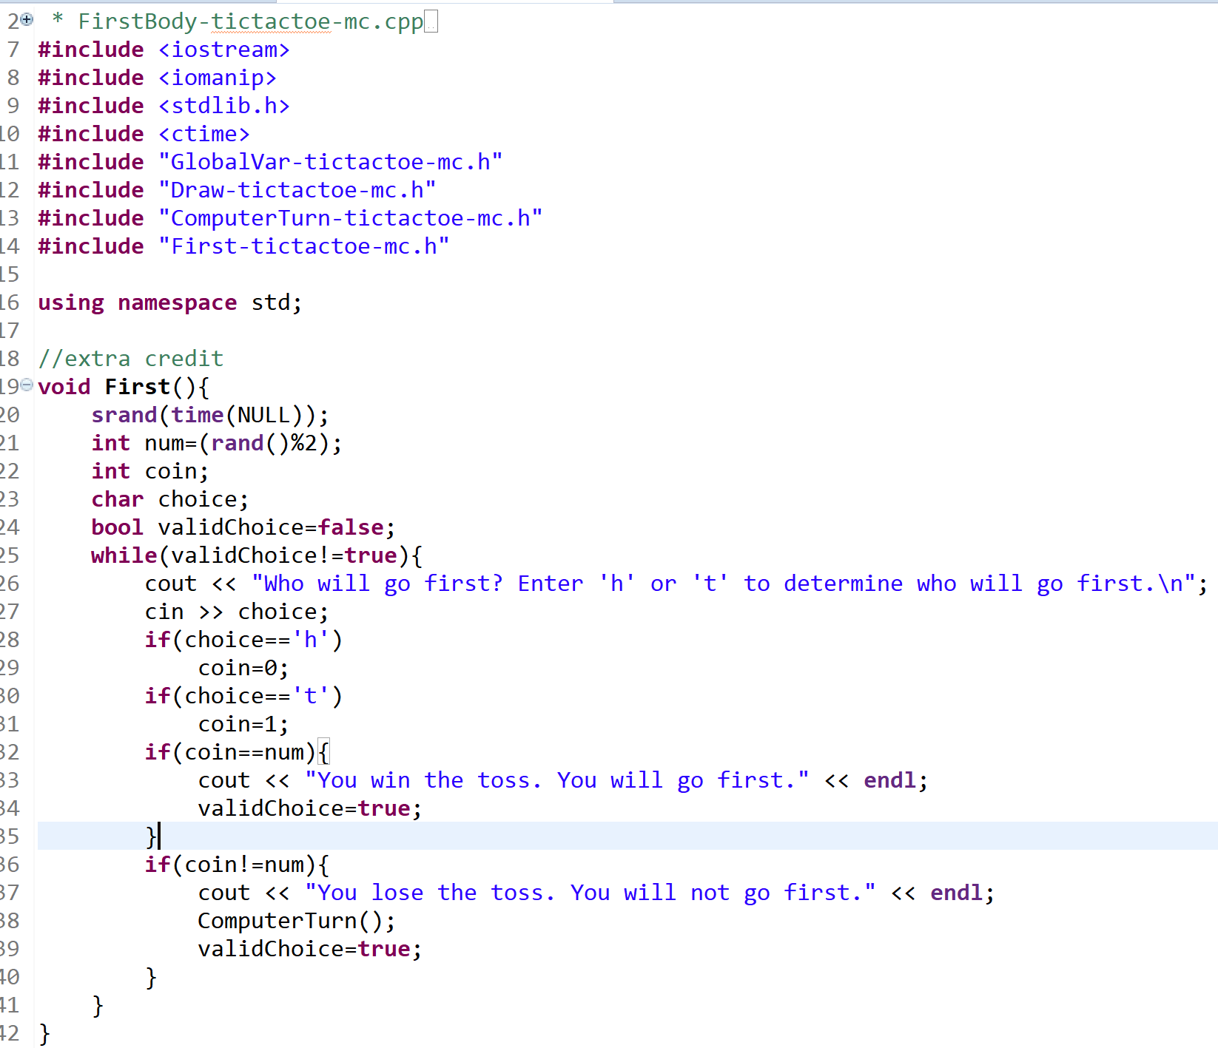
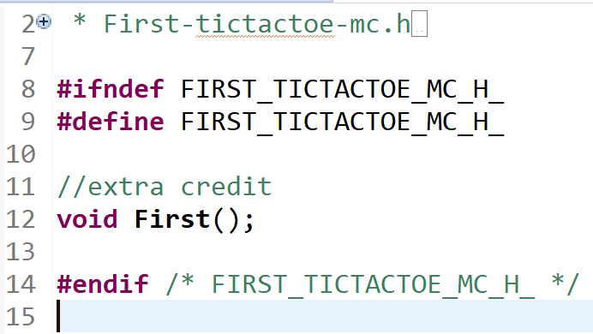
First

Slide 12
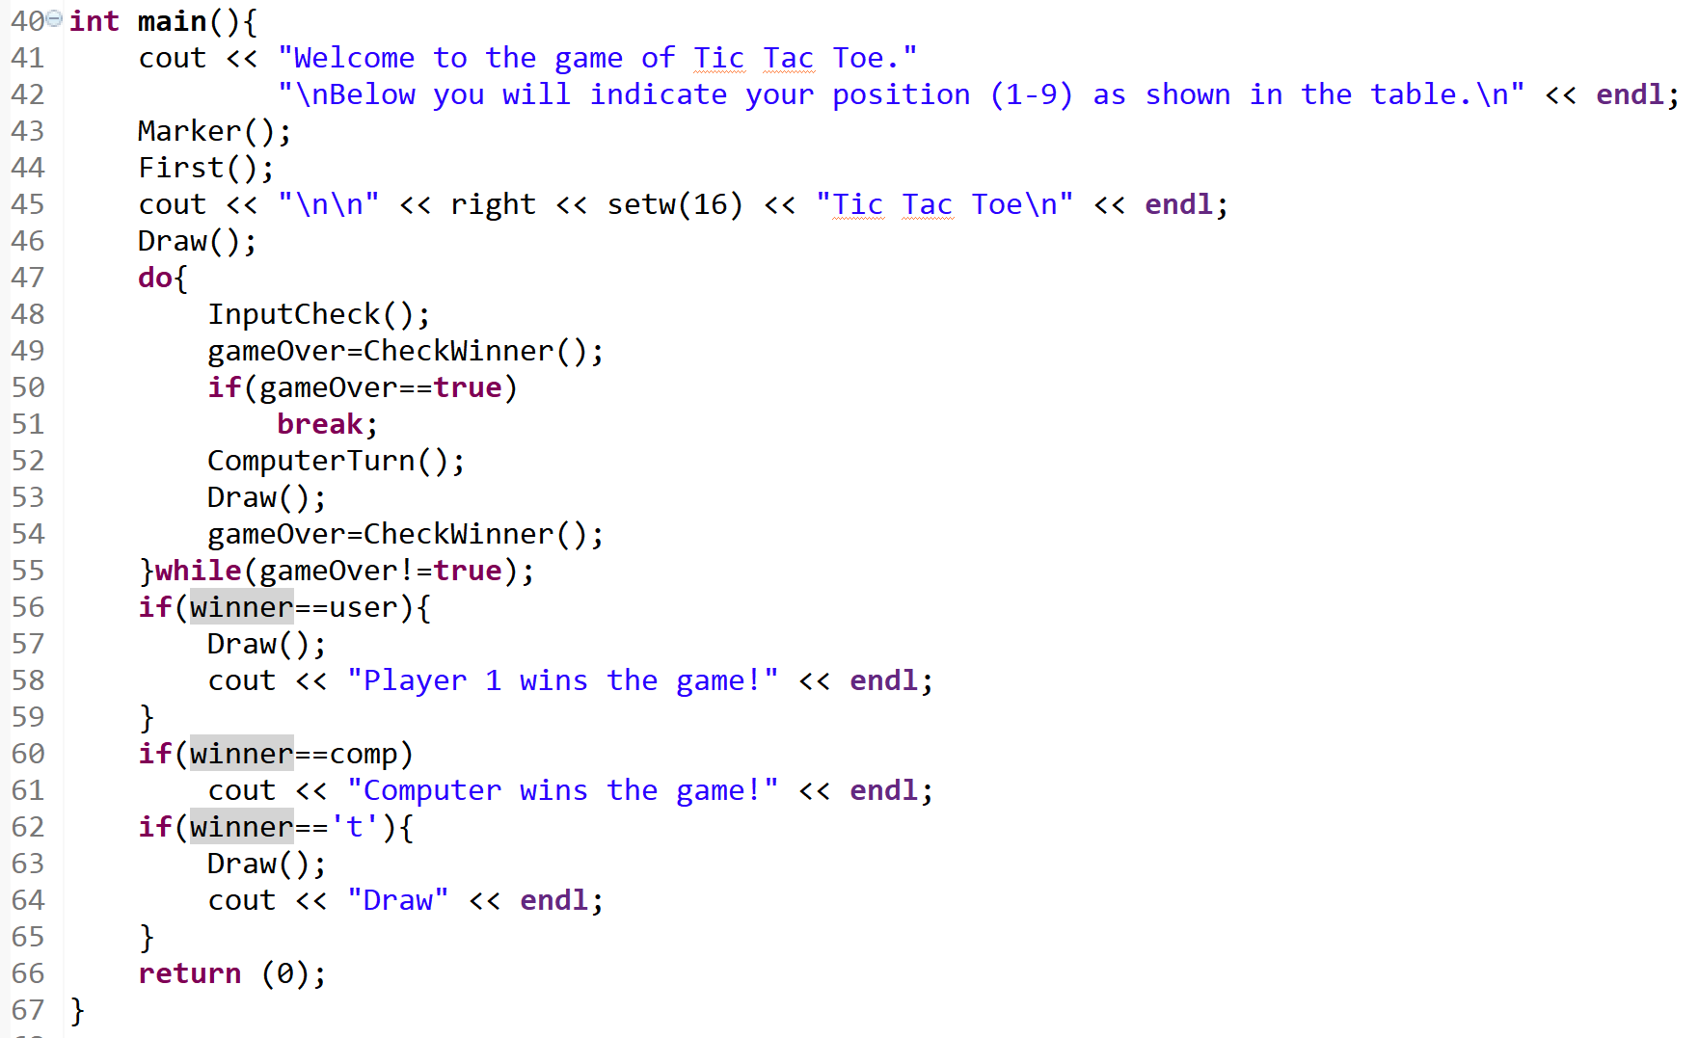
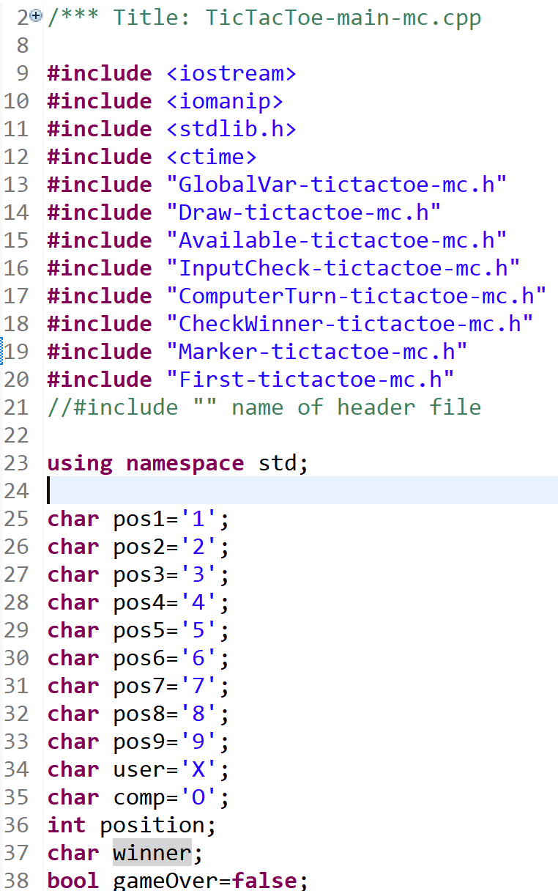
main

Slide 13
Problems
As you may have noticed, the code interacted with itself heavily and used multiple while loops. That caused a lot of errors only fixed by printing each step of the code
Modifying some parts of the code to serve dual purposes, like the function that checks the availability of the slot, took some careful reading. The code was originally programmed to assume the user was “X”, so replacing loose characters with the appropriate character variable took a bit of examination

Slide 14
Testing
Test Set 1 (4X)
Player: “X” Computer: “O”
Win: 3 in a row Lose: Player 3 in a row
Lose: Computer 3 in a row Win: 3 in a row
Draw: All spaces filled Draw: All spaces filled
Test Set 2 (4X)
Player: “O” Computer: “X”
Win: 3 in a row Lose: Player 3 in a row
Lose: Computer 3 in a row Win: 3 in a row
Draw: All spaces filled Draw: All spaces filled

