Slide 1
Image Resolution
Matthew Chu

Slide 2
Problems (Issue 1)
The first issue was displaying the original coordinates.
When the program converted the rectangular coordinates to polar coordinates, the original idea was to rewrite the former rectangular coordinates variables in order to save memory space.
However, that made it impossible to report the original coordinates, so a series of temporary variables (tmp) were created to hold the values being converted.

Slide 3
Problems (Issue 2)
The second issue was an order of operations problem.
Though the polar to rectangular coordinate conversion formula was correctly applies, adjusting the angle was problematic.
The first two coordinates were rotated smoothly, but the program failed to follow the order of operations for the last two coordinates, thus outputting incorrect coordinates.
The issue was fixed when parentheses were applied to the formula to simplify the order of operations.

Slide 4
Testing
Test 1 Inputs: Width: 50
Height: 100
Angle: -60
Test 2 Inputs: Width: 100
Height: 60
Angle: 30

Slide 5
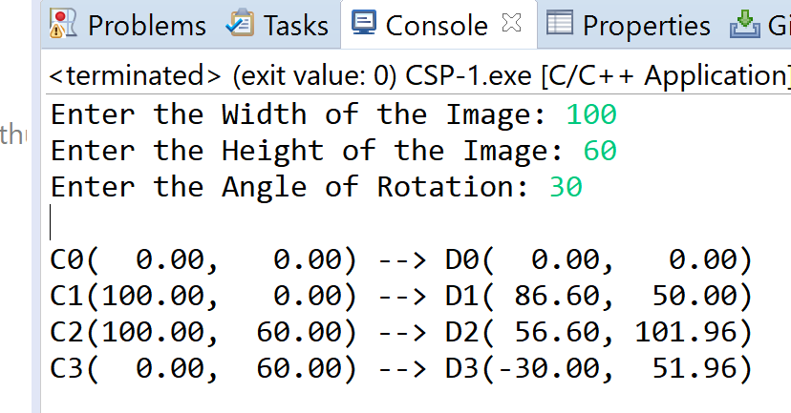
Test 1

Slide 6
Testing
The first test result was to test for accuracy
The second test inputs were to test for negative numbers

Slide 7
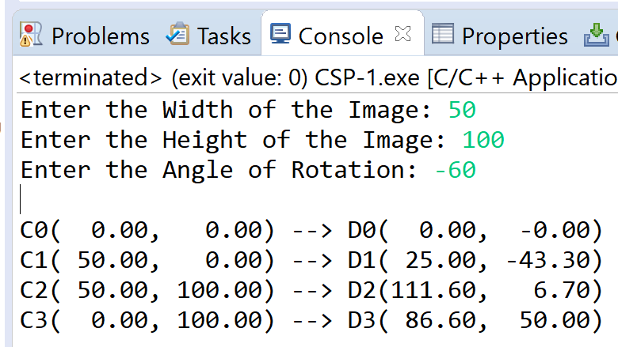
Test 2

