Slide 1
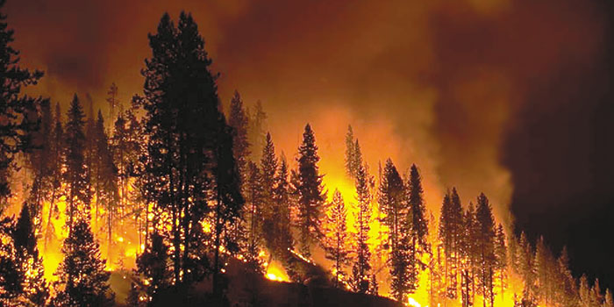
Forest fire
Group 07
Figueiredo Marques Christophe
Thielen Daniel
Duarté Stevie
Notes:
Présentation général du group et du projet, innovation -> sensor, drones

Slide 2
Actors and their tasks
Witness
Declare alerts
Admin
User management
Employee
Handle drone/senor errors
Control drone camera

Slide 3
Actors and their tasks
Fire station officer (FSO)
Handle fire
Request reinforcement
Declare end of alert
Major
Give an evacuation order
Declare “safe zone”
Police
Handle evacuation order and “safe zone”

Slide 4
Sensors
Send data of their environment
Wind speed
Temperature
Air humidity
Air density

Slide 5
Drones
Fly over forests
Mission
Periodical control
Check fire

Slide 6
How does an alert start?
Witness
Phone call
Mobile app
Sensor
Data send = parameters for alert
Employee
Detects fire through drone

Slide 7
How is the alert handled?
Incomming alert
Red alert (fire)
Inform FSO and major
Orange alert (to be checked)
Deleted
Red alert
If parameters hold
fire
No fire

Slide 8
During red alert
FSO
request reinforcement
declare end of alert
Major
Give an evacuation order
Declare “safe zone”
Police
Handle evacuation order and “safe zone”

Slide 9
Project development life cycle
Specs :
User Manual : Product Information → Introduction → Errors And Problems → Usage Guides → Software Operation
Mock-up : APP → Home → Sensor → Drone → Alerts → Views for each Actor and it’s operations
Use Case Model
Environment Model
Concept Model
Operation Model

Slide 10
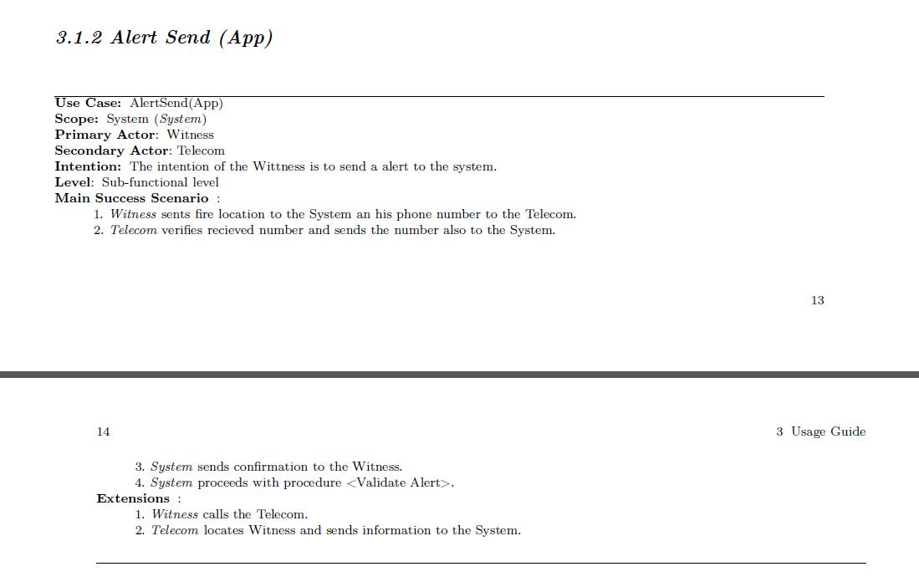
2 Cases:
Witness calls
Witness sends location via app
Notes:
Quelques infos : pages, ce qu’il y a écrit

Slide 11
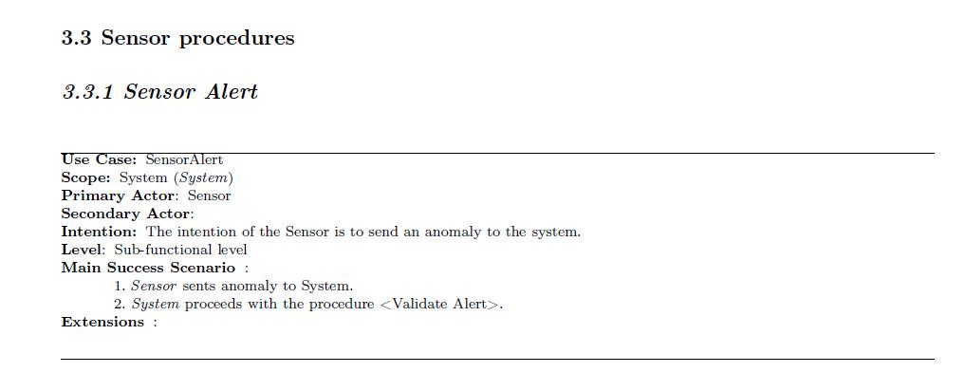
Sensor evaluates data
Sends alert if the parameters hold

Slide 12
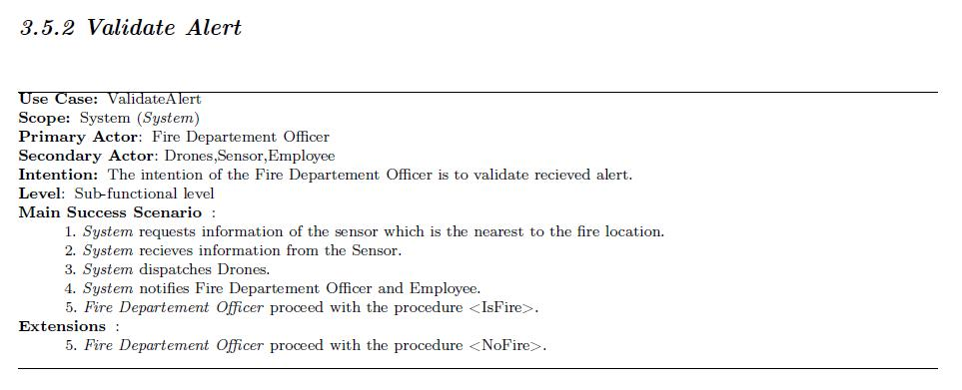
2 cases:
There is a fire
There is no fire

Slide 13
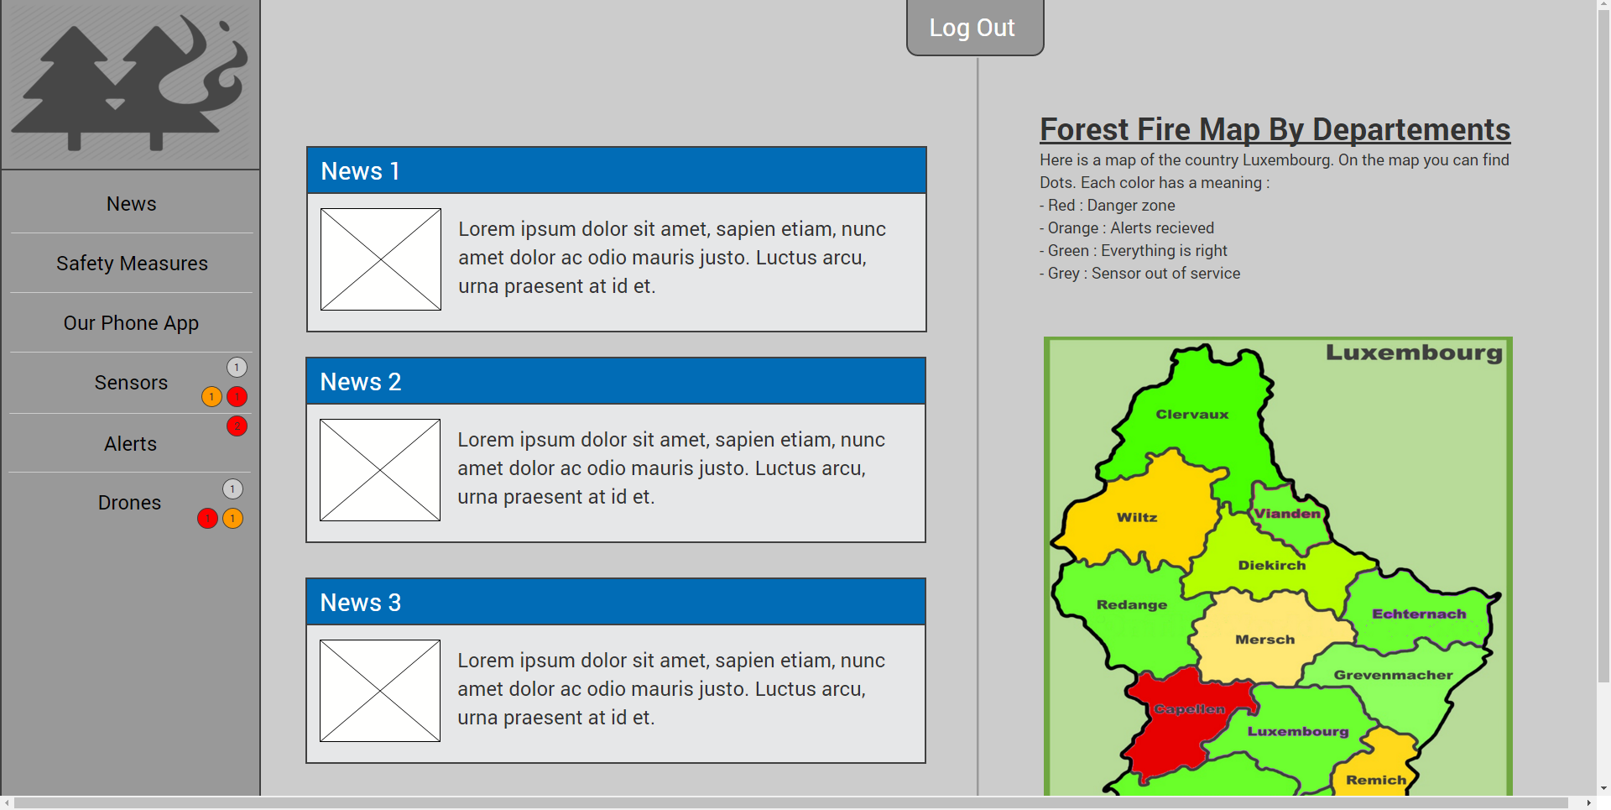
Alert start : mockup
Notes:
Quelques info : organisation, designe

Slide 14
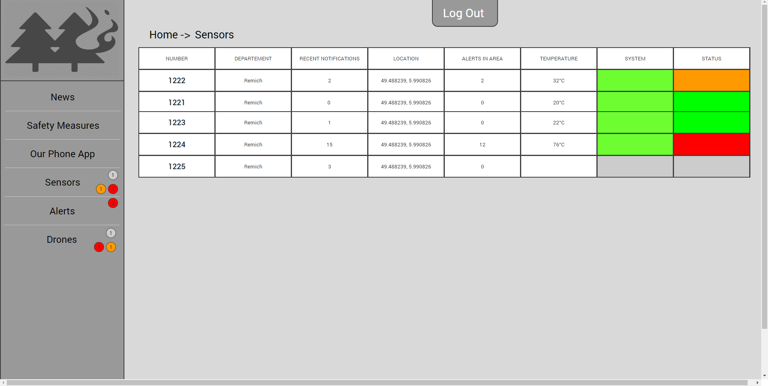
Alert start : mockup

Slide 15
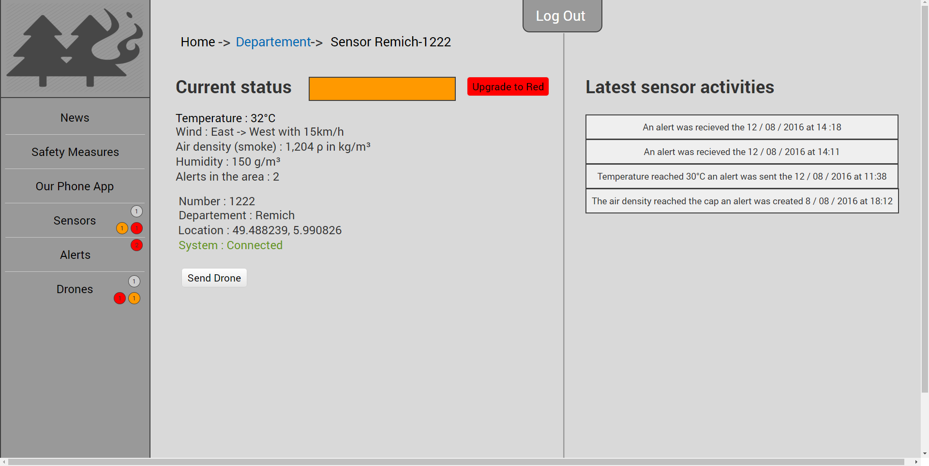
Alert start : mockup

Slide 16
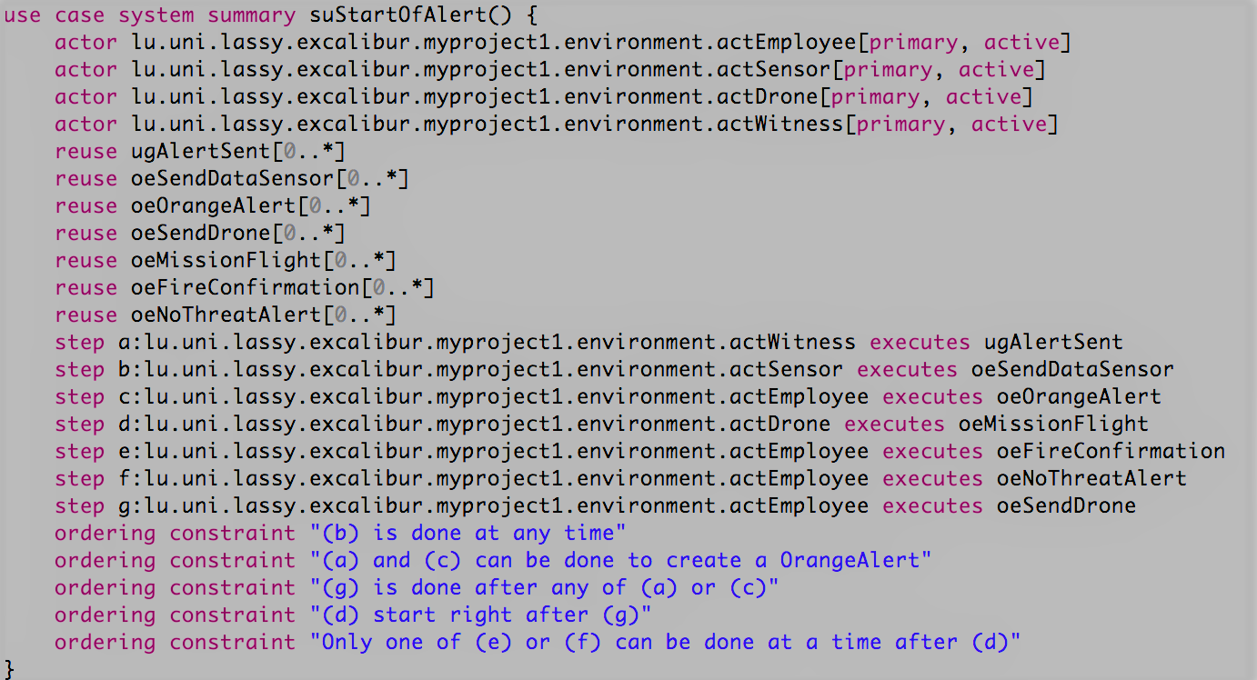
Alert start: Specifications
Specification of the Use Case Summary suStartOfAlert
Actors involved : Employee, Drone, Sensor, Witness
ugAlertSent and oeSendDataSensor are the ones identifying an alert
After alert gets identified a drone flies off to the alert’s location
FireConfirmation and oeNoThreatAlert are there to confirm whether the is a fire or not

Slide 17
Total: 200h
50h
70h
80h

Slide 18
Self appreciation of our work

Slide 19
Course appreciation

