Slide 1
n-PRO-3DP: Using non-SPI LCD
Background:
Smoothieware/Smoothieboard does not have an option for using character LCD. It can drive only graphical SPI LCDs.
This is probably due to lack of GPIO pins (Ethernet functionality is using a lot of GPIO…)
Smoothieboard developer offers an add-on board, that can translate the SPI bitstream for
I2C LCDs
The more common PARALLEL LCD
This board has a complex shape and fits only on Smoothieboard
But
The firmware is open source, called Universal Panel Adapter (UPA), is available in Github
and
can be used with Arduino boards or plain ATmega328 microprocessor.
On this mini project https://github.com/nikoschalikias/firm-universal-panel-adapter we deploy UPA firmware on a minimal and tidy implementation, to be used with n-PRO-3DP
https://github.com/wolfmanjm/universal-panel-adapter
http://smoothieware.org/panel
n-blocks.net/nmodules/doku.php?id=nblocks:ni-pro-3dp

Slide 2
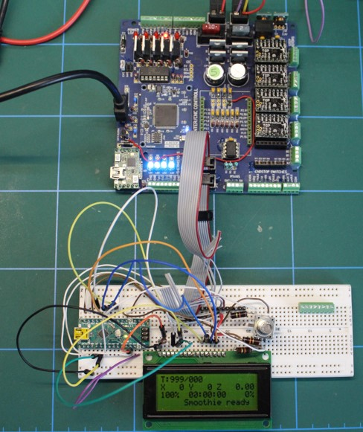
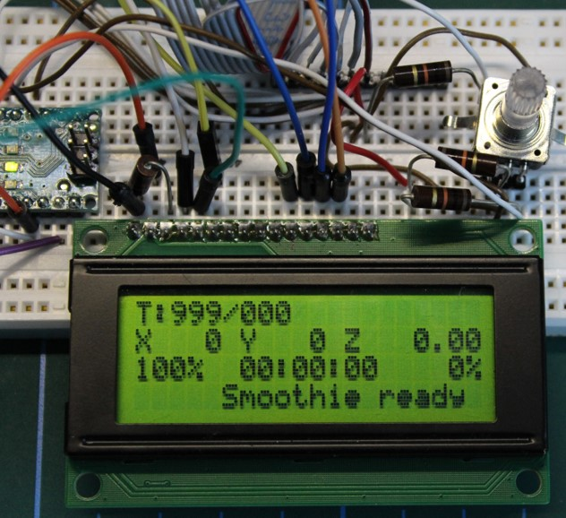
n-PRO-3DP: Universal-Panel-Adapter Firmware in Arduino Nano
Smoothieware can be used with common 4x20 characters LCD
https://github.com/nikoschalikias/firm-universal-panel-adapter
https://github.com/wolfmanjm/universal-panel-adapter
http://smoothieware.org/panel
https://stackoverflow.com/questions/42826755/wiring-h-missing-in-arduino/42827754
NEXT: Minimal Implementation on 43x33mm Perforated board

Slide 3
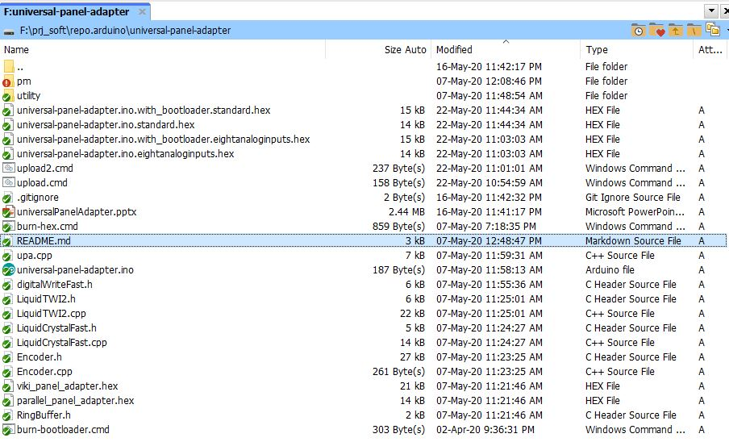
n-PRO-3DP: Universal-Panel-Adapter
Arduino hex
From Arduino IDE : Sketch: Export compiled Binary
This creates 4 hex files as below:

Slide 4
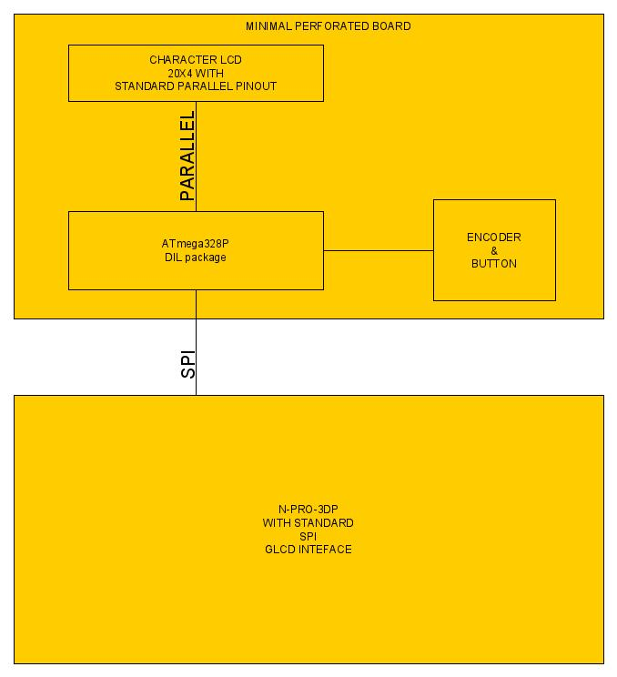
n-PRO-3DP: Universal-Panel-Adapter
Minimal Implementation Block Diagram

Slide 5
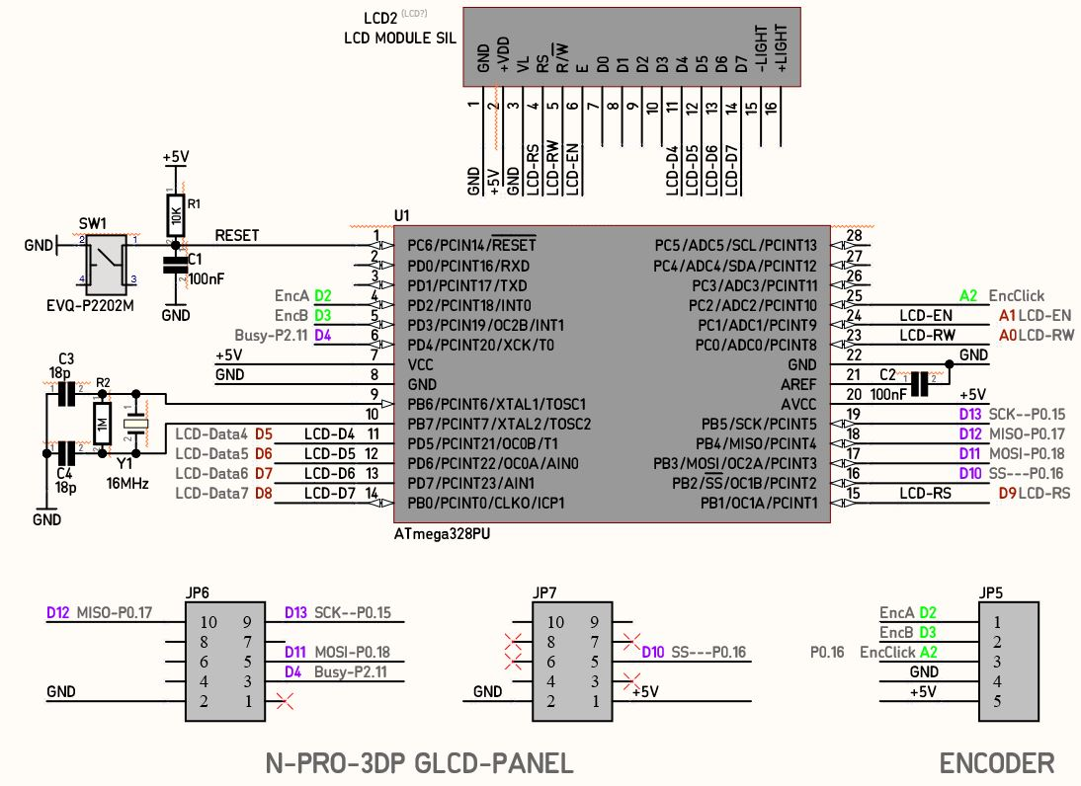
n-PRO-3DP: Universal-Panel-Adapter
Minimal Schematic for Dual In Line ATmega328

Slide 6
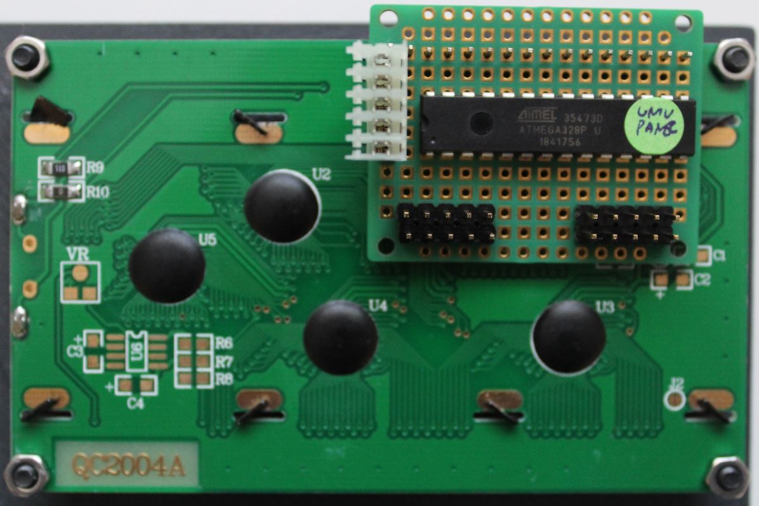
n-PRO-3DP: Universal-Panel-Adapter
Minimal Perforated Board

