Slide 1
n-PRO-3DP: Using non-SPI LCD
Smoothieware/Smoothieboard does not have an option for using character LCD. It can drive only graphical SPI LCDs.
This is probably due to lack of GPIO pins (Ethernet functionality is using a lot of GPIO…)
Smoothieboard developer offers an add-on board, that can translate the SPI bitstream for
I2C LCDs
Thee more common parallel LCDs.
This open source firmware is called Universal Panel Adapter and is available in Github and can be used with atMega328 microprocessor and Arduino boards.
https://github.com/wolfmanjm/universal-panel-adapter
http://smoothieware.org/panel

Slide 2
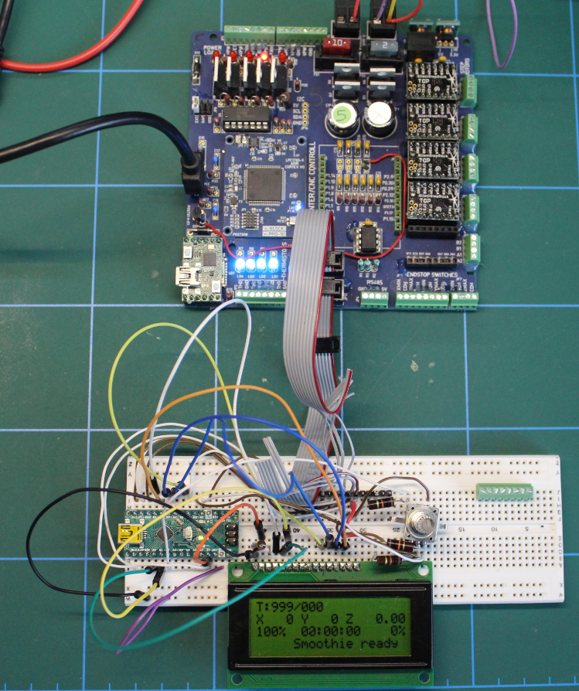
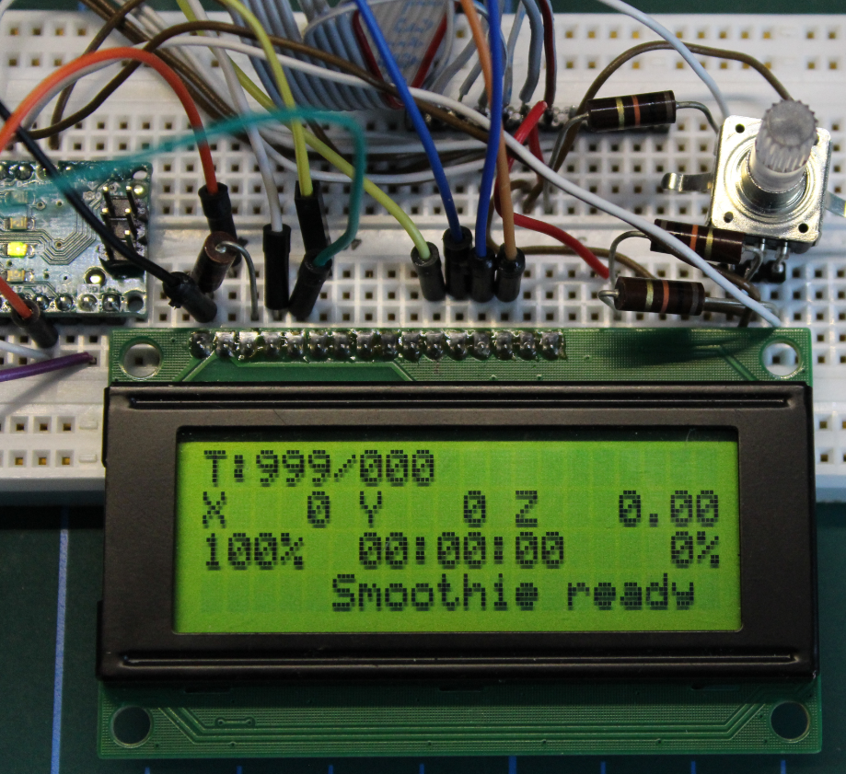
n-PRO-3DP: Universal-Panel-Adapter Firmware in Arduino Nano
Smoothieware can be used with common 4x20 characters LCD
https://github.com/nikoschalikias/firm-universal-panel-adapter
https://github.com/wolfmanjm/universal-panel-adapter
http://smoothieware.org/panel
https://stackoverflow.com/questions/42826755/wiring-h-missing-in-arduino/42827754

