Slide 1
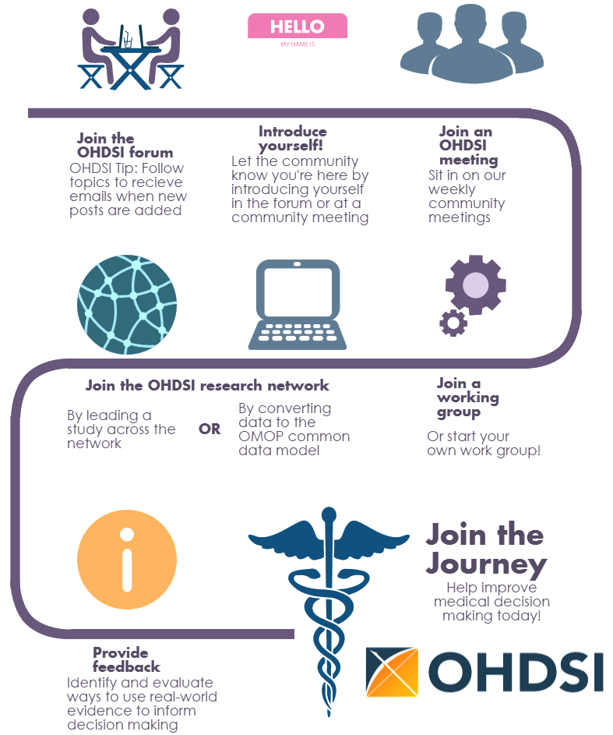
HELLO
s
MY NAME IS
Join the OHDSI forum
OHDSI Tip: Follow topics to receive emails when new posts are added
Introduce yourself!
Let the community know you’re here by introducing yourself in the forum or at a community meeting
Join an OHDSI meeting
Sit in on our weekly community meetings
Join the OHDSI research network
Join an working group
Or start your own work group!
By leading a study across the network
By converting data to the OMOP Common Data Model
OR
Join the Journey
Help improve medical decision making today!
Provide feedback
Identify and evaluate ways to use real-world evidence to inform decision making

