Slide 1


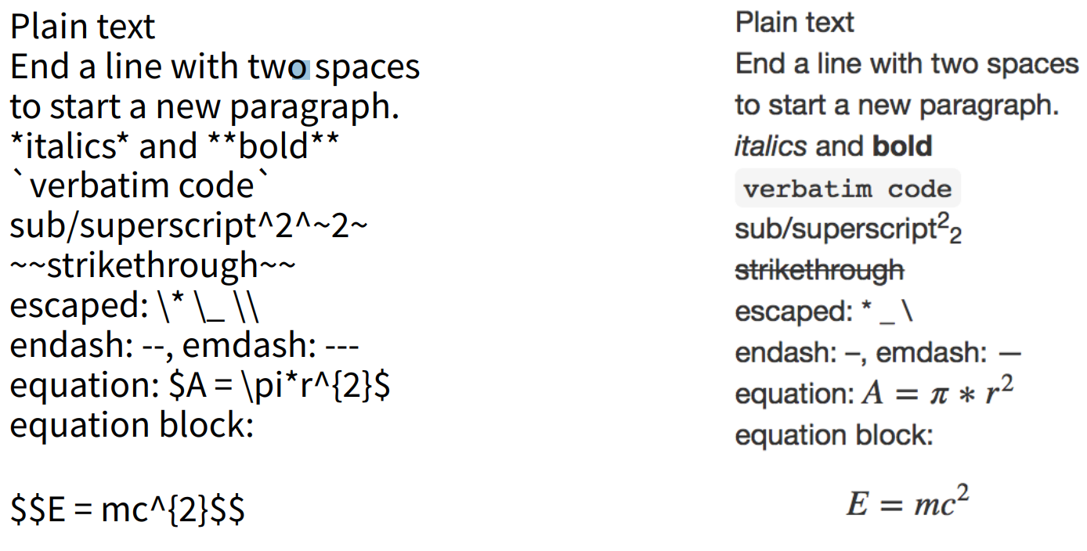

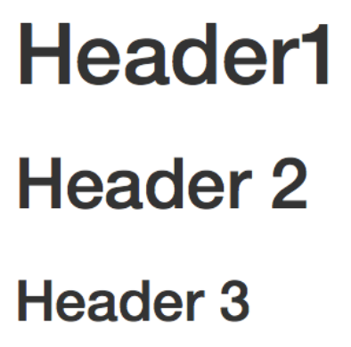


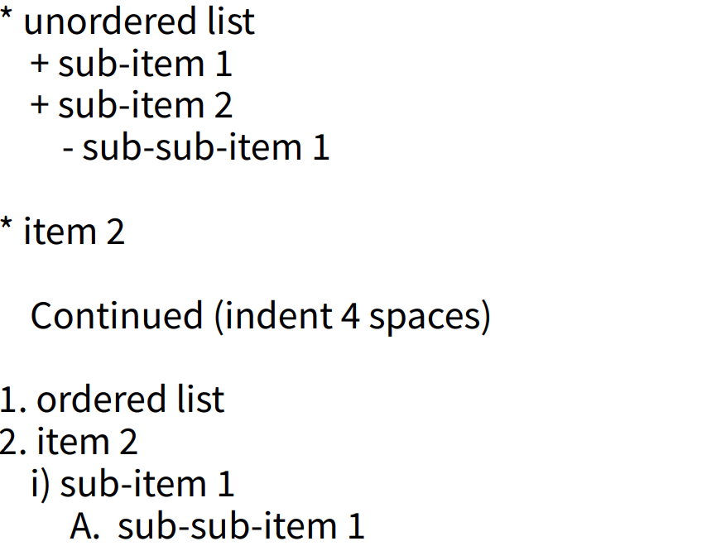
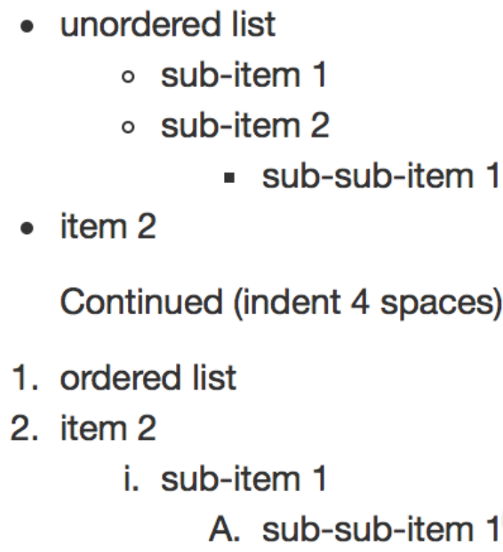
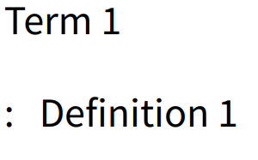
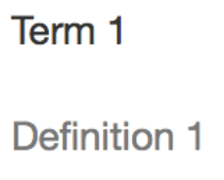
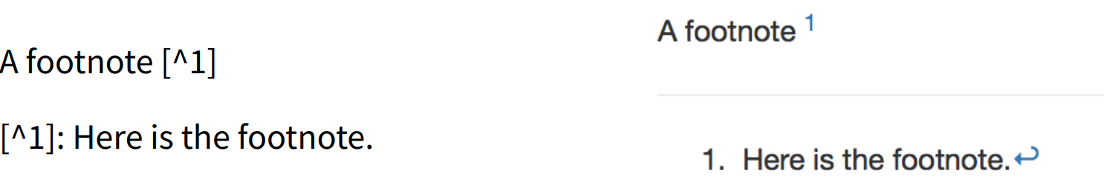
Referring to things in the book
Literature references
See Table \@ref(tab:conceptTable) for a table.
See Figure \@ref(fig:coolFigure) for more.
Refer to Chapter \@ref(Cohorts) for details.
Adding citation information
Citations should be provided in BibTeX format in the book.bib file. There are two ways to get BibTeX formatted citations:
Using TexMed, a BibTeX interface for PubMed
Reference managers such as Zotero will also allow you to export to BibTeX.
Note that there is only one boob.bib file for the entire book.
Citing in text
The first field in the BibTeX is its label, and this label can be used to cite in the text. This can be done with and without square brackets. For example, As proposed by @reps2018 will render to `As proposed by Reps et al. (2018)`, while As proposed elsewhere [@reps2018] will render to `As proposed elsewhere (Reps et al. 2018)`
Cheat Sheet
http://book.ohdsi.org
Rmarkdown syntax
Tables
Table: (\#tab:conceptTable) A table with two concepts.
| Concept ID | Name |
| ---------- | ---- |
| 8532 | FEMALE|
| 8507 | MALE|
The number of hyphens in the second row determines how wide the table is. The relationship between number of hyphens and table width is not documented, but 10 hyphens translates into approximately 10-20% width.
Figures
Add figure files to a subfolder of the images folder. The subfolder should have the same name as the chapter Rmd file. Keep filename extensions in lower case, so 'figure.png', not 'figure.PNG'.
Code blocks
```{r tidy=FALSE,eval=FALSE}
print("Hello world")
```
```{r coolFigure, fig.cap=‘A cool figure',echo=FALSE, out.width='100%', fig.align='center'} knitr::include_graphics("images/Intro/coolFigure.png")
```
Code blocks should preferably have eval=FALSE, meaning the code is shown but not run.
Software environment
Adding ATLAS screenshots
It is hard to take screenshots of ATLAS where the resulting font size in the image in the book is big enough to read. Try to keep screenshots to a minimum. If you need to make a screenshot, here are instructions for making ok screenshots:
In Chrome, open the dev tools using Ctrl + Shift + i.
Click the second button top left that looks like a mobile phone.
In the main Chrome window, set the width to 1000 and the zoom to 150%
Use for example the Windows Snipping Tool to capture the screen. However, you cannot include the full screen width, and for example it is best to leave out the left navigation bar
Install these tools:
R https://cran.r-project.org/
Rstudio https://www.rstudio.com/
Git https://git-scm.com/
In R, run install.packages("bookdown").
To start editing the book, first fork the TheBookOfOhdsi repo at https://github.com/OHDSI/TheBookOfOhdsi.
Then clone the fork using RStudio.
Chapter outline
Chapters should aim to follow this outline
Introduction
Theory
Practice
Exercises

