Slide 1
ASSESSMENT 2 · TOPIC 9
Supply Chain Logistics Pipeline
An End-to-End Data Engineering Pipeline for Delivery-Delay Prediction
Motty · DxValley
August 2026

Slide 2
AGENDA
From raw logistics data to an ML-ready dataset
01
02
03
Problem & Objectives
Architecture
Ingestion & Storage
04
05
06
Cleaning & Feature Engineering
Data Quality & Orchestration
Versioning & Results
07
Findings, Challenges & Next Steps
Assessment 2 · Supply Chain Logistics Pipeline
2

Slide 3
PROBLEM & OBJECTIVES
Late deliveries are a data problem before they're a logistics problem
Raw order and carrier-tracking data is inconsistent, incomplete, and carries no engineered signal for delay risk. This project builds the full pipeline that turns it into a trustworthy, ML-ready dataset for predicting delivery delay.
103,548
clean, feature-engineered orders (98.1% retention from 105,525 raw rows)
2+ ingestion sources (file + REST API)
21 / 21
2+ storage formats (SQLite + Parquet)
10+ engineered features
Great Expectations checks passing (100%)
Great Expectations quality gate
7-task DAG
PySpark aggregations & window functions
Airflow orchestration, DVC versioning
executed end-to-end via Airflow — verified, not just authored
Assessment 2 · Supply Chain Logistics Pipeline
3

Slide 4
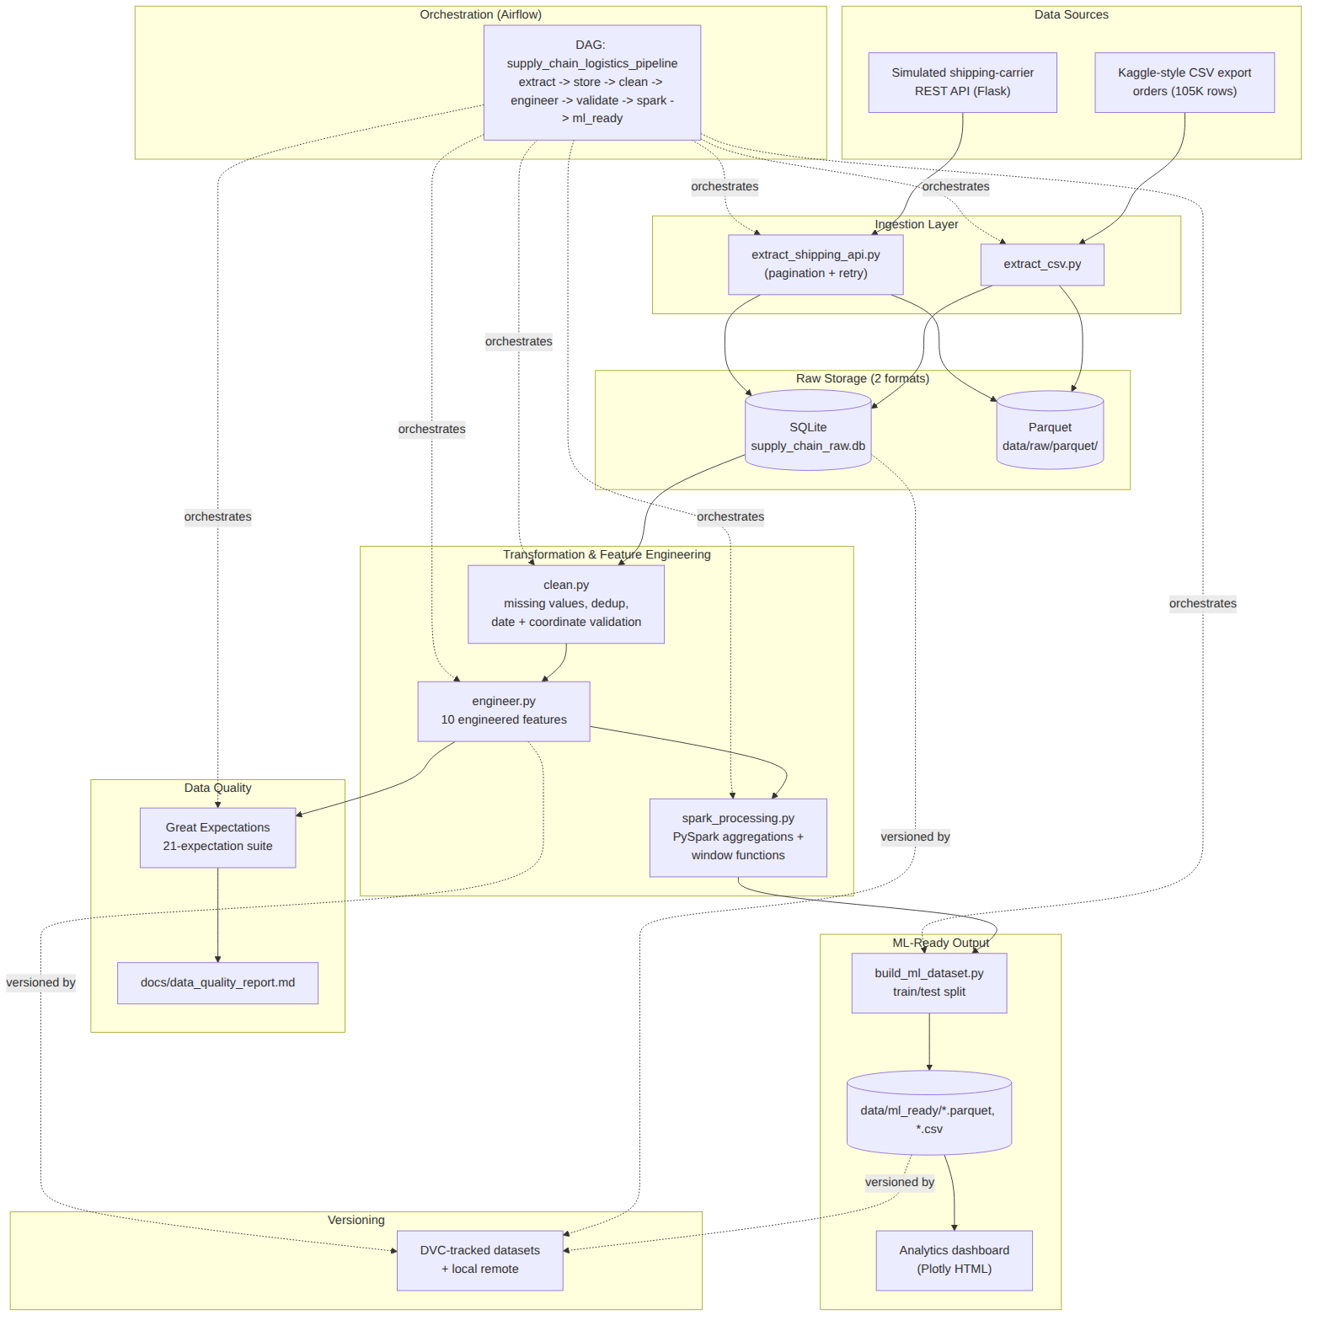
ARCHITECTURE
Two sources in, one ML-ready dataset out
Assessment 2 · Supply Chain Logistics Pipeline
4

Slide 5
INGESTION & STORAGE
Two independent sources, two storage formats
Source 1 — Order CSV export
Source 2 — Shipping-Carrier API
kaggle_supply_chain_orders.csv
105,525 rows · 25 columns
carrier, distance, cost, delivery windows, destination coordinates
Simulated Flask REST API
188,299 tracking events, 6 carriers
Paginated, rate-limited, retried on transient 503s
Storage format 1 — SQLite
Storage format 2 — Parquet
supply_chain_raw.db
Ad-hoc SQL queryability over the raw extract
data/raw/parquet/
Columnar storage feeding Spark & Pandas downstream
Assessment 2 · Supply Chain Logistics Pipeline
5

Slide 6
CLEANING & TRANSFORMATION
98.1% of records survive a real quality pass
522
317
1,138
duplicate rows removed
malformed dates dropped
invalid coordinates removed
2,120
1,053
103,548
missing delivery-days imputed
missing shipping-cost imputed
clean rows retained
Assessment 2 · Supply Chain Logistics Pipeline
6

Slide 7
FEATURE ENGINEERING
10 domain-relevant features, each with a rationale
delivery_delay
distance_category
1
6
shipping_cost_per_unit
warehouse_utilization
2
7
route_efficiency_score
inventory_turnover
3
8
carrier_performance_score
reorder_risk_score
4
9
seasonal_demand_index
shipment_size_category
5
10
Assessment 2 · Supply Chain Logistics Pipeline
7

Slide 8
DATA QUALITY
Great Expectations: 21/21 checks pass
Uniqueness & null checks, categorical set membership, numeric range checks (price, cost, coordinates, distance, delivery time), regex format validation, and range checks on every [0,1]-bounded engineered score.
100%
Cross-checked independently: carrier on-time ranking from the cleaned orders data agrees with the shipping API's own carrier-performance endpoint.
suite pass rate
Assessment 2 · Supply Chain Logistics Pipeline
8

Slide 9
ORCHESTRATION
One Airflow DAG, seven tasks, verified end-to-end
extract → store → clean → engineer → validate → spark → ml_ready
Schedule
Retries
Daily @ 02:00 UTC, catchup off, max 1 concurrent run
2x with exponential backoff (3–15 min)
Quality gate
Verified
Fails the run if <90% of GX checks pass
`airflow dags test` → DagRun Finished, state=success
Assessment 2 · Supply Chain Logistics Pipeline
9

Slide 10
VERSIONING & REPRODUCIBILITY
Every dataset is versioned, every step is reproducible
DVC-tracked: raw CSV, SQLite DB, cleaned & feature-engineered Parquet, ML-ready train/test splits
Full reproduction guide
python -m venv venv
pip install -r requirements.txt
python -m src.ingestion.generate_seed_dataset
python -m src.ingestion.shipping_api_server &
... (full 7-stage pipeline)
airflow dags test supply_chain_logistics_pipeline
Local remote configured; `dvc push` / `dvc checkout` restore any historical version
Two committed versions (v1, v2) across the git history
Assessment 2 · Supply Chain Logistics Pipeline
10

Slide 11
RESULTS
An ML-ready dataset for delivery-delay prediction
103,548 rows · 82,840 train / 20,708 test · 22 features · 2 targets
Assessment 2 · Supply Chain Logistics Pipeline
11

Slide 12
KEY FINDINGS
Where delay risk actually concentrates
Counter-intuitively, Local shipments have the highest average delay — international shipments carry more schedule buffer that absorbs the same variability.
Assessment 2 · Supply Chain Logistics Pipeline
12

Slide 13
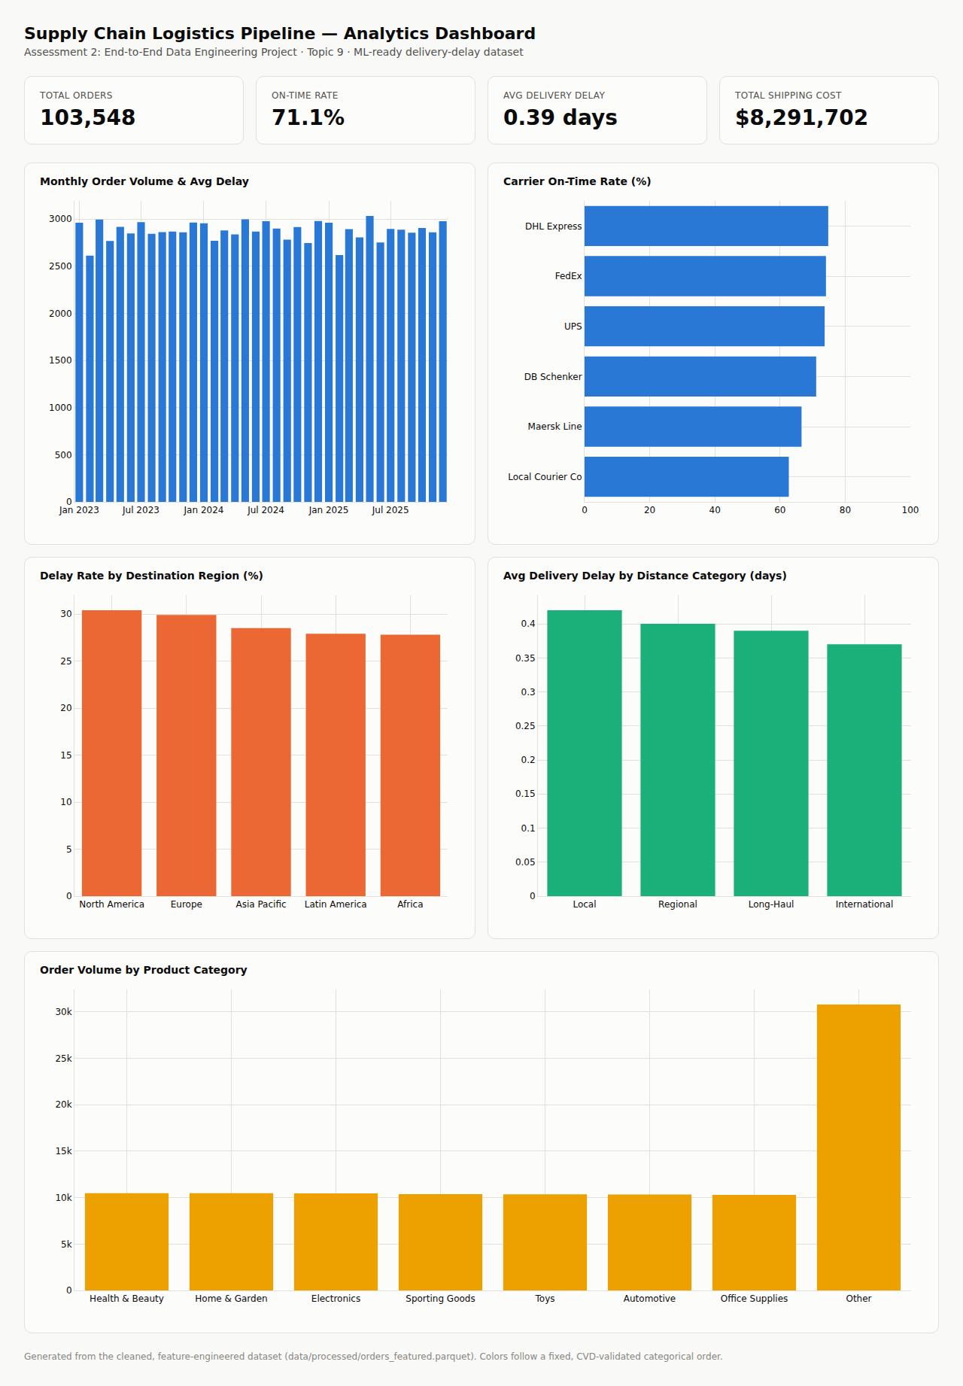
ANALYTICS DASHBOARD
A self-contained, interactive dashboard
Assessment 2 · Supply Chain Logistics Pipeline
13

Slide 14
CHALLENGES
What got in the way — and how it was resolved
No live Kaggle API access in the build sandbox
Generated a schema-faithful, seeded synthetic dataset; documented a one-file swap-in for real Kaggle data
Flask/Airflow dependency conflict
Pinned Flask to the version in Airflow's official constraints file
Great Expectations 1.x Fluent API differs from older docs
Built and tested against the actual installed 1.20 API
PySpark 4.2 / pandas 3.x compatibility warning
Verified correctness in testing; flagged for monitoring
Assessment 2 · Supply Chain Logistics Pipeline
14

Slide 15
FUTURE WORK
Where this goes next
1
Swap in a real Kaggle/UCI/Zenodo dataset once credentials are available
2
Train & evaluate delivery-delay models on the ML-ready dataset produced here
3
Deploy to AWS/GCP/Azure (cloud bonus): managed Airflow, cloud DVC remote, warehouse-native analytics
4
Replace the simulated carrier API with a real carrier/aggregator API
5
Add data-drift monitoring alongside the existing Great Expectations checks
Assessment 2 · Supply Chain Logistics Pipeline
15

Slide 16
CONCLUSION
A complete, verified data engineering pipeline
Every Core Requirement in the assessment brief implemented and tested, not scaffolded
103,548-row ML-ready dataset, 100% data-quality pass rate, a working Airflow DAG, and DVC-versioned data
Full documentation: architecture diagram, data dictionary, reproduction guide, and this report
Thank you — Questions?
Assessment 2 · Supply Chain Logistics Pipeline
16

