Slide 1
Breast Cancer Detection Using Machine Learning
Fabiha Afrose Redita(1807069)
Sanjida Akter Mou(1807118)

Slide 2
Outline
Introduction
Related work
Proposed Model
Dataset Used
Convolutional Neural Network(CNN)
Proposed Method
Performance Analysis
Presentation of Results/Features
Conclusion and Future Scope
References

Slide 3
1. Introduction
Breast cancer has the second highest mortality rate after Lung & Bronchial cancer.
Advancing the fight against cancer requires early detection which can only be possible with an efficient detection system . Techniques have been developed to detect breast cancer, including medical image processing. These sonogrpahic images can be collected and used for developing computer-aided detection systems .
Manual detection is a tedious, tiring task and most likely to comprise human error, as most parts of the cell are frequently part of irregular random and arbitrary visual angles.
The goal is to identify whether a tumor is benign or malignant in nature, as malignant tumors are cancerous and should be treated as soon as possible to reduce and prevent further complications.
In short, it is a binary classification problem and can be resolved by various machine learning methods. It has been shown in the past that machine learning algorithms perform better than a human pathologist.

Slide 4
2.Related work
There are various methods and manual networks proposed by various scholars to classify breast cancer.
For example, Artificial Neural Networks depend upon MLE (Maximum Likelihood Estimation) , RBF Neural Networksare , the GRU-SVM model which is the ML algorithm combined with a type of recurrent neural network (RNN) and gated recurrent unit (GRU) with the support vector machine (SVM).
Along with these techniques, other scholars have developed methodology to obtain better results with less computational complexity
A combination of NN and multivariate adaptive regression splines(MARS) are also utilized to detect cancer.
Descriptors such as CLBP, GLCM, LBP, LPQ,ORB, PFTAS with classification of breast cancer up to a maximum accuracy of 85.1%.
There is another system that consists of the fuzzy-artificial immune system and the K-NN algorithm

Slide 5
3.Proposed Model
In the CNN model, EfficientNetB3 architecture has been used
To reduce overfitting problem, there has been added noise to the under-constrained neural network model.
Keras supports the addition of Gaussian noise via a separate layer called the GaussianNoise layer. This layer can be used to add noise to an existing model.
The tf.layers.globalAveragePooling2d() function is used for applying global average pooling operation for spatial data.
In this model, the ReLu and sigmoid activation function has been used. In order to normalize the input to activation function, BatchNormalization function has been used.
Batch normalization is used so that the distribution of the inputs (and these inputs are literally the result of an activation function) to a specific layer doesn't change over time due to parameter updates from each batch (or at least, allows it to change in an advantageous way).

Slide 6
4.Dataset Used
We have collected the ultrasound images for both cancerous and non-cancerous from the web and created a new dataset.
There are two parts to our dataset which are training and testing for both detection and localization.
The train set has 8116 images, accounting for nearly 70% of the whole dataset.
The test set has 900 images, that is about 15% of the total dataset.
Source : Ultrasound Breast Images for Breast Cancer | Kaggle

Slide 7
5.Convolutional Neural Network(CNN)
CNN is a modified variety of deep neural net which depends upon the correlation of neighboring pixels.
The CNN architecture has two main types of transformation.
The first is convolution, in which pixels are convolved with a filter or kernel. This step provides the dot product between image patch and kernel. The width and height of filters can be set according to the network, and the depth of the filter is the same as the depth of the input.
A second important transformation is subsampling, which can be of many types (max_pooling, min_pooling and average_pooling) and used as per requirement.
The size of the pooling filter can be set by the user and is generally taken in odd numbers. The pooling layer is responsible to lower the dimensionality of the data, and is quite useful to reduce over fitting .
After using a combination of convolution and pooling layers, the output can be fed to a fully connected layer for efficient classification. The visualization of the entire process is presented below.

Slide 8
6.Proposed Method
Our project introduces and assesses a deep learning architecture for automized breast cancer detection that incorporates concepts of machine learning and image classification.
We have described different Deep Neural Network architectures, especially those adapted to image data such as Convolutional Neural Networks.
This used the labeled(benign/malignant) input image from the raw pixels and highlighted the visual patterns, and then utilize those patterns to distinguish between non-cancerous and cancer containing tissue, working a kin to digital staining, which spotlights image segments crucial for diagnostic decisions, with the help of a classifier network.
The CNN was trained using 4574 benign and 4442 malignant samples belonging to the RGB color model. Therefore,the dataflow of the proposed system depicted below provides an effective classification model for classifying breast tissue as being either benign or malignant.

Slide 9
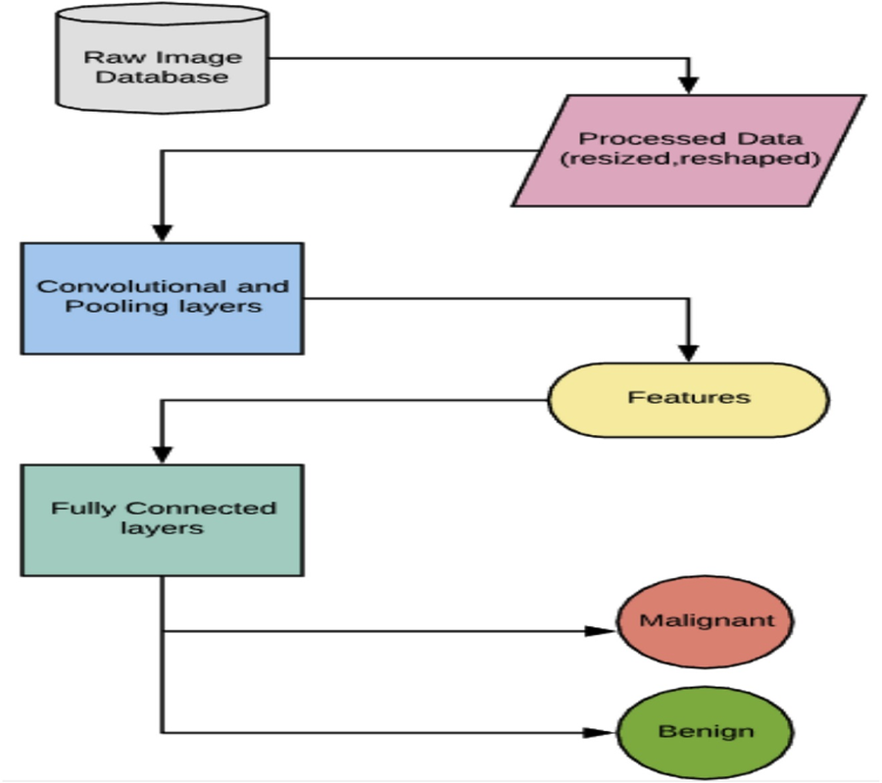

Slide 10
7.Performance Analysis:
By considering the previously described setup, we have obtained a training accuracy of 89.45% with a test train split of 0.2.
Precision is a probabilistic measure to determine whether a positive case, defined on our terms, actually belongs to the positive class.
A recall is a probabilistic measure to determine if an actual positive case is correctly classified with the positive class.
We can see that precision for the benign and malignant classes are found to be 90.35% and 88.66%, respectively.
Cell Name Precision
Benign 0.90
Malignant 0.88
Avg/total 0.89

Slide 11
8.Presentation of Results/Features
A study has shown that the breast is sensitive to shapes, while computers are more sensitive to patterns and texture. Because of this fact, feature learning is entirely different for manual versus machine.
In this case images are fed to an architecture such as CNN, along with its class as a label (Benign or Malignant).
From the automatic update of filter values in the training process, CNN is able to extract the computational features.
In this approach, CNN takes raw pixels of an image and gives output as learned filter weights. These weights serve input to the dense architecture of the deep neural network for final prediction.
In our proposed architecture, the convolutional neural network is made up of two types of layers:
(i) Convolutional Layers
(ii) Pooling Layer
The details of the network are illustrated in the table, followed by its visual representation in the figure below.
When the convolution process is done, the depth of input is increased by the number of filters used, and when the pooling layer is applied , depth remains the same and size is reduced.

Slide 12
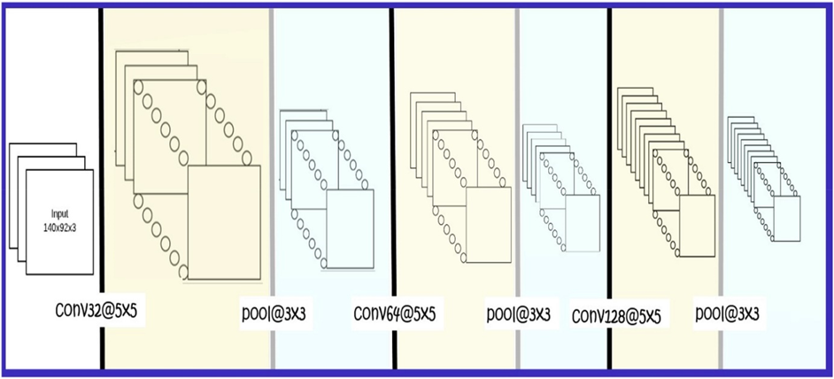

Slide 13
9.Conclusion and Future Scope
Breast cancer detection by using digital/digitized sonography images is a milestone in the field of medical imaging.
It has also opened a door to new opportunities for research as there are many undiscovered areas that can be revealed by techniques and tools of machine learning and deep learning.
We may obtain improved results by altering the network design and parameters.
As an improvement to the proposed method, one can implement an auto encoder instead of manually reducing image size.
It can compress data without losing the prominent features, because auto encoders can regenerate up to 90% of the original image.
From the point of method improvement, we can incorporate spectral imaging.
Additionally, we may combine various imaging technologies such as MRI, CT Scan, and mammographic images, and determine their collective results. This technique is known as multi model fusion.
Problems stated above can again readily be solved by deep learning, and can be used to perform high quality research that might provide even better results.

Slide 14
10.References
[1] Siegel RL, Miller KD, Jemal A. Cancer statistics, 2017. CA - Cancer J Clin 2017;67(1):7–30.
[2] Spanhol FA, Oliveira LS, Cavalin PR, Petitjean C, Heutte L. Deep features for breastcancer histopathological image classification. In: 2017 IEEE internationalconference on systems, man, and cybernetics, SMC 2017, banff, AB, Canada,october 5-8, 2017; 2017. p. 1868–73. https://doi.org/10.1109/SMC.2017.8122889. https://doi.org/10.1109/SMC.2017.8122889.
[3] Spanhol FA, Oliveira LS, Petitjean C, Heutte L. Breast cancer histopathologicalimage classification using convolutional neural networks. In: 2016 internationaljoint conference on neural networks, IJCNN 2016, vancouver, BC, Canada, july 24-29, 2016; 2016. p. 2560–7. https://doi.org/10.1109/IJCNN.2016.7727519.
[4] A. Alias, B. Paulchamy, Detection of breast cancer using artifical neural network,International Journal of Innovative Research in Science 3 (3).

Slide 15
[5] Agarap AF. On breast cancer detection: an application of machine learningalgorithms on the Wisconsin diagnostic dataset, CoRR abs/1711.07831.1711.07831. http://arxiv.org/abs/1711.07831.
[6] Sahan S, Polat K, Kodaz H, Günes S. A new hybrid method based on fuzzy-artificialimmune system and k-nn algorithm for breast cancer diagnosis. Comput Biol Med2007;37(3):415–23. https://doi.org/10.1016/j.compbiomed.2006.05.003.https://doi.org/10.1016/j.compbiomed.2006.05.003.
[7] R. A. Johnson, D. W. Wichern, Multivariate analysis, Encyclopedia of StatisticalSciences 8.
[8] Lowe A KMe a, Grunkin M. Visiopharm digital pathology blog philips teams upwith visiopharm to boost breast cancer diagnosis objectivity throughcomputational patthology. 2016. http://www.visiopharm.com/blog/category/image-_analysis

Slide 16
Thank You

