Slide 1

Developing a clustering model that identifies emerging trends and topics
CSE 445.5
Group 09
Group Members:
Habiba Alam Raisa | 2231272642
Sadia Islam | 2212030042
Shakela Mostafa Priya | 2132049642
Tanushree Das | 2212225042

Slide 2


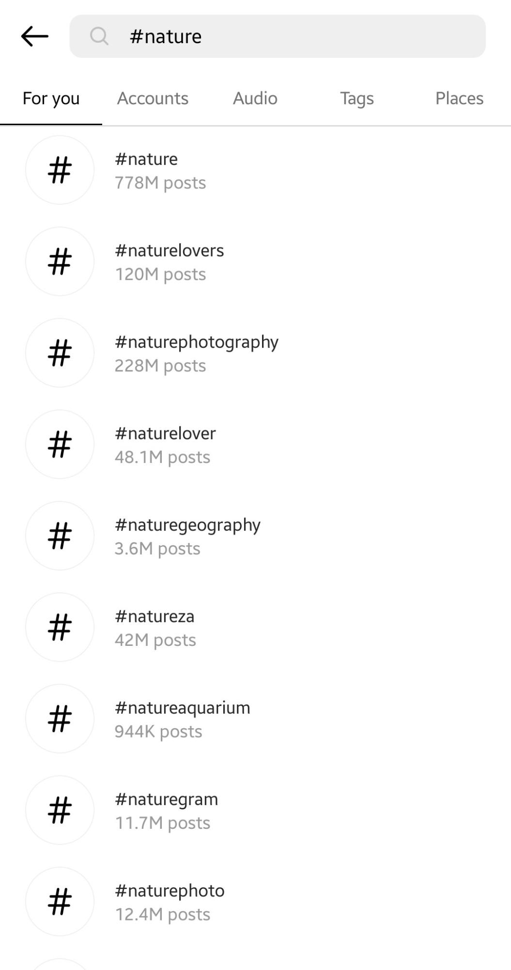
Our project aims to collect a diverse dataset of public social media posts from various platforms and develop a clustering model that identifies emerging trends and topics in these posts.

Slide 3
Data Collection
Platforms
Reddit: Public posts from various subreddits.
Instagram: Public captions and posts.
Dataset Scale
The combined dataset consists of 1,017,100 entries, providing a robust foundation for trend analysis.
Attributes
Each entry includes text content and a source identifier for the platform.

Slide 4
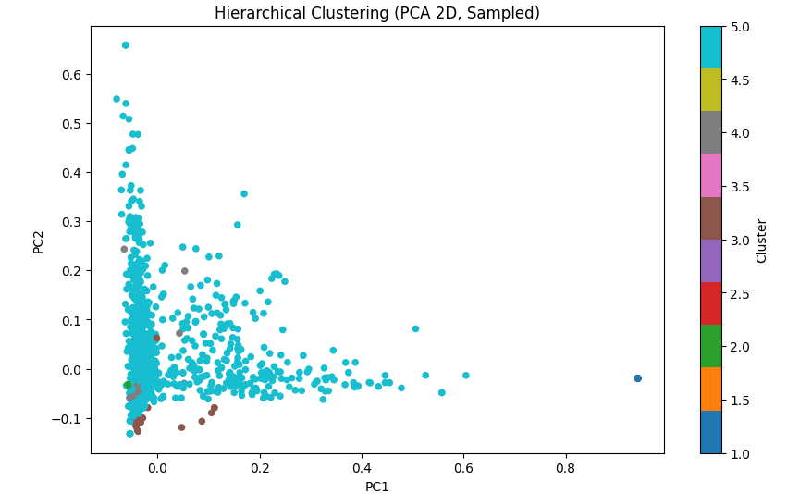
Feature Extraction
TF-IDF Vectorization
SVD
PCA
BERT Embeddings

Slide 5
Methodology: A Multi-Model Approach
Mini-Batch K-Means
To overcome the limitations of static K-Means
Cluster centroids are updated incrementally
BIRCH
memory-efficient clustering algorithm
scales well for high-dimensional data.
HDBSCAN
to find clusters of varying density while automatically identifying noise
Agglomerative Clustering
to find clusters of varying density while automatically identifying noise
Gaussian Mixture Models
GMM is employed to model clusters as probabilistic distributions
provides additional insight into overlapping trends
Key Models Used:
• Centroid-Based: K-Means, Mini-Batch K-Means
• Hierarchical: BIRCH, Agglomerative Clustering
• Density-Based: HDBSCAN
• Probabilistic: Gaussian Mixture Models (GMM)

Slide 6
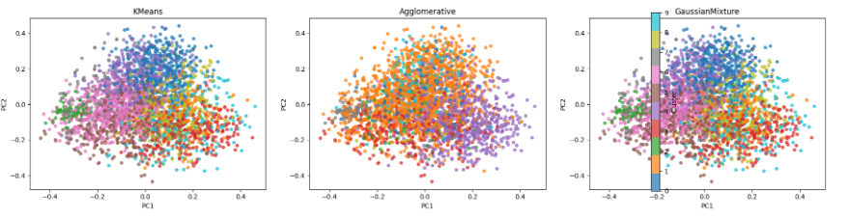
Ensemble Approach
K-Means and Gaussian Mixture Models
K-Means with TF-IDF
HDBSCAN with BERTopic

Slide 7
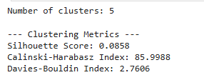


Model Evaluation
Quantitative Evaluation
Silhouette Score
Davies-Bouldin Index
Calinski-Harabasz Index

Slide 8
Comparison of Clustering Performance Metrics
Clustering Method | Silhouette Score | Davies-Bouldin Index | Calinski-Harabasz Index
Hierarchical Clustering | 0.0019 | 5.2744 | 2.91
K-Means (TF-IDF) | 0.026 | 4.77 | 35.37
K-Means (SBERT embeddings) | 0.027 | 3.25 | 103.44
Agglomerative | 0.012 | 5.59 | 18.50
Gaussian Mixture | 0.026 | 4.77 | 35.37
HDBSCAN | 0.5644 | 0.5329 | 13349.22

Slide 9
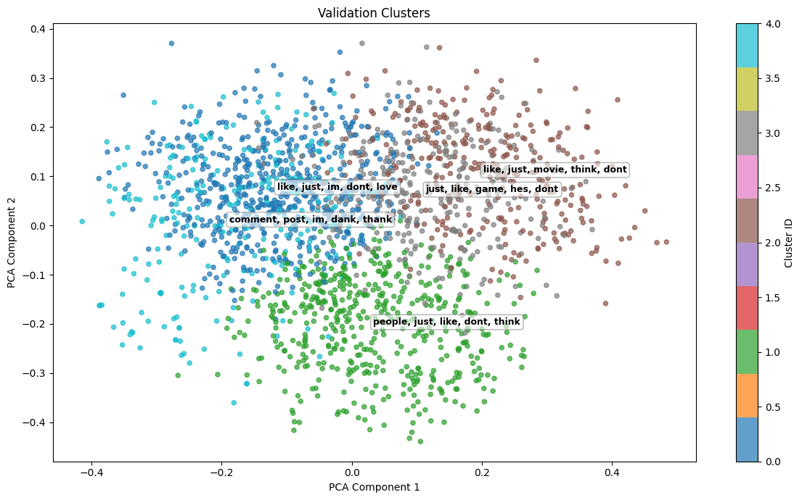
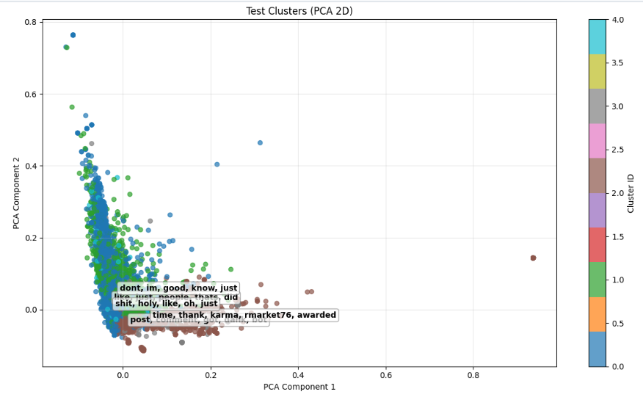
Qualitative Evaluation
TF-IDF keywords
PCA visualization of SBERT embeddings

Slide 10
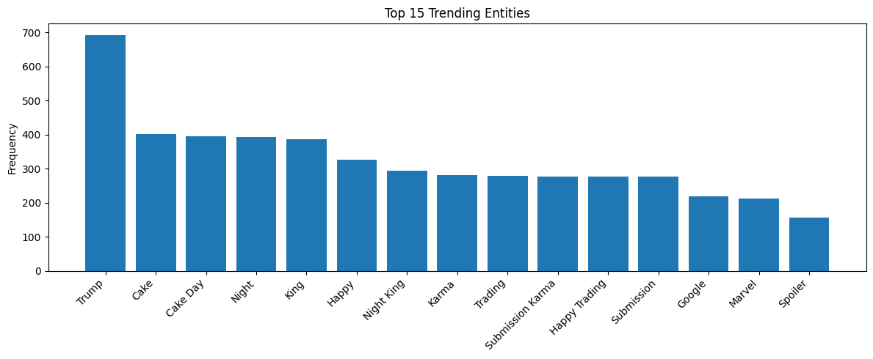
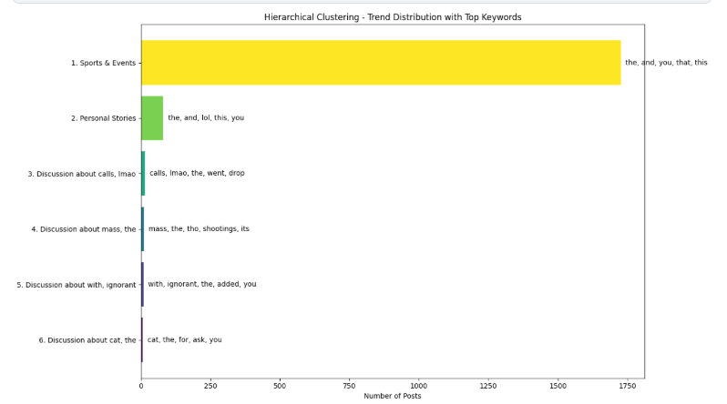
Trend Analysis
Hashtags and Mentions
Named Entities
Word/Phrase Frequencies

Slide 11
conclusion Future work
The proposed dynamic clustering framework effectively identifies emerging social media trends and provides a scalable solution for analyzing continuously evolving online content.
Future work will focus on real-time, multilingual trend detection using online and neural clustering methods to better track evolving social media discussions.

Slide 12


