Slide 1
Volunteer Connection Account Sign up Process
Red Cross at CSULB
dm us on IG (@csulbrcclub) or email for any questions:
abbas.abdulhasan@student.csulb.edu

Slide 2
What is Volunteer Connection (VC)?
Online tool to keep track of volunteer hours and sign up for volunteer shifts off-campus
There is a mobile app (just search volunteer connection on the App Store)
VC is the only way to keep track of your hours, without an account you cannot volunteer!
Singing up to Volunteer Connection is a requirement to be part of our club

Slide 3
Tracking volunteer hours is important, because it:
Demonstrates the value of our volunteers’ time in service to the red cross mission, allowing the red cross to dedicate a higher percentage of expenses to direct services and programs.
Provides specific information to understand volunteers’ contributions to their community through their Red Cross service and allows the red cross to recognize and appreciate these accomplishments.
Shows our community leaders and the general public the quantifiable power of Red Cross volunteers.

Slide 4
How to Get Started
Click on Youth-Services: Los Angeles
Click on “Join a Red Cross Youth Corps!”
Scroll all the way down to “Red Cross College Corps”
Click on “CSULB”
Check the next few slides for a pictorial demo

Slide 5
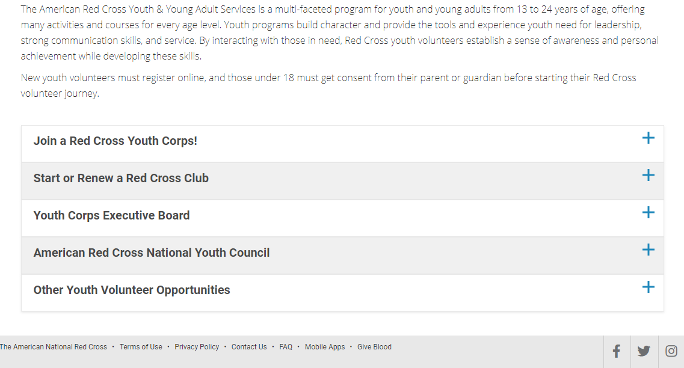

Slide 6
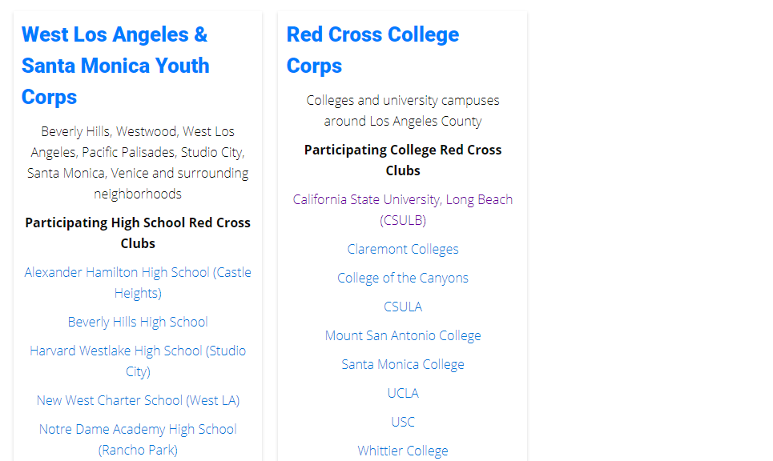

Slide 7
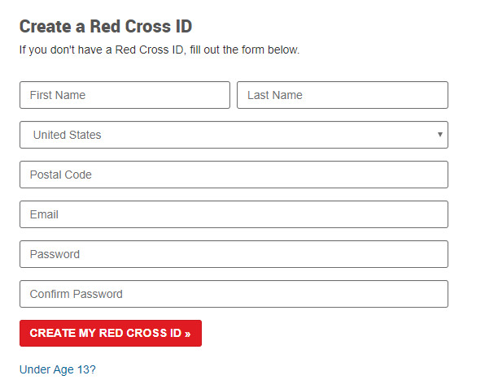
Getting started
You should now see this page
Fill the required information under “Create a Red Cross ID”

Slide 8
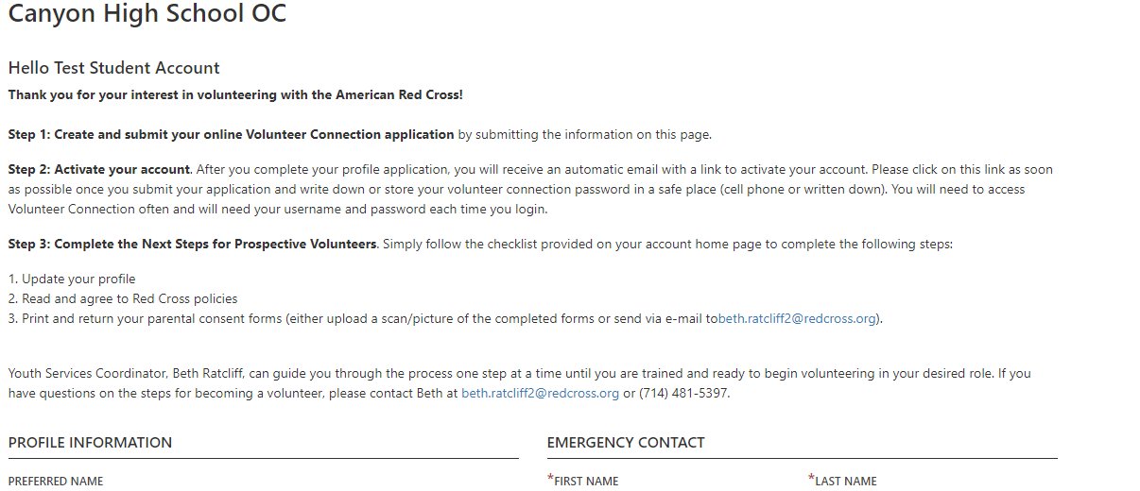
You should see this page now
If you don’t see this page and/or are redirected to the “self service help” page please try the following:
Clear Website Data and Browser Cookies, or switch to different device/browser
Google “Volunteer Connection” and click first link. Try signing in again.
*When it asks for “Your Closest Chapter”, select American Red Cross of LA County

Slide 9
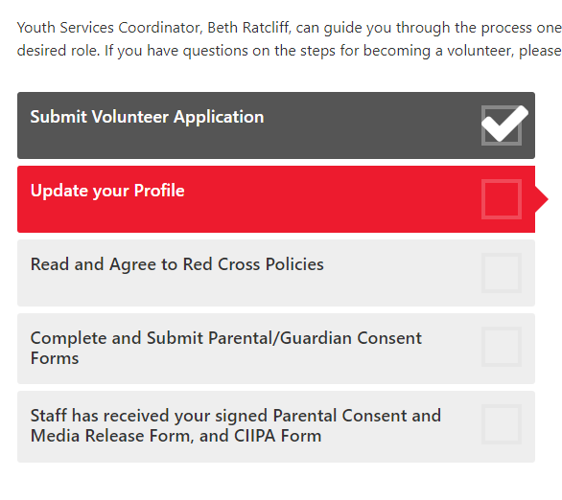
Getting started
Fill out info on previous page and then press “Create Account”
You will be redirected to a page with checkboxes and will also get an email with a verification link. Click on the verification link, sign in, and your account will be activated.
Complete the checkboxes on this page.
Start with “Update your profile.”
See next slide

Slide 10
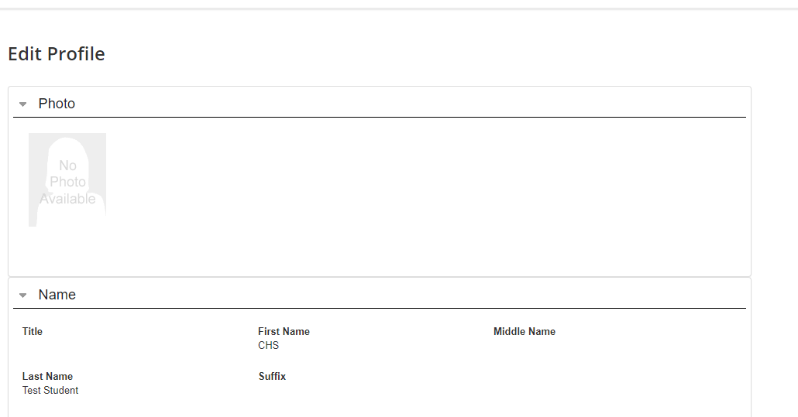

“Update your Profile”
Fill out required info. Hit Submit when done.
You will then be taken to a page that says “My Profile”. Get out from here by going to in the top right. Press “Home” to complete the other checkboxes.

Slide 11
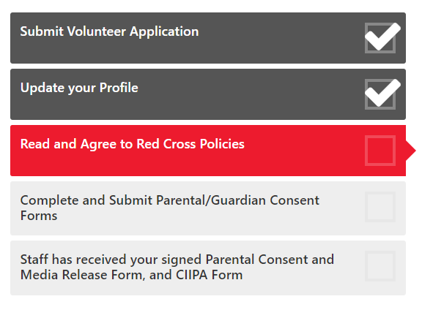
“Read and Agree to Red Cross Policies”
Complete this step by simply agreeing to the statements on the page you are redirected to.
Once completed you will be redirected to the page with checkboxes

Slide 12
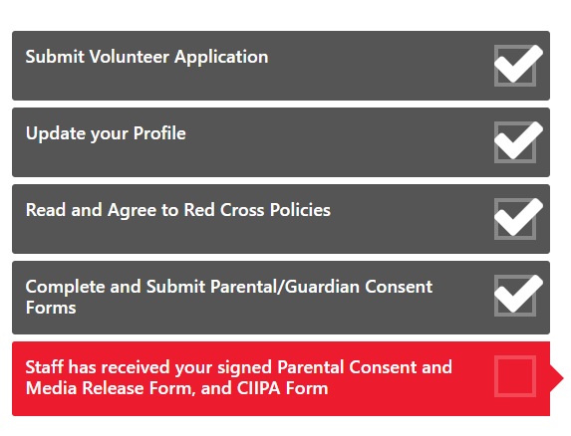
Wait for Staff to receive forms
**May take 1-3 Days, be sure to check status
Parental Consent not needed unless under 18

Slide 13
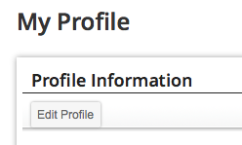
Finishing Up
“Update Profile”
click “Edit Profile” and fill in all required fields

Slide 14
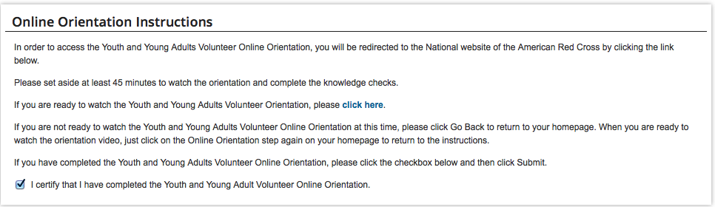
Finishing Up
“Online Orientation”
click link on the check box
check the checkbox

Slide 15
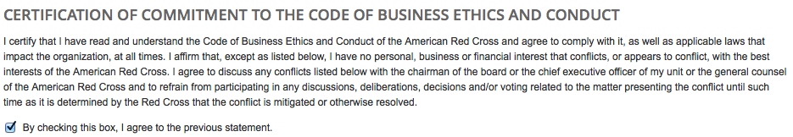
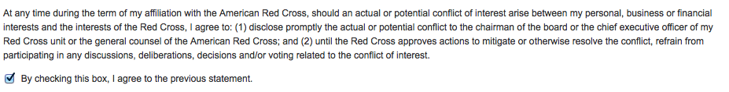
Finishing Up
“Read and Agree to Red Cross Policies”
click link on “check box”
read policies and then check both checkboxes stating you agree
click “Submit”

Slide 16
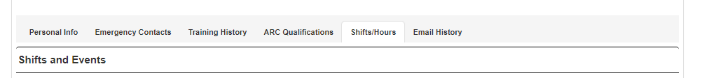
Entering Hours
Submit hours by going to “My Profile” and then the heading “Shift/Hours”.
Scroll down to “Submit Hours”

Slide 17

Mobile Application
Make sure you have already signed up for an account and all the checkboxes have been filled
Available on Apple and Android
Lets you submit hours right after event
Easy access to hours logged

Slide 18
Questions?
Email for any questions: abbas.abdulhasan@student.csulb.edu
Or DM @csulbrcclub on instagram!

