Slide 1
Traffic Flow State Modeling Using Markov Chain
By Mouad Zemzoumi

Slide 2
Introduction
Traffic flow modeling and the significance of using Markov Chains to predict traffic states.
Uncertainties related to this process like weather conditions, road conditions and human behaviors.
Risks that can impact the different crucial activities of the city especially in the medical and economical ones.
Dynamic decision making as it is crucial to make decisions immediately based on different changing parameters.

Slide 3
Problem Statement
Current traffic modeling challenges include uncertainty in state transitions and real-time traffic variations. The Markov Chain model addresses these issues by providing a probabilistic framework by including external impacting factors.

Slide 4
Methodology
The Markov Chain model represents traffic states as nodes with transition probabilities. Data on traffic flow is collected, and transition matrices are constructed to predict the likelihood of state changes.

Slide 5
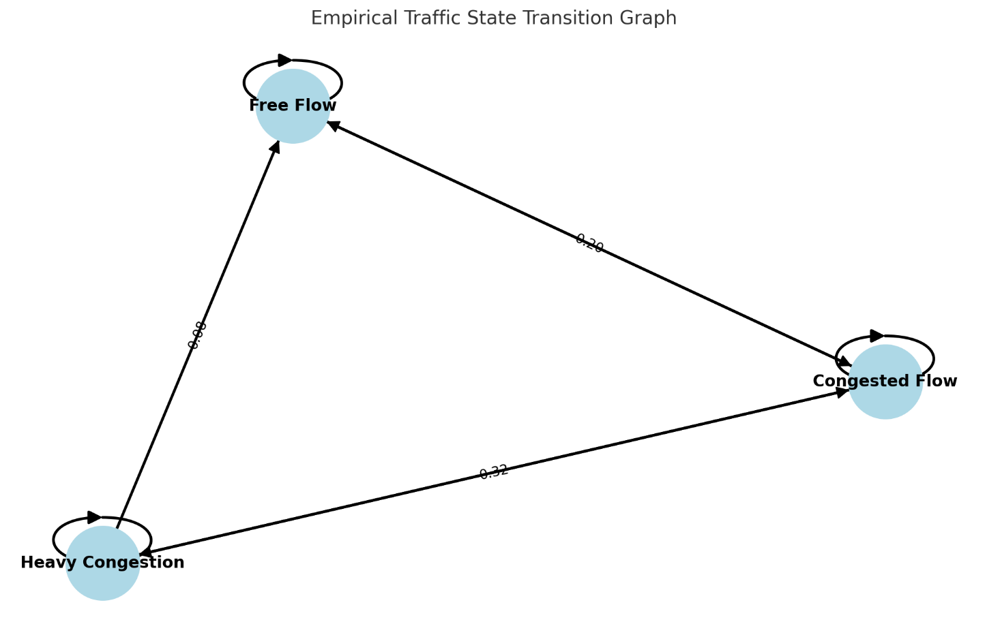

Slide 6
Implementation
The model was implemented using traffic data from observed road conditions. Transition probabilities were calculated using historical data and external factors (generated separately), and the system was validated against real-world scenarios. To predict Traffic Flow Markov chain coupled to Monte Carlo simulation models were used.

Slide 7
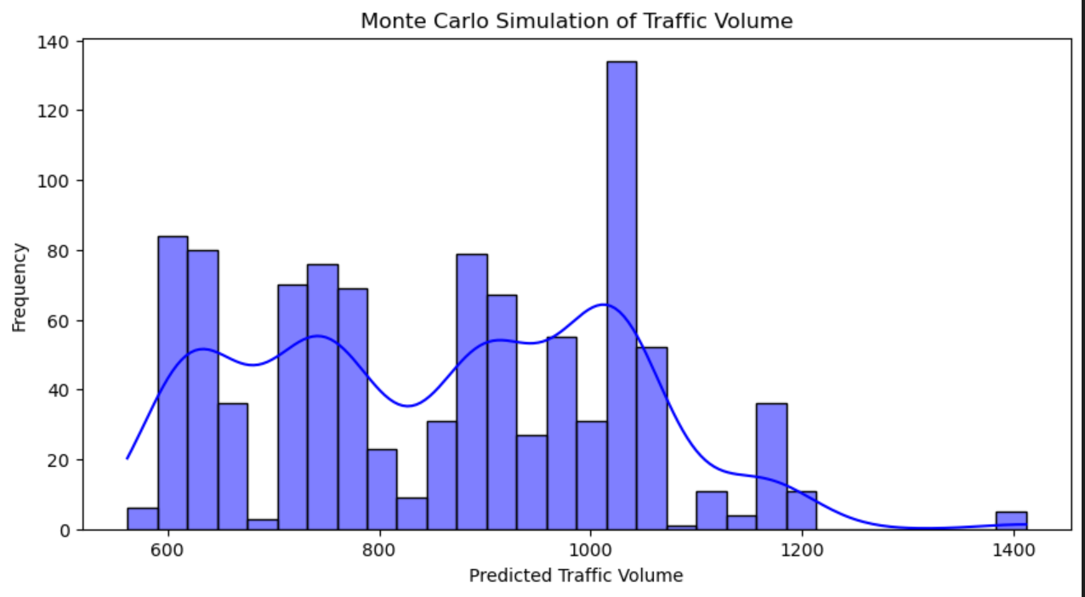

Slide 8
Results
The Markov model coupled with Monte Carlo for the simulation part successfully predicted traffic state changes with a high accuracy rate given external factors like weather condition and holiday days. Findings indicate that integrating real-time data can enhance prediction accuracy further.

Slide 9
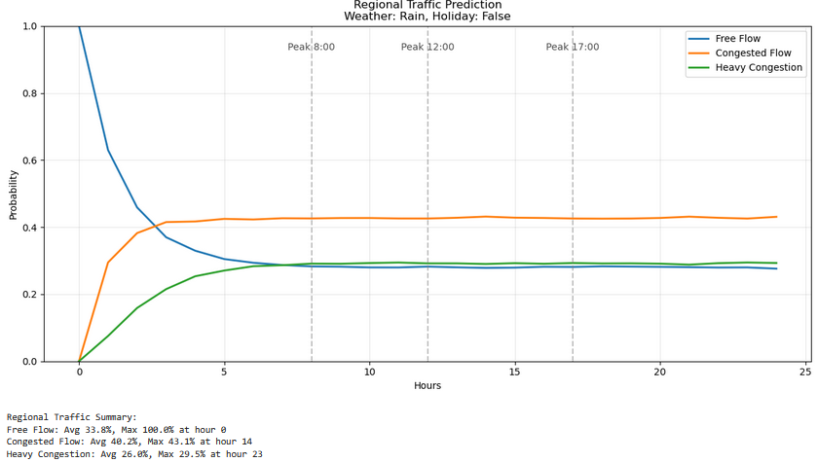

Slide 10
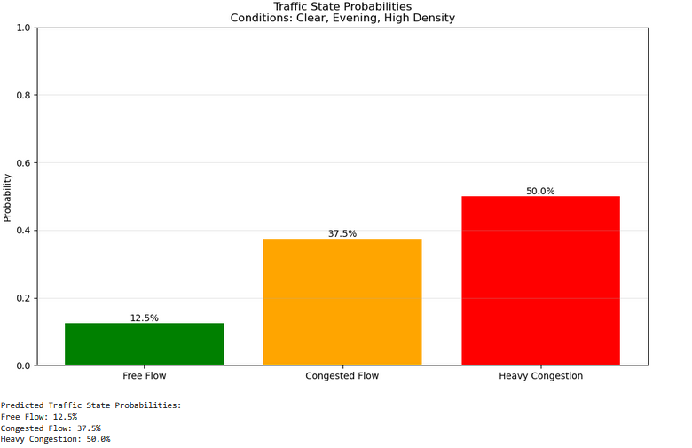

Slide 11
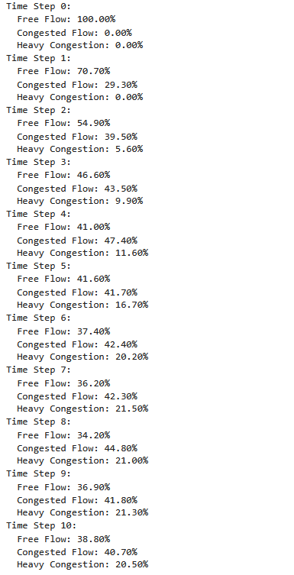

Slide 12
Simulation and Estimation
Based on a generated new transition matrix we simulated the same process to see how the model would perfom.
This serves as an estimation and evaluation of the model.

Slide 13
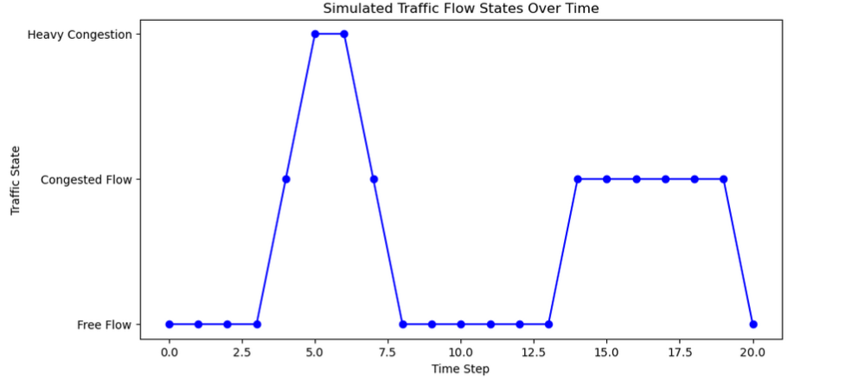

Slide 14
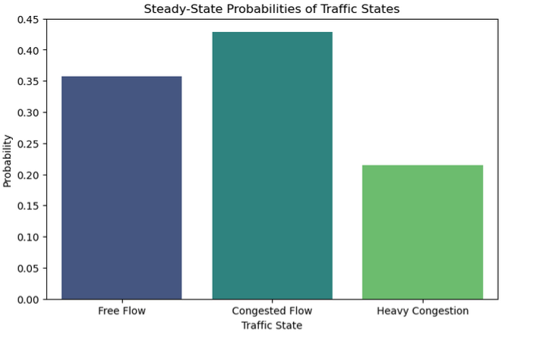

Slide 15
Conclusion & Future Work
While the model provides valuable predictions on the traffic state using Monte Carlo simulation , improvements can be made through real-time data integration, IoV systems (Internet of vehicules), edge computing and gamification for adaptive traffic management.

Slide 16
References
Taplin, John. (2008). Simulation models of traffic flow.
Philip, Babitha. (2016). Traffic Flow Modeling and Study of Traffic Congestion.
Zaki, John & Ali-Eldin, Amr & Hussein, Sherif & Saraya, Sabry & Areed, Fayez. (2019). Time Aware Hybrid Hidden Markov Models for Traffic Congestion Prediction. International Journal on Electrical Engineering and Informatics. 11. 1-17. 10.15676/ijeei.2019.11.1.1.
Sayed, S.A., Abdel-Hamid, Y. & Hefny, H.A. Artificial intelligence-based traffic flow prediction: a comprehensive review. Journal of Electrical Systems and Inf Technol 10, 13 (2023). https://doi.org/10.1186/s43067-023-00081-6
J. A. Fadhil and Q. I. Sarhan, "Internet of Vehicles (IoV): A Survey of Challenges and Solutions," 2020 21st International Arab Conference on Information Technology (ACIT), Giza, Egypt, 2020, pp. 1-10, doi: 10.1109/ACIT50332.2020.9300095.
Sadiku, Matthew & Tembely, Mahamadou & Musa, Sarhan. (2018). INTERNET OF VEHICLES: AN INTRODUCTION. International Journal of Advanced Research in Computer Science and Software Engineering. 8. 11. 10.23956/ijarcsse.v8i1.512.
Sahil, Sandeep Kumar Sood, Smart vehicular traffic management: An edge cloud centric IoT based framework, Internet of Things, Volume 14, 2021, 100140, ISSN 2542-6605, https://doi.org/10.1016/j.iot.2019.100140.
Khan, A., Khattak, K. S., Khan, Z. H., Gulliver, T. A., & Abdullah. (2023). Edge Computing for Effective and Efficient Traffic Characterization. Sensors, 23(23), 9385. https://doi.org/10.3390/s23239385
Eugénie Avril, Angèle Picco, Colin Lescarret, Céline Lemercier, Amaël Arguel, Loïc Caroux, Gamification in the Transport and Mobility Sector: A Systematic Review, Transportation Research Part F: Traffic Psychology and Behaviour, Volume 104, 2024, Pages 286-302, ISSN 1369-8478, https://doi.org/10.1016/j.trf.2024.06.004.
Alyamani, H., Alharbi, N., Roboey, A., & Kavakli, M. (2023). The Impact of Gamifications and Serious Games on Driving under Unfamiliar Traffic Regulations. Applied Sciences, 13(5), 3262. https://doi.org/10.3390/app13053262.

