Slide 1

Report on Information and Communication Technologies (ICT)
Team 27 members:
Slimani imad 232331397617
Ait yahia Sarah MASSYLIA 232332138602
Barkou abderrahmane 232331572705
Kennouche Mouad 232331573213
Admane abdelMalek 232331551111

Slide 2

Table of Contents:
Introduction.
Key Technologies in Information and Communications Technology (ICT).
Understanding Google Services and Their Role in Connectivity:
Gmail.
Google drive
Google Docs, Sheets, and Collaborative Platform.
Embracing Microsoft Tools:
Office Suite (Word, Excel, PowerPoint).
Microsoft teams.
Navigating Git and GitHub:
Git
Github
Impact on Development Practices.
Web Technologies:
HTML and CSS.
Conclusion.

Slide 3

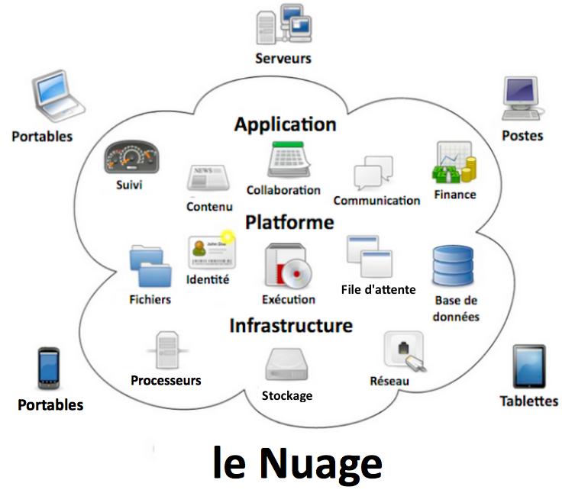
Introduction:
ICT encompasses a wide range of information technology, combining telecommunications with computer systems. It goes beyond hardware and software, aiming to empower users by facilitating access, storage, and manipulation of information. The goal is to revolutionize how humans interact with data across various domains, from business to leisure activities. The seamless integration of telecommunications and computational systems forms the core of ICT, aspiring to transcend boundaries and foster advancements in human endeavors.

Slide 4

Key Technologies in Information and Communications Technology:
Information and Communications Technology (ICT) is a broad field that integrates various aspects, connecting the internet and wireless mobility. It encompasses traditional technologies like landline telephones and radio, alongside modern advancements such as artificial intelligence and robotics. Key components include the internet, IoT, the metaverse, virtual reality, and crucial social media platforms. Integral services like cloud computing, video conferencing, and unified communications enhance connectivity. Ongoing developments like 5G/6G networks, Web3, and quantum computing contribute to the expanding ICT landscape. In essence, ICT covers any technology or infrastructure facilitating communication, data sharing, and global connectivity between individuals or humans and machines.

Slide 5


Understanding Google Services and Their Role in Connectivity:
Gmail: Electronic mail (email or e-mail) is a method of transmitting and receiving messages using electronic devices. It was conceived in the late–20th century as the digital version of, or counterpart to, mail (hence e- + mail). Email is a basic and necessary part of many processes in business, commerce, government, education, entertainment, and other spheres of daily life in most countries.
Google drive: Google Drive is a file storage and synchronization service developed by Google. Launched on April 24, 2012,editing of documents, spreadsheets, presentations, drawings, forms, and more.
Google docs, google sheets and collaborative platforms:

Slide 6


Google Docs:
Online Word Processor
Multi-User Collaboration
Cloud Storage
Google Sheets:
Online Spreadsheets
Collaborative Environment
Integration
Collaborative Platforms:
Real-Time Collaboration
Commenting and Revision History
Enhanced Teamwork

Slide 7
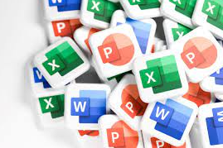
Embracing Microsoft Tools:
Office Suite (Word, Excel, PowerPoint):
Microsoft's Office Suite—Word, Excel, and PowerPoint—significantly boosts productivity:
Word: Streamlines document creation and collaboration.
Excel: Empowers data management and analysis.
PowerPoint: Creates engaging and impactful presentations.
These tools optimize workflows, aiding document creation, data handling, and presentation delivery across various sectors.
Microsoft Teams:
Microsoft Teams stands as an all-in-one collaborative platform, reshaping teamwork and communication within organizations. Its key features include:Unified Communication, Team Collaboration, Remote Work Support.

Slide 8


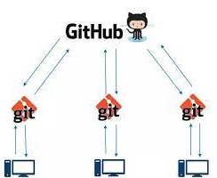
Navigating Git and GitHub
Git: Git is a distributed version control system that tracks changes in any set of computer files, used for developing source code during software development Its support for distributed, non-lineargoals include speed, data integrity, and workflows .
Github:GitHub, Inc. is an AI-powered developer platform that allows developers to create, store, and manage their code. It uses Git software.
Impact on Development Practices:
Facilitates seamless collaboration among developers worldwide.
Enables a structured approach to coding, reducing conflicts.
Collaborative coding with Git and GitHub transforms development
practices by fostering efficient collaboration and streamlined
workflows among developers.

Slide 9
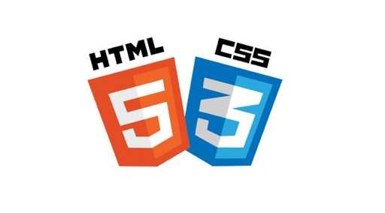
Web Technologies
HTML and CSS: HTML and CSS form the fundamental building blocks of web development:
HTML (Hypertext Markup Language): Serves as the backbone for structuring web content, utilizing tags to define elements and their relationships within a webpage.
CSS (Cascading Style Sheets): Complements HTML by providing styling and presentation options, enhancing the visual appeal and layout of web pages.
Web Content Design: HTML defines the content structure, while CSS determines the visual presentation, allowing for flexible and responsive web design.
HTML and CSS, as integral components of web development, work in tandem to create visually appealing and well-structured web content.

Slide 10
Conclusion:
The exploration of Information and Communications Technology (ICT) highlights its dynamic nature in the digital ecosystem. Innovations like Google's services and collaborative tools such as Microsoft Teams, Git, and GitHub significantly contribute to connectivity and productivity. Foundational web technologies like HTML and CSS create captivating online experiences, while trends like 5G/6G and quantum computing promise transformative shifts. ICT's pervasive influence improves business, education, healthcare, and entertainment. Embracing these advancements fosters efficiency and empowers individuals and organizations in navigating the evolving digital landscape for a future full of possibilities.

Slide 11
Thanks for reading , best whishes

