Slide 1


Numbering Systems
Computer Science Department
Comp 1310

Slide 2

SUCCEED
You will never know if you don't keep trying, the next time might be your time to succeed.
Abdallah Karakra

Slide 3
Outline
Converting Fractions.
Adding Binary Fractions.
Binary Subtraction.
Data Representation.
Characters and Integers Representation.
Floating Point Representation.
Summary
Abdallah Karakra

Slide 4
Converting Fractions
When converting a fractional decimal value to binary, we need to use a slightly different approach. Instead of dividing by 2 ,we repeatedly multiply the decimal fraction by 2.
Let’s take an example !
Abdallah Karakra

Slide 5
Converting Fractions
Convert 11.375₁₀ to it’s binary equivalents.
First convert 11 to binary .
We know from the last week 11₁₀ = 1011₂
Now convert .375₁₀ to binary
Abdallah Karakra

Slide 6
Converting Fractions
0.375 * 2 = .750
0.750 * 2 = .500
0.500 * 2 = .000
0
1
1
.375₁₀ = .011₂
11.375₁₀ = 1011.011₂
Abdallah Karakra

Slide 7

Converting Fractions
Convert the following numbers to their binary equivalents.
(26.75₁₀ ) =
(37.375₁₀ ) =
11010.11₂
H.W
Abdallah Karakra

Slide 8

Converting Fractions
Exercise:
Convert the following decimal number to binary?
(0.2) ₁₀ = ( ) ₂
(0.3) ₁₀ = ( ) ₂
0.0011
0.01001
Abdallah Karakra

Slide 9
Adding Binary Fractions
Example:
1011.0+0.011=
1011.0
+ 0.011
----------------
1011.0 11
Abdallah Karakra

Slide 10
Adding Binary Fractions
Example:
110.01+1.011=
110.01
+ 1.011
----------------
111.101
1
Abdallah Karakra

Slide 11
Binary Subtraction
Solve the following 8-bit subtraction problem using 2's complement representation.
  01111111₂ – 76₁₀ =???
Think if we rewrite the above problem as
01111111₂ + (– 76)₁₀
Abdallah Karakra

Slide 12
Binary Subtraction
  76 → 01001100
  1’s complement → 10110011
  2’s complement→ + 1
  ------------------
  10110100 →(-76)
Example: 01111111₂ + (– 76)₁₀
1
1
Abdallah Karakra

Slide 13

Binary Subtraction Cont.
  01111111
  + 10110100
  ------------------
  100110011
01111111₂ + (– 76)₁₀
1
1
1
1
127
7 6
-----------
51
Overflow
Abdallah Karakra
Notes:
307 with 1 which is not equal to 51

Slide 14
Binary Subtraction Cont.
  125 → 01111101
  1’s complement → 10000010
  2’s complement→ + 1
  ------------------
  10000011→(-125)
Example: 00110010₂ + (– 125)₁₀
Abdallah Karakra

Slide 15
Binary Subtraction Cont.
  00110010
  + 10000011
  ------------------
  10110101
The 2’s comp for the result (10110101) is 01001011 equivalent to (75) ₁₀
00110010₂ + (– 125)₁₀
1
50
125
-----------
-75
Abdallah Karakra
Notes:
(10110101)2= (181) 10

Slide 16


Data Representation
Computer understand two things: on and off .
Data represented in binary form .
Bit is the basic unit for storing data 0→off ,1→on .
Byte is a group of 8 bits. That is, each byte has 256(2⁸) possible values.
Two bytes form a word
Abdallah Karakra

Slide 17
Parity bit
Used for error detection
Two types: 1. Odd parity (number of 1’s are odd)
2. Even parity (number of 1’s are even)
Abdallah Karakra

Slide 18
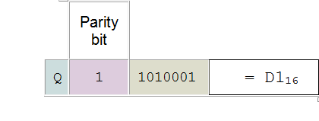

Characters Representation
(81)10=(01010001)2
Memory
Using the even parity bit to represent the character Q (Q = 81 in ASCII ) in memory (Hexadecimal) ?
D1
A=65
B=66
.
.
a=97
b=98
.
.
Note: ASCII for A=65 and a=97
American Standard Code for Information Interchange
Abdallah Karakra

Slide 19
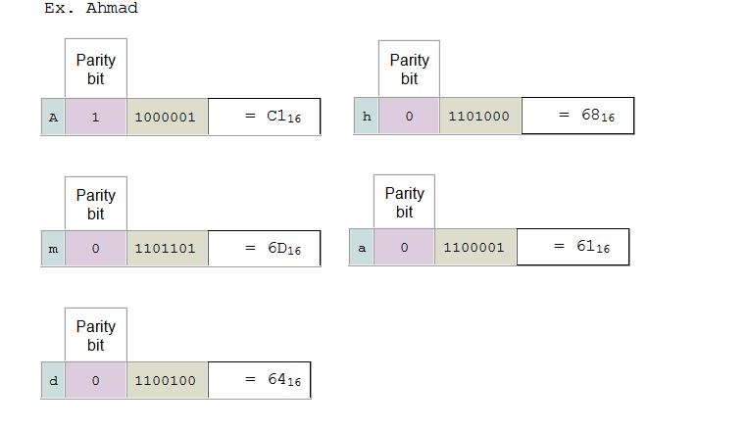
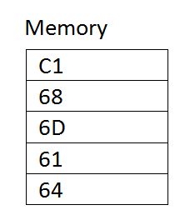
Characters Representation
Using the odd parity bit to represent your name in memory ?
A 01000001
h 01101000
m 01101101
..
Abdallah Karakra

Slide 20
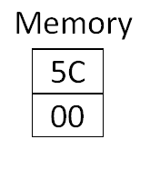

Integers Representation
Represent the following integer in memory using 2 byte?
92
92 = 1011100
Answer
0000 0000 01011100
0 0 5 C
Abdallah Karakra
Notes:
Low and high memory

Slide 21
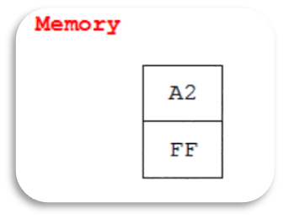
Integers Representation
Represent the following integer in memory using 2 byte?
-94
94 = 0000000001011110
1’s → 11111111110100001
2’s →+
---------------------------------
1111111110100010
F F A 2
1
Abdallah Karakra

Slide 22
Floating Point Representation
32 bits divided into three sections
X | XXXXXXXX | XXXXXX…..X
1 bit For sign | 8 bits For Exponent | 23 bits For Mantissa
0 for Positive
1 for Negative
Abdallah Karakra

Slide 23

Floating Point Representation
32 bits divided into three sections
X | XXXXXXXX | XXXXXX…..X
1 bit For sign | 8 bits For Exponent | 23 bits For Mantissa
2⁸ =256
0-255
What about negative ??
Abdallah Karakra

Slide 24

Floating Point Representation
255/2=127.5 we take the integer part 127
0---------------------- 255
0---------------------- 255
-127 -127
-127 ---------------- 128
Let’s take an example !
Abdallah Karakra

Slide 25

Floating Point Representation
Use the 32-bit floating representation to represent the following the binary number and show how it will represented in the memory?
(26.75) ₁₀
Answer:
Convert the number from decimal to binary
Abdallah Karakra

Slide 26
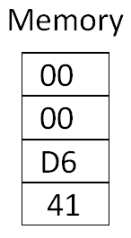
Floating Point Representation
(26.75) ₁₀ = (11010.11) ₂
(11010.11) ₂ =(1.101011 *2⁴ ) _{2 Scientific notation}
Exponent = 127+4=131
(131) ₁₀ =(10000011) ₂
0 | 10000011 | 10101100000000000000000
4 1 D 6 0 0 0 0

Slide 27

Summary
Converting Fractions.
Adding Binary Fractions.
Binary Subtraction.
Data Representation.
Characters and Integers Representation.
Floating Point Representation.
Abdallah Karakra

