Slide 1
TALEED PROCUREMENT SELF-ASSESSMENT
Prototype Walkthrough
Across Three Roles
Champion · Analyst · Super Admin — an end-to-end capability diagnostic
captured from a live run of the local prototype.
Local-first React + Redux prototype · Synthetic demonstration data only

Slide 2
What is the Taleed Procurement Self-Assessment?
A local-first web tool that helps a company measure how mature its procurement function is. The company answers 40 simple Yes/No questions across four capability areas and instantly receives a maturity score, a maturity level and a short list of practical next steps.
01
02
03
04
Category
Management
Spend
Analysis
Strategic
Sourcing
Supplier
Relationships
Category ownership, strategies and performance reviews.
Spend visibility, data quality and decision-ready insight.
Sourcing discipline, supplier selection and realized value.
Governance, performance and supplier collaboration.
40 Yes/No questions · 4 capability areas · 0–100% maturity score · 16 tailored recommendations · 3 roles: Champion, Analyst, Super Admin

Slide 3
What this deck covers
01
The product
A 40-question, 4-domain procurement maturity diagnostic scored 0-100%.
02
Champion journey
Register - verify - profile - answer 40 - submit - results - report - history.
03
Analyst journey
Read-only portfolio, organizations and like-for-like comparison; no exports.
04
Super Admin journey
Portfolio with exports, corrections and people & access management.
05
How scoring works
Yes = 1, No = 0; four maturity bands; 16 tailored recommendations.

Slide 4
02
The Company Champion
A company's authorized representative registers, completes the assessment and receives an instant maturity result with tailored recommendations. Everything is saved locally in the browser.

Slide 5
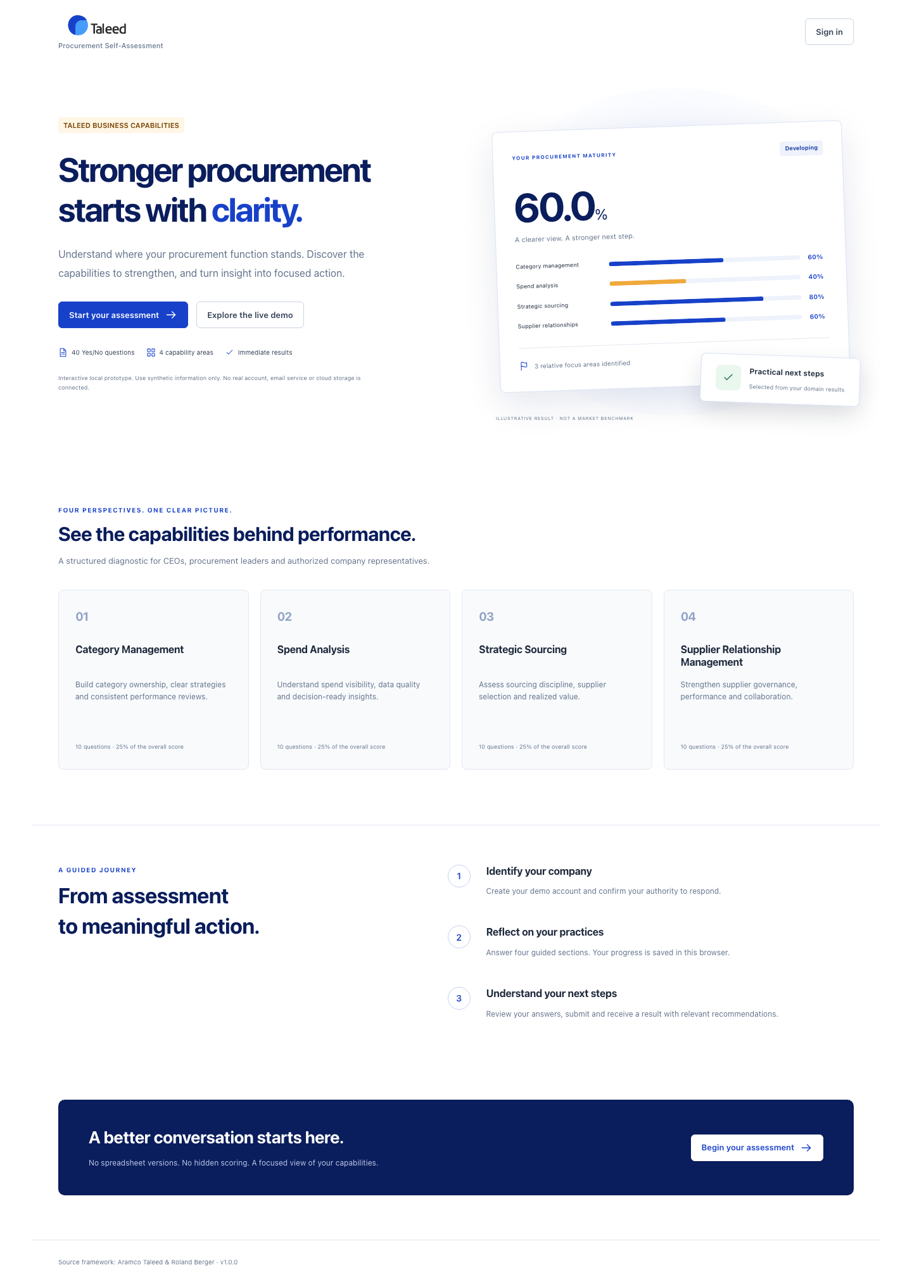
2.1
Public landing
WHAT YOU SEE
The introduction explains the diagnostic: 40 Yes/No questions, four capability areas, immediate results.

Slide 6
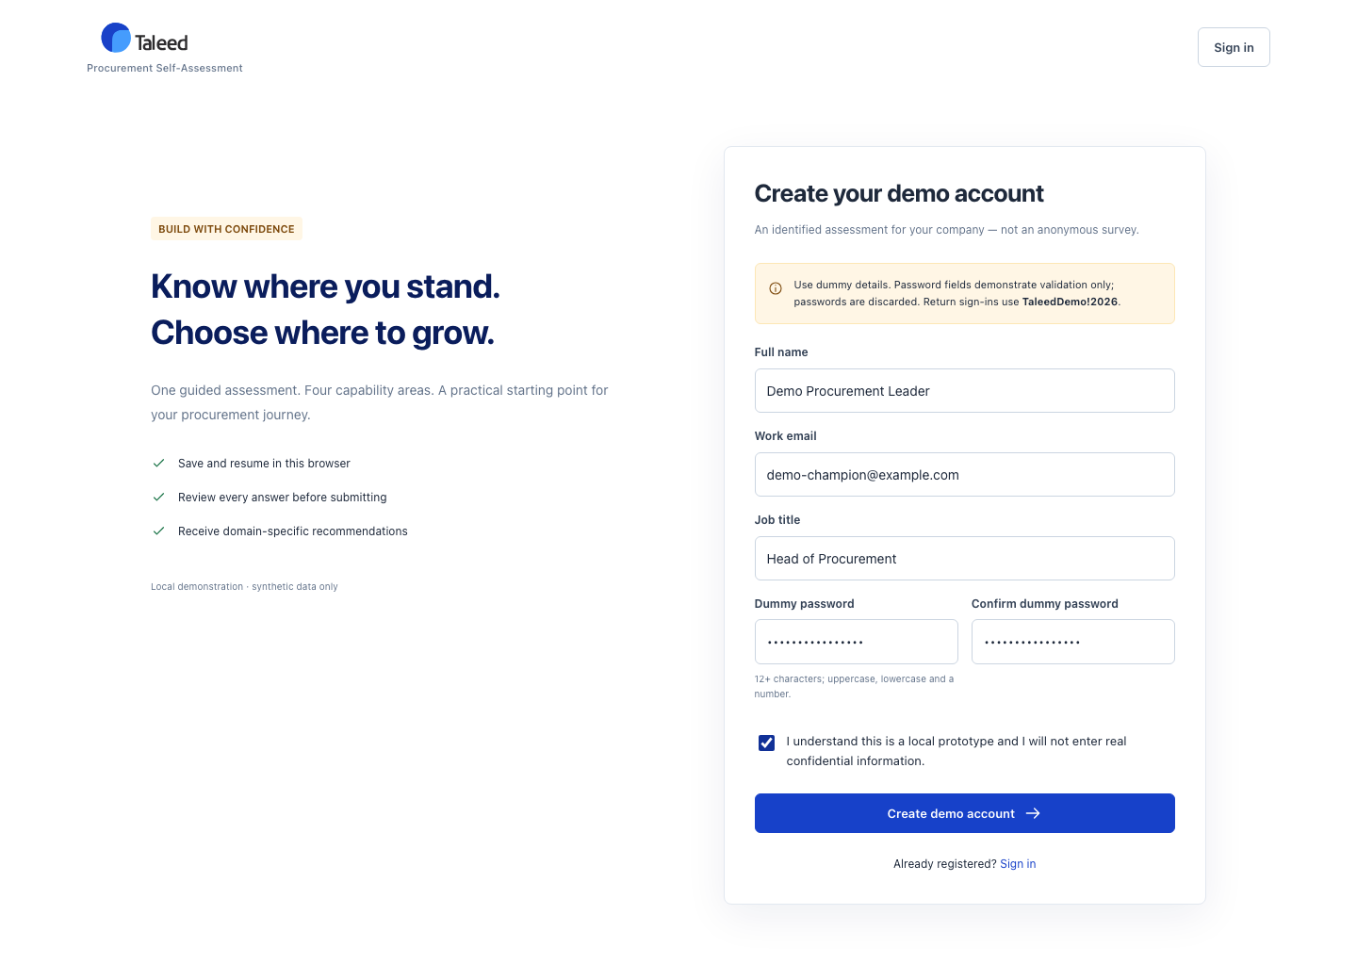
2.2
Register a demo account
WHAT YOU SEE
Name, work email, job title and a dummy password. Passwords are never stored — this is a simulation.

Slide 7
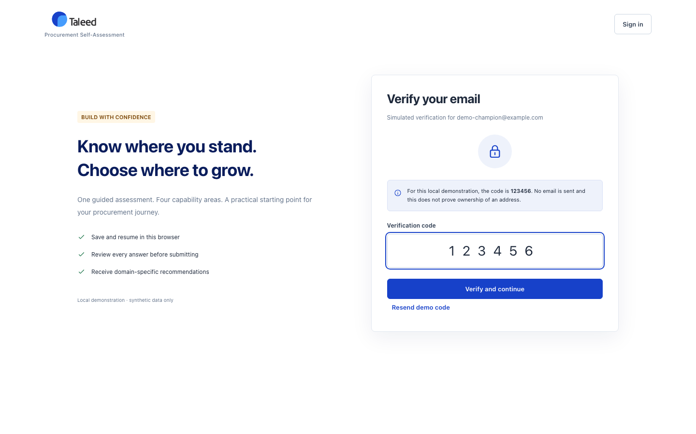
2.3
Simulated verification
WHAT YOU SEE
A fixed demo code (123456) stands in for an email link. No real email is sent.

Slide 8
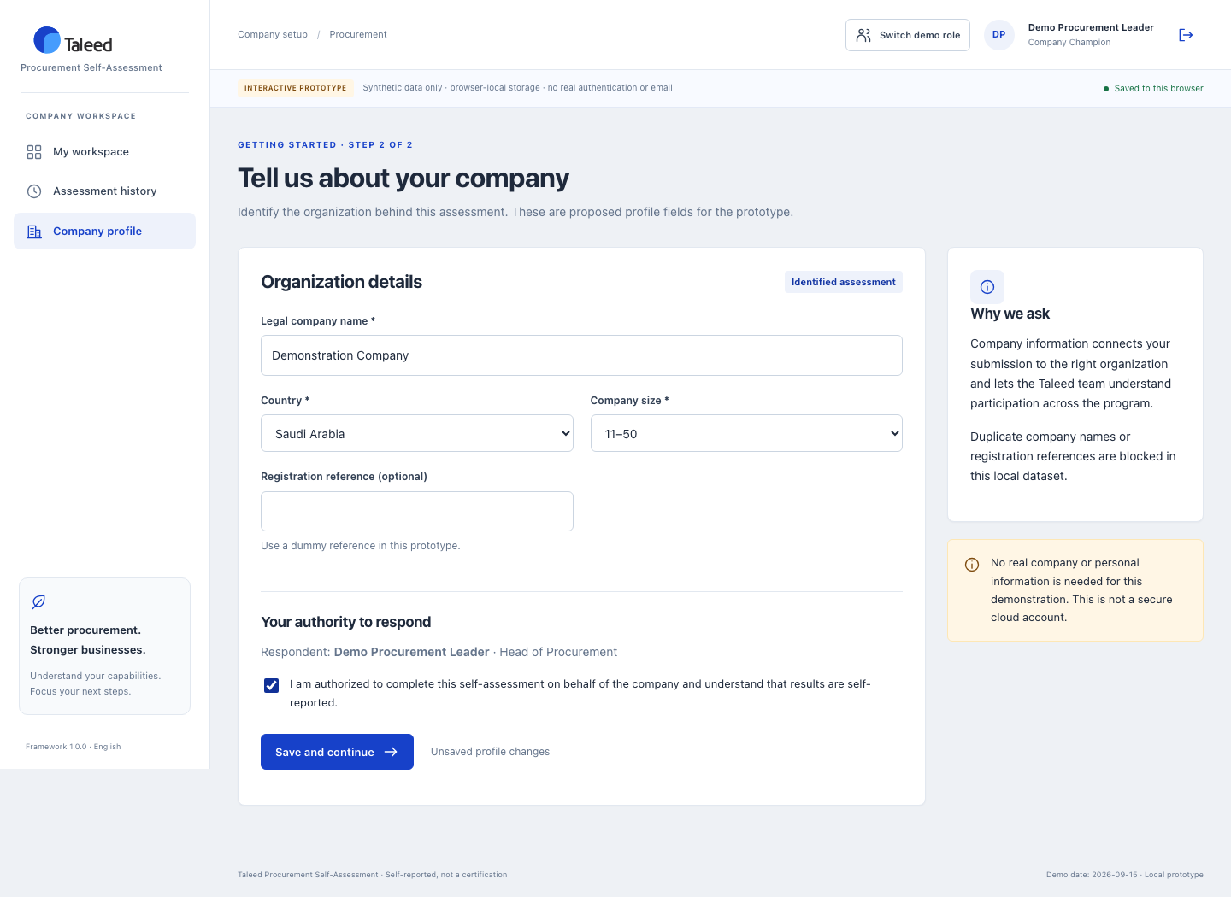
2.4
Company profile
WHAT YOU SEE
Company name, country, size and an authority declaration connect the assessment to the organization.

Slide 9
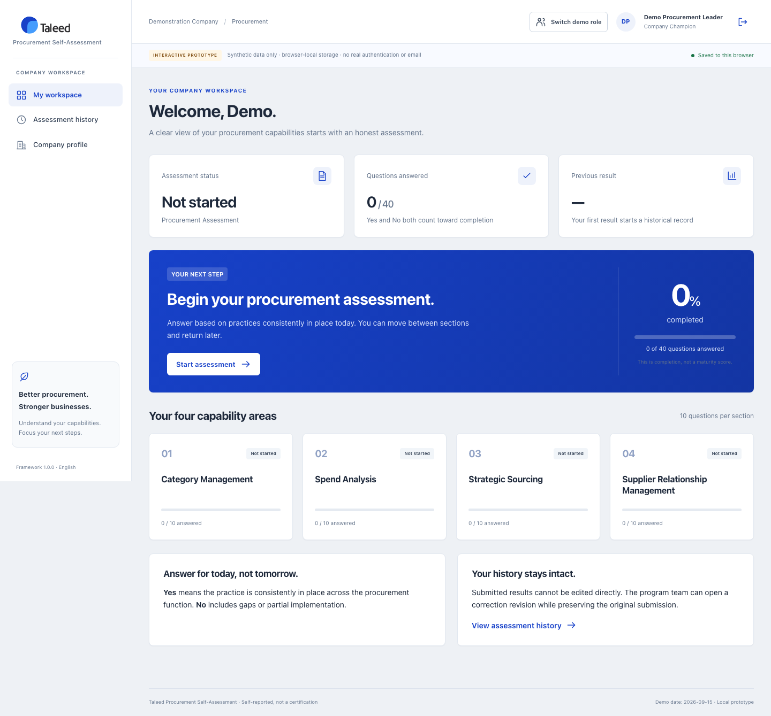
2.5
Champion dashboard
WHAT YOU SEE
A clear next step, completion tracking and four capability-area cards. Completion is not a score.

Slide 10
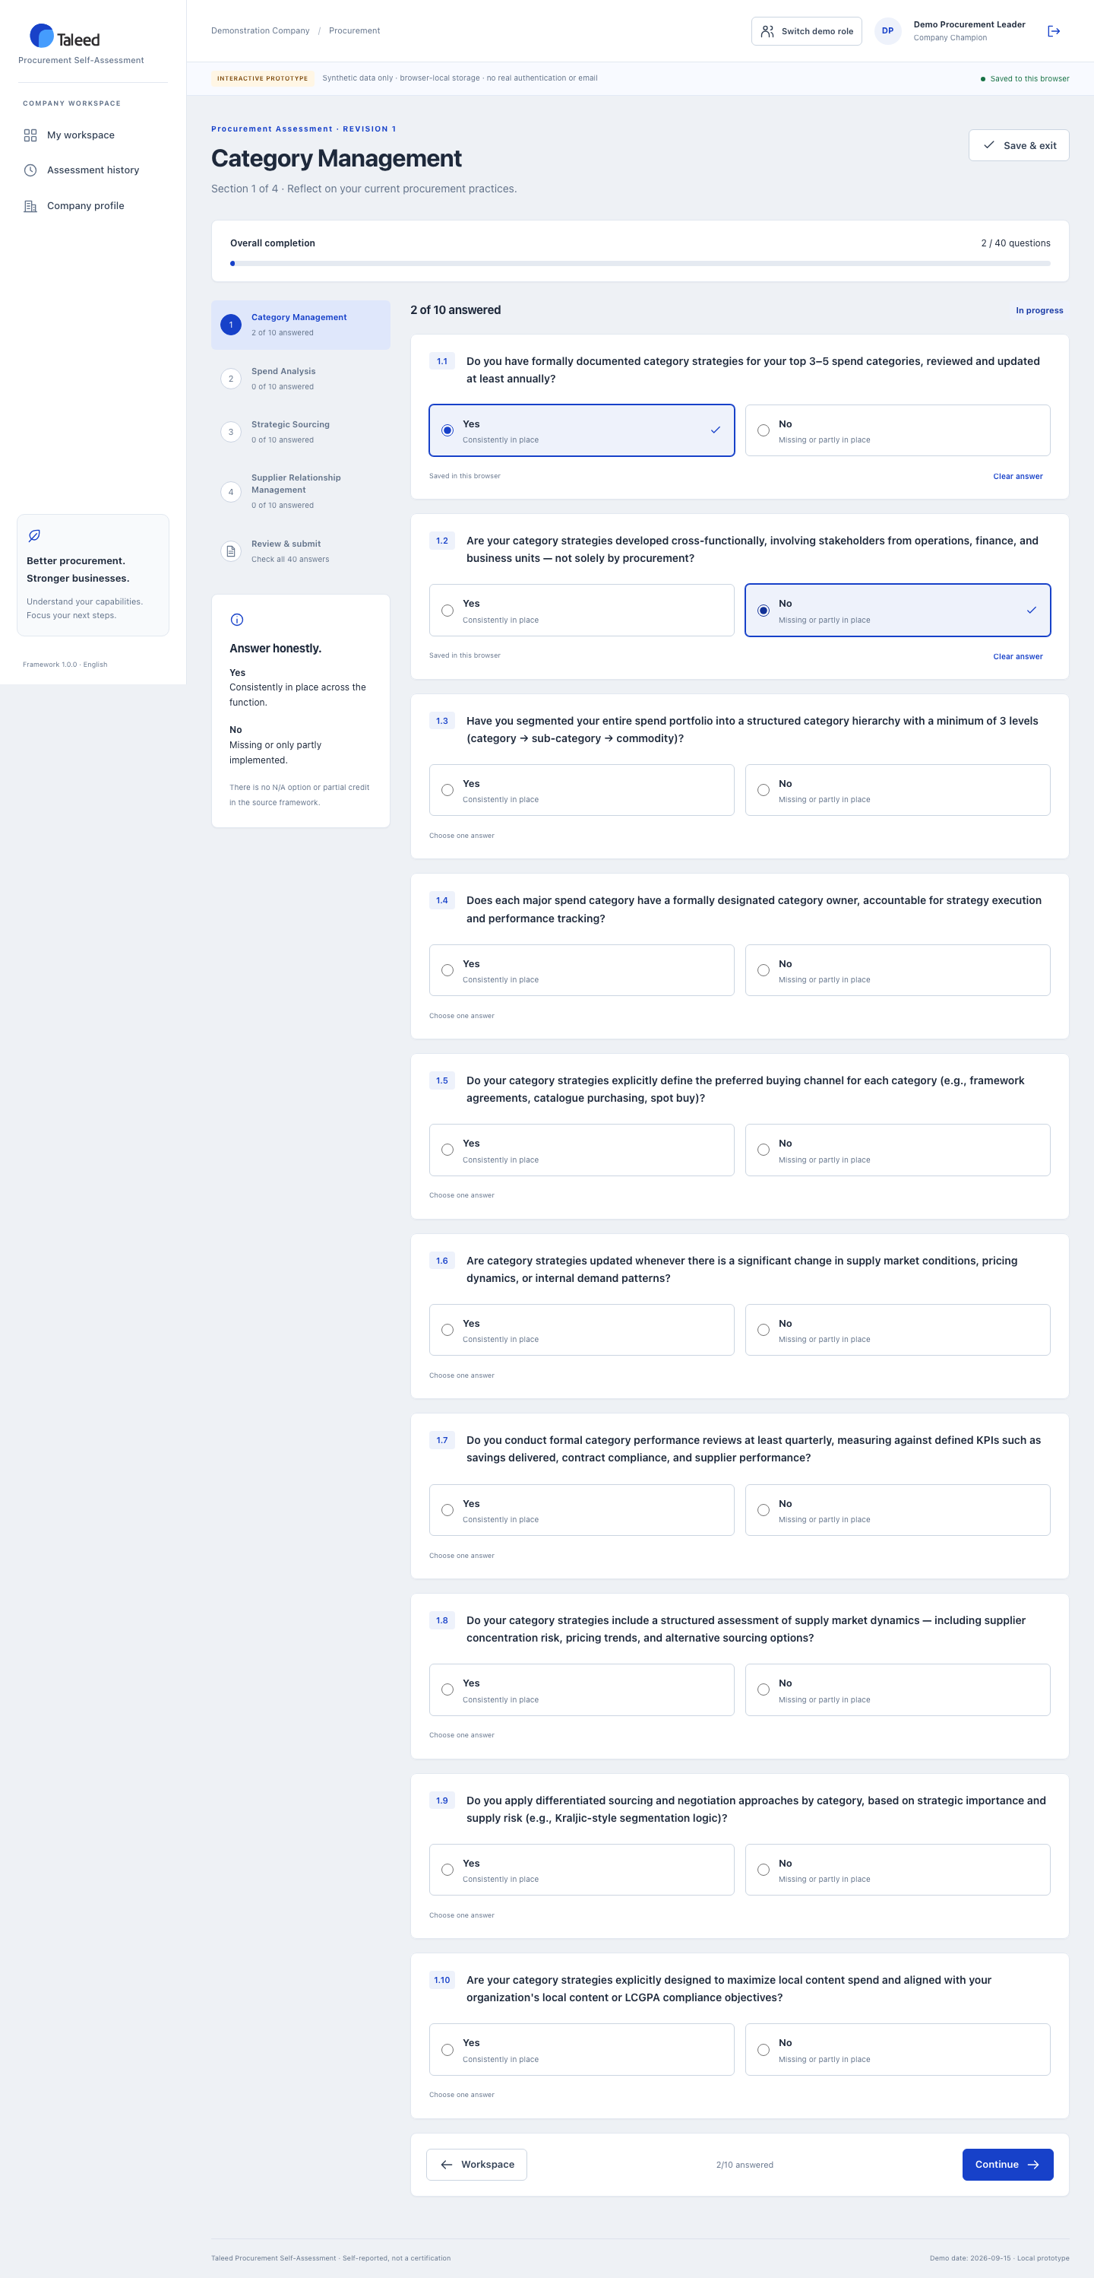
2.6
Answering questions
WHAT YOU SEE
Each question is Yes / No / unanswered. Answers save instantly to the browser.

Slide 11
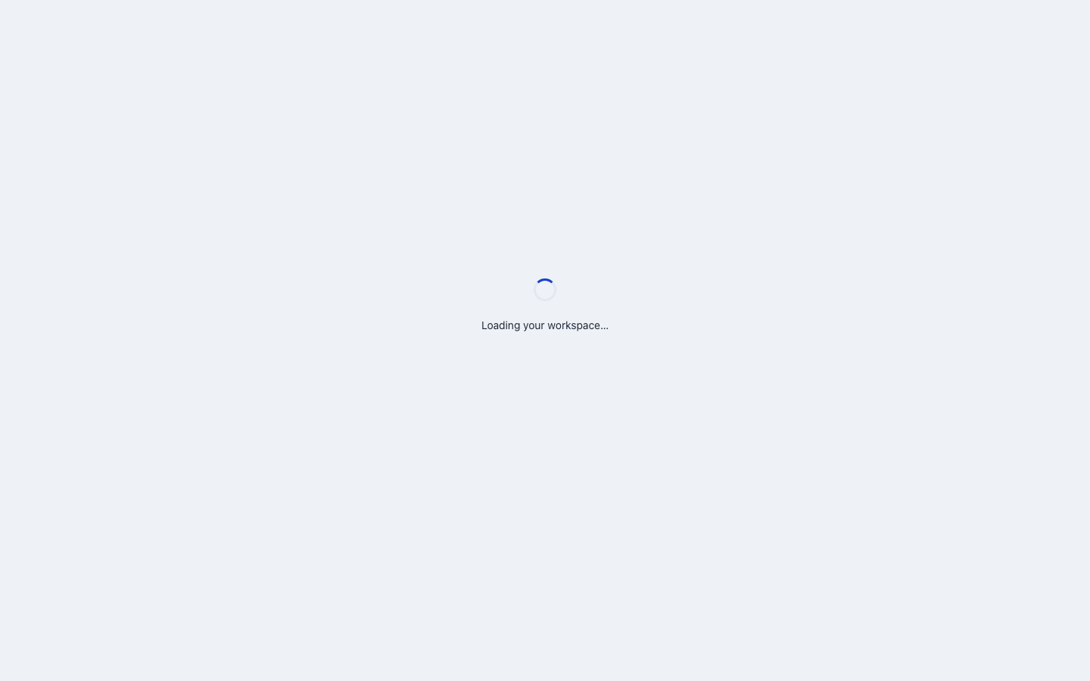
2.7
Review before submit
WHAT YOU SEE
All 40 answers are checked for completeness, with links to any missing question.

Slide 12
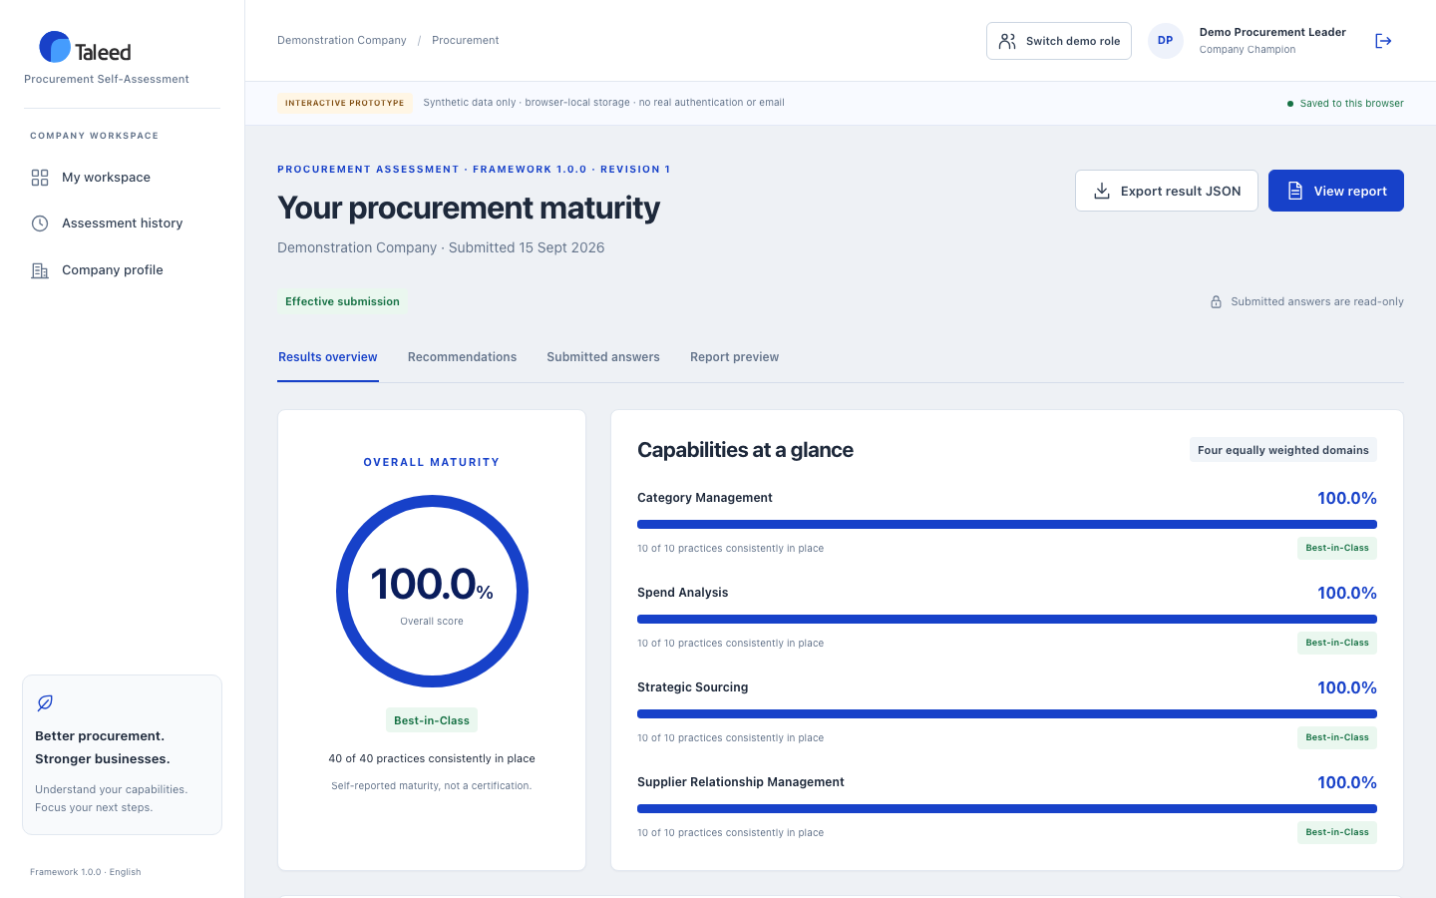
2.8
Instant results
WHAT YOU SEE
Overall maturity, four domain scores, a band and three relative focus areas.

Slide 13
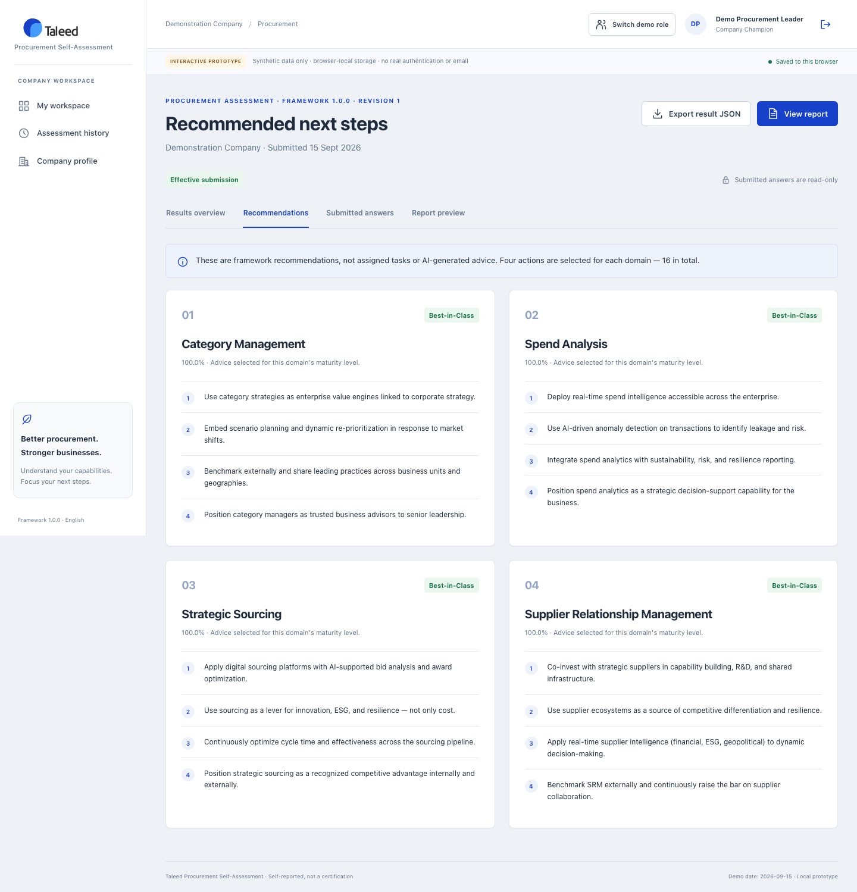
2.9
16 recommendations
WHAT YOU SEE
Four tailored actions per domain, selected from that domain's own maturity band.

Slide 14
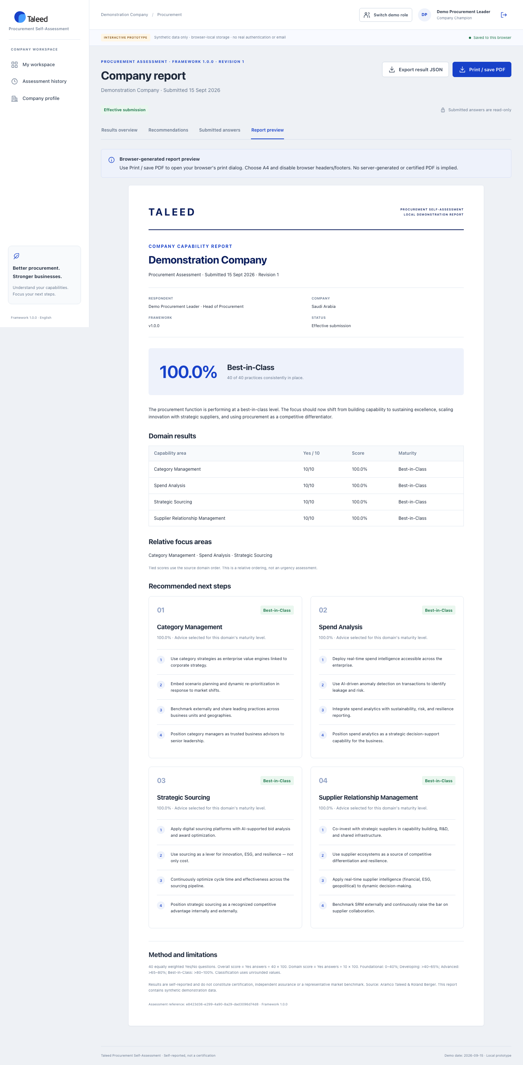
2.10
Printable report
WHAT YOU SEE
An A4 report preview for browser Print / Save as PDF.

Slide 15
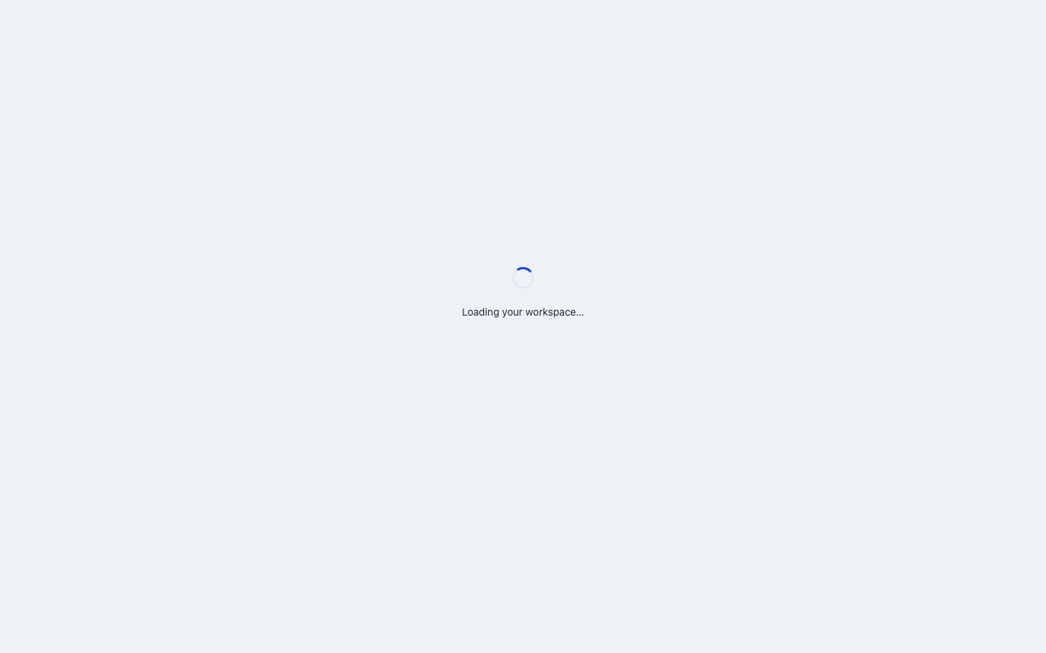
2.11
Assessment history
WHAT YOU SEE
Every submitted revision is retained; corrections never overwrite the original.

Slide 16
03
The Taleed Analyst
A program analyst reviews participation and maturity across all submitted companies — read-only. Draft answers are never exposed, and exports are disabled unless granted.

Slide 17
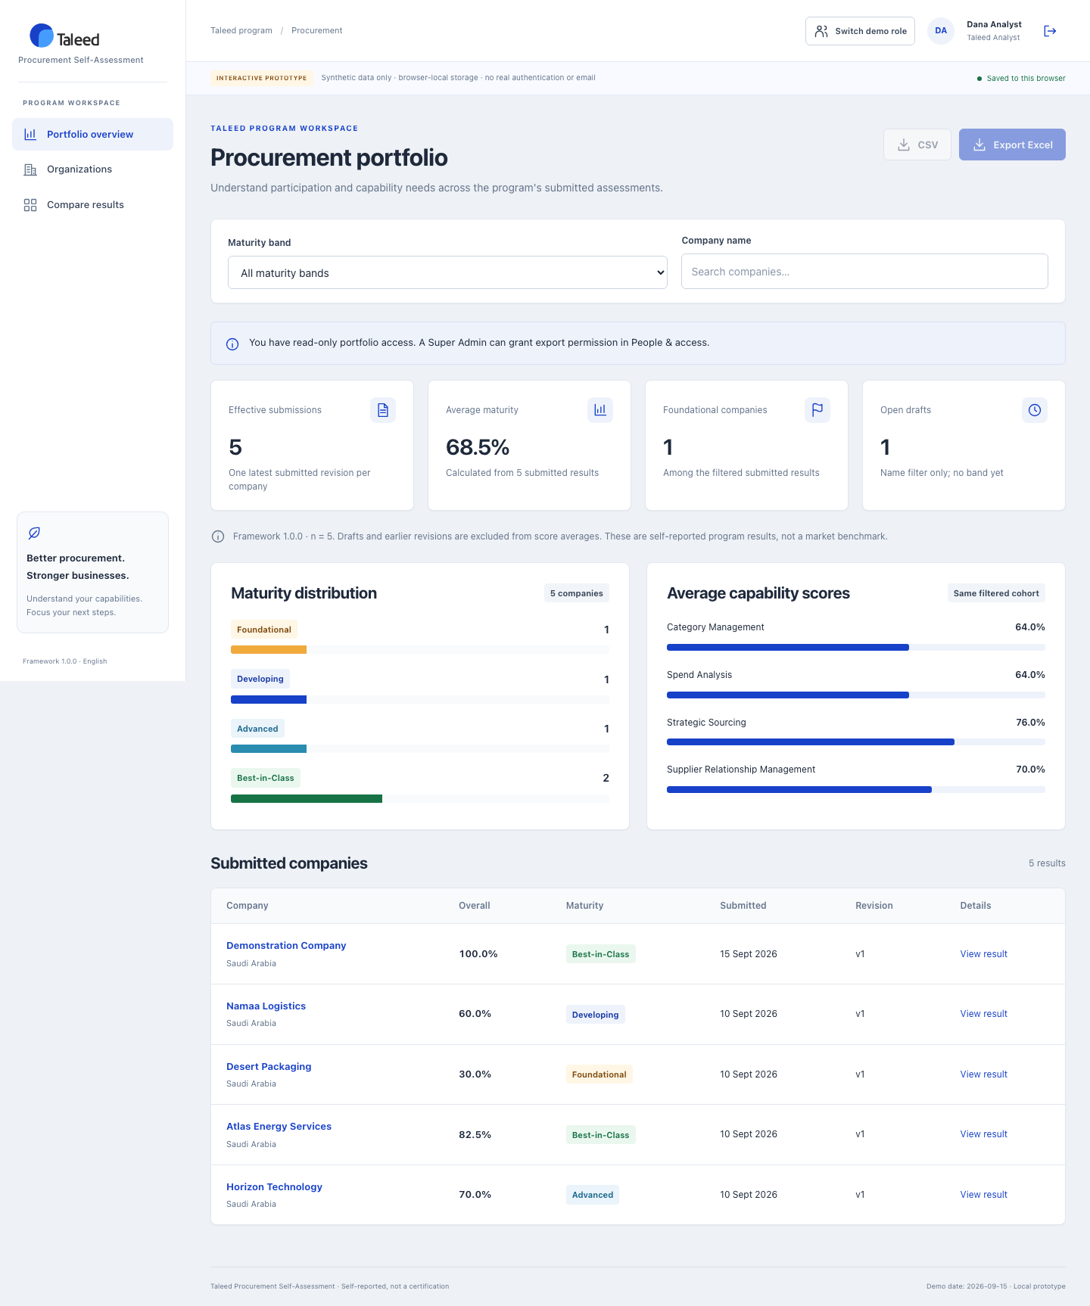
3.1
Portfolio overview
WHAT YOU SEE
Participation, average maturity and score distribution across submitted companies. Export buttons are disabled.

Slide 18
3.2
Organizations directory
WHAT YOU SEE
Company profiles and participation at a glance.

Slide 19

3.3
Like-for-like comparison
WHAT YOU SEE
Compare two to four submitted companies side by side.

Slide 20
04
The Super Admin
The Taleed program administrator has all analyst capabilities plus data exports, controlled corrections and people & access management.

Slide 21
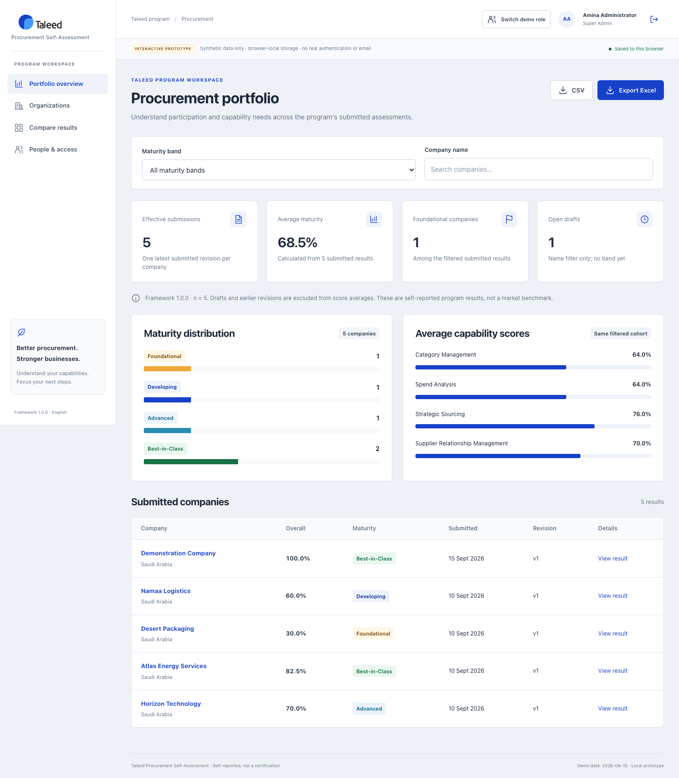
4.1
Portfolio with exports
WHAT YOU SEE
Same portfolio as the analyst, but CSV and Excel exports are enabled.

Slide 22
4.2
Organization detail & correction
WHAT YOU SEE
Open a controlled correction while the original submission stays effective.

Slide 23
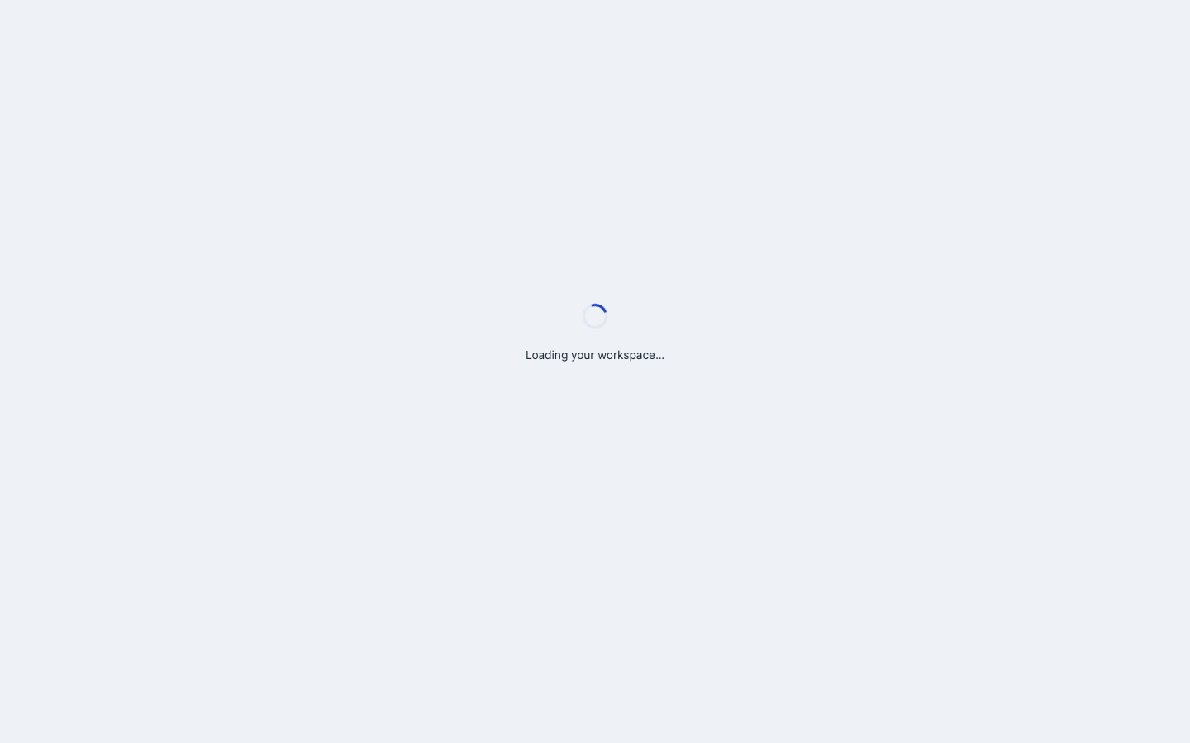
4.3
People & access
WHAT YOU SEE
Manage staff access and grant analyst export permission. Guardrails protect the last admin.

Slide 24
05
How scoring works
40 equally weighted Yes/No questions across 4 domains (10 each). Yes = 1, No = 0.
Overall % = total Yes / 40 x 100. Domain % = domain Yes / 10 x 100.
0 - 40%
41 - 65%
66 - 80%
81 - 100%
Foundational
Developing
Advanced
Best-in-Class
Results are self-reported and for demonstration only — not a certification or an external market benchmark.

Slide 25
THANK YOU
A clearer view of
procurement capability.
Live prototype: http://127.0.0.1:5173 · Demo accounts use password TaleedDemo!2026
Champion: register your own · Analyst: analyst@example.com · Super Admin: admin@example.com
Local-first React + Redux prototype · Synthetic demonstration data only

