Slide 1
Smartphone
Are Smartphones affecting productivity in the workplace, social engagement and education?

Slide 2
Content page
What are Smartphones?
Pictures of various smartphones
Effects of smartphones in the workplace
Statistics of productivity in the workplace due to smartphones
Effects of smartphones in education
Effects of smartphones in social engagement
Conclusion

Slide 3
What are Smartphones?
A smartphone is a mobile phone that presents more advanced computing capabilities and connectivity than the modern characteristic phone.
They usually contain a combination of the utilities of a camera phone and a personal digital assistant(PDA).

Slide 4
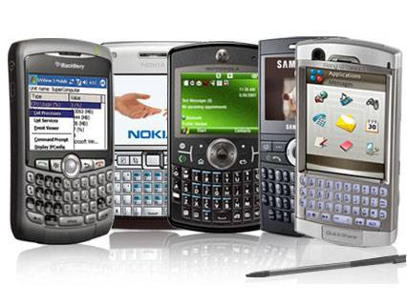
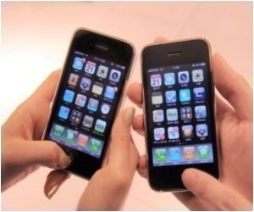
Pictures of various smartphones

Slide 5
Effects of Smartphones in the workplace
The effects of smartphones and productivity in the workplace has been a positive one in that employees have access to clients and colleagues.
meaning that in having this sort of access the productivity of employees is good because they get the work done from being on their smartphones.

Slide 6
Statistics of productivity in the workplace due to smartphones
70% of employees with smartphones regularly check their emails outside the normal business hours.
42% of employees log onto their business email accounts while home on sick leave.
43% of employees connect to their emails on their smartphones in order to get ahead and ease their workloads for the following business day.

Slide 7
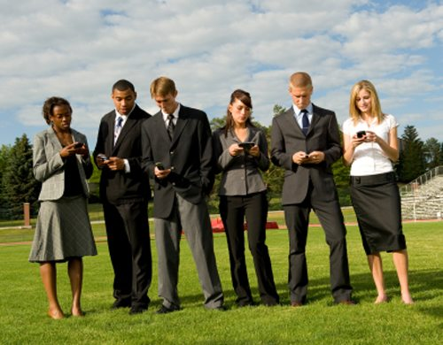
Pictures of how smartphones are used
In this picture we can see that smartphones do not reduce the productivity in the workplace because employees are always in connection with the clients and colleagues .

Slide 8
Effects of Smartphones in education
Because of the internet that smartphones provide:
Having a smartphone means that students can have permanent access to textbooks.
Students, teachers and parents can have access to the student marks without having to go in at school
Online sources which to access various information e.g. moodle
The are no limits

Slide 9
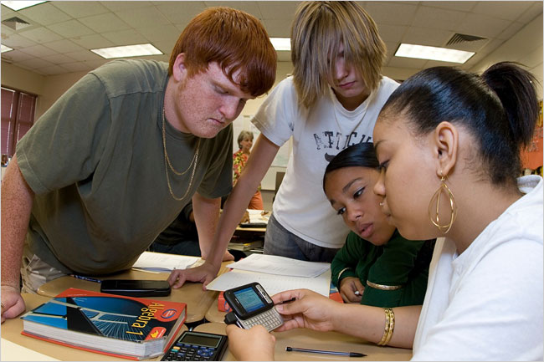
In this picture we can see
students surrounding a
smartphone doing research.
So the smartphone also
contributes in education

Slide 10
The effects of smartphones in social engagements
There are various ways in which smartphones have accessed our social engagements:
Social media tools e.g. Facebook and Twitter usage has accelerated with the ability to update, post and tweet while on the go.
It is a time killer in that whilst in line at the grocery store, waiting in a doctors office, eating, waiting at a red light, taking a break from work or even in the restroom the smartphone has become dominant
Smartphones are very ADDICTIVE!

Slide 11
Conclusion
So my answer to the statement is no I do not agree that smartphones are affect the productvity on the workplace, social engagement and in education. In fact they are essential in this generation.
I say this because from the information I have gathered there seems to be more positive than negative effects from using smartphones.

Slide 12


