Slide 1
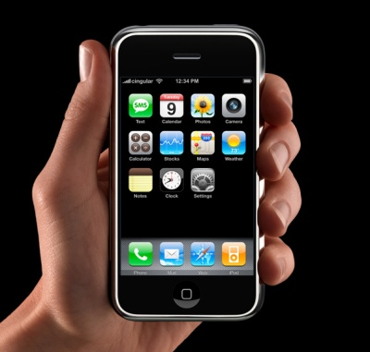
Smartphone Applications

Slide 2
Smartphone Overview
Smartphone- a mobile phone with advanced capabilities that often functions like a PC.
First smartphone designed by IBM in 1992
-E-mail, calendar, address book, games
Today, most include e-mail, internet browsers, ability to read business documents, navigation software, QWERTY keyboard or touch screen, camera
Often use a particular operating system and can add applications developed by the manufacturer of the device, by the network operator, or by a third-party software developer

Slide 3
BlackBerry Business Solutions
Create and edit Word, Excel, PowerPoint files
Automatically updated data that can be prioritized
Access sales, product, and organizational data
Managers monitor employee performance and receive updates on their progress
Employees have access to Customer Relationship Management (CRM) databases
View customer information and schedule meetings
Check on status of orders, inventory, sales forecasts and targets

Slide 4
http://www.youtube.com/watch?v=lcB8CKa73B0

Slide 5
Applications for Managing Money

Slide 6

Mint.com
Balances of your checking, savings, credit cards, investment, and loan accounts
Monthly income v. expenses
Monthly budgets in real time
Purchases and deposits you’ve made
Mint alerts you to activity
Low on available credit or cash
Unusual spending
Check clears the bank

Slide 7
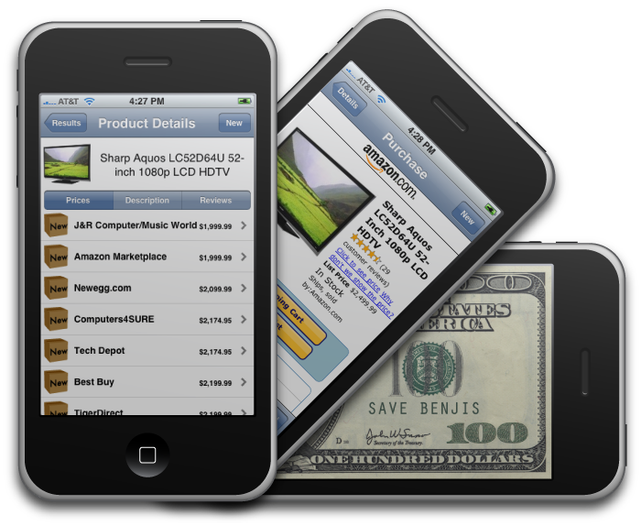

Save Benjis
Price Comparisons
While you’re out you can
compare prices to anything you want to buy
If you find a better price, you can buy right on the application
Allows customer to go to nearest store and see the physical product, but still get the cheapest price

Slide 8

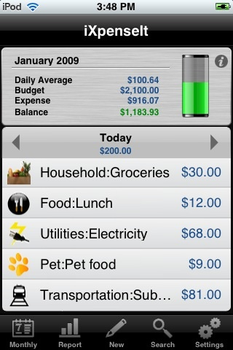
iXpenseIt
Can record expenses anywhere
Allows you to take a photo
of your receipt
Simplifies expense tracking
and monthly budgeting
Generates expense reports
for work

Slide 9
Risks
Overloading slows down your entire smartphone
Some applications are no longer allowed by the services
Slingplayer is one of these applications

Slide 10
Discussion Time
How do you feel about keeping all your data and personal information on a smartphone? How do you feel about a company keeping data on a phone?
Is it safe to use or would you recommend to use the traditional method of a regular computer?

Slide 11
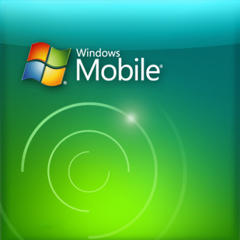
Windows Mobile
The goal of Windows Mobile is to provide a fast secure way to access your business on the go
Designed to make your schedule and email more accessible
Offers programs like Life Mesh
Can manage up to ten email accounts

Slide 12
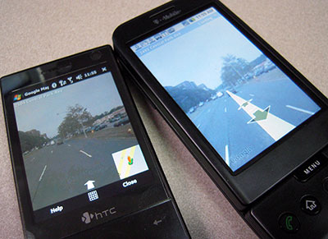
Windows Mobile Continued
Enhanced mobile e-mail
Microsoft office mobile
Mobile Desktop
Google Maps with streetview

Slide 13
Discussion Part Deux
With the increasing popularity of smarthphones in the business world do you think companies will lean towards having more mobile workers to cut down on the overhead cost of office space?

Slide 14
How Apps can help small businesses

Slide 15
There are already thousands of apps on the market
But for a small business trying to expand or gain a competitive advantage these may be useless.

Slide 16

The most primitive software designers.
If you are looking for someone to build an iPhone, iPod or mobile application and you have a nice big fresh supply of bananas waiting for us then please read our business services page.

Slide 17


Small Business Apps
The Inner fence Visa payment app
A landscape garden app
Church group app

Slide 18
Cost of Creating Apps
A developer will charge a company between $6,000 and $8,000 for a typical app
There are also ones that have less features but will only around $2,000
Companies on a tight budget can design apps on their own. Apple's iPhone Developer Program ($99 for the standard edition, $299 for the enterprise version)

