Slide 1

Working Hours and Economic Productivity
A Cross-Country Analysis
Mouhamadou SENE
MSc Data Science & Organizational Behavior
December 2025

Slide 2



Context & Motivation
Does working more hours lead to greater economic output?
As debates around the 4-day work week intensify globally, understanding the relationship between working hours and productivity becomes crucial for:
Policy Makers
Organizations
Economists

Slide 3
Research Question & Hypotheses
Does reducing average working hours improve or harm economic productivity across countries?
Hypotheses
H1: Countries with lower average working hours have higher GDP per hour worked
H2: The relationship between working hours and productivity varies by income level
H3: Over time, countries that reduced working hours saw productivity gains

Slide 4



Data Sources
Our World in Data
ourworldindata.org - Three Main Datasets
127
33
3,213
Countries
Years (1990-2022)
Observations
Working Hours
Productivity
GDP per Capita
Income Groups
Annual hours per worker
GDP per hour worked
PPP constant 2021 USD
4-level classification

Slide 5
Analysis
Python Libraries Used: pandas, numpy, matplotlib, seaborn, scipy, statsmodels
Data Lifecycle Steps
1. Data Collection: Downloaded three datasets from Our World in Data
2. Data Wrangling: Standardized columns, filtered 1990-2022, merged datasets
3. Feature Engineering: Created income groups, log transformations
4. Statistical Analysis: Correlation tests, ANOVA, regression models
5. Visualization: Distribution plots, scatter plots, trend analysis

Slide 6

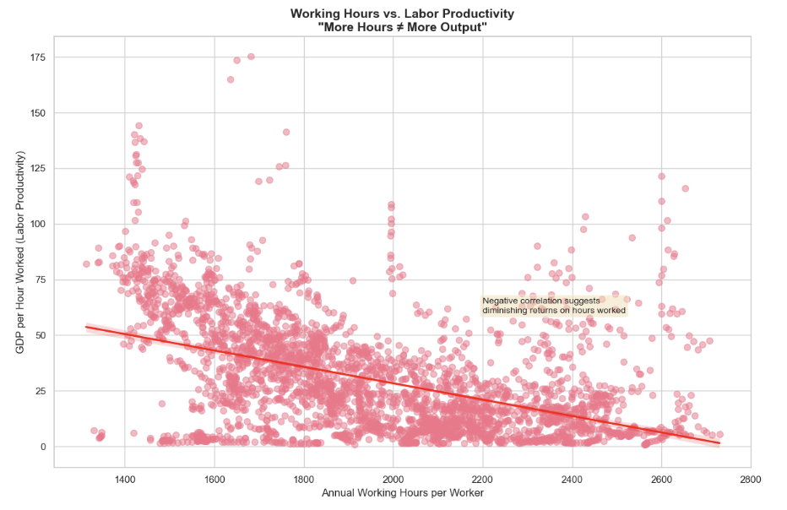
Result: H1 - Working Hours vs. Productivity
Scatter Plot: Working Hours vs. Labor Productivity
(Negative Correlation with Regression Line)
r = -0.47, p < 0.001
Countries with lower average working hours have significantly higher GDP per hour worked. The negative correlation suggests diminishing returns.
H1 SUPPORTED: More Hours ≠ More Output

Slide 7
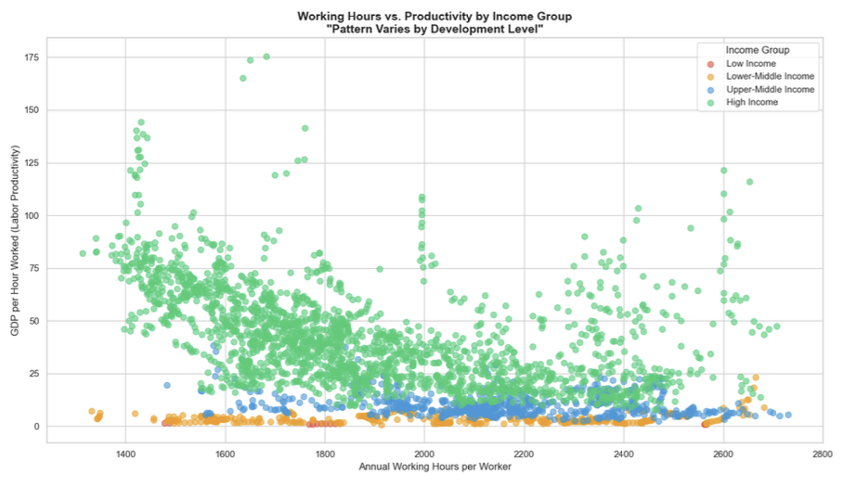




Result: H2 - Moderation by Income Level
Low Income
Lower-Middle
Upper-Middle
High Income
-0.63
+0.12
-0.20
-0.46
The relationship varies significantly by income level (ANOVA: F = 882.7, p < 0.001). High-income countries show the strongest negative relationship.
Hypothesis H2 SUPPORTED: Development Level Matters

Slide 8

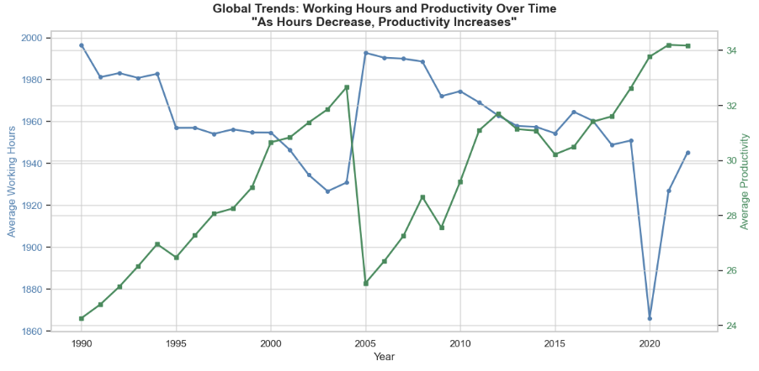
Result: H3 - Longitudinal Trends
r = -0.76, p < 0.001
Over the study period, global working hours decreased while productivity increased. The strong negative correlation confirms productivity gains from reduced work hours.
1990-2022 Trend: Average working hours declined globally, yet economic output per hour worked rose consistently.
Hypothesis H3 SUPPORTED: Time Reveals Gains from Reduction

Slide 9




Regression Analysis (Bonus)
Simple OLS
Multiple OLS
Log-Log Model
R2 = 0.22
R2 = 0.85
R2 = 0.94
Key Insights
Working hours coefficient remains negative across all models (all p < 0.001), providing robust evidence that longer working hours do not translate to proportionally higher output.
Elasticity Interpretation (Log-Log Model)
A 1% increase in working hours is associated with a 0.67% decrease in productivity

Slide 10
Conclusions
More hours does not equal more output: Strong negative relationship between working hours and labor productivity across countries
Development matters: High-income countries show stronger productivity gains from reduced hours
Historical evidence: Global trend shows declining hours with rising productivity (1990-2022)
Robust findings: Relationship persists across multiple statistical models and specifications
Policy Implication: Evidence supports exploring reduced work hours (4-day work week) without sacrificing economic output

Slide 11
Thank You
Questions?
Mouhamadou SENE
MSc Data Science & Organizational Behavior
December 2025

