Slide 1

Know your Acceptance
By team-7 (Ds 2nd yr)

Slide 2
Analysis from the dataset – UCBAdmissions (Main factors in dataset)
Admit
It consist of two category (variables) ~
1. Admitted
2. Rejected
1
Gender
It consist of two category (variables) ~
1. Male
2. Female
2
Dept
It consist of six category
1. A
2. B
3. C
4. D
5. E
6. F
3
Freq
It consist of numerical values in accordance with Admit, Gender, Dept.
4

Slide 3
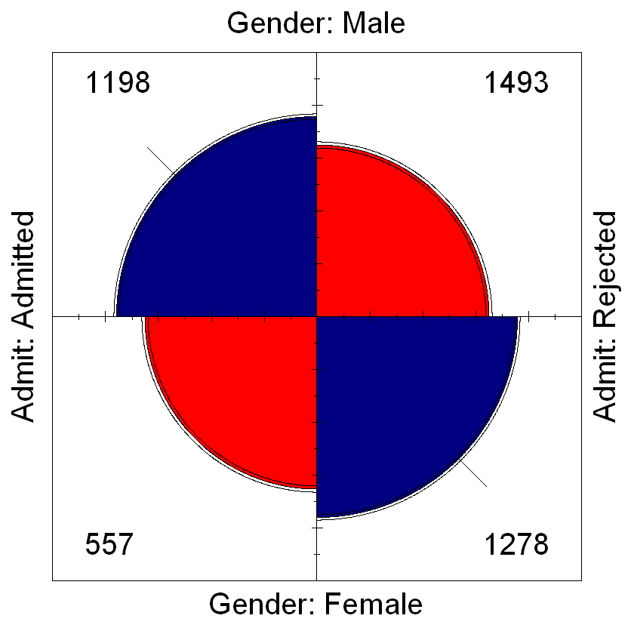
Fourfold plot
It is showing the total number of male and females, admitted and rejected.
More number of boys going for admission than girls
The Admission process is hard, as very less number of students are admitted, and more number of students are rejected.
The acceptance rate for male is 2.25 ( 1198 + 1493 ) / 1198
The acceptance rate for female is 3.29 ( 557 + 1278 ) / 557
Hence the acceptance rate for female is more than male.

Slide 4
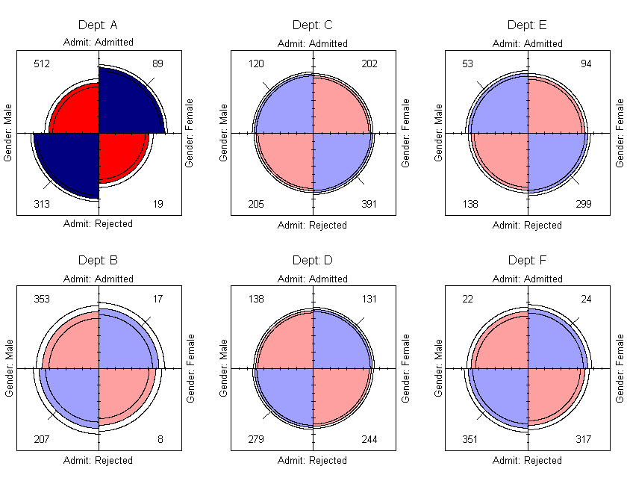
Three-way plot
It is showing the fourfold plot for six different departments, same as the earlier slide.
Here as are seeing the admission of male and female by departments.
The admission of male and female is quite similar except department A with much variation.
Females are more accepted in departments A, B, D and F.
Males are more accepted in departments C and E.

Slide 5
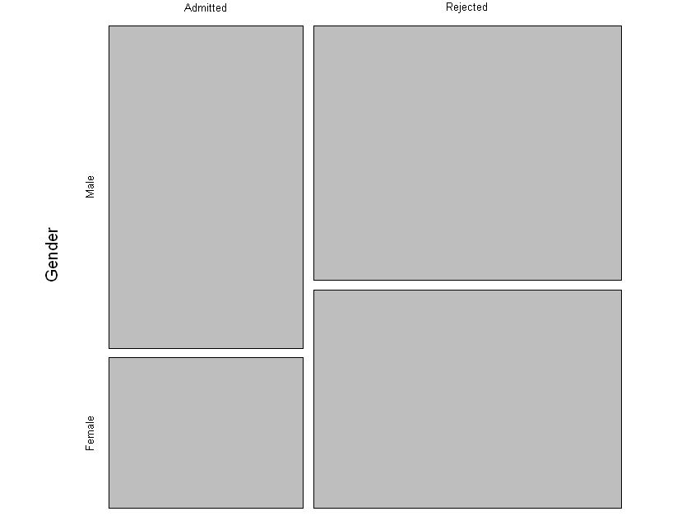
Mosaic plot
This plot is showing the overall admission of male and female in a box format.
Here it is clearly seen that the proportion of student admitted is less and more are rejected.
It also shows that more males are admitted than female, and more males are rejected than female, which means there are more male participants than female.

Slide 6
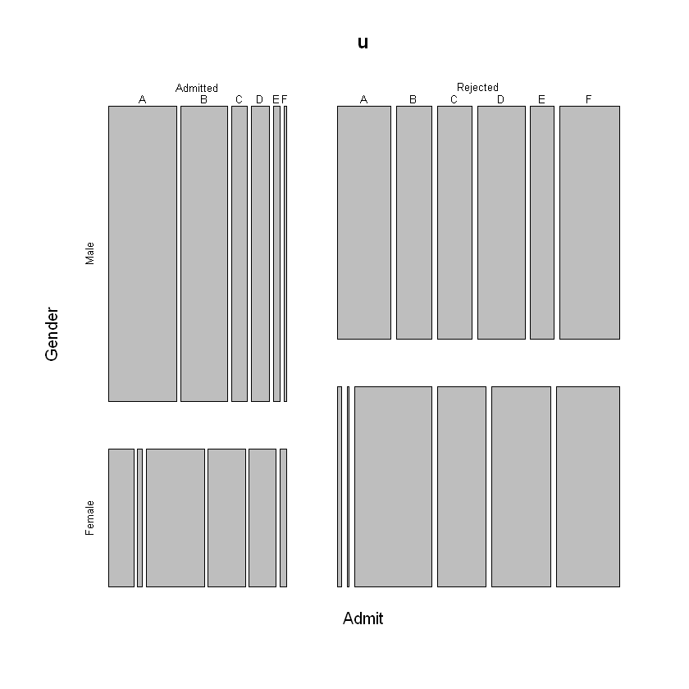
General plot
Here it represents the whole admission of both male and female together by department-wise.
Males are admitted more in department A then the admitted proportion gradually decreases all the way to department F. But rejection at the departments is not in any order.
Females admitted mostly in department C and then it decreases. And also most rejection is at department C. It’s quite interesting.

Slide 7
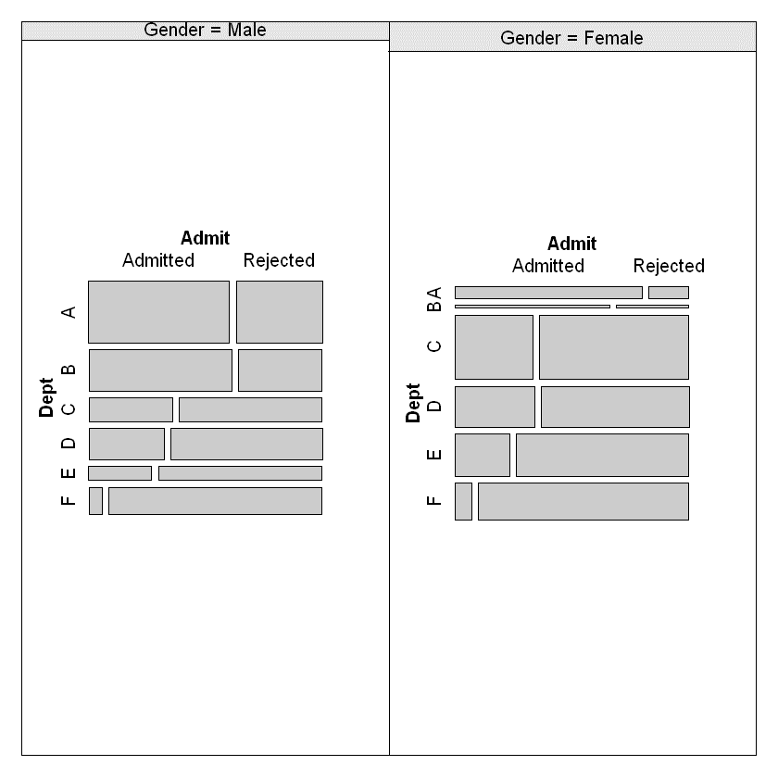
Cotab plot
By visualising the data we are able to better understand the relationship between the three variables: Admit, Gender and Dept.
For male, from department A to F admission rate decreases, and also the number of male members decreases from A to C, then there is a rise and again downfall.
For female, from department A to F admission rate decreases, and the number of female member is more at department C, then it decreases to D and from there onwards it’s quite seems constant. Very least number of female went for department B.

Slide 8
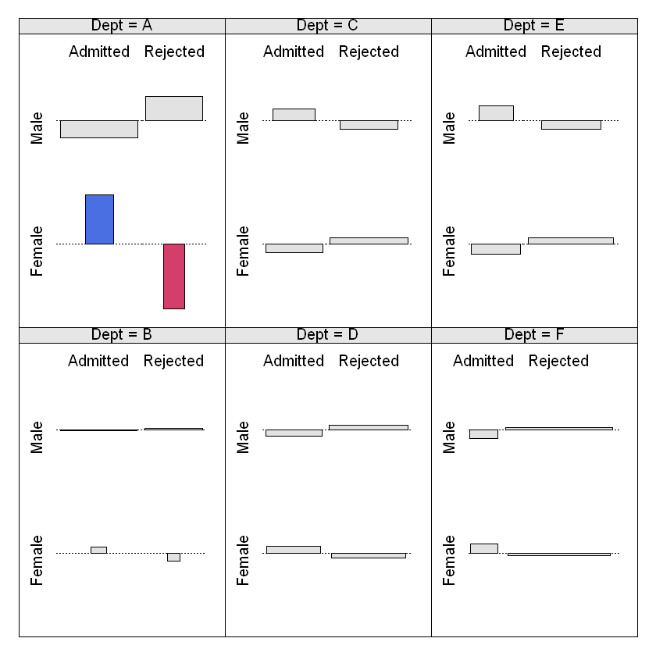
Cotab plot
Every department is emphasized in this plot along with the male and female admission.
Department A is different from all the other departments. Most of the participants are going for A (mostly boys).
Department B is also quite different from rest. It shows that the even though more number of boys then girls, applying for B but more girls are admitted in it.

Slide 9
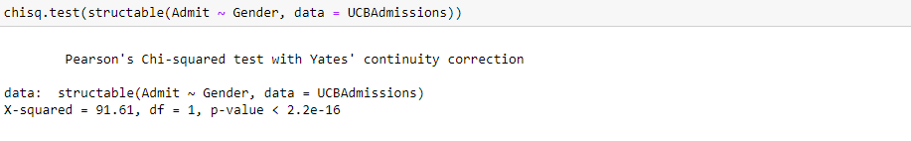
Testing dataset
Here p-value is very much smaller than the significance value (0.05), so we will reject the null hypothesis and we conclude that the two variable ( here Admit and Gender are dependent ) and they have significance differences in the mean values.

Slide 10
Conclusion
From the Analysis of the University of Berkeley admission dataset ( dataset name – UCBAdmissions ) we concluded the following assumptions –
More number of male students are applying to the University than females students .
In terms of overall perspective male candidate are admitted more, but in terms of proportion of candidates applying and getting admitted female candidate are accepted more than the males.
The admission to the University is hard as the students admitted are very less with respect to students rejected.
Number of students admitted decreases from department A to F, and number of students rejected increases from department A to F (except department C).

Slide 11

Thank you !
Appreciate your time for having a look over our analysis report.
This analysis is from the Team 7 .

