Slide 1

Supply Chain
Prediction of next year yield
By- 4708 Manash

Slide 2
Dataset
Train_data.csv - (20216100, 4)
Farm_data.csv - (1449, 6)
Train_weather.csv - (139773, 9)
Merged Traindata.csv - (20216100, 16)
As the dataset has 20 Million rows, computation was slow

Slide 3
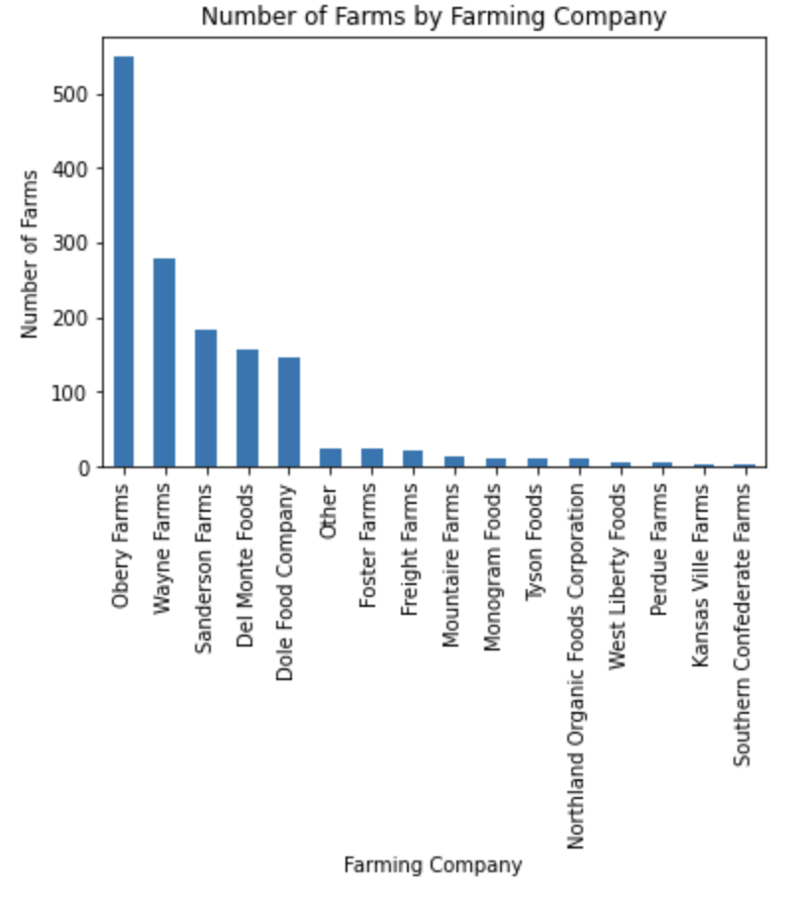
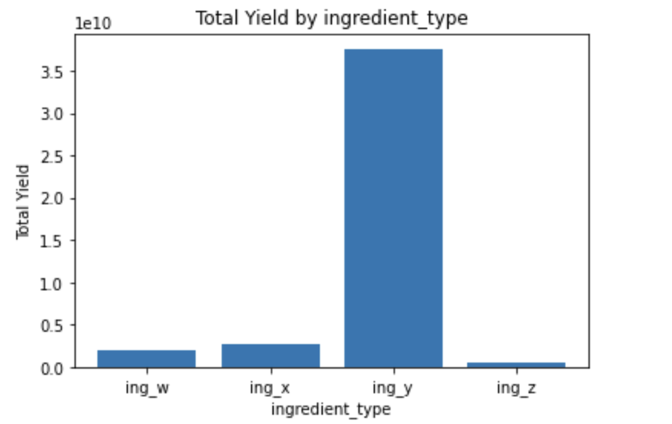
Visualization

Slide 4
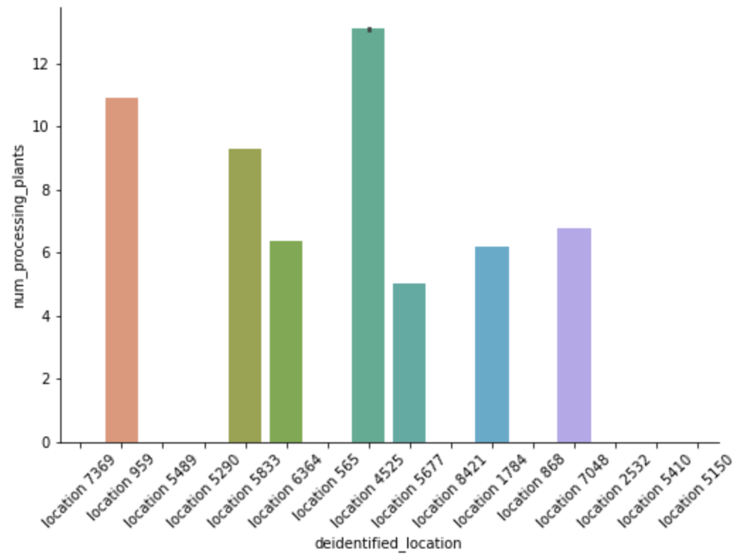
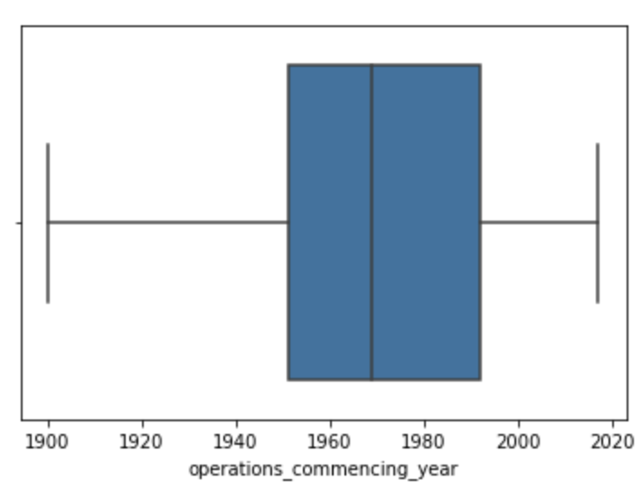

Slide 5
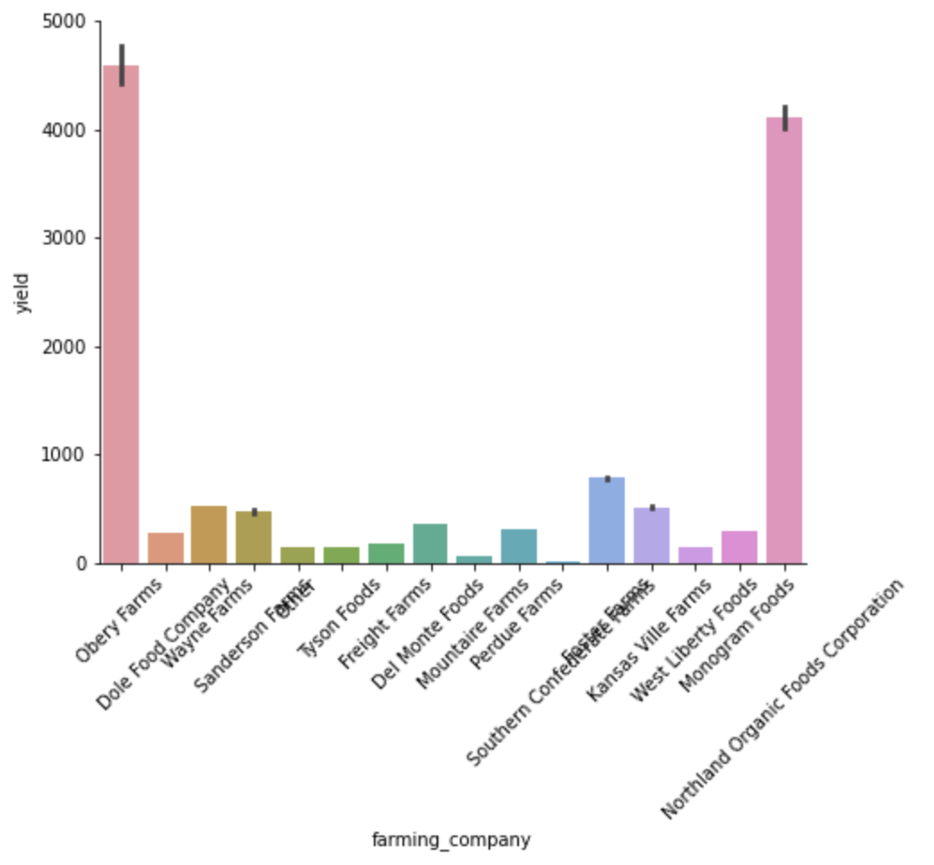
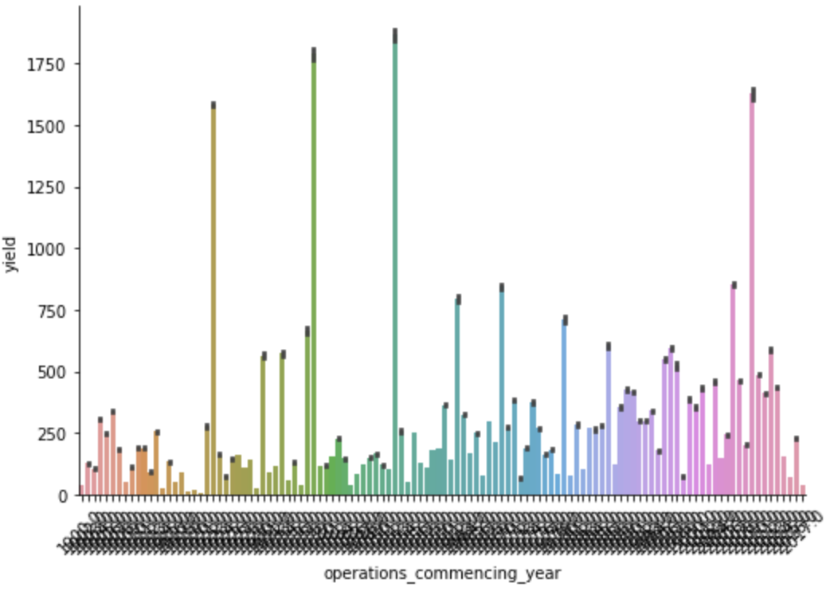

Slide 6
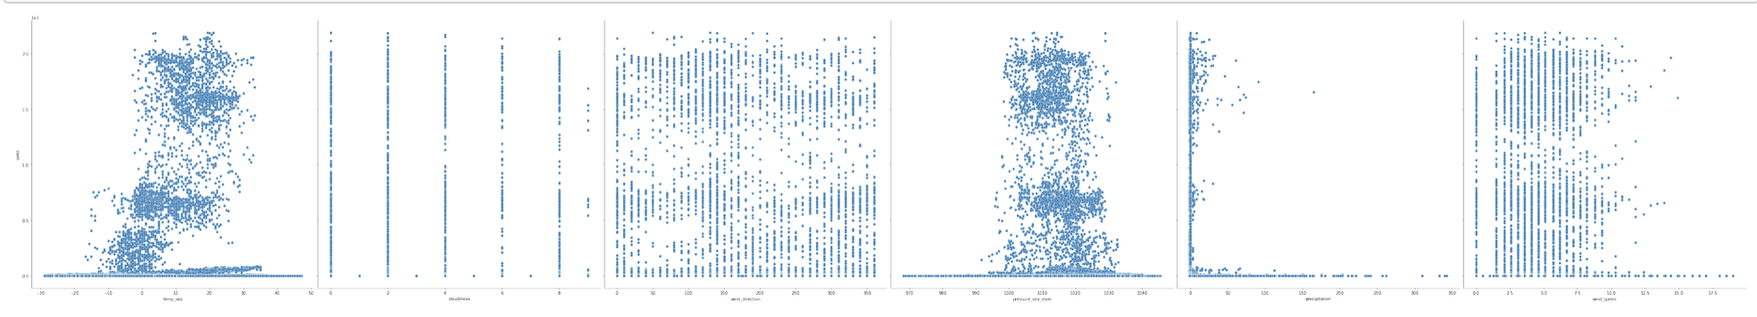
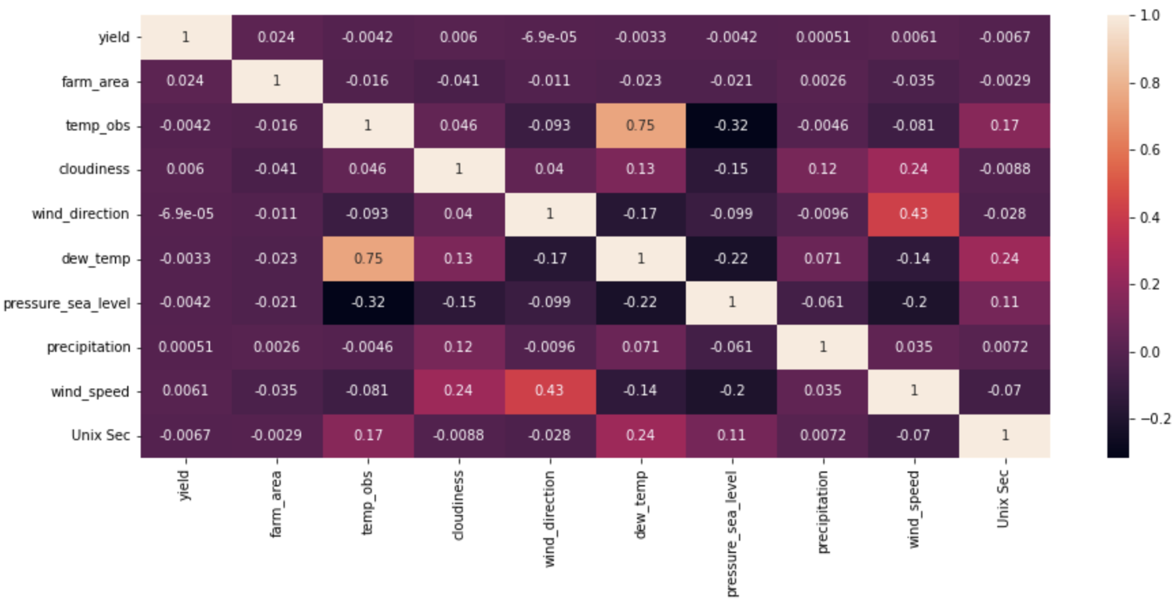

Slide 7
Steps
Merged the train, farm and weather dataset using merge.
Dropped few columns (more than 50% of missing values)
Imputed missing values with median
Label encoding categorical features
Standardizing the features
Performing train-test split
Applying Random Forest for model building
RMSE as metric (0.279)
Generating prediction for test_data
Uploading submission.csv

Slide 8
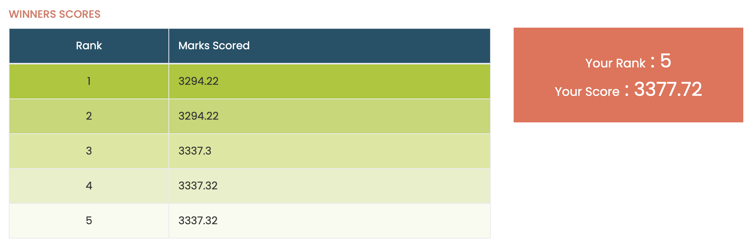
Leaderboard

Slide 9
Problems mitigated
Merged issue - duplicates
Runtime crash - 20% of data and batch training
Creating submission file - concat()
Future improvement
Batch training
Hyperparameter tuning
Bagging techniques

Slide 10


